Slide 1


AEB 07 – Euro NCAP Summary
Overview
Euro NCAP is a private consumer test organization, based in Leuven, Belgium,
partly funded by European governments
Euro NCAP was established in 1997
Euro NCAP tests apply to (passenger car) vehicles with standard equipment across EU-28
Euro NCAP tests are optional,
one does not need to have a valid star rating to be able to sell a vehicle in Europe
Euro NCAP stars are intended to be consumer information,
there is no other implication from the test results

Slide 2





AEB 07 – Euro NCAP Summary
2018 Rating Scheme
5 star threshold to be achieved in each box
Adult Occupant Protection
(AOP)
Child Occupant Protection
(COP)
Pedestrian Protection
(PP)
Safety Assist
(SA)
Offset Frontal Impact 8 points
Full-width Frontal Impact 8 points
Side Impact (MDB) 8 points
Side Impact (Pole) 8 points
Whiplash Front 1,5 points
Whiplash Rear 0,5 points
AEB City 4 points¹
Sum 38 points
Dynamic Tests Frontal 16 points
Dynamic Tests Side 8 points
Installation of CRS 12 points
Safety features in vehicle 13 points
Sum 49 points
Head Impact 24 points
Leg Impact 6 points
Upper Leg Impact 6 points
AEB VRU-Pedestrian 6 points²
AEB VRU-Cyclist 6 points²
Sum 48 points
Seat Belt Reminder 3 points
Speed Assist System 3 points
Lane Support Systems 4 points
AEB Interurban 3 points
Sum 13 points
80% (30.4 points)
80% (39.2 points)
60% (28.8 points)
70% (9.1 points)
70% (26.6 points)
70% (34.3 points)
50% (24.0 points)
60% (7.8 points)
60% (22.8 points)
60% (29.4 points)
40% (19.2 points)
50% (6.5 points)
50% (19.0 points)
50% (24.5 points)
30% (14.4 points)
40% (5.2 points)
40% (15.2 points)
40% (19.6 points)
20% (9.6 points)
30% (3.9 points)
1: minimum 1,0 points for Whiplash Front required to gain any AEB City points
2: minimum 22,0 points for passive safety measures inside the PP box required to gain any AEB VRU points
a car with a five star rating does not need to have any AEB system

Slide 3
AEB 07 – Euro NCAP Summary
AEB Vehicle-to-Vehicle
AEB V2V is part of the rating since 2014
Scoring is based on collision speed
AEB City: - Adult Occupant Protection Box (4/38 points) (max. speed tested 50 km/h)
- Automatic Intervention
- stationary target only
AEB Interurban: - Safety Assist Box (3/13 points) (max. speed tested 80 km/h)
- Forward Collision Warning followed by Dynamic Brake Support
and/or Automatic Intervention
- stationary, moving and braking target
Rating of FCW/DBS is based also on collision speed (pre-configured brake robot triggered by FCW)

Slide 4
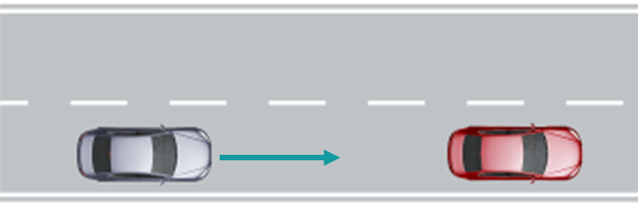
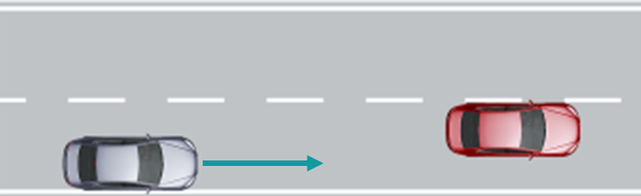
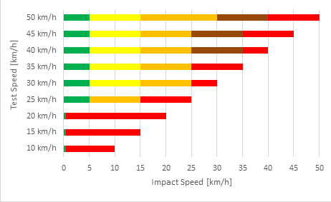
AEB 07 – Euro NCAP Summary
AEB City Test Scenarios
GRID example:
Overlap
Total 45 AEB City tests:
Stationary target vehicle (GVT)
9 different ego speeds (10 km/h – 50 km/h in steps of 5 km/h)
5 different variants of lateral overlap
(50% left - 75% left - 100% - 75% right - 50% right)
Score is dependent on impact speed.
OEM hands in a prediction “grid” (based on own tests, simulation, etc.), no participation of Euro NCAP in prediction
Euro NCAP will perform sample tests to verify the results,
a correction factor could apply
Total score: 4 points
v₀ | 50% L | 75% L | 100% | 75% R | 50% R
50
45
40
35
30
25
20
15
10
VUT Test Speed
Full score (4 points):
No collision at 10 – 20 km/h
max. 5 km/h impact speed at 25 – 50 km/h

Slide 5
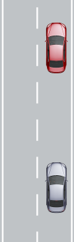
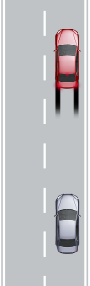
AEB 07 – Euro NCAP Summary
AEB Interurban Test Scenarios
Stationary target vehicle (CCRs)
Ego: 30 – 80 km/h
Test of FCW/DBS only (braking robot) (30-80 km/h)
Slower target vehicle (CCRm)
Ego: 30 – 80 km/h
Target: 20 km/h
Test of Automatic Intervention (30-80 km/h) and/or FCW/DBS (braking robot) (50-80 km/h)
Braking target vehicle (CCRb)
Distance: 12/40m
Ego: 50 km/h, Target: -2/-6 m/s²
Test of Automatic Intervention and/or FCW/DBS (braking robot)
Grid approach
- as in AEB City
- variation of overlap value for CCRs and CCRm test
- No grid applied for CCRb test (100% overlap only)
For full score (3 points, combination of Automatic Intervention (1.5), FCW/DBS (1.0) and HMI (0.5)):
max. 5 km/h (relative) impact speed allowed across the complete speed range

Slide 6
AEB 07 – Euro NCAP Summary
AEB Vehicle-to-Pedestrian
AEB V2P is part of the rating since 2016
Pedestrian/VRU Protection Box (6/48 Points)
Tests during daylight and obscure light conditions
Lateral and longitudinal tests
Rating is based on collision speed

Slide 7
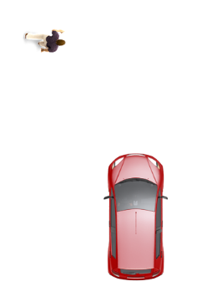
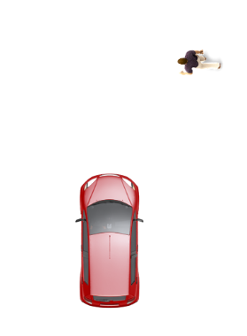
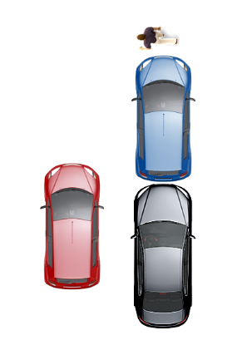
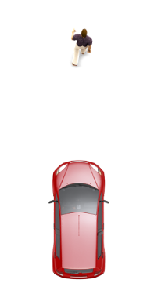
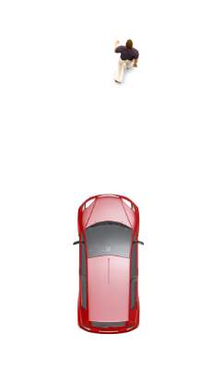
AEB 07 – Euro NCAP Summary
AEB VRU Pedestrian Scenarios
6 Points in total:
3 Points for day tests
3 Points for night test
 | CPFA-50 | CPNA-25 | CPNA-75 | CPNC-50 | CPLA-50 | CPLA-25
VUT speed | 20-60 km/h | 20-60 km/h | 20-60 km/h | 20-60 km/h | 20-60 km/h | 50-80 km/h
Ped speed | 8 km/h | 5 km/h | 5 km/h | 5 km/h | 5 km/h | 5 km/h
Obstruction | No | No | No | Yes | No | No
Impact point | 50% | 25% | 75% | 50% | 50% | 25%
AEB/FCW | AEB | AEB | AEB | AEB | AEB | FCW
Test conduct:
All tests performed by Euro NCAP
OEM has a prediction for performance
If deviation between prediction and test results by >5km/h:
up to three tests for each speed

Slide 8
AEB 07 – Euro NCAP Summary
AEB VRU Pedestrian Scoring Principle
Lateral Scenarios (CPFA-50, CPNA-25, CPNA-75, CPNC-50):
Longitudinal Scenario Braking (CPLA-50):
Longitudinal Scenario Warning (CPLA-25):
v₀ (km/h) | 20 | 25 | 30 | 35 | 40 | 45 | 50 | 55 | 60
 | Scoring by linear sliding scale (e.g. 40% speed reduction  40% score) |  |  |  |  | Min. speed reduction of 20km/h per test PASS/FAIL
v₀ (km/h) | 20 | 25 | 30 | 35 | 40 | 45 | 50 | 55 | 60
 | Scoring by linear sliding scale (e.g. 40% speed reduction  40% score) |  |  |  |  | Min. speed reduction of 20km/h per test PASS/FAIL
v₀ (km/h) | 50 | 55 | 60 | 65 | 70 | 75 | 80
 | FCW warning at TTC >= 1.7s per test PASS/FAIL
Full score (6 points):
No collision at 20 – 40 km/h
Min. speed reduction of 20 km/h from 45 km/h onwards
Warning at min. 1.7 TTC for CPLA-25 scenario

Slide 9
AEB 07 – Euro NCAP Summary
AEB Vehicle-to-Bicyclist
AEB V2B is part of the rating since 2018
Pedestrian/VRU Protection Box (6/48 Points)
Tests during daylight conditions
Lateral and longitudinal tests
Rating is based on collision speed

Slide 10
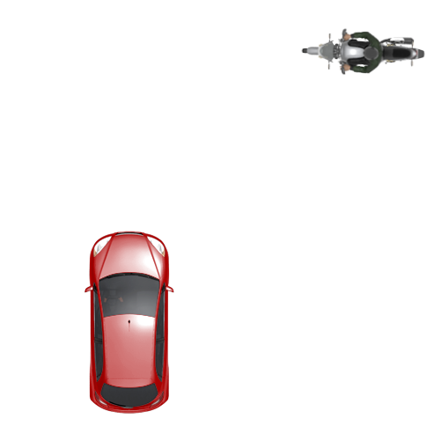
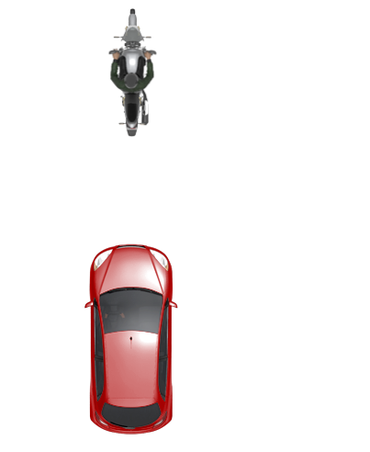
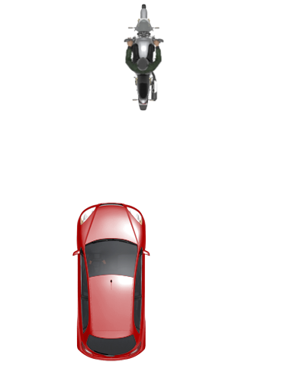
AEB 07 – Euro NCAP Summary
AEB VRU Bicyclist Scenarios
6 Points in total
 | CBNA-50 | CBLA-50 | CBLA-25
VUT speed | 20-60 km/h | 25-60 km/h | 50-80 km/h
Cyclist speed | 15 km/h | 15 km/h | 20 km/h
Obstruction | No | No | No
Impact point | 50% | 50% | 25%
AEB/FCW | AEB | AEB | FCW
Test conduct:
All tests performed by Euro NCAP
OEM has a prediction for performance
If deviation between prediction and test results by >5km/h:
up to three tests for each speed

Slide 11
AEB 07 – Euro NCAP Summary
AEB VRU Bicyclist Scoring Principle
Lateral Scenario (CBNA-50):
Longitudinal Scenario Braking (CBLA-50):
Longitudinal Scenario Warning (CBLA-25):
v₀ (km/h) | 20 | 25 | 30 | 35 | 40 | 45 | 50 | 55 | 60
 | Scoring by linear sliding scale (e.g. 40% speed reduction  40% score) |  |  |  |  | Min. speed reduction of 20km/h per test PASS/FAIL
v₀ (km/h) |  | 25 | 30 | 35 | 40 | 45 | 50 | 55 | 60
 |  | Scoring by linear sliding scale (e.g. 40% speed reduction  40% score) |  |  |  | Min. speed reduction of 20km/h per test PASS/FAIL
v₀ (km/h) | 50 | 55 | 60 | 65 | 70 | 75 | 80
 | FCW warning at TTC >= 1.7s per test PASS/FAIL
Full score (6 points):
No collision at 20/25 – 40 km/h
Min. speed reduction of 20 km/h from 45 km/h onwards
Warning at min. 1.7 TTC for CBLA-25 scenario

Slide 12
AEB 07 – Euro NCAP Summary
Outlook 2020/2022
Euro NCAP plans to
  allow automatic emergency steering (AES) as an alternative to braking for applicable AEB scenarios from 2020
  include intersection and crossing scenarios for AEB V2V and V2P starting from 2020
  include Reverse AEB V2P starting from 2020
  update AEB existing V2B requirements in 2020
  include PTW as target for AEB VRU from 2022
  include an AEB Head-On function from 2022
From 2020 AEB is an (implicit) requirement for five stars in Euro NCAP
Four stars are (theoretically) still possible w/o AEB

Slide 13
AEB 07 – Euro NCAP Summary
Summary
Euro NCAP tests are optional, one does not need to have a valid star rating to be able to sell a vehicle in Europe
Euro NCAP stars are intended to be consumer information, there is no other implication from the test results
until today (2018) AEB is no prerequisite for a five star rating
some AEB tests are sample tests only
in some cases it is possible to repeat a failed AEB test,
or repeat a test where the result deviates from the prediction of the OEM
full collision avoidance across the complete defined speed range is not required for a full score in any AEB test scenario

