Slide 1


AEB 07 – Industry Input

Slide 2
AEB 07 – Industry Input
Sensor Misalignment
5.1.4.1.2. Any non-electrical failure conditions (e.g. sensor misalignment) shall be detected within a urban driving time of 300 seconds and shall be signalled to the driver upon detection.
5.1.4.1.3. There shall not be an appreciable time interval between sensor blindness conditions detection and subsequently there shall not be an appreciable delay in illuminating the warning signal, in the case of blindness conditions.
It is difficult to ensure that any non-electric failure can be detected after 300 seconds as this is dependant on the driving condition.
While most conditions, that affect the AEBS’ performance, can be detected within 300s of regular urban driving, some conditions may take longer to detect. Also it may be difficult / impossible to detect failure conditions if driving off road or without other road users. e.g. vehicle needs to encounter:
speed between X-X km/h,
braking event of X m/s²,
Corner with radius of X m,
detect X other road users.

Slide 3
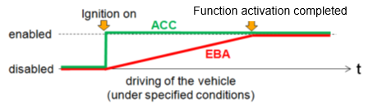
AEB 07 – Industry Input
Sensor Misalignment
Emergency systems like AEB will take longer to calibrate than comfort systems like ACC. This because false positive may lead to more critical situations.
Calibration time depends on the software and is specific to the vehicle manufacturer.
Creating a reproducible test procedure for any condition other than blockage is going to be very difficult and cause enormous effort for type approval testing.

Slide 4
AEB 07 – Industry Input
De-escalation of warnings
5.1.1. …
Collision warning and emergency braking may be aborted on decision of the system, if it detects a very low probability of a collision. e.g. the situation de-escalates because changes in trajectory of the other road users.
If a pedestrian is crossing the path of a vehicle, in much more than 95%, it will turn out all right, because the pedestrian is able to estimate the speed of the vehicle correctly and the dangerous zone (vehicle path)
  Will not been entered, because the pedestrian stops in time
  Will be entered, but the situation will be de-escalated by stepping back
  Will be entered, but the situation will be de-escalated by the pedestrian speeding up and leaving the dangerous vehicle path

Slide 5
AEB 07 – Industry Input
False Reaction Requirements and Tests
5.1.6. False reaction avoidance
The system shall be designed to minimise the generation of collision warning signals and to avoid autonomous braking in situations where the driver would not recognise an impending [forward or crossing] collision. This shall be demonstrated in accordance with Paragraph 6.10. Annex 3 of this Regulation.
Specific false reaction tests should be removed from the regulation as they are too specific considering there are an infinite number of possible scenarios.
The requirement for false reactions to be minimised should remain and should be tested through the Annex for complex electronic systems.

Slide 6
AEB 07 – Industry Input
False Reaction Requirements and Tests
Typical critical situations:
  Pedestrian moves towards the road edge, sees the vehicle in time and stops in time
  Pedestrian deescalates the situation by leaving the collision path in due time
Pedestrians are highly dynamic.
Probability for a False Intervention increases with ego vehicle speed.
These False Interventions are situation based and cannot be overcome by different/better sensors.
False Interventions are annoying and reduce end consumer acceptance and could lead to additional accidents.

Slide 7
AEB 07 – Industry Input
Laden and Unladen effect on AEBS performance
Additional mass of the vehicle does not reduce the level of deceleration that can be achieved, but increase the time taken to achieve this level of deceleration.
Taking this into consideration, it reduces the performance of the vehicle based on the calculations originally used from the previous meetings.
For M1 Category vehicles
LVW : 9m/s² + 0,6s 42km/h avoidance
GVW : 9m/s² + 0,66s 40km/h avoidance
For N1 Category vehicles
LVW : 9m/s² + 0,6s 42km/h avoidance
GVW : 9m/s² + 0,73s 38km/h avoidance

Slide 8
AEB 07 – Industry Input
Laden and Unladen effect on AEBS performance
In Special resolution no. 1, concerning the common definitions of vehicle categories, masses and dimensions (S.R. 1)
There are definitions for Mass in Running Order and Gross Vehicle mass.
2. "Unladen Vehicle Mass" means the nominal mass of a complete vehicle as determined by the following criteria:
2.1. Mass of the vehicle with bodywork and all factory fitted equipment, electrical and auxiliary equipment for normal operation of vehicle, including liquids, tools, fire extinguisher, standard spare parts, chocks and spare wheel, if fitted.
2.2. The fuel tank shall be filled to at least 90 per cent of rated capacity and the other liquid containing systems (except those for used water) to 100 per cent of the capacity specified by the manufacturer.

Slide 9
AEB 07 – Industry Input
Laden and Unladen effect on AEBS performance
3. "Mass in running order" means the nominal mass of a vehicle as determined by the following criteria:
Sum of unladen vehicle mass and driver’s mass. The driver’s mass is applied in accordance with paragraph 6.1. below.
In the case of category 1-2 vehicles, additional crewmembers for which seating positions are provided shall be included, their mass being equal to, and incorporated in the same way as, that of the driver.
6.1. "Driver Mass" means the nominal mass of a driver that shall be 75 kg (subdivided into 68 kg occupant mass at the seat and 7 kg luggage mass in accordance with ISO standard 2416–1992)
4. "Gross vehicle mass" of a vehicle means the maximum mass of the fully laden solo vehicle, based on its construction and design performances, as declared by the manufacturer. This shall be less than or equal to the sum of the maximum axles’ (group of axles) capacity

Slide 10
AEB 07 – Industry Input
Laden and Unladen effect on AEBS performance
Sample of weights from N1 category vehicles.

Slide 11
AEB 07 – Industry Input
Laden and Unladen effect on AEBS performance
Sample of weights from N1 category vehicles.

Slide 12
AEB 07 – Industry Input
AEBS Braking Requirements
Prevents manufacturers implementing different braking strategies dependent on the vehicles speed and scenario. Manufacturers tend to ramp up the level of deceleration provided by the system over several phases. Lower speed may be different to the strategy used at higher speed.
At lower speeds LTB is behind LTS. So it’s possible to brake safe and less harsh after LTS has passed.
May only need slight speed reduction in order to avoid the collision, particularly in crossing scenarios.
Using AEBS as a comfort function is unlikely. The peak deceleration of more than 4 m/s² and a remaining gap to another vehicle less than 1 m in an AEB event are uncomfortable for the driver and very uncommon considering normal driving.

Slide 13
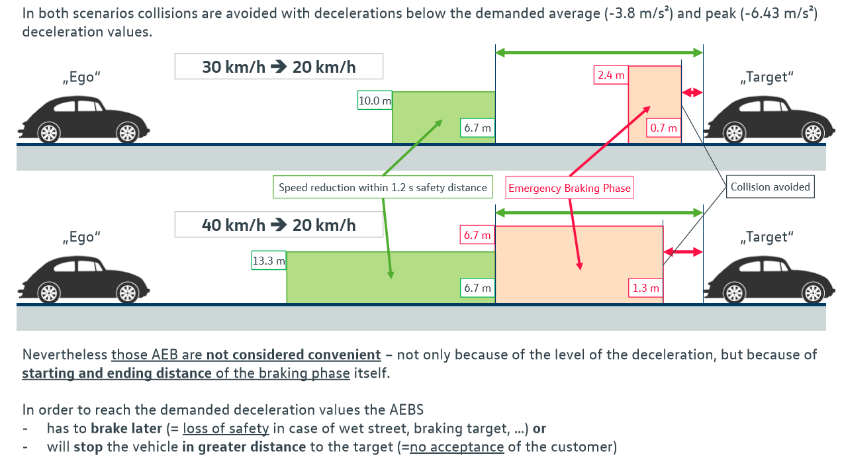
AEB 07 – Industry Input
AEBS Braking Requirements

Slide 14

CCRm-Scenarios: today in the market, not convenient
AEB 07 – Industry Input
AEBS Braking Requirements
30 kmph ➔ 20 kmph
peak decel. 4.7 mps²
average decel. 2.4 mps²
Motoring Fine area
(German Bußgeldkatalog)
„Target“
„Ego“
Avg. decel.: 2.5 mps²
Peak decel.: 4.7 mps²
10.0 m
2.4 m
6.7 m
0.7 m
Begin comfort braking
(keeping 1.2 s safety distance)
Begin Emergency
Braking
Collision avoided
„Ego“
Motoring Fine area
(German Bußgeldkatalog)
„Target“
40 kmph ➔ 20 kmph
peak decel. 5.0 mps²
average decel. 3.1 mps²
Avg. decel.: 3.1 mps²
Peak decel.: 5.0 mps²
6.7 m
13.3 m
6.7 m
1.3 m
Nevertheless those AEB are not considered convenient – not only because of the level of the deceleration, but because of starting and ending distance of the braking phase itself.
In order to reach the demanded deceleration values the AEBS
has to brake later (= loss of safety in case of wet street, changing conditions e.g. braking target, …) or
will stop the vehicle in greater distance to the target (=unnecessarily increasing hazard for following vehicles)

Slide 15
AEB 07 – Industry Input
AEBS Braking Requirements
Impact of demanded average deceleration (-3.8 m/s²) on emergency braking in lower speed range.
Keeping todays begin of emergency braking phase
Passing todays emergency braking point in order to keep todays final distance to target
„Ego“
30 km/h
Avg. decel.: 2.5 mps²
Peak decel.: 4.7 mps²
„Target“
20 km/h
New braking point according to 2.
New final distance according to 1.
2.4 m
1.7 m
1.4 m
0.7 m
1. Emergency Braking
2. Emergency Braking
Original Emergency Braking
Loss of safety = 0.7 m
increased hazard for following vehicle = 0.7 m

Slide 16
AEB 07 – Industry Input
AEBS Braking Requirements
Impact of demanded average deceleration (-3.8 m/s²) on emergency braking in lower speed range.
Keeping todays begin of emergency braking phase
Passing todays emergency braking point in order to keep todays final distance to target
„Ego“
40 km/h
Avg. decel.: 3.1 mps²
Peak decel.: 5.0 mps²
„Target“
20 km/h
New final distance according to 1.
New braking point according to 2.
6.7 m
5.4 m
2.6 m
1.3 m
1. Emergency Braking
2. Emergency Braking
Original Emergency Braking
Loss of safety = 1.3 m
increased hazard for following vehicle = 1.3 m

Slide 17
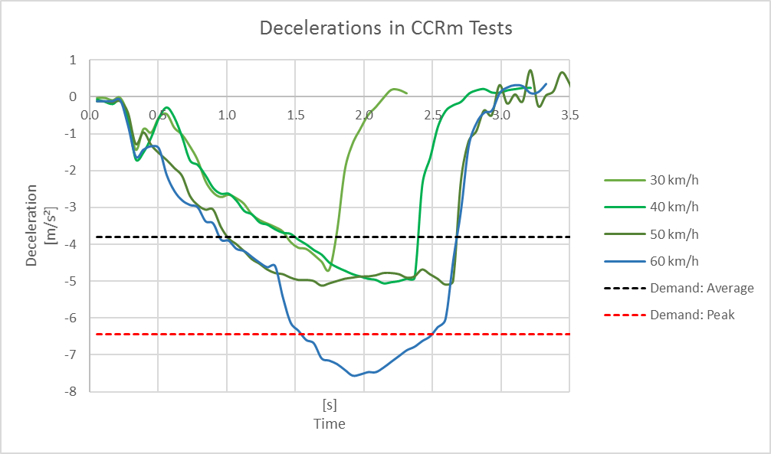
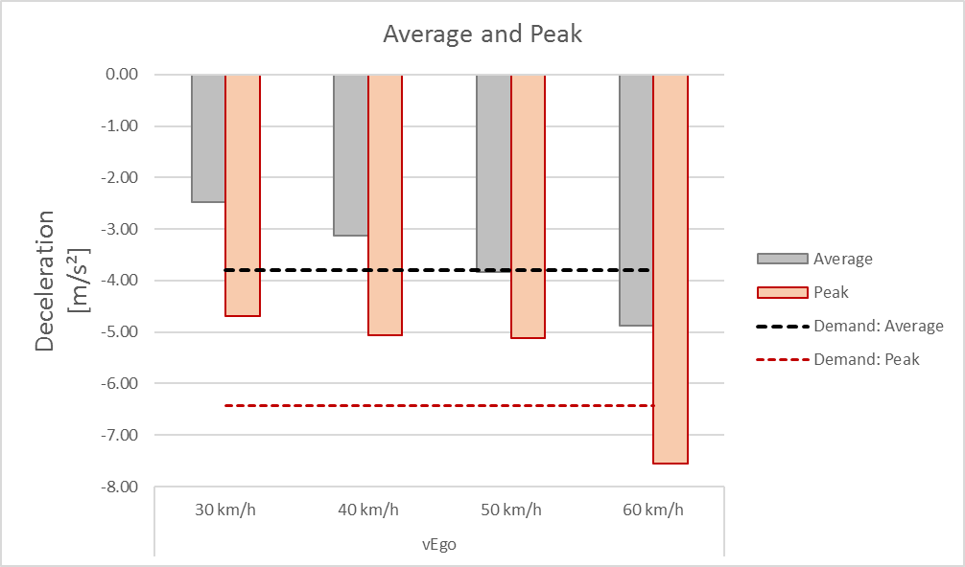
AEB 07 – Industry Input
AEBS Braking Requirements
Speeds up to 30km/h relative speed did not achieve the vehicle deceleration required by the draft regulation.
Example (current AEBS):
Braking from 30 km/h to 20 km/h on a moving vehicle
Peak approx. -4,6 m/s²
Average approx. -2,3 m/s²

Slide 18
Deceleration distribution in real-world traffic
AEB 07 – Industry Input
AEBS Braking Requirements
Exposure to deceleration ranges
(customer-near validation testing – Europe – 130000km / 2280h)
Exposure [s]
Cumulated Freq. [%]
Cumulated frequency
Exposure [s]
Deceleration classes [m/s2]

Slide 19
Exposure of Decelerations based on customer-near validation testing ( ca. 170.000 km, evaluated driving time ca. 1900h)
AEB 07 – Industry Input
AEBS Braking Requirements
 | Exposure
Speed / Scenario | E4 (>10% Driving Time) | E3 (1-10% Driving Time) | E2 (<1% Driving Time)
5-55 km/h (Urban) | <1,5 m/s² | 1,5-3,75 m/s² | > 3,75 m/s²
56-115 km/h (Interurban/Highway) | <0,75 m/s² | 0,75-2,5 m/s² | > 2,5 m/s²
>115 (Highway) | <0,75 m/s² | 0,75-2m/s² | > 2 m/s²

Slide 20
AEB 07 – Industry Input
AEBS Braking Requirements
5.2.1.2. Emergency braking
When the system has detected the possibility of an imminent collision, there shall be an emergency braking intervention emitting an average a braking demand of at least [3.8 m/s² deceleration, with at least a peak at 6.43 4 m/s², to the service braking system of the vehicle.
This shall be tested demonstrated in accordance with Paragraphs 6.4. and 6.5. Annex 3 of this Regulation.
Braking demand cannot be tested easily through normal test procedures, so shall be covered by the Annex for complex electronic systems.
Late, unnecessary harsh braking will trigger accidents of following vehicles and therefor rather reduce road safety
The manufacturer has an own motivation to activate the system as late as possible, in order to not annoy the driver and reduce false reactions (the later you activate, the more sure you are regarding environment interpretation).

Slide 21
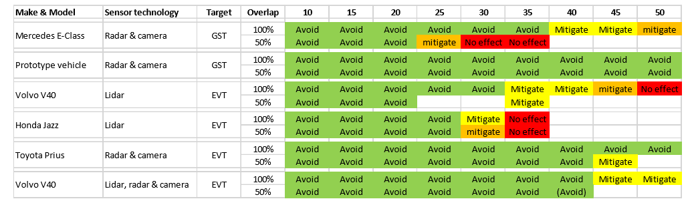
AEB 07 – Industry Input
Car to Car Reduced Overlap Performance
Test procedure should define a tolerance for lateral offset of +/- 0.1m.
0.5m proposed by CPs equals approximate lateral offset of 75%. Such a test has only recently been prescribed in EuroNCAP 2018 test protocol for Car to Car AEB. And should therefore not be defined in regulation yet as real world experience is too low.
Combined Test tolerances in CCRm test at +/-0.1m for subject vehicle and target vehicle. This can lead to a lateral offset of 0.2m, this should be sufficient to cover other cases experienced in the real world.
Performance in real world of 50% overlap as reviewed at AEBS 02.

Slide 22
AEB 07 – Industry Input
Car to Car Reduced Overlap Performance
What happens if the overlap varies?
  Last Point to Steer changes to a later point in time,
  because less y-distance is needed to steer around.
What is a reasonable range of overlap,
that still resembles the same maneuver?
  +/- 0,25m
When and why can the max. performance no longer be guaranteed?
  With the last point to steer shifting to a later point in time, the maximum achievable speed reduction decreases
  The risk of annoying the attentive driver is high
  In the sense of an “assistance system” -> when it is not clear that the driver needs assistance, the system should not activate.

Slide 23
AEB 07 – Industry Input
Car to Car Reduced Overlap Performance
Decreasing the overlap for car to car scenarios, reduces the Last Point to Steer. If manufacturers apply the principle that the vehicle should not brake before either the Last Point to Steer or the Last Point to Brake whichever is latest the speed at which full avoidance is required is reduced.

Slide 24
AEB 07 – Industry Input
Cyclist Warning Requirements
ENCAP test requirements require a warning at the latest 1.7 seconds TTC.
In order to fulfil such requirements in a regulation, manufacturers would need to tune their vehicles to warn at 2 seconds.
2 seconds in the real world may cause unwanted warning interventions.
Industry propose a warning no later than 1.2 seconds before the collision.
This is deemed acceptable as the driver is most likely to steer to avoid the collision at the last point to steer in such a scenario is very late.

Slide 25
AEB 07 – Industry Input
Justification for Manual Deactivation
Discussed compromised position from AEBS 06:
Permanently deactivate the system after a manual deactivation within 10 ignition cycles in a row
Permanently deactivate the system after 5 manual deactivations within 1 ignition cycle.
Industry are not in favour of offering a permanent deactivation of the system until fixed at a dealership because a permeant deactivation would reduce the effectiveness of mandating such a safety feature.
Industry propose instead to implement an audible as well as optical warning if the AEBS is manually deactivated 10 ignition cycles in a row. As this clearly indicates a misuse of the safety system.

Slide 26
AEB 07 – Industry Input
Test Repetition
Current test requirements in the draft regulation are more stringent than those in ENCAP.
If a manufacturer does not meet the performance requirements for any test, the manufacturer will not receive a type approval.
In NCAP if a vehicle impacts with a target, the manufacturers are allowed to repeat the test.
This is important when testing vehicles outside of the laboratory and environmental conditions can effect the performance of the vehicle. Provisions need to be included in the regulations to allow the manufactures a tolerance if the specified performance is not met.
e.g.
Repetition of failed tests (Average of 3 tests)
Pass >80% of tests carried out.

