Slide 1


Meeting rules confirmation
2019.01.24
EVS-IWG Secretary
Kenichiroh KOSHIKA

Slide 2
Outline
Submission condition for 17th IWG
2

Slide 3
Submission condition in EVS 17th meeting
77% of technical presentations were submitted before the deadline
Thank you for your cooperation !
3

Slide 4
Submission condition in EVS 17th meeting
Score continuously decreased
 | Total presentation | Delay | On time | Score
15th Beijing | 15 | 1 | 14 | 93.3%
16th Gothenburg | 20 | 2 | 18 | 90.0%
17th Detroit | 13 | 3 | 10 | 76.9%
Denominator: total number of giving presentation in IWG
Please submit before the deadline.
4

Slide 5
Thank you !

Slide 6
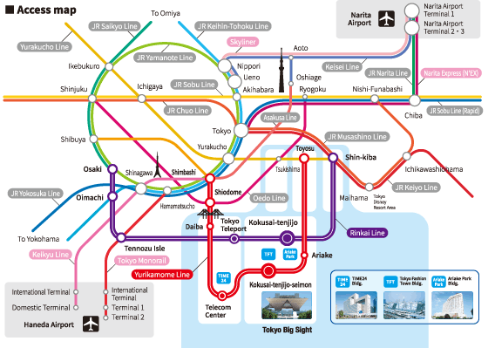
Next IWG-MTG
18th EVS-IWG meeting: Tokyo
6/11-13 (3days)
6/10 optional MTG
6/14 R100 MTG
Candidate MTG area: Yotsuya
6

