Slide 1
Short Presentation –
Response to
EVS17-E1TP-0700
Submitted by OICA

Slide 2
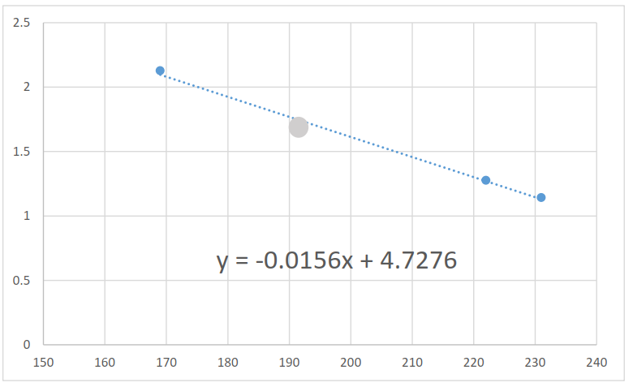
Question slide 11:
Please explain the graph and how it was derived:
Is the line inclination in graph based on three (3) test?
Please elaborate conclusion.

