Slide 1
Japan’s response to
Action item 2
EVS-GTR IWG#17

Slide 2
Key messages
“(A) Is thermal propagation due to an internal short single cell thermal runaway a problem in the field?” and “(B) Simulation of a single cell thermal runaway” are important in order to continue research.
Simulate “Internal short circuit caused by cell manufacturing failure” in this test.
If there is another cause which may lead to thermal runaway and thermal propagation, clarify this and set new test to prevent this from resulting in thermal runaway, not initiate forcible thermal runaway in thermal propagation test to cover this.
Need to investigate the methods which can simulate “Internal short circuit caused by cell manufacturing failure”.
 | Action Items | Responsibility | Due
2 | All members identify specific questions in the white paper to contracting parties for agreement in order to continue with research. | ALL China, EC, Japan, US, Canada, Korea, OICA | 12/01/18

Slide 3
Action item2 in IWG#16
(A) and (B) are preconditions of this test. Need to decide these first.
 | Questions | Note
(A) | Is thermal propagation due to an internal short single cell thermal runaway a problem in the field? | Preconditions of this test. Necessary to decide first. Forcible thermal runaway or internal short circuit?
(B) | Simulation of a single cell thermal runaway
(C) | Elimination of Detection and Intervention Technologies | Depends on test methods and conditions. These will be decided based on (B).
(D) | Ignition of vented gases and other risks | No conflict
(E) | Evaluation Criteria | Important but no conflict
(F) | Repeatability and Reproducibility | Depends on test methods and conditions. These will be decided based on (B).
(G) | Manipulation of test-device
(H) | Specifics of initiation methods and environmental conditions
(I) | Re-testing and re-homologation | Same as other tests
(J) | Documentation requirements | No conflict

Slide 4
Responses from CPs and OICA
 |  | EU/JRC | OICA | KOREA | JAPAN | CHINA | CANADA | US
(A) | Is thermal propagation due to an internal short single cell thermal runaway a problem in the field? |  |  |  | Selected | Selected
(B) | Simulation of a single cell thermal runaway | Selected | Selected | Selected | Selected | Selected
(C) | Elimination of Detection and Intervention Technologies
(D) | Ignition of vented gases and other risks
(E) | Evaluation Criteria |  | Selected
(F) | Repeatability and Reproducibility
(G) | Manipulation of test-device
(H) | Specifics of initiation methods and environmental conditions
(I) | Re-testing and re-homologation
(J) | Documentation requirements

Slide 5
Causes which may lead to thermal runaway
Various causes may lead to thermal runaway.
GTR20 covers these causes except for internal short circuit caused by manufacture failure.
Example of FTA resulting in “Thermal runaway” and “Thermal propagation”
Thermal propagation
Thermal runaway
Overcharge
Over-discharge
Heat
External heat
Fire
Self Heating
Over temperature
Over current
Short circuit (External)
:Covered by requirements in GTR20*
Short circuit (Internal)
Low temperature
:Not covered by requirements in GTR20*
*Except for current thermal propagation requirement
Shock
+/- electrodes/
foils contact
Crush
Manufacture failure
Covered by thermal propagation test

Slide 6
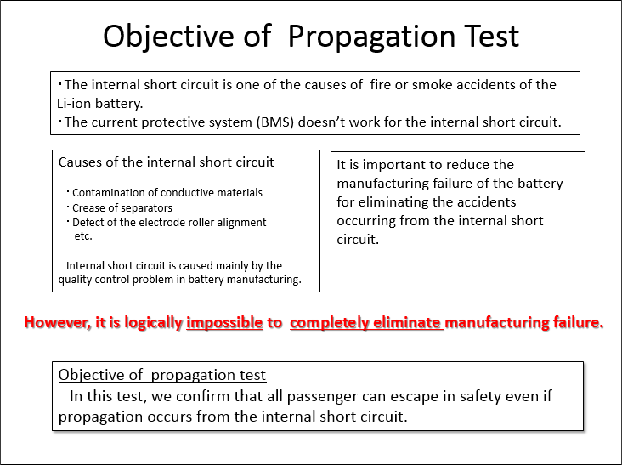
Causes which may lead to thermal runaway
Manufacturing failures will not be completely eliminated in theory.
TF5 meeting 5/2015 *not uploaded

Slide 7
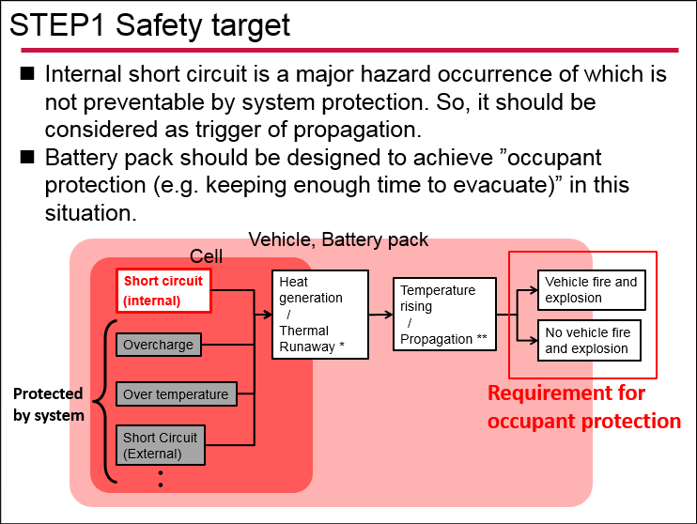
Causes which may lead to thermal runaway
Causes are also prevented by system (e.g. BMS, fuse, etc.)
But internal short circuit is not preventable. (OICA reported that detection may be possible, but prevention is difficult.)
EVS-06-23e

Slide 8
Causes which may lead to thermal runaway
If there is another cause which may lead to thermal runaway, clarify this and set new test to prevent this from resulting in thermal runaway, not initiate forcible thermal runaway in thermal propagation test to cover this.
Example of FTA resulting in “Thermal runaway” and “Thermal propagation”
Thermal propagation
Thermal runaway
Overcharge
Over-discharge
Heat
External heat
Fire
Self Heating
Over temperature
????
Over current
Should be covered by new test
Short circuit (External)
Short circuit (Internal)
Low temperature
:Covered by requirements in GTR20*
Shock
:Not covered by requirements in GTR20*
+/- electrodes/
foils contact
*Except for current thermal propagation requirement
Crush
Manufacture failure
Covered by thermal propagation test

Slide 9
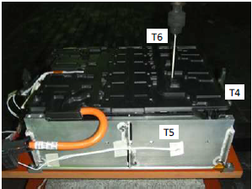
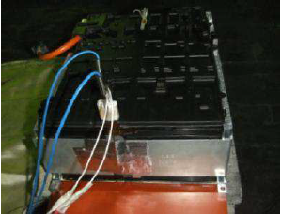
Initiation method research
 | Nail | Heater | Laser | ・・
 |  |  | Now researching | ・・
Challenges | It’s hard to control penetration layers. Need manipulation to insert nail. | There are some samples which are hard to induce internal short. Need manipulation to set heater. | Now researching | ・・

Slide 10
Summary
“(A) Is thermal propagation due to an internal short single cell thermal runaway a problem in the field?” and “(B) Simulation of a single cell thermal runaway” are important in order to continue research.
Simulate “Internal short circuit caused by cell manufacturing failure” in this test.
If there is another cause which may lead to thermal runaway and thermal propagation, clarify this and set new test to prevent this from resulting in thermal runaway, not initiate forcible thermal runaway in thermal propagation test to cover this.
Need to investigate the method which can simulate “Internal short circuit caused by cell manufacturing failure”.

Slide 11
Future Plan
Need to investigate the method which can simulate “Internal short circuit caused by cell manufacturing failure”.
Assess new initiation methods whether it can simulate this scene.
 | 2017 | 2018 | 2019 | 2020
IWG
Japan Research
#14
#15
#16
#17
Report
Report
Repeatability and reproducibility test (Nail)
Repeatability test (Heater)
Field data investigation
Possible initiation method test research (e.g. Laser)

Slide 12
Thank you for your attention

Slide 13
APPENDIX

Slide 14
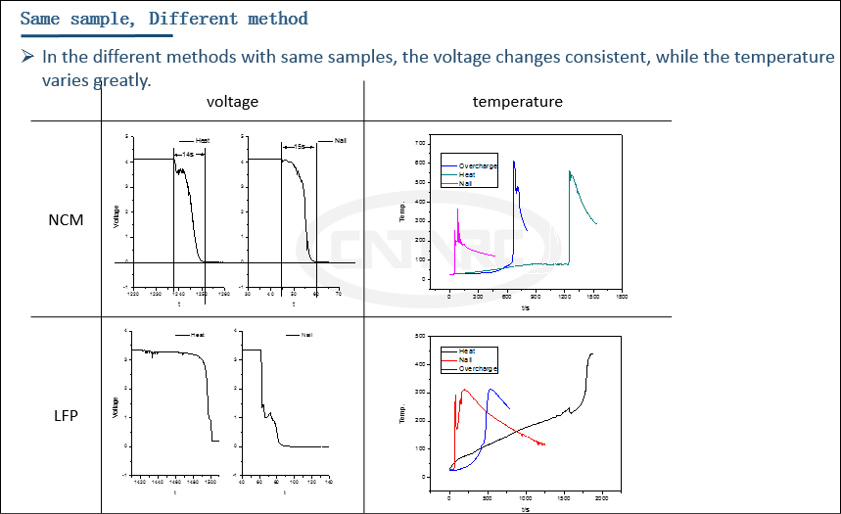
Difference of phenomena in thermal runaway
Depending on initiation methods, the phenomena in thermal runaway are different.
Need to clear the cause of thermal runaway and set initiation method which can simulate this.
EVS1416-603

Slide 15
Q&A
 | Slide No. | Questions | Answers

