Slide 1
Smoke Gas Toxicity
Dr. Patrick Seiniger
BMVI, Section StV 22

Slide 2
Structure
Previous research on bus fire safety
Accidentology
Smoke gas toxicity
Upcoming research
Other activities that contribute to bus safety
Summary

Slide 3
Previous Research
Study on smoke production, development and toxicity in bus fires
Project duration 2009-2013
Research project by BAM, the Federal Material Research Institute, financed by BASt
Recommendations for the upgrade of the fire safety requirements for bus interior materials
  Burning behavior
  Smoke gas toxicity
  Technical assistance systems (e.g. fire detectors)
General conclusion of the researchers: alignment of vehicle standards to rail standards necessary!

Slide 4
Accidentology
Approximately 75% of all bus fires start in engine compartment
Approximately 85% of busses were driving while fire started
Mostly city busses (60%)
Fatalities typically from catastrophic bus fires
Study leaves open how often accidents contributed to the fire or to the injuries

Slide 5
Improved Standards: Modifications to UN R118, UN R107
Fire sensor in engine compartment
                (eff. 31.12.2012/31.12.2013)
Burning behavior internal materials (cables)
(eff. 9.12.2015/9.12.2015)
Fire extinguisher system in engine compartment
(eff. 10.6.2018/10.6.2019)
Burning behavior internal materials (fire speed, test direction)
(eff. 26.7.2017/26.7.2020)
Emergency exits
(eff. 10.6.2018/10.6.2020)

Slide 6
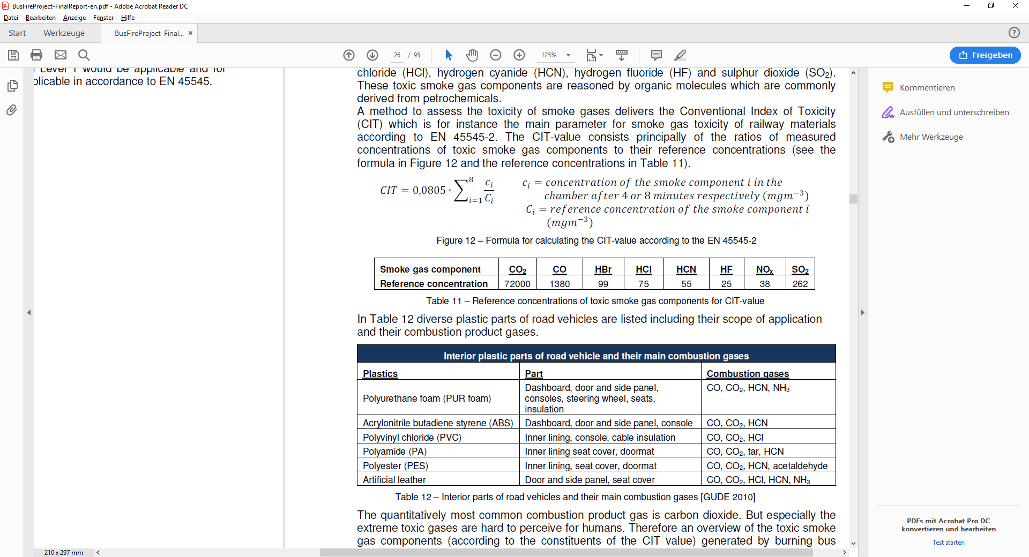
Smoke Gas Toxicity – Rail Standards
Carbon Dioxide
Carbon Monoxide
Hydrogen Bromide
Hydrogen Chloride
Hydrogen Cyanide
Hydrogen Fluoride
Nitrous Gases
Sulphur Dioxide
Conventional Index of Toxicity –
„Average Toxicity?“

Slide 7
Threshold Values For CIT Calculation And Their Meaning
CO₂: 80000 ppm → Unconsciousness, short-termed death
CO: 1380 ppm → Headaches in 20 min, fatal within 1-2 hours
HBr: 99 ppm → Hard incapacitating impact on escape after 10 min
HCl: 50 ppm → breathes stopped by lung irritation
HCN: 100 ppm → Fatal after almost 1 hour
HF: 24 ppm → Hard incapacitating imacpt on escape after 1 hour
NOX: 50 ppm → Strong irritation on respiratory tract and eyes
SO₂: 100 ppm → Life-threatening
CIT = 0.64: all values at threshold

Slide 8
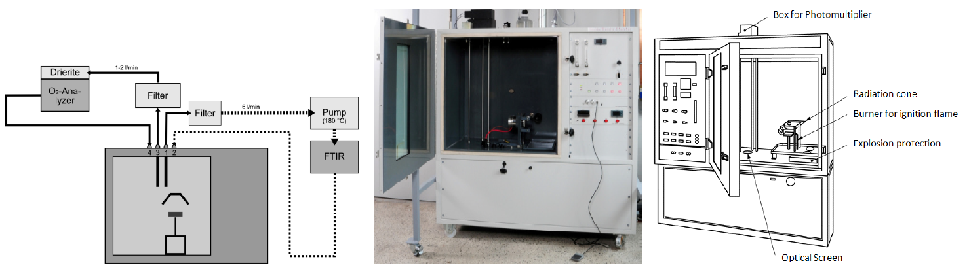
Experiments
Body insulation
Floor covering
Side panel
Ceiling (seats, gangways)
Foam of seats

Slide 9
Results
CIT: „Conventional Index for Toxicity“
CIT = 0.64 if all components approach the specified reference concentration
 | 4 min – CIT OK? | 8 min – CIT OK? | Individual concentrations
Body insulation | Ok | Ok | Ok
Floor covering | Not Ok | Not Ok | Toxic HCl
Side panel | Ok | Ok | 4 min: Fatal ~ 10 min 8 min: Fatal << 10 min
GRP part | Ok | Ok | 8 min: Fatal 30-60 min
Ceiling seat | Not Ok | Not Ok | Toxic HCl
Ceiling gangway | Not Ok | Not Ok | Toxic HCl
Foam of seats | Ok | Ok | Ok
?
HCN

Slide 10
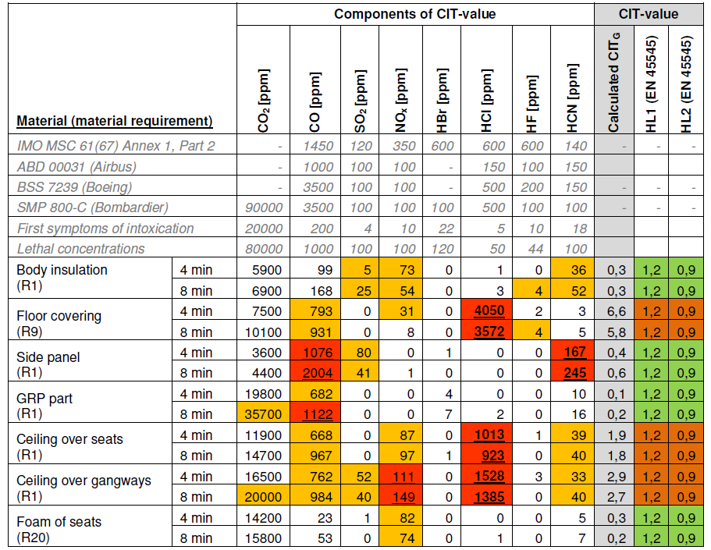
Results (2)
>>
10 min
~30-60 min
~30-60 min
<<
10 min

Slide 11
Conclusion – Smoke Gas Toxicity
In general CIT and individual toxic concentrations in line
In one case, the Hydrogen Cyanide concentration approaches values for fatality (and CO after 30-60 minutes)
  after 10 min (4 min burning test)
  less than 10 min (8 min burning test)
In another case, CO is fatal after ~ 30 – 60 min
At this stage, it is still unclear whether the CIT value is a good criterion for bus materials
What is a good criterion for smoke gas toxicity on busses?
Is a new criterion needed?
Is a tailored test for the bus sector more appropriate?

Slide 12
Upcoming Research
Identification of appropriate criterion to limit smoke gas toxicity in busses
Identification of smoke gas toxicity from current materials
Identification of relevant materials
Identification of relevant smoke gas components
Definition of a simplified test procedure
Derivation of threshold values for simplified test procedure
Project will last 10 month, has not started as of now. Input from BMFE still possible. Intermediate results could be provided to BMFE.

Slide 13
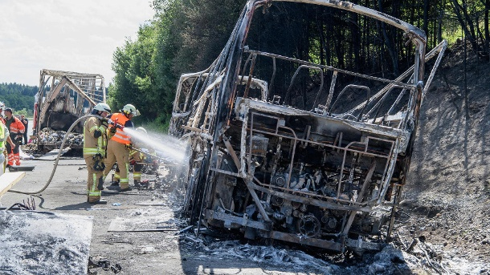
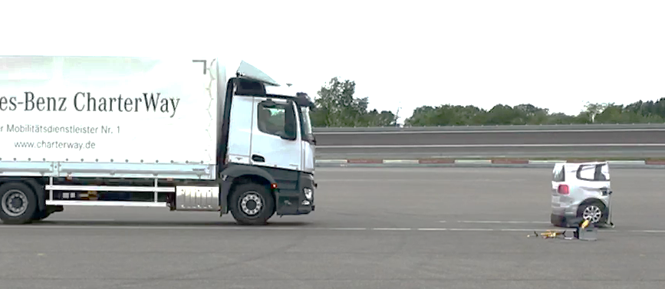
Recent Severe Fire (July 2017)
Bus (2013) impacts stationary
truck with 60-70 km/h impact speed
Damaged tank, pneumatic reservoir
contribute to quick fire spread,
18 fatalities,
Vehicle fully compliant with regulations
applicable at that time, i.e. NOT equipped
with AEBS!
Today’s AEBS: - 20 km/h on stationary tgt.
German proposal to increase requirements (GRVA)
  No impact up to 70 km/h
  Impact ≤25 km/h from 80 km/h
  Impact ≤40 km/h from 90 km/h
  Impact ≤55 km/h from 100 km/h
  Impact ≤65 km/h from 110 km/h

Slide 14
Summary
Bus fires typically start in the engine compartment (>75%)
Bus fire safety has been improved
Improved standards not all effective as of now (for new busses!)
Smoke gas toxicity not yet limited
Criterion for smoke gas toxicity under investigation
Severe bus fires typically after severe accidents
Improvement of AEBS → German proposal at GRVA
Improvement of crash safety → GRSP activities
High potential to address catastrophic bus fires with additional measures!

Slide 15
Thank you for your attention!
Federal Ministry of Transport
and Digital Infrastructure
Robert-Schuman-Platz 1
D-53175 Bonn

