Slide 1
Questions/Comments on ECE/TRANS/WP.29/GRSG/2019/10
IG VRU-Proxi, 8th Meeting
VRU-Proxi-08-08

Slide 2
Principle
Design Intention of Regulation
Possible Designs
Possible Designs, Not Realistic
Vehicle
Vehicle
Vehicle
Vehicle
Vehicle
Vehicle
Vehicle
Vehicle
Class VIII Field
CMS and/orMirror and/or direct view
Audible Device
Audible Device
Audible Device
Audible Device
Audible Device
CMS ...
[1 m]
CMS ...
CMS ...
Audible Device
[3.5 m]
1
2
A
B
C
D
E

Slide 3
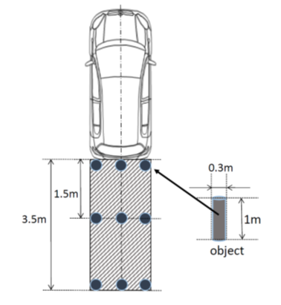
FoV rear-end pole location
15.2.4.8.1.
(a) A transverse vertical plane through the outermost point of the rear of the vehicle;
to be
(a) A transverse vertical plane 300 mm behind of the outermost point of the rear of the vehicle;
Cf. FMVSS 111
0.3m
1.5m
3.5m
Picture Source: Wikimedia Commons

Slide 4
FoV rear-end pole location
Justification
Proposal is actually 0.15m gap range
of pole existence. VRU can not exist
in this space due to body dimensions.
2) Comparison of visibility of pole shows
almost the same of JNCAP 20cm width
markings. “To see 20 cm markings”
seems the same as “at least part
of each cylindrical objects” at this
position(very small viewing angle).
3) This condition is almost the same
as Audible warning system (sonar)
test procedure in Annex 13 (Evaluation start from
0.2 m as per ISO17386 also used in India.)
4) Korea & US both identified space between monitoring area and rear end of vehicle
0.90m
0.90m
0.74m
0.74m
0.15m
0.15m
0.30m
0.30m
JNCAP
Pole
22.5°
22.6°
27.1°
28.5°
Marking zone
Marking zone
Normal size vehicle: almost same
Small size vehicle: More strict proposal
Comparison of visibility of pole

Slide 5
Combination of CMS of Class VI and Class VIII
Today applications use same screens for class VI (front view) and rear view (until now unregulated).
There is no overlap situations based on the description of the the application. Class VI is for forward with speed above 10 km/h, Class VIII is vor backward driving.
If combination is not allowed, an additional screen is needed, which even in the instrument panel of trucks is a space issue, since the sreen needs tobe in direct view of the driver. Also an additional screen might cause higher distraction.
Paragraph 15.2.1.1.2., amend to read:
"15.2.1.1.2. In the case a camera-monitor system is used for rendering (the) field(s) of vision, the relevant field(s) of vision shall be permanently visible to the driver when the ignition is on or the vehicle master control switch is activated (whichever is applicable). However, when the vehicle is moving forward at a speed above 10 km/h or backwards, the monitor or the part of the monitor intended for rendering the Class VI field of vision may be used for other information (excluding Class VIII). However, when the vehicle is moving forward, the monitor or the part of the monitor intended for rendering the class VIII field of vision may be used for other information . Multiple images may be used or displayed provided that the monitor has been approved in this mode.
Furthermore, in the case of a camera-monitor system intended for rendering the Class VIII field of vision, it may be such that the relevant field of vision is permanently visible to the driver only when the vehicle is moving backwards."

Slide 6
Alternative: Class VIII field or Obstacle Detection
Regulation needs a clear statement that monitoring is equivalant to a vision device field of vision and that this physical area is not the same.
Current draft text: „15.2.4.8.2. ... In addition, the requirement may be met using a combination of mirrors of Class VIII and other Class(es) or using an obstacle detection system. “
This statement mixes combination and replacement with obstacle detection system.
Vehicle
Vehicle
Class VIII Field of Vision (Mirrors or CMS or direct vision)
Monitoring Area (Audible Device) alternative to Class VIII Field
[1 m]*
3.5 m
➔ New Text Proposal on Slide 8
* If larger than 1 m possibility for pure visual warning should be allowed for monitoring areas beyond 1 m -> Reduce Annoyance.

Slide 7
Multimodal Approach
Need to make sure that combination of devices is allowed. Current text does not allow for smaller monitoring area or R1 device to be used in combination with other devices for Class VIII or direct vision. Unfortunately same text (as slide before) used for multimodal approach.
Vehicle
Current text in table in paragraph 15.2.1.1.3:
„May be viewed using a combination of direct view and indirect vision devices (of Classes I through VI). “
and
“15.2.4.8.2. If the field of vision defined in paragraph 15.2.4.8.1. can be perceived via a combination of devices for indirect vision of other Classes or directly from the driver's looking back ocular points described in paragraph 15.2.4.8.3., it is not mandatory to equip the vehicle with a Class VIII close-proximity rear-view device. In addition, the requirement may be met using a combination of mirrors of Class VIII and other Class(es) or using an obstacle detection system.”
Does current text really allow for any combination ?
Class VIII Field of Vision (Mirrors or CMS or direct vision)
Monitoring Area (Audible Device)
smaller 1 m
3.5 m
➔ New Text Proposal on Slide 8

Slide 8
Proposal on Alternative and Multimodal Approach
Three Intentions:
If exiting device cover the Class VIII field, then no Class VIII field device must be installed.
Class VIII field can be combined from existing devices, new devices and direct view (Multimodal)
If Obstacle Detection System meeting monitoring area requirements of Annex 13 is installed, then no Class VIII field device is required.
Proposal: Cover it with three separate sentences, do not mix:
“15.2.4.8.2. If the field of vision defined in paragraph 15.2.4.8.1. can be perceived via a combination of devices for indirect vision of other Classes or directly from the driver's looking back ocular points described in paragraph 15.2.4.8.3., it is not mandatory to equip the vehicle with a Class VIII close-proximity rear-view device.
If above combination only covers a portion of the Class VIII field of vision, only the remaining portion must be covered by a Class VIII device or an obstacle detection system or an combination of both.
In addition, if an obstacle detection system complying to the requirements of Anney 13 is installed, it is not mandatory to equip the vehicle with a Class VIII close-proximity rear-view device.”

Slide 9
Can the audible device cover more than the regulatory Monitoring Area ?
Current Text in Regulation Draft Annex 13:
2.1. Audible information
When an object is detected in the rear horizontal area as described in paragraph 5.1. below, audible information in accordance with ISO 15006:2010 shall be given.
...
5.1. Monitoring area
The maximum detection distance in Clauses 5.4.2 and 5.4.3 of ISO 17386 :2010 shall be [1.0] m (Class R2).
Current Intention
Possible ?
Vehicle
Vehicle
Vehicle
OK
Audible Device
Class VIII Field
Monitoring Area (Audible Device)
[1 m]
NOK
[3.5 m]
Proposal: The required detection distance ... shall be [ 1.0 ] m maximum (Class R2).
For clarity recommended to add a picture of the detection zone (width of vehicle x 1m)

Slide 10
Does the test have to be repeated for each grid square in the monitoring area or only once ?
§ 4: detection latency 0.6 s: in deviation of ISO 17386 the poles are placed on the grid prior selection of rear gear „locate the test object behind the vehicle” ➔ 1 test spot ? Which ? Center of Area, Border ?
§ 5.2 (minimum detection rate) „There shall be no undetected hole larger than a square consisting of two-by-two grids. “
  ➔ every second grid of the defined 0,1x0,1 grids. Example: vehicle with 2 m width the monitoring area is 0.8 m times 2 m, which gives 160 grids, which results in minimum 40 tests !

Slide 11
Audible Warning Device:
Pause function – Default Mode?
ISO 17386 clearly defines the possibility of pause functions in §5.1. This section is not referenced from regulation.
Draft notes that the system must be activated prior test 4.2.1 „The test vehicle in the initial state shall be with the detection system being activated “ and notes clearly defines switch off when operation with trailers in §7.
It needs to be clarified if switch off button is generaly allowed.
It needs to be clarifed if there is a default mode at vehicle start when system was switched off
If a switch off button is generaly not allowed, it must be clarified with in which situation the system is allowed to be automatically deactivated or which vehicle types are exempted.

Slide 12
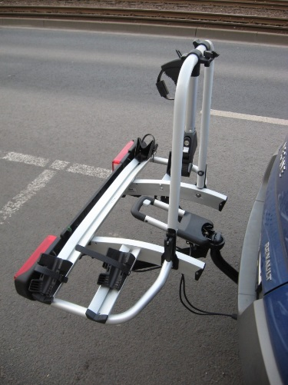
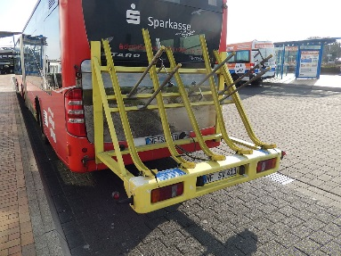

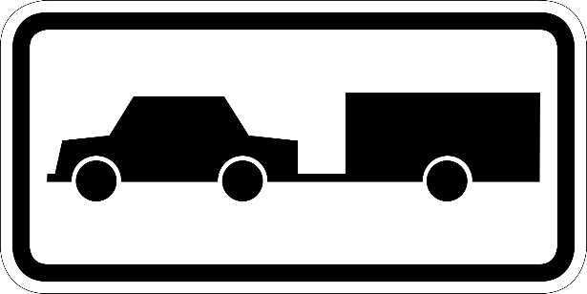
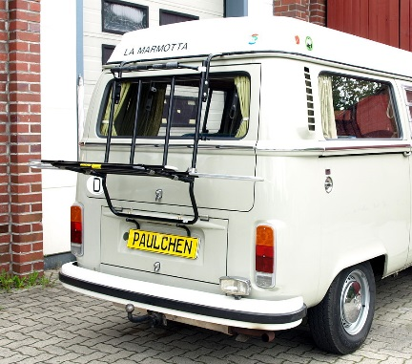
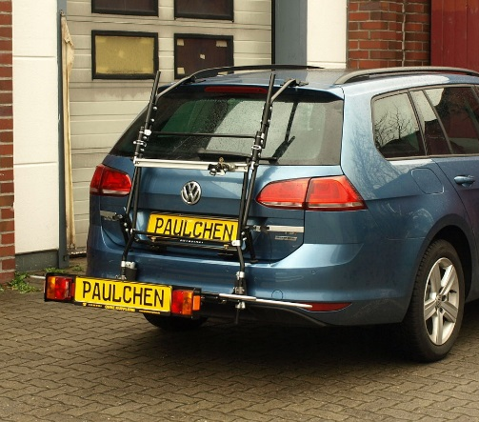
Audible Warning Device: Pause Function
✓
?
Does this cover any equipment to trailer hitch ?
This could be manual or automatic deactivation.
Any Trailers
?
What about equipment not using the trailer hitch ?
This could be only manual deactivation.
7. Operation with trailers
As per Clause 5.6 of ISO 17386 :2010.
Picture Source: Wikimedia Commons

Slide 13
Next pages:
Examples of N2, N3, M2 and M3 with special equipment for discussion
some only CMS might be possible
some only obstacle detection might be possible
some might not have an easy solution

Slide 14
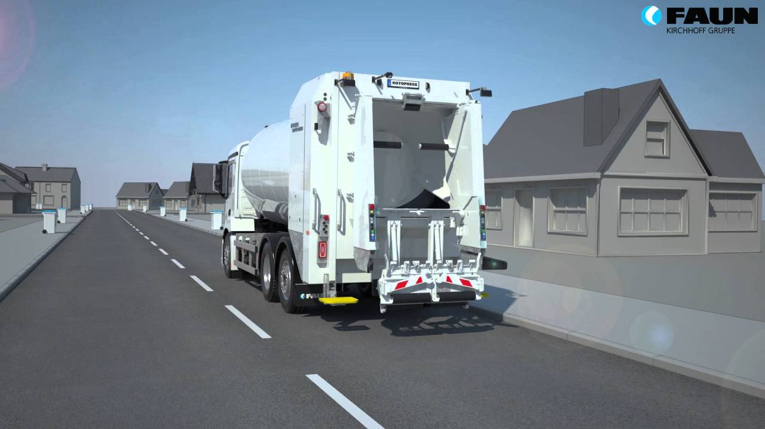
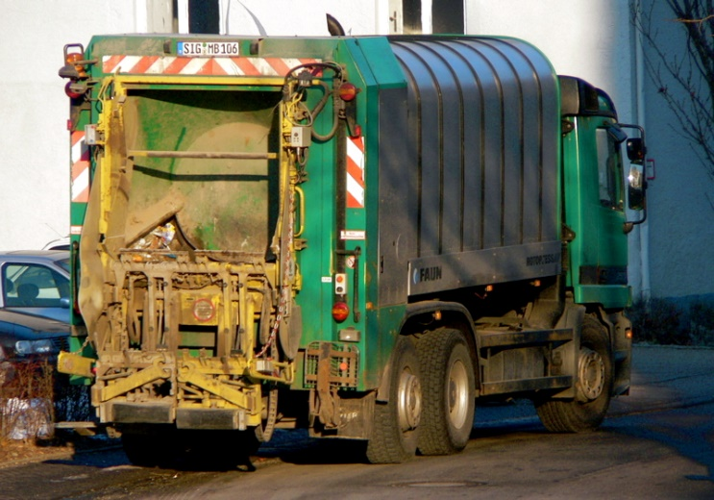
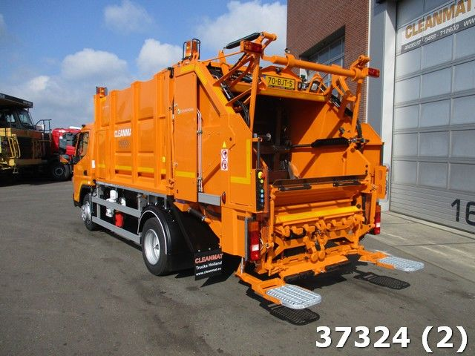
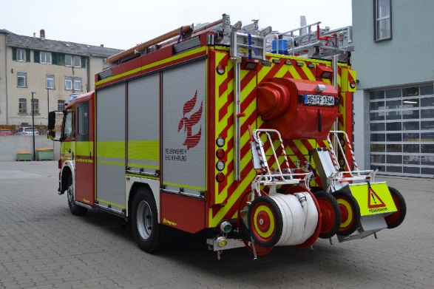
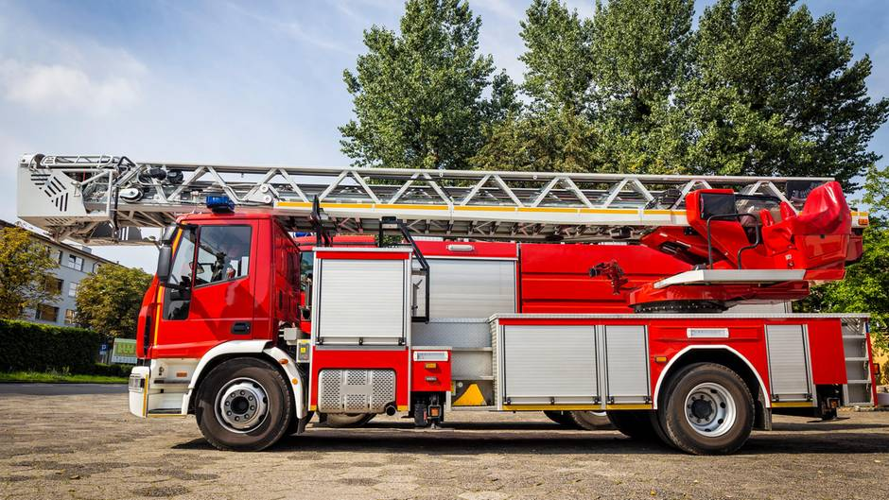
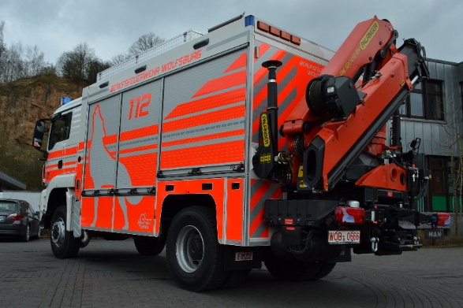
N2/N3 vehicles with special equipment
CMS only
?

Slide 15
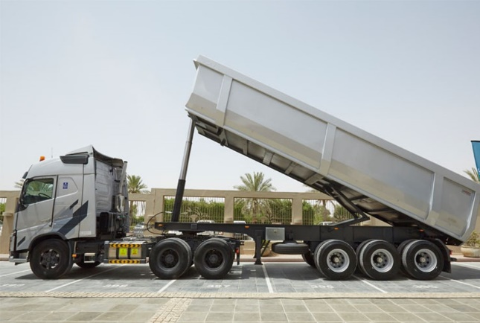
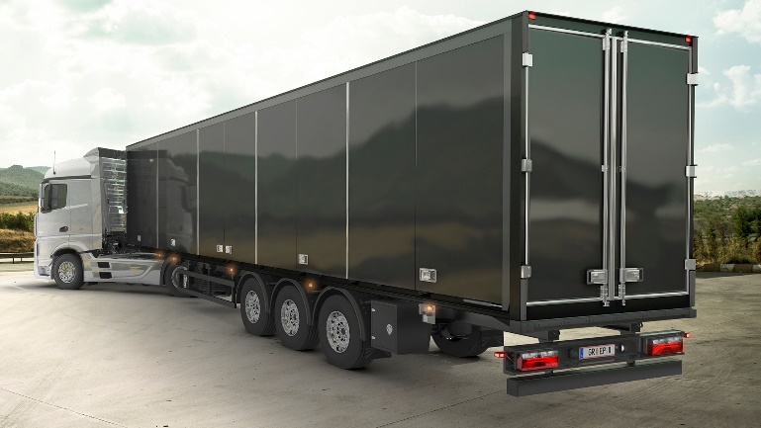
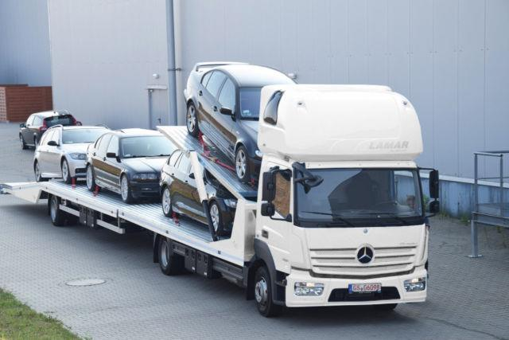
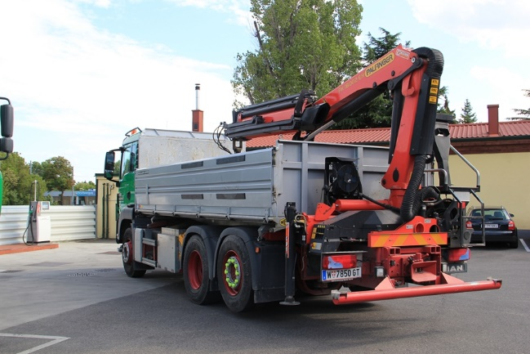
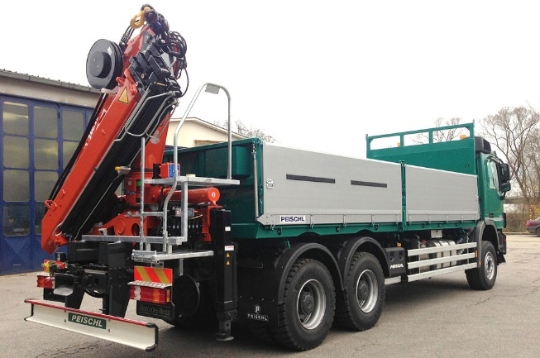
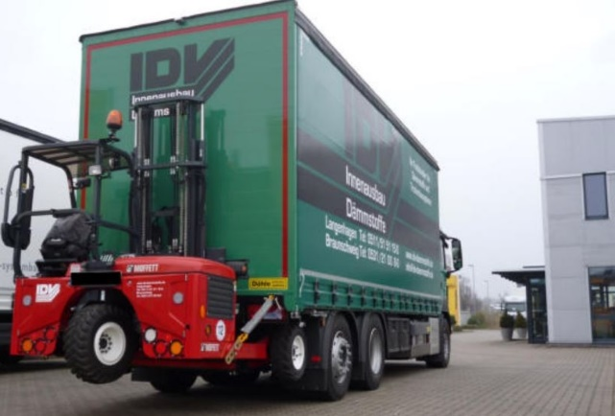
N2/N3 vehicles with special equipment
Trailers, not in scope
?

Slide 16
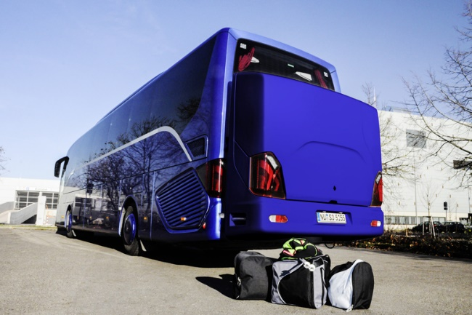

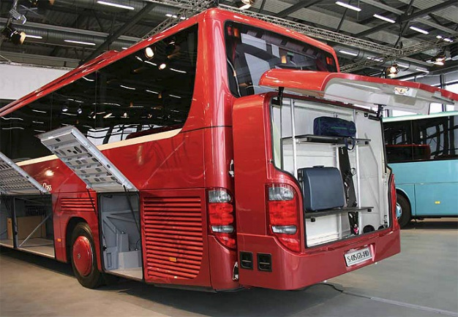
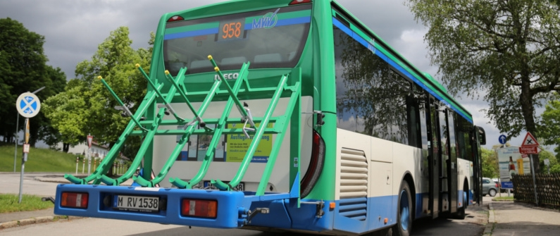
M2/M3 vehicles with special equipment
Aftermarket fittments
In scope ?
Or as trailers out of scope ?

