Slide 1
VRU-Proxi Reversing Motion Regulation
Regulation framework proposal
Performance requirements (discussion)
Main questions
VRU-Proxi-08-10

Slide 2
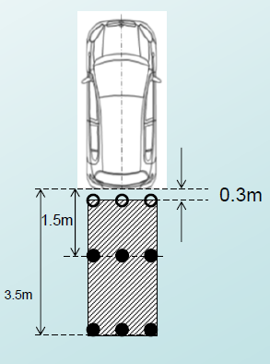
VRU-Proxi Reversing motion regulation framework (compromise proposal)
Part | R46 | Rxx (new regulation)
Component | Mirrors (Class I to VII) CMS (Class I to VII) | Detection CMS Class VIII Mirror Class VIII
Installation | CMS (Class I to VII) Mirrors (Class I to VII) | CMS (Class I and VIII) (reference to R46 and Rxx) Mirrors (Class I and VIII) (reference to R46 and Rxx) Detection Direct vision

Slide 3
Performance Requirements (discussion)
Parking Scenarios
< 6 km/h
Portion of Person is sufficient for recognition
Audible Reaction time is shorter than Visual Reaction time
Possible Recognition of
1 m
Thorax depth
Fallen Person
Standing Small Child
Translates into System Related Requirements
Vision system:
Detection system:
Calculate in
Audible Reaction Time of Driver
Detection System Latency [0.2s]
convert to
Mirror:
Calculate in
Visual Reaction Time
of Driver
convert to
CMS:
Calculate in
Visual Reaction Time of Driver
CMS Latency 0.2 s
convert to
Horizontal Area above [Thorax depth] m above floor
Vehicle width x [1.5 m]
Floor Area
Vehicle width x 3.5 m
Floor Area
Vehicle width x 3.5 m

Slide 4
Main questions
Nr | Main questions | What / who?
1 | Fallen person to be taken into account? | Accidentology (ask CP’s for in-depth data)
2 | Shall detection system give an audible and/or optical warning?
3 | Do we allow direct vision (turning head)?
4 | Do we allow a combination of devices with different type of HMI?
5 | Shall each row of poles (perpendicular to the longitudinal direction of the vehicle) be seen/detected by one (single) device? | CP’s to answer
6 | Do we allow mirror-to-mirror solution (periscope)?
7 | How to test, static or random position of poles?
8 | Shall exemptions be implemented in the UN Regulation or not? | CP’s to answer

