Slide 1
Study about Audible Warning system effects for VRU safety
JAPAN
VRU-Proxi-08-11

Slide 2
Test Methods
Participants: Total 24 drivers
Average 38.5±11.7 years old (20’s, 30’s, 40’s, 50’s x male/female x 3)
Test condition
Audible warning timing
5 cases of timing, every participants experienced each conditions 5 trials (randomized order)
 | Positions of audible warning indication
Case 1 | 0.0m reversing (just after R-range selected)
Case 2 | 0.5m reversing
Case 3 | 1.0m reversing
Case 4 | 2.5m reversing
Case 5 | No warning
Measurements
- GPS for vehicle motion and camera for driver behavior equipped for test vehicle.
Measurements |  | Device | Accuracy
Vehicle motion | Position (reversing distance) Speed (reversing speed) Audible warning output Gear position (Reverse range) | VBOX3i SL-RTK VBOX3i SL-RTK VBOX3i SL-RTK VBOX3i SL-RTK | 0.01m (100Hz) 0.01km/h (100Hz) 0.1mV (100Hz) ON/OFF (100Hz)
Driver behavior | Pedal operation Eye sight direction | Small camera Small camera | (30Hz) (30Hz)

Slide 3
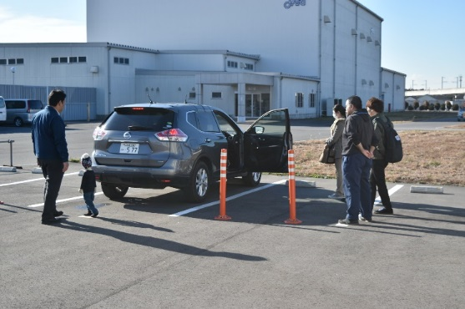
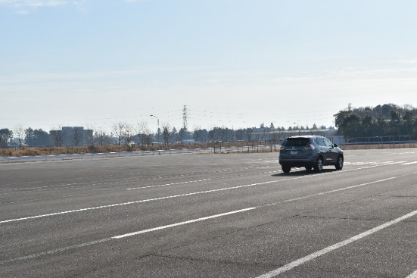
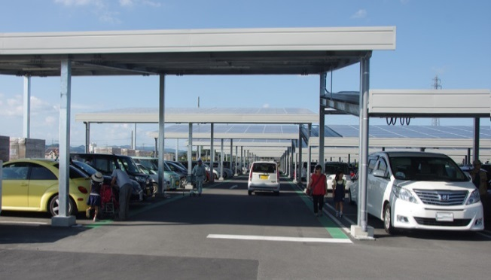
Test Methods
Instructions for participants
- Reversing to parking lot about 10m behind.
- In case of aware audible warning, braking for decelerate vehicle and stop as soon as possible.
- Carefully drive imagining being at a parking lot of typical commercial facilities where people and cars come and go.
Before driving,
- Participants confirm the difference between audible warning and information sound for “reverse gear”.
- Participants confirm not to easy to see small child (about 1m height) behind the vehicle by direct or indirect vision from the driver’s seat.
- Participants exercised velocity, acceleration feel and braking feelings of test vehicle beforehand.
Instructions for audible waring and rear vision
Exercise of reversing of test vehicle
Image of a parking lot of typical commercial facilities

Slide 4
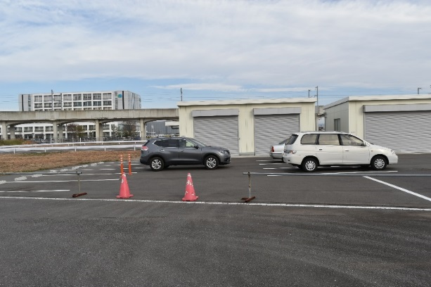
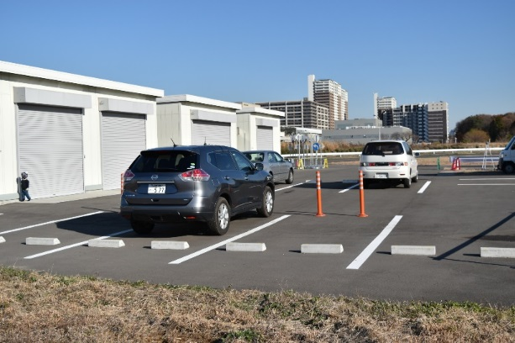
Test Methods
Methods for driving
Environments imitating public parking space set at proving ground (JARI)
Task
1) Reversing to parking lot about 10m behind
2) In case of audible warning indication (buzzer), braking, decelerate and stop the vehicle.
Audible warning was made for any timing indication.
No obstacles located behind the vehicle.
Area for examiners
Pylons
Car stop
Car stop
Pylons

Slide 5
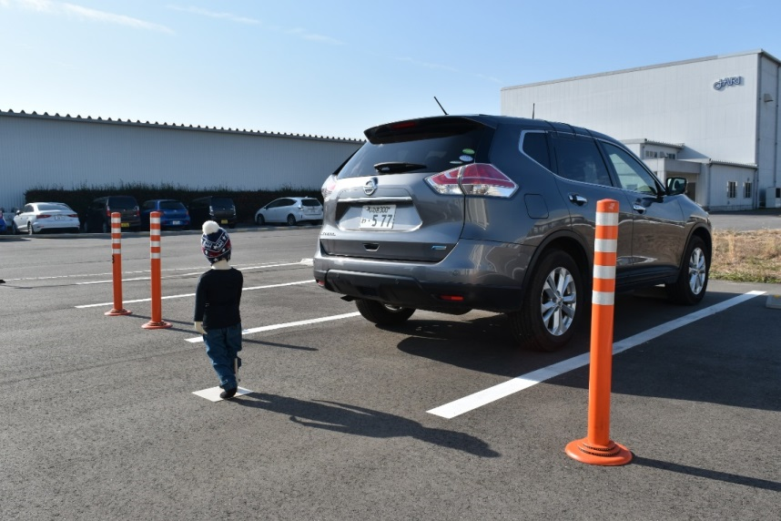
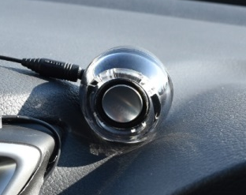
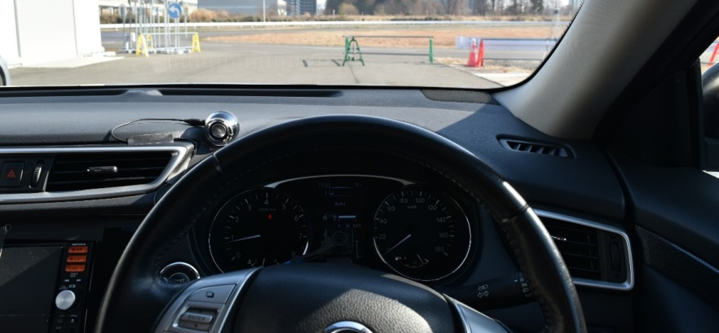
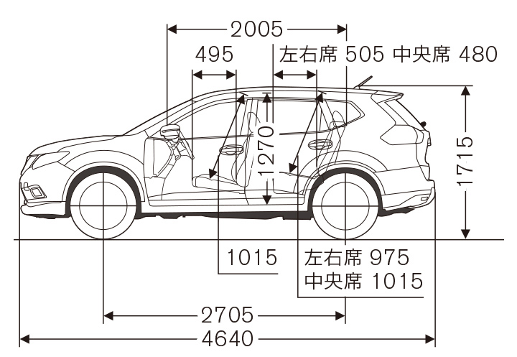
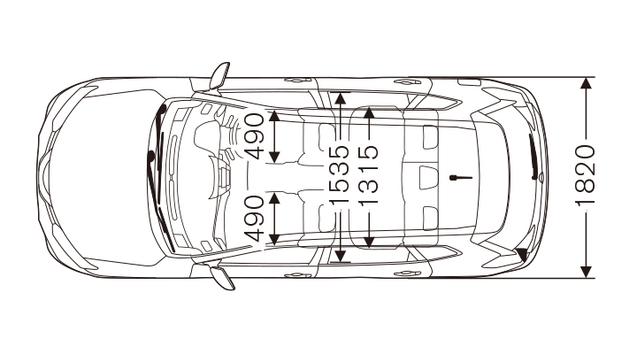
Test Methods
Test vehicle
SUV (Nissan X-trail) used.
Audible warning provided small speaker located upper-side of cluster.
Audible warning
・Continuous 1,220Hz
・70db at headrest
（http://history.nissan.co.jp/X-TRAIL/T32/1312/spec_dimensions.html）

Slide 6
Acquired data
1) | t_{start} | Time to vehicle move
2) | α_{a} | Acceleration
3) | V_{max} | Maximum velocity
4) | V_{w} | Velocity at warning
5) | t_{r} | Reaction time to warning
6) | t_{d} | Time to reduce speed
7) | α_{d} | Deceleration ratio
8) | L_{stop} | Stop distance
Reverse gear selected
Reversing motion started
Audible warning
Stop
R gear
Warning sound
V_{max}
V_{w}
Reversing speed [km/h]
Reversing distance [m]
V_{max}×0.8
Reversing speed
Reversing distance
α_{a}
α_{d}
V_{max}×0.2
Time [sec]
t_{start}
t_{r}
t_{d}
L_{stop}

Slide 7
Results
Number of cases
Cumulative cases [%]
Time to motion [sec]
Time to motion from reverse gear selected
(2~5 trial at Condition 2~5, N=384)

Slide 8
Results
※Total 6 time were not stopped. It was composed by 3 of 24 drivers.
Number of cases
Cumulative cases [%]
Stop distance [m]
Stop distance just after reverse gear selected
(2~5 trial at Condition 1, N=384)

Slide 9
Results
Stop distance [m]
Stop distance [m]
Speed at warning [km/h]
Reaction time for warning [sec]
Speed at warning and stop distance
（2~5 trials at condition 2~4, N=384 ）
Reaction time for warning and stop distance
（2~5 trials at condition 2~4, N=384 ）
Stop distance [m]
Stop distance [m]
Deceleration [m/s2]
Deceleration time [sec]
Deceleration and stop distance
（2~5 trials at condition 2~4, N=384 ）
Deceleration time and stop distance
（2~5 trials at condition 2~4, N=384 ）

Slide 10
Modeling of reversing behavior for warning
Estimated stop distance
Vw
※Deceleration characteristics
V_{w} | Speed at warning
α_{d} | Deceleration
t_{r} | Reaction time for warning
t_{d} | Time for deceleration
Stop distance [m]
α_{d}
Estimated stop distance [m]
t_{r}
t_{d}
Case: Estimated using minimum data from subjects
Stop distance [m]
Stop distance [m]
Estimated stop distance [m]
Estimated stop distance [m]
Case: Estimated using mean data from subjects
Case: Estimated using maximum data from subjects

Slide 11


Methods for numerical simulation
Calculate Stop distance (D_{vp}) for all combinations (total 31,104 cases) of Warning distance(R_{w}), Pedestrian distance (L_{p}) and drivers (ID01~ID24).
Pedestrian
Stop
Audible warning
Initial location
Choice of Range of audible warning (R_{W})
※0.1m step from 0.0～3.5m (total 36 cases)
L_{p}
R_{w}
_{vp}
D_{w}
D_{vp}
D_{stop}
Choice of Pedestrian distance (L_{P})
※0.1m step from 0.0～3.5m (total 36 cases)
V_{w}
Choice of driver
※ID01~ID24 (total 24 cases)
Conditions | R_{w} | Range of audible warning (0.0~3.5m)
 | L_{p} | Pedestrian distance（0.0m～3.5m）
 | D_{dbsw} | Stop distance in case of warning indicated before reversing motion (ID01~ID24) -> Maximum for each participants (condition 1)
 | α_{a} | Reversing acceleration (ID01~ID24) -> Maximum for each participants (condition 5)
 | V_{max} | Maximum of reversing speed (ID01~ID24) -> Maximum for each participants (condition 5)
 | T_{cv} | Deceleration characteristics (ID01~ID24) -> Mean for each participants (condition 2~4)
Calculated data | D_{w} | Reversing distance for audible waring
 | V_{w} | Speed at audible warning
 | D_{stop} | Estimated stop distance
 | D_{vp} | Stop distance to pedestrian
Indicate waring before reversing motion (L_{P}≦R_{w})
YES
NO
Calculate Speed at audible warning (V_{W})
$Vw = \sqrt{2\left(Lp− Rw \right)αa}$ （$\sqrt{2\left(Lp− Rw \right)αa}≤$ V_{max} ）
$=Vmax$ （ V_{max}$>\sqrt{2\left(Lp− Rw \right)αa}$ ）
Estimate Stop distance (D_{stop})
Estimate Stop distance (D_{stop})
$$Dstop= Tcv∙Vw$$
$$Dstop=Ddbsw$$
Calculate Stop distance to pedestrian (D_{vp})
$$Dvp=Rw− Dstop$$

Slide 12
Calculations of the waring effects
Percentage of “vehicle stop before reaching pedestrian (D_{vp}<0)“ were calculated as Ratio of accident reduction in each warning distance cases (total 864 cases).
87% accident was reduced at 1m warning distance.
Ratio of accident reduction
Warning distance to pedestrian [m]
Effects of waring for damage reduction are shown in deceleration.
Vehicle speed of contact pedestrian is about 4km/h, Rap between vehicle and pedestrian is about 0.2m in the most of cases (95%tile) at 1m waring .
Cumulative cases [%]
Cumulative cases [%]
Vehicle velocity to contact pedestrian
Rap between vehicle and pedestrian

Slide 13
Simulation results
Almost 1.0 at 1m regarding fatality reduction
1.0 at 1.5m
0.87 at 1m
Rap between vehicle and pedestrian
Ratio of accident reduction
Warning distance to pedestrian [m]
Cf. Small vehicle rear overhang short type : 0.43m

Slide 14
Appendix

Slide 15

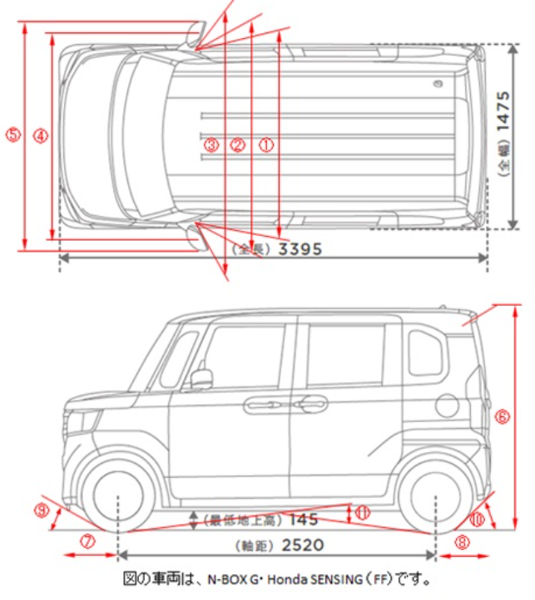
Honda N-WAGON dimension
Honda HP
（https://customer.honda.co.jp/faq2/userqa.do?user=customer&faq=faq_auto_sp&id=69628&parent=60455）

Slide 16
Monitoring Range of Audible Warning System
Extracted from published material.
OEM | Vehicle Name | Monitoring Range (cm) |  |  |  | Comment
 |  | Front Center | Front Corner | Rear Center | Rear Corner
MALSO(ISO17386) |  | 60 | 50 | 100 | 50
TOYOTA | Crown:2018 | 100 | 60 | 150 | 60
NISSAN | LEAF:2017 | 100 | 60 | 150 | 60
HONDA | LEGEND:2018 | × | 60 | 110 | 60
Mazda | CX-8:2017 | 100 | 55 | 150 | 55
Mitsubishi | Eclipse-cross:2018 | 60 | 60 | 125 | 60
Subaru | Levorg:2017 | × | × | 150 | ？
Daihatsu | Thor:2017 | 100 | 60 | 150 | 60
Daimler | C class:2014 | 100 | 60 | 120 | 80
Daimler | A class:2018 | 30 | ？ | 100 | ？ | @default setting
BMW | 7 series:2016 | 70 | 60 | 150 | 60
VW | Golf7:2013 | 120 | 60 | 160 | 60
VW | Passat:2014 | 120 | 60 | 160 | 60
Volvo | XC40：2018 | 80 | ？ | 150 | ？
Tesla | Model S:2015 | 70※ | ？ | 90※ | ？ | Measurement value

