Slide 1
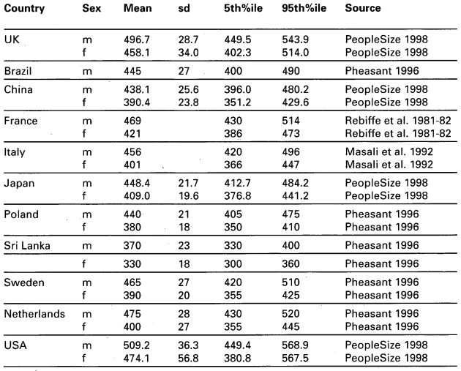
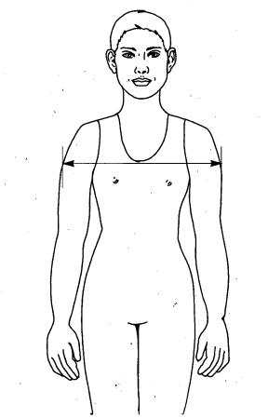
CHALLENGE: Vision-Based System Blind Spots
Worst-case scenario lower blind spot
VRU-Proxi-08-14
150 mm
920 mm
300 mm
300 mm
1500 mm

Slide 2
SOLUTION: Vision-Based System Blind Spots
0.5 m pole height for Row 1????
VRU-Proxi-08-14
150 mm
380 mm
300 mm
300 mm
1500 mm

Slide 3
CHALLENGE: Vision-Based System Blind Spots
Worst-case scenario lateral blind spot
VRU-Proxi-08-14
535 mm
300 mm
300 mm
300 mm
535 mm

Slide 4
SOLUTION: Vision-Based System Blind Spots
Visibility of 150 mm section on pole
VRU-Proxi-08-14
350 mm
300 mm
300 mm
300 mm
350 mm

