Slide 1

SIMPLIFICATION.
Status after GTB WG FL meeting November 28th , 2018
SLR-27-13

Slide 2
Introduction
Definition of requirements for basic/”C” passing beam which is technologically neutral and performance oriented.
Definition of Low speed /”V” and Motorway /”E” passing beam requirements
How to manage AFS?
Driving beam
Front fog beam and Cornering beam
How to manage beams / vehicles categories?

Slide 3

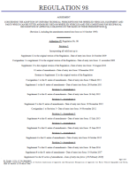
Strategy
R112 Class A
Class B
Class AR
Class BR
R98 Class DC
Class DR
R123 Class C
Class E
Class V
Class W
Class XR
ADB
R113 Class AS
Class BS
Class CS
Class DS
Class ES
Class R-BS
Class R-CS
Class R- DS
Class R- ES
R19 Class B- F3
R119 Class K
Class A
Class B
Class AR
Class BR
Class DC
Class DR
Class C
Class E
Class V
Class W
Class XR
ADB
Class AS
Class BS
Class CS
Class DS
Class ES
Class R-BS
Class R-CS
Class R- DS
Class R- ES
Class F3
Class K
Currently RID In the future: RID stage 2
Basic /”C” Passing beam
Low speed /”V” Passing beam
Motorway/”E” Passing beam
Basic Driving beam
Low speed Driving beam
ADB
AS BS for mopeds
CS DS for motorbikes /11KW 125cm3)
Fog beam
Cornering beam
1 regulation
12 ? Beam patterns
…
6 regulations
24 Beam patterns
TC4-45 SAE J2829
Expertise of Optical engineers
1 regulation
23 Beam patterns

Slide 4
Next steps?
Polishing the strategy:
  How to manage the different technical requirements -> Done
    Basic passing beam, low speed/ town passing beam , Motorway Passing beam , AFS, which light distribution for which vehicles?
Technical requirements:
  Validation of basic requirement for passing beam. -> Done
  Validation of Passing beams for 2 wheelers : AS, BS: same as today, new CS and new DS
  Management of AFS/ ADB. -> Feb. 19
    Definition of requirement for Low speed /Town passing beam/ Motorway passing beam. -> Done .
    ADB -> work in progress. -> first proposal in Feb. 19
    Adverse Weather Passing beam part of AFS: work in progress. -> first proposal in Feb. 19
  Definition of requirements for driving beam. -> Review of proposal. Validation in Feb. 19
  Front fog beam-> Done:.
  Cornering -> Done. Similar to SAE requirements. Justification to be submitted.
Redaction:
  Rewrite / optimization of RID text ready to start including ADB and class W consideration .

Slide 5

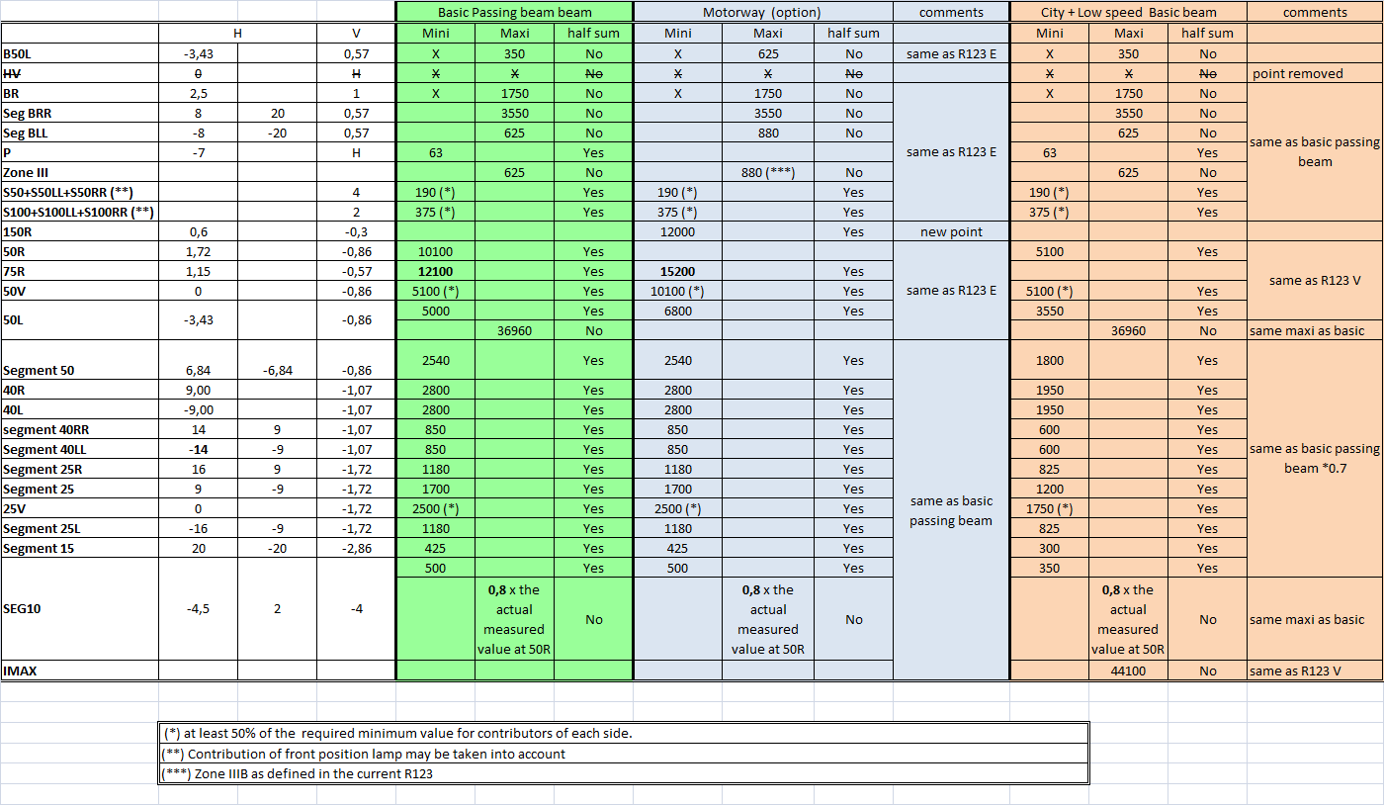
Grids for Passing beams
Validated by WGFL
1000 lm status :
GRE 76-04 rev1 Proposal
The photometric requirement for each single measuring point or segment of these functions applies to half of the sum of the respective measured values from all lighting units of the system applied for this function, except opposite prescription (i.e. “No” with regard to a certain test point or segment) in the column “half sum” of the table.

Slide 6
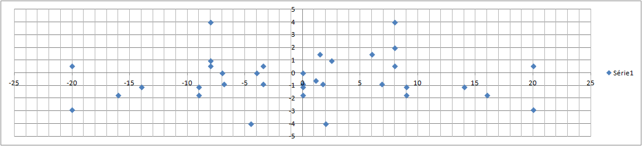
Measurement points and SEGMENTS
ZoneIII
BLL
B50L
BR
BRR
75R
50R
Seg 40LL
40L
50L
50V
Seg 50
40R
Seg 40RR
Seg 25L
Seg 25
Seg 15
25V
Seg 25R
Seg 10

Slide 7
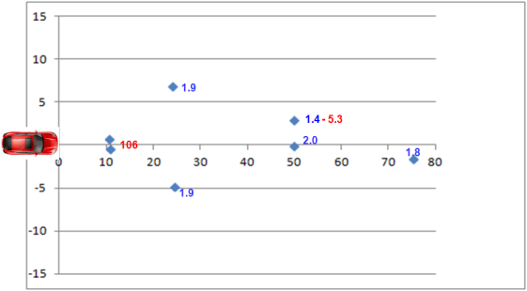
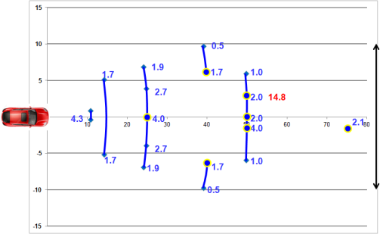
for comparison:
Illumination projected on the road for basic /”C” passing beam and current requirement RID class C (R123 Class C).
Bird’s eye view
Values in blue: Mini
Values in red: Maxi
RID class C
Proposal Basic/”C” Passing Beam
Significant improvement of the proposal / R123 class C
Width on the road : 20m instead of 11.6 m .
+20% at 75 m.

Slide 8
Proposal for 2 wheelers, CS, DS
Current UN R113-01/02 |  |  |  |  |  |  | IMMA Symmetrical passing beam proposal |  |  |  |  |  |  | Description
Test points |  |  | Minimum |  |  | Maximum | Test points |  |  | Class CS-base: for low-performance vehicle (<= 125 cm3) |  | Class DS-base: for high-performance vehicle (>125 cm3)
 |  |  | Class CS | Class DS | Class ES | Classes CS,DS,ES |  |  |  | Minimum | Maximum | Minimum | Maximum
1 | 0.86°D | 3.5°R | 2,000 | 2,000 | 2,500 | 13,750 | Seg 1 | 0.86°D | 3.5°R to 3.5L | 2,000 | 13,750 | 2,000 | 13,750 | Integrated with No.3 / segmentised (equiv. to Segment 50)
2 | 0.86°D | 0 | 2,450 | 4,900 | 4,900 | - | 2 | 0.86°D | 0 | 2,450 | - | 4,900 | -
3 | 0.86°D | 3.5°L | 2,000 | 2,000 | 2,500 | 13,750 | 3 | 0.86°D | 3.5°L | 2,000 | 13,750 | 2,000 | 13,750 | Removed by integration to No.1
4 | 0.50°U | 1.50°L and 1.50°R | -- | -- | -- | 900 | 4 | 0.50°U | 1.50°L and 1.50°R | -- | 900 | -- | 900 | Removed by integration to Zone 1
 |  |  |  |  |  |  | Seg 3 | 1.07D | 9L to 9R | 425 | - | 850 | - | New segment introduced (equiv. to Segment 40) The value for Class DS is from Basic passing beam proposal in WG-FL. For Class CS is a half of the value. See discussion for detail
 |  |  |  |  |  |  | 4 | 1.72D | 0 | 1250 |  | 2500 |  | New point introduced (equiv. to 25V) to judge the maximum requirement for No. 6 The value for Class DS is from Basic passing beam proposal in WG-FL. For Class CS is a half of the value.
5 | 2.00°D | 15°L and 15°R | 550 | 1,100 | 1,100 | -- | Seg 5 | 2.00°D | 15°L to 15°R | 550 | － | 1,100 | -- | Segmentised (equiv. to Segment 25/15) See discussion for detail
6 | 4.00°D | 20°L and 20°R | 150 | 300 | 600 | - | Seg 6 | 4.00°D | 20°L to 20°R | 150 | 0.8*the actual measured value at point 4 | 300 | 0.8*the actual measured value at point 4 | Segmentised (equiv. to Segment 10/15) Maximum requirement is introduced See discussion for detail
7 | 0 | 0 | -- | -- | -- | 1,700 | 7 | 0 | 0 | -- | 1,700 | -- | 1,700
Line 1 | 2.00°D | 9°L to 9°R | 1,350 | 1,350 | 1,900 | - | Line 1 | 2.00°D | 9°L to 9°R | 1,350 | - | 1,350 | - | Removed by integration to No.5
8** | 4.00°U | 8.0°L | ∑ 8 + 9 + 10 ≧ 150 cd ** |  |  | 700 | 8** | 4.00°U | 8.0°L | ∑ 8 + 9 + 10 ≧ 150 cd ** | 700 | ∑ 8 + 9 + 10 ≧ 150 cd ** | 700
9** | 4.00°U | 0 |  |  |  | 700 | 9** | 4.00°U | 0 |  | 700 |  | 700
10** | 4.00°U | 8.0°R |  |  |  | 700 | 10** | 4.00°U | 8.0°R |  | 700 |  | 700
11** | 2.00°U | 4.0°L | ∑ 11 + 12 + 13 ≧ 300 cd ** |  |  | 900 | 11** | 2.00°U | 4.0°L | ∑ 11 + 12 + 13 ≧ 300 cd ** | 900 | ∑ 11 + 12 + 13 ≧ 300 cd ** | 900
12** | 2.00°U | 0 |  |  |  | 900 | 12** | 2.00°U | 0 |  | 900 |  | 900
13** | 2.00°U | 4.0°R |  |  |  | 900 | 13** | 2.00°U | 4.0°R |  | 900 |  | 900
14** | 0 | 8.0°L and 8.0°R | 50 cd** | 50 cd** | 50 cd** | - | 14** | 0 | 8.0°L and 8.0°R | 50 cd** | - | 50 cd** | -
15** | 0 | 4.0°L and 4.0°R | 100 cd** | 100 cd** | 100 cd** | 900 | 15** | 0 | 4.0°L and 4.0°R | 100 cd** | 900 | 100 cd** | 900
Zone 1 | 1°U/8°L-4°U/8°L-4°U/8°R -1°U/8°R-0/4°R-0/1°R -0.6°U/0-0/1°L-0/4°L-1°U/8°L |  | -- | -- | -- | 900 | Zone 1 | 1°U/8°L-4°U/8°L-4°U/8°R -1°U/8°R-0/4°R-0/1°R -0.6°U/0-0/1°L-0/4°L-1°U/8°L |  | -- | 900 | -- | 900
Zone 2 | >4U to <15 U | 8°L to 8°R | -- | -- | -- | 700 | Zone 2 | >4U to <15 U | 8°L to 8°R | -- | 700 | -- | 700
The tables will be updated, to modify Seg3 and to remove Point4.

Slide 9
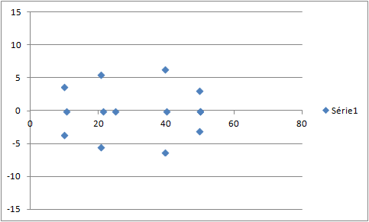
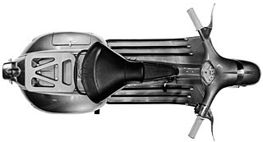
Comparison Current DS/ Proposal
2.4
2.4
0.5
0.8
5.5
2.6
0.8
5.5
2.6
2.9
Line 1
2.0
2.6
4.0
0.5
2.0
2.6
2.9
0.8
5.5
0.8
5.5
2.4
2.6
2.4
0.5
Current DS
Proposal DS

Slide 10
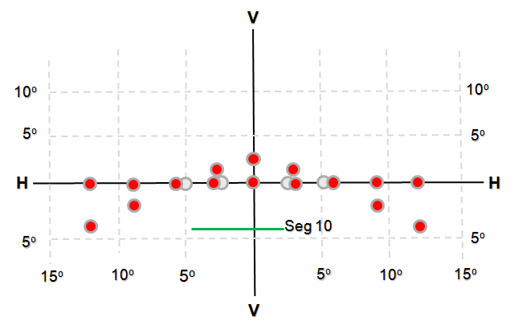
Proposal driving beam
Grids are under study.
HR/HRM >80% removed
Remark: points below HH line disregarded if passing beam remains ON
too many points?
Segment 10 still in discussion.
Driving beam for motorbikes not frozen
  updated comments from IMMA expected
2 wheelers & agricultural only

Slide 11

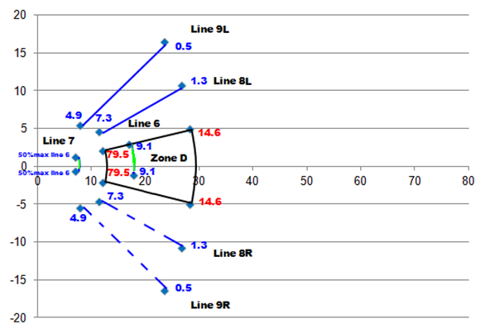
Front Fog lamp
Same requirements for all F3 front fog lamps with half
of the sum allowed for Lines 8 and 9.
(same as the original requirements of R19,
04 series of amendments - Date of entry into force: 9 December 2010)
Bird’s eye view
submitted in July 18 .
validated in November

Slide 12

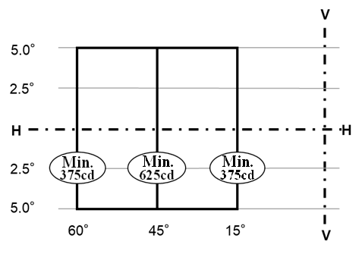
Cornering BEAM
Still in discussion. Justification based on improvement of Safety to be submitted during the next meeting
30°

Slide 13
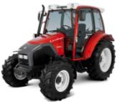
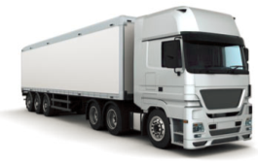
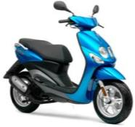

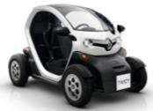
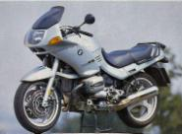
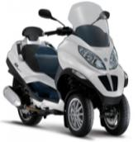

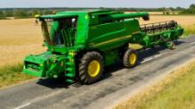
Which beam(s) for which vehicle?
To be addressed with WG-I

Slide 14

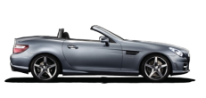


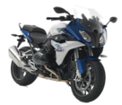
Installation requirements after SLR step 1 Regulation RID
AS
BS, R-BS
CS, R-CS
DS, R-DS
ES, R-ES
A, AR
B, BR
CS, R-CS
DS, R-DS
ES, R-ES
Class B, BR
Class DC, DR
F3
R74
Class B, BR
Class DC, DR
Class C
Class E
Class V
Class W
Class XR
ADB
Class F3
Class K
Class A, AR
Class B, BR
Class DC, DR
Class AS
Class BS, R-BS
Class CS, R-CS
Class DS, R-DS
Class ES, R-ES
Class F3
Class K
< 50 Km / h
R53
R48
R86
<125 cm³
2 x CS, 2 x R-CS
DS, R-DS
ES, R-ES
A, AR
B, BR
DC, DR
F3
Black: mandatory
Green : optional
Should the beam requirements be based on the category of the vehicle?
>125 cm³

Slide 15




Proposal
Basic/”C” passing beam, Low Speed/”V” passing beam, Motorway/”E” passing beam.
Which passing beam/speed/driving conditions?
“W”
Basic/ “C” passing beam
Low speed / “V” passing beam
Motorway/“E” passing beam
0
[50]
[110] km/h
No Feed Back from Agricultural Machines Industry.

Slide 16
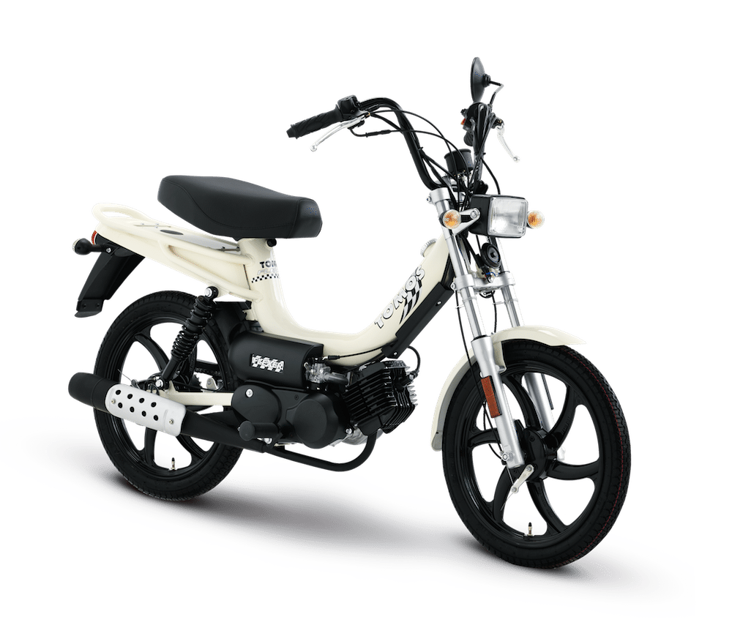
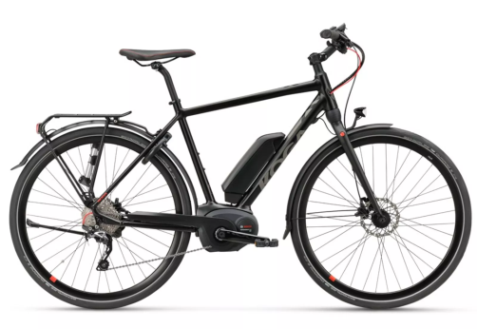
Alternative for Two Wheelers
DS
CS
0
11kW
125cm³
Power (kW)
Displacement (cm³)
Mopeds and electrical bikes
AS , BS
16

Slide 17
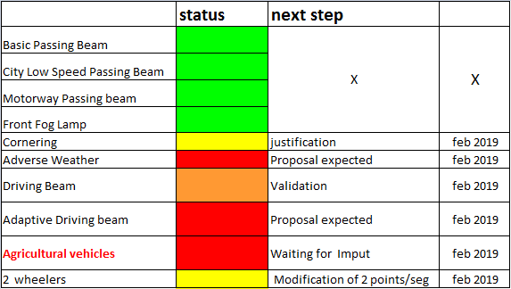
Synthesis

