Slide 1
ISO 16254 Measurement Variation – Field Experience
Relevant for GRBP IG on Reverse Alarm
Summary of ISO TC43/SC1
WG42 November 2018,
Matsue, Japan

Slide 2
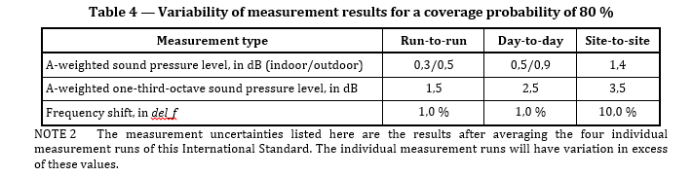
Overview
Fundamental Issue: Observed test variation is significantly greater than assumed and in excess of stated measurement uncertainty in ISO 16254.
Coverage probability at 95% is 1.58 times greater.
Measurement variation observed in testing does not meet the principles of repeatability and reproducibility.

Slide 3
Investigation of reasons for variation
Hypothesis: Constructive / Destructive wave interference cause by multi-path sounds. Sound source with direct and reflected paths.
Experiments:
  Place sound source on reflective floor, determine if change of source location distance follows distance law (1/r²) or has other characteristics.
  Vary microphone position, determine if change of microphone location distance follows distance law (1/r²) or has other characteristics.
  Conduct outdoor testing with array of microphone spaced over small distance, determine if change of microphone location distance follows distance law (1/r²) or has other characteristics.

Slide 4
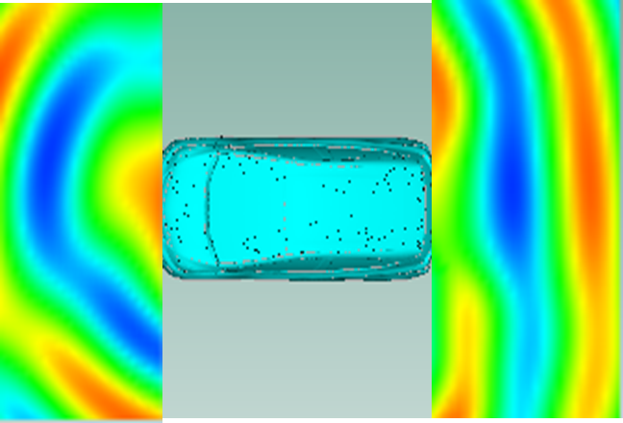
CAE investigations
Evaluate magnitude of spatial variation
Evaluate potential improvement with microphone array
Microphone
Speaker

Slide 5
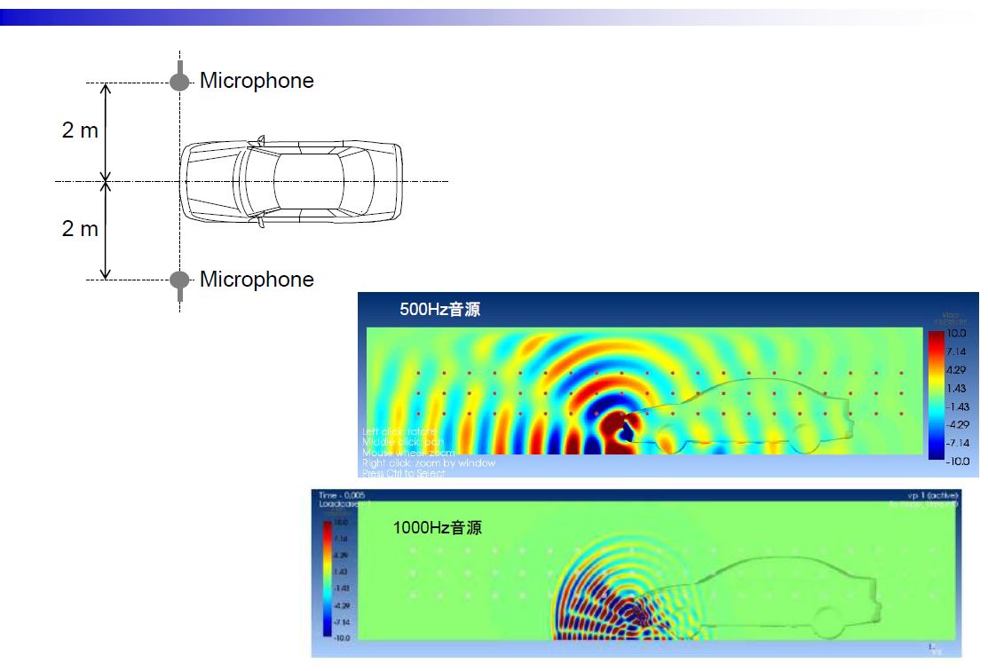

Slide 6
Conclusions
Field testing shows variation greater than expected uncertainty stated in ISO 16254. Current measurement process does not meet expected repeatability and reproducibility criteria.
In lab testing shows Sound Pressure Level does not follow distance expectations.
Testing with absorption on floor indicates reflective cancelation/amplification.
CAE results show magnitude of possible error > 20dB.
Use of measurement array can reduce theoretical error to 5 dB.
Use of “Max Hold” 1/3 octave measurement can also reduced observed variation.

Slide 7
ISO 16254 Proposal
Replace single microphone with array microphone.
Report highest 1/3 octave band result within the array.
Use “Max Hold” as 1/3 octave reporting method.
Justification:
Reduce variation and improve repeatability and reproducibility.
Measurement results better correlated to human experience

