Slide 2
78th UNECE GRPE session
PMP IWG Progress Report
Geneva, 8th -11th January 2019
UNITED NATIONS

Slide 3
PMP meetings in 2018
2018-01-10: PMP 46th (GRPE Geneva summary)
2017-05-16/17??: PMP 47th
2018-11-7/8 PMP 48th
NEXT F-2-F MEETING: 3rd – 4th April 2019 (Location: JRC Ispra - tbc)

Slide 4
EXHAUST PARTICLE EMISSIONS

Slide 5
Main open points
Round Robin Sub-23nm
Raw exhaust sampling
Round Robin PNC (Particle Number Counter)
Horizon 2020 projects
Particle emissions from gas engines
WLTP low temperature PN testing
Effect of fuel on PN

Slide 6
Sub23 nm Round Robin
Development of a sub23nm (cut-off size:∼ 10 nm) particle number measurement procedure based on the existing PMP methodology conveniently adapted.
Main purpose: Monitoring particle emissions of new engine/after-treatment technologies.
Assessment of the repeatability/reproducibility of the proposed particle counting methodology by means of a “round robin”.

Slide 7
Investigation of sub23nm protocol
Two systems with CS and 10nm CPC to circulate
Each lab PMP system plus a 10nm CPC (to circulate)
One golden vehicle (Opel Astra GDI – no GPF)
  The PMP group would have preferred 6d technology for the golden vehicle, this was not available in the program timing and will need investigation later

Slide 8
RR measurement equipment
CVS
Provided
By PMP RR
LabPMP
VPR
APC,
CS
(AVL)
SPCS,
CS
(HORIBA)
CPC, 23 nm
CPC, 10 nm
CPC, 10 nm
AM10
TSI10
CPC,
23 nm
TSI23
(TSI, 3791)
PUMP
PUMP

Slide 9
Details about the RR
7 European laboratories studied
Possible continuation 2 Chinese, a Japanese (and maybe US)
Comparison of Catalytic Stripper (CS) equipped PN measurement system, to current methodology (PMP) system
PN10 and PN23 measured for both PN system types

Slide 10
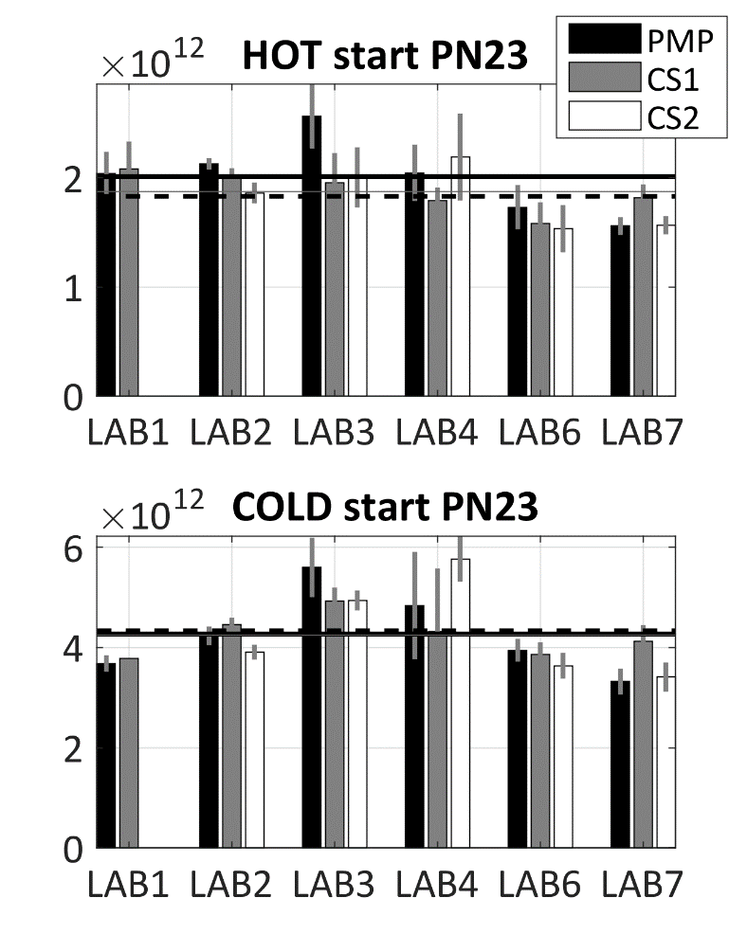
PMP PN23 results
The average PN23s in laboratories
  The PN23 for different instruments within 10%
Repeatability/Reproducibility Better for CS1 than for PMP or CS2
10¹²/km | HOT | COLD
PMP | 2.0 ± 0.3 | 4.3 ± 0.8
CS1 | 1.9 ± 0.2 | 4.2 ± 0.4
CS2 | 1.8 ± 0.3 | 4.3 ± 1.0
Average
lines
 | HOT/COLD
PN23 | Repeatability | Reproducibility
PMP | 0.17 /0.19 | 0.20 /0.23
CS1 | 0.10 /0.10 | 0.14 /0.16
CS2 | 0.15 /0.23 | 0.20 /0.24
Normalized
to mean

Slide 11
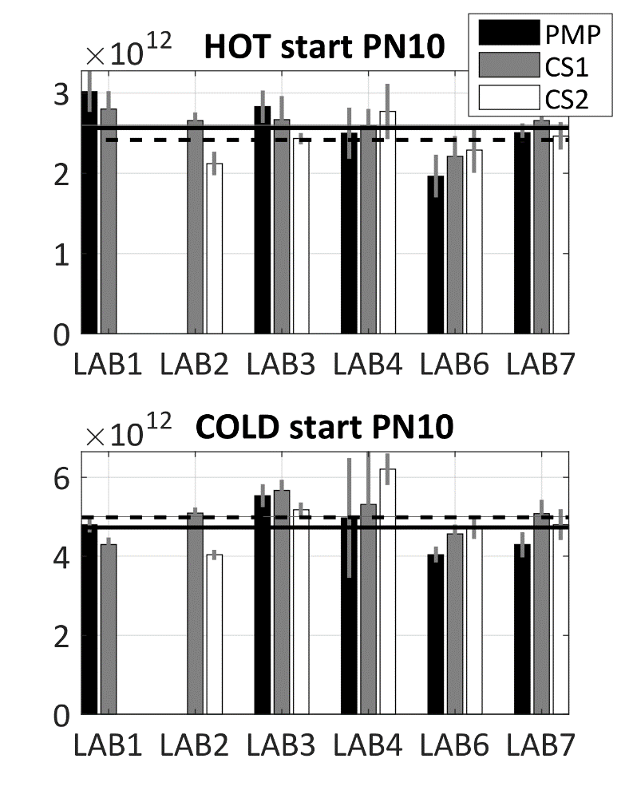
PMP PN10 results
The average PN10 in laboratories
  The PN10 for different instruments within 15% (Note for PN23 10%)
Repeatability/Reproducibility Better for CS1 than for PMP or CS2
  Better for PN10 than PN23
10¹²/km | HOT | COLD
PMP | 2.6 ± 0.4 | 4.7 ± 0.6
CS1 | 2.6 ± 0.2 | 5.0 ± 0.5
CS2 | 2.4 ± 0.2 | 5.0 ± 0.8
Average
lines
 | HOT/COLD
PN10 | Repeatability | Reproducibility
PMP | 0.16 /0.12 | 0.18 /0.20
CS1 | 0.08 /0.10 | 0.11 /0.15
CS2 | 0.10 /0.16 | 0.14 /0.17
Normalized
to mean

Slide 12
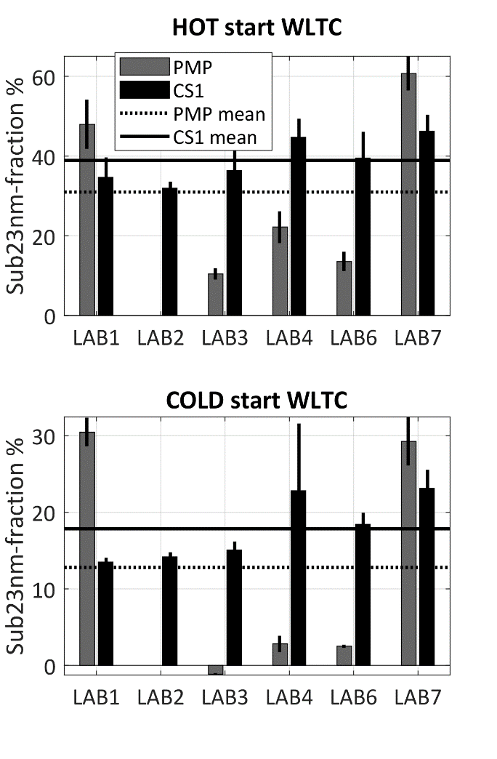
Sub23nm-fraction
(PN10-PN23)/PN23 %
Sub23nm-fraction PMP<CS1
  No clear artefacts in PMP systems
    From the PMP RR data CS need is not justified
    CS recommended due to artefacts reported in literature for Evaporation Tube
  High variability between labs PMP
    Lab PMPs are of different design, thus, different losses for PN10
  PMP negative Sub23nm- values
    LOSSES of PN10 in the current methodology PMP-systems, CPC calibration uncertainties
Recalibration/-design needed
  Current methodology →
    High variation of Sub23nm between laboratories
    LOSSES at Sub23nm-fraction
WLTC | HOT | COLD
PMP | 31 ± 22 | 12 ± 16
CS | 39 ± 6 | 18 ± 4

Slide 13
Draft requirements and calibration procedures of sub23nm protocol
Calibration: Thermally stable particles 5000-10000 p/cm³ at 15nm
PCRF(15nm)/PCRF(100nm)<1.8-2.0
PCRF = average (15nm ?,30nm, 50nm, 100nm)
  If Evaporation tube, minimum primary dilution 100
  Catalytic stripper
PNC (Particle counter)
  Counting efficiency 10nm: 50%-70%
  Counting efficiency 15nm: >90%
  Material: Emery oil (soot, silver)

Slide 14
PN Counting from Raw Exhaust via Fixed Dilution
Interest in this approach confirmed by some engine manufacturers and some instrument manufacturers
01 Series of amendments to Reg. 132 already includes such possibility but the procedure is not defined
First analysis of potential benefits/issues presented during the last meetings
Correlation with other methods (CVS and partial flow system) and advantages/disadvantages to be checked – Additional data required

Slide 15
Raw exhaust (tailpipe) sampling
Preliminary results generated by the JRC show 20% differences
Input from others is necessary
Theoretical investigation of uncertainty
Data presented by the industry during the 43rd meeting confirming good correlation
A well designed experimental programme has already started by OICA with the support of JRC. The first results are promising.

Slide 16
OICA-JRC experimental programme
Objectives:
Assess raw exhaust sampling for type approval
  Uncertainty TP vs CVS or PFDS
  Robustness of TP systems
  Technical specifications
Sub-23 nm
  Support PMP

Slide 17
Scope
The exercise should cover:
CNG, DPF regenerations, high bio-fuels
Crankcase (open system) emissions connected to tailpipe
Instruments will be calibrated (especially 10 nm CPCs)
Extension to China (VECC and CAAM) and US (Cummins) under consideration

Slide 18
Timeline (Europe)
OEM1: w41-45
OEM2: w47-49
JRC validations
OEM3: w3-7 (2019)
OEM4: w8-10
JRC validations
OEM5: w13-17
OEM6: w19+ (tbc)

Slide 19
Setup
Instruments (in green provided by JRC)
  CS10 at tailpipe (JRC) (+CPC23nm JRC)
  PMP23 at PFDS (+CPC10nm JRC)
  PMP23 at tailpipe (TP23) (optional, only few OEMs)
Other CPCs can be connected at the systems with the instructions provided by JRC
OEM will test many instruments from different manufacturers
  JRC to contact instrument manufacturers

Slide 20
Protocol (indicative)
Protocol covers complete engine map and dynamics (e.g. for one shift day):
  WHTC cold + WHTC hot, WHSC, FTP, NRTC, (CO2 mapping), WHTC hot + WHTC hot
    Last day: WHTC hot with active regen
  PM filters and gaseous measurements to be taken
  Standard fuels and lubricants but should be analyzed
  Exhaust gas temperature at sampling location shall be measured (at PFDS should be ok)

Slide 21
Testing sequence
Influence of position compared to PFDS (few OEMs, within 1 m or with probes at same cross-section)
PMP23 at PFDS, TP23 and CS10+23 at tailpipe with high PCRF
PMP23 at PFDS high PCRF, TP23 and CS10+23 at tailpipe with low PCRF
TP23 or CS10+23 with longer sampling line (residence time <3s) temperature>150°C
Tests with and without crankcase emissions
TP23 with “pre-diluter” (if available)

Slide 22
Setup
Provided by lab
Provided by JRC
Extra CPCs
PMP23
CPC10
PFDS
TP23
optional (TP23=PMP23 at tailpipe)
ENGINE
Heated tube
CS10
CPC23

Slide 23
Next steps
Preliminary results at OEM1 show good results:
  Excellent comparability partial flow – raw exhaust for both 23 and 10 nm CPCs
  No artifacts from crankcase emissions
Horiba pre-diluter will be tested at some OEM

Slide 24
PNC Calibration Round Robin
Final report finished – Available on the PMP website
Several reccomendations for calibration procedure improvement
Soot aerosol suitable material but did not improve calibration uncertainty
Agreement within PMP group that at this moment in time changes to the calibration procedure make sense only in combination with the development of a sub-23 nm procedure

Slide 25
HORIZON 2020 projects
The group is monitoring the progress of the three projects funded by EU under the H2020 scheme
  DownToTen
  PEMS4nano
  SUREAL-23
These projects have the objective of investigating sub23 nm emissions and to develop new test procedures to measure these particles
Representatives of the consortia provide regular updates to PMP group – Presentations available on the PMP website

Slide 26
Low Temperature testing
Testing is done since >10 years
Input is necessary on experimental setup / difficulties encountered or topics to be investigated
No specific question received so far
From PMP perspective it is closed. PMP recommended:
- No problem to include it WLTP if sampling from CVS: no condensation takes place until the measurement of the SPN23 (or PM) at –7°C.

Slide 27
Short literature review about effects of gasoline characteristics on solid PN-Emissions, GDI
Aromatics are suggested to increase PN emissions
  Hard to decompose, High ΔHv
  Low volatility,
  Decompostion directly to soot precursors
Volatility of the fuel is suggested to imply lower PN emissions
  Low volatility of fuel can affect mixture formation  wall wetting  PN
  (Too) high volatility fuel  possible flash evaporation  enhanced PN
  "Moderate" volatility increase  PN decrease
Oxygenates are suggested to decrease PN emissions
  Oxidative reduction of soot precursors, Enhanced oxidation of soot, enhanced combustion in first place
  At high Oxygenate levels, possibility to increase PN

Slide 28
Fuel Aromatic content on PN
High aromatic content increase PN (M) emissions
  High heat of vaporization, hard to decompose
  Decomposition straight to soot precursors
  Low volatility→ affect the spray and mixture characteristics
The fuel aromatic effect on PM (N) forecasted sometimes with PM Index (Aikawa et al. 2010)
PMI missing (for example)
  Fuel Oxygenates
  vehicle (operating) parameters
Many attempts to improve PM index, create Index for PN and to take vehicle (operating) parameters into account

Slide 29
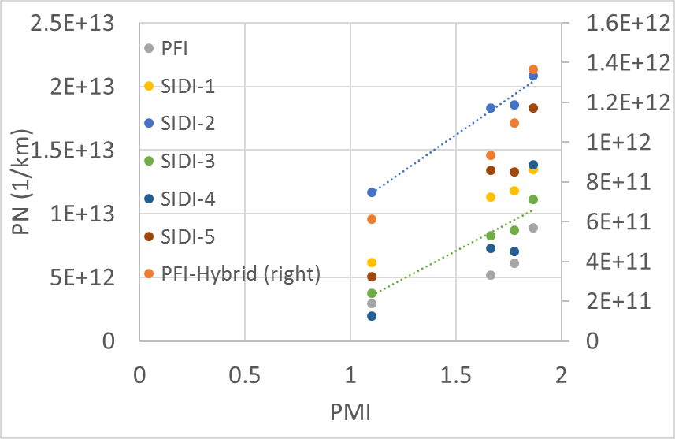
Fuel Aromatic content on PN
PMI forecasts well even PN when fuels designed for aromatic targets
3 fuels with total aromatics targets (15%, 25%, and 35% by volume) + base fuel
Different engine types
Data extracted from papers
Guide for eye
Karavalakis et al 2015

Slide 30
NON-EXHAUST PARTICLE EMISSIONS

Slide 31
NON-EXHAUST PARTICLE EMISSIONS
BRAKE WEAR EMISSIONS
TASK
DEVELOPMENT OF A COMMON METHOD FOR
SAMPLING AND MEASURING BRAKE WEAR PARTICLES

Slide 32
DEVELOPMENT OF A COMMON METHOD FOR
SAMPLING AND MEASURING BRAKE WEAR PARTICLES
STEP 1 - Development of a new real-world braking cycle
WLTP Database Analysis (Concluded)
Comparison of WLTP data with Existing Industrial Cycles (Concluded)
Development of a first version of the novel (WLTP based) braking schedule (Concluded)
Validation of the novel cycle - Round robin (Deadline: January 2019)
STEP 2 - Definition of a set of minimum requirements for the emissions measurement setup
Selection of the testing methodology (Concluded)
Comparison of existing systems/test rig configurations (Concluded)
Selection/definition of testing parameters (Deadline: March 2018 – Still on-going)
Validation of the selected configuration(s) & measurement methods (Deadline: December 2019)

Slide 33
DEVELOPMENT OF A COMMON METHOD FOR
SAMPLING AND MEASURING BRAKE WEAR PARTICLES
STEP 1
DEVELOPMENT OF A NEW REAL-WORLD BRAKING CYCLE

Slide 34
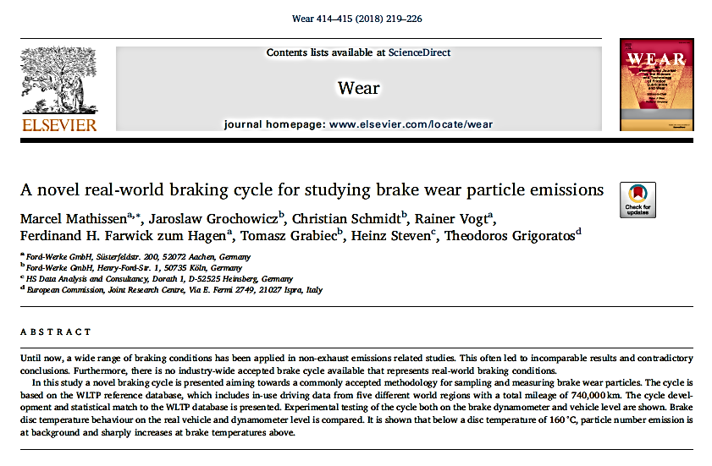
Development of a NEW REAL-WORLD BRAKING CYCLE
NOVEL CYCLE
The novel cycle has been developed and is freely available to the public in Mendeley (WLTP-based Real-World Brake Wear Cycle) https://data.mendeley.com/ datasets/dkp376g3m8/1
Technical details regarding the cycle are described thoroughly in a peer-reviewed publication and have been presented to conferences (SAE Brake Colloquium, EuroBrake) as well as to PMP meetings

Slide 35
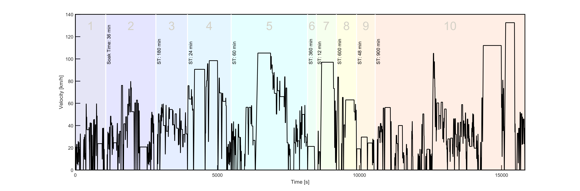
Development of a NEW REAL-WORLD BRAKING CYCLE
NOVEL CYCLE
THE CYCLE AT A GLANCE
10 trips with 303 stops in 4½ h and 192 km cycle
Average vehicle speed of 44 km/h with maximum speed of 133 km/h
Deceleration rates of 0.5–2.2 m/s² are applied (mean value of 1.0 m/s²)
The cycle has already been tested at several labs and some preliminary results have been presented to the 48th PMP Meeting. More results are expected to be published in 2019

Slide 36
Development of a NEW REAL-WORLD BRAKING CYCLE
OPEN ISSUES FOR TF1 CONSIDERATION
Q1. Low/high cooling air flow during dyno testing will lead to higher/lower average and maximum temperatures than observed in the field. How can we reproduce correct temperature levels?
Q2. Not all brake dyno setups are similar to each other. What would be the temperature level and cooling influence on other test setups particularly for emission testing
Q3. What temperature will be achieved for other brake systems (vehicle classes) and how to adapt cycle to other vehicle classes?
Q4. One of the main difficulties of the novel cycle is the long soak times between the trips required for the brake system to reach the correct starting temperature of the next trip (ambient temperature). What is the influence of breaks between the trips

Slide 37
Development of a NEW REAL-WORLD BRAKING CYCLE
OPEN ISSUES FOR TF1 CONSIDERATION
Q1. Low/high cooling air flow during dyno testing will lead to higher/lower average and maximum temperatures than observed in the field. How can we reproduce correct temperature levels?
This topic is being investigated at the TF1 Round Robin
The cooling curve provided by Ford from vehicle measurements is used as reference with the aim of adjusting the cooling air flowrate at the different dynos (laboratories);
The adjustment takes place based on trip 10 of the novel cycle as this block is considered representative to the whole cycle. The featured block is repeated again and again (instead of the whole cycle) until the cooling curve is matched;
Identical brake parts as during vehicle testing have been used by the participating labs. This includes "dummy" parts that are being used for the adjustment of the cooling rate in each individual lab;
Practically, each lab will come up with its individual cooling air flowrate for their dyno; however, all labs are expected to provide similar/identical temperature profiles

Slide 38
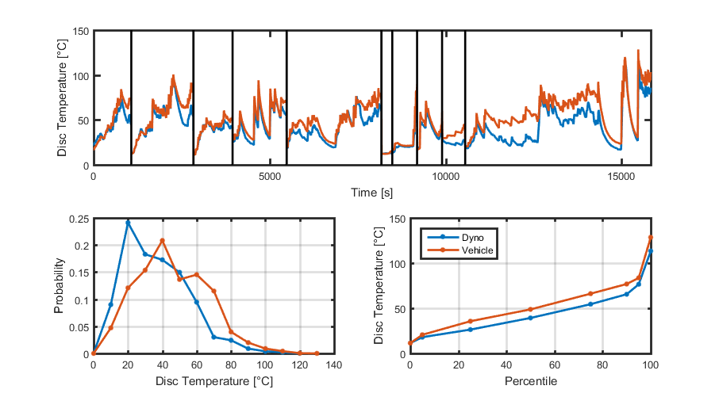
VALIDATION of THE NOVEL REAL-WORLD BRAKING CYCLE
ROUND-ROBIN EXERCISE
RR: The overall objective is to demonstrate that the novel cycle is repeatable at brake dyno level and reproducible at different labs/dynos. For that reason the brake temperature profile recorded at the vehicle during the development phase should be reproduced at the dyno level
RR is conducted in standard brake dyno test setup and NOT emissions setup
Preliminary results from 3 labs demonstrate a difference between vehicle and dyno temperature lower than 10°C
FORD EXAMPLE
Mathissen et al. 2018

Slide 39
Development of a NEW REAL-WORLD BRAKING CYCLE
OPEN ISSUES FOR TF1 CONSIDERATION
Q2. Not all brake dyno setups are similar to each other. What would be the temperature level and cooling influence on other test setups particularly for emission testing?
This topic is being investigated at the TF1 Round Robin and will further be investigated in TF2
Cooling air flowrate adjustment is also proposed in this case in order to overcome the differences (i.e. dimensions) between the various emissions setups (laboratories);
The adjustment will be more difficult than at standard brake dyno test setup mainly due to the enclosure but also due to the need for PM and PN measurements;
Each lab will come up with its individual cooling air flowrate for their emissions setup; however, a minimum set of specifications for the setup design will be proposed from TF2 to ensure a minimum quality standard;
TF2 will deal with this issue in the following months

Slide 40
Development of a NEW REAL-WORLD BRAKING CYCLE
OPEN ISSUES FOR TF1 CONSIDERATION
Q3. What temperature will be achieved for other brake systems (vehicle classes)? How to adapt the cycle to other vehicle classes?
The novel cycle has been initially validated at the brake dyno level (Ford) based on vehicle measurements conducted with a specific set of brakes (Mid-size vehicle brake of 15”);
The cooling air flowrate at the different dynos is currently being adjusted by the TF1 members based on the temperature profile of this particular brake set;
The temperature profile will differ for other brake systems and as a result the cooling air flowrate shall be adjusted accordingly;
So far no discussions about this topic have been conducted as the activities has been focused on proving that the novel cycle is repeatable and reproducible;
Actions will be taken after the completion of the TF1 RR

Slide 41
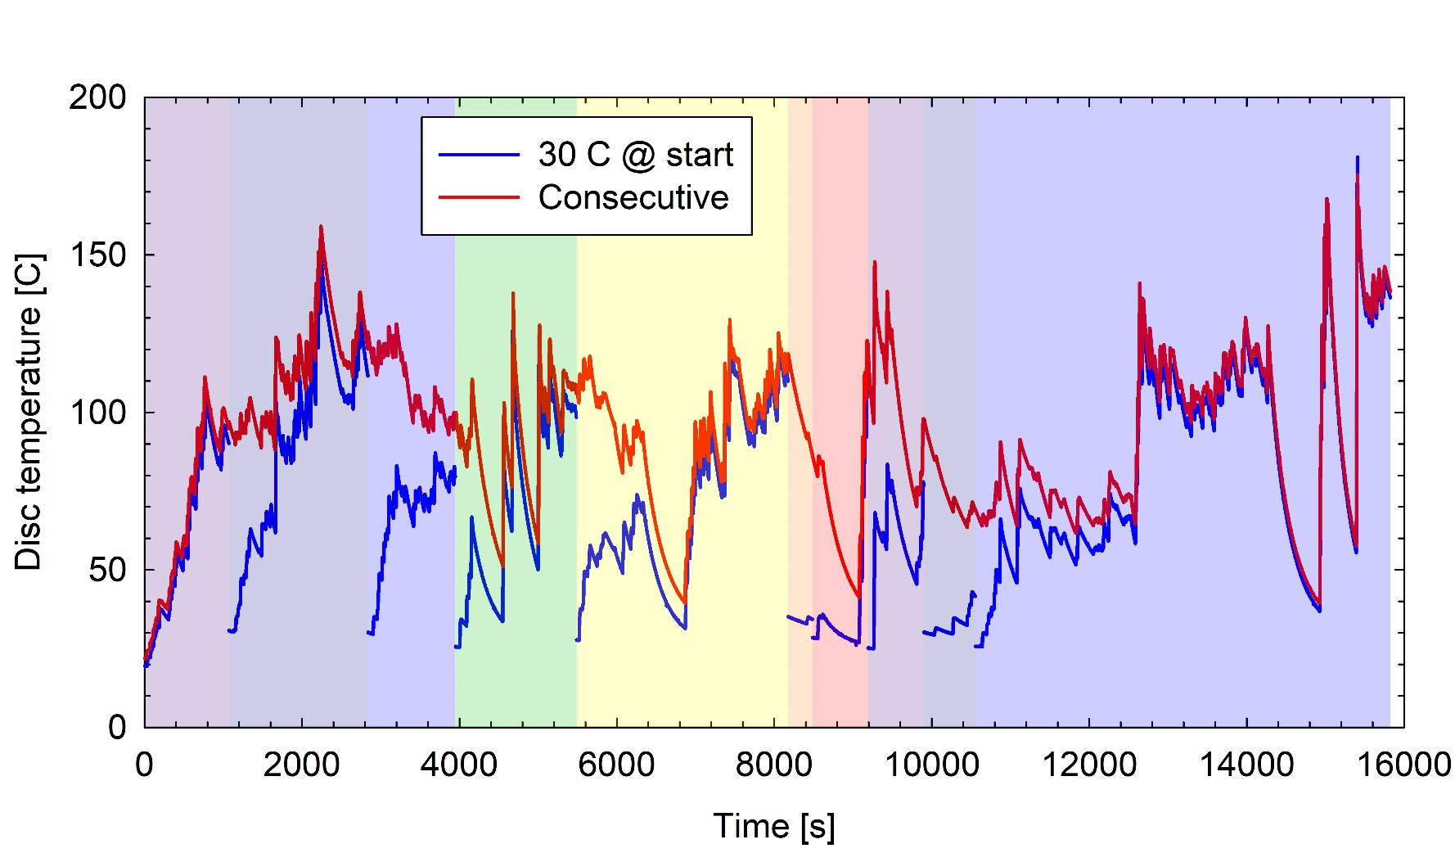
Development of a NEW REAL-WORLD BRAKING CYCLE
OPEN ISSUES FOR TF1 CONSIDERATION
Q4. What is the influence of breaks between the trips (soak time)?
One of the main difficulties of the novel cycle is that includes very long soaking times (can take as long as 37 h compared to 4 ½ h of actual measurement);
AVL and TU Ilmenau demonstrated that the start temperature did not significantly affect the peak temperature of the different segments when running the cycle with and w/o the application of soak times;
More experiments will take place in different labs to confirm the initial findings
Mamakos et al. 2018 - 48th PMP Meeting

Slide 42
Development of a NEW REAL-WORLD BRAKING CYCLE
NEXT STEPS
A report based on the TF1 RR findings will be prepared and submitted to the PMP group
The TF1 has agreed to investigate the situation with regards to the other brake systems (vehicle classes) and how to adapt the measurement setups to them

Slide 43
DEVELOPMENT OF A COMMON METHOD FOR
SAMPLING AND MEASURING BRAKE WEAR PARTICLES
STEP 2
DEFINITION OF A SET OF MINIMUM REQUIREMENTS
FOR THE EMISSIONS MEASUREMENT SETUP

Slide 44
BRAKE DUST SAMPLING AND MEASUREMENT
MAIN TASKS
Selection of the testing methodology (Concluded) – Details can be found at GRPE Progress Report June 2018
Comparison of existing systems/test rig configurations (Concluded) - Details can be found at GRPE Progress Report June 2018
Selection/definition of testing parameters (Deadline: March 2018) – Still on-going but most parameters have been agreed
Validation of the selected configuration(s) & measurement methodologies (Deadline: December 2019)
Data processing method (Deadline: To be defined depending on the progress)

Slide 45
BRAKE DUST SAMPLING AND MEASUREMENT
MAIN TASKS
Task 3. Selection/definition of testing parameters - Main steps
Define the scope based on the mandate and what is feasible to achieve with the current state of experience in the TF2 (Concluded)
Structure the work in different thematic topics (Concluded)
Define individual groups within the TF2 to deal with each thematic topic (Concluded)
Start collecting experimental data within the TF2 (June and onwards)

Slide 46
SELECTION/DEFINITION OF TESTING PARAMETERS
DEFINITION OF THE SCOPE BASED ON THE MANDATE
There is a common agreement that both PM₁₀ and PM_{2.5} as well as PN emissions should be investigated
Challenge: Optimal layout and sampling conditions might be different for mass and PN measurement! A compromise could be needed to achieve all measurements simultaneously
Challenge: There is no agreement yet on whether the PN concentration measurement shall focus on solid particles like in case of exhaust emissions or on total particles

Slide 47
SELECTION/DEFINITION OF TESTING PARAMETERS
STRUCTURE THE WORK IN DIFFERENT THEMATIC TOPICS
The work has been structured in 9 Chapters based on the needs identified at the discussion for the definition of the scope
1. Introduction, rationale, scope and list of topics not addressed
2. Nomenclature, definitions, and terminology, including ISO and EN standards
3. Brake dynamometer capabilities
4. Sampling system
5. Brake emissions mass measurement system
6. Brake emissions number measurement system
7. System calibration, validation, and sign-off
8. Appendixes

Slide 48
SELECTION/DEFINITION OF TESTING PARAMETERS
CURRENT STATUS
The minimum testing requirements/specifications for the data collection have been agreed. Agreement on the following parameters/topics has been reached:
1. Defined Cycle (WLTP-novel)
2. Background/blank concentration check
3. Defined range of cooling air temperature and RH
4. Common brake system for the first round of experiments
5. Definition of a common bedding-in procedure
6. Common method for measuring the brake temperature
7. Measurement of PM concentration based on the gravimetric method described in Chapter 5
8. Calculation of residence time in the enclosure and in the duct
9. List of parameters to be registered

Slide 49
BRAKE DUST SAMPLING AND MEASUREMENT
CURRENT STATUS
Collection of experimental data within the TF2 (on-going)
Data already exist from previous projects (already presented in 37th – 48th PMP Meetings)
TF2 members are involved in many on-going projects and more data will come from there in the near future
Based on this data the TF2 will define all necessary testing parameters and will come up with a minimum set of requirements for the sampling set-up and the necessary instrumentation

Slide 50
FUTURE TECHNOLOGIES - CHALLENGES
The test rig approach clearly focuses only on the brake system
Other technologies (e.g. regenerative braking, smart braking, ADAS) have the potential to reduce brake wear emissions
How to assess these technologies?
  The topic has been discussed in the last 2 PMP meetings – Presentation from VDA and TU Ilmenau showing a potential of between60-90% decrease in PN emissions
  Different options have been identified (modified cycle, modified brake dynos, eco-innovation like approach, modelling…)
  Further analysis will follow once the common methodology development is concluded

Slide 51
TYRE WEAR PARTICLES
In the 48th PMP meeting 3 sessions were dedicated to the subject
JASIC (Japan) presented their methodology for Tire dust emission measurement for a passenger vehicle.
TU Ilmenau presented the results of laboratory measurements of tire wear emissions from their common project with AUDI (Presentation will become available in May)
ETRMA provided an overall perspective of the tyre industry not only for tyre wear particle emissions but also for Microplastic emissions

Slide 52
PMP NEXT STEPS

Slide 53
PMP Mandate
Current mandate expires in June 2019
The PMP group had submitted to GRPE in June 2016 an updated draft version of the ToR and requested a new mandate with two main new concrete objectives:
  Sub 23 nm exhaust particles:
    Demonstrate the feasibility to measure sub23nm particles with the existing PMP methodology with appropriate modifications and assess measurement differences/uncertainties by means of a round robin (RR)
      Development of a suggested common test procedure for sampling and assessing brake wear particles both in terms of mass and number

Slide 54
PMP Mandate
The informal group on Particle Measurement Programme should complete the tasks described in the revised TOR by June 2019. A prolongation and extension of the mandate of the group, in relation to the above tasks should be considered in due time by GRPE.
The new mandate should be defined/requested taking into consideration the post-Euro 6/VI standard discussion just started in Europe

Slide 55
Post-Euro VI/6
A number of new measures will be assessed in the next months in view of a possible introduction in the post-Euro 6/VI standards or in a separate EU regulation.
These include:
  Reduction of the cut-off size below 23 nm (at least 10 nm) of the particle number measurement methodology
  Assessment of the possibility to introduce a standard on brake emissions
  Methodology for the measurement of tyre abrasion rate

Slide 56
Sub-23 nm exhaust particles
Strong political pressure to reduce the cut-off size down to at least 10 nm
Methodology should be ready, from a technical point of view, by the end of 2020
This means a number of decision to be taken in the short term to leave enough time to assess different engine technologies and provide inputs for the definition of the limits

Slide 57
Potential timeline /Milestones

Slide 58
BRAKE WEAR EMISSIONS
DEVELOPMENT OF A COMMON METHOD FOR
SAMPLING AND MEASURING BRAKE WEAR PARTICLES
STEP 1 - Development of a new real-world braking cycle
WLTP Database Analysis (Concluded)
Comparison of WLTP data with Existing Industrial Cycles (Concluded)
Development of a first version of the novel (WLTP based) braking schedule (Concluded)
Validation of the novel cycle - Round robin (Deadline: January 2019)
STEP 2 - Definition of a set of minimum requirements for the emissions measurement setup
Selection of the testing methodology (Concluded)
Comparison of existing systems/test rig configurations (Concluded)
Selection/definition of testing parameters (Deadline: Still on-going)
Validation of the selected configuration(s) & measurement methods (Deadline: December 2019)

Slide 59
WHAT NEXT FOR REGULATORY PURPOSE?
Building on the methodology developed within PMP seems to be a sensible approach
Once the suggested methodology has been “completed” from a technical point of view, a monitoring phase to assess typical emission levels of brake systems as well as repeatability and reproducibility should follow
Considering that PMP is based on voluntary participation/contribution, this requires a strong commitment from OEM and OEM suppliers

Slide 60
Potential timeline /Milestones

Slide 61
TYRE WEAR EMISSIONS
EU Third Mobility Package included the decision to develop a standard methodology to measure tyre abrasion rate
Very likely this methodology will be developed by an ad-hoc group set up by the EU Commission with strong involvement of main stakeholders, especially tyre manufacturers
The focus will be on the amount of material released into the environment by tyres (microplastics issue)
PMP could be involved again afterwards to investigate any possible correlation between abrasion rate and contribution to airborne PM10-2.5

Slide 62
Any questions?
You can find me at giorgio.martini@ec.europa.eu

