Slide 2
Safety Assessment of
Automated Vehicles
VMAD-02-08
M. Cristina Galassi – EC DG JRC C.4
2nd Session of VMAD IWG on April 1 - 2, 2019

Slide 3
1st Technical Workshop – 22nd Nov 2018
Small group of experts (16 participants) representing MSs, industry and EU international projects
Different approaches proposed for AVs certification
Goal
Discuss what already exists, which are the merits/limits of the different methodologies
Debate on the way forward, with focus on short term needs for a harmonized European approach

Slide 4
2nd Technical Workshop – 7th March 2019
Enlarged group of experts (written contribution)
Goal
How do we define a safe automated vehicle and how this shall be demonstrated
Which tools can be used now for safety demonstration and what can be used at a later stage (and when)
Open discussion on JRC proposal and way forward

Slide 5
Different Approaches
Mathematical model formalizing the duty of care
Horizontal Regulation
Scenario based approach
Software audit & driving license
Tool-chain for HIL tests
Proactive safety analysis performed at early stage
Tests & audit
OEMs certification plus technical tests

Slide 6
PHASE 1: NOW
Different Approaches
Mathematical model formalizing the duty of care
Horizontal Regulation
Scenario based approach
Software audit & driving license
Tool-chain for HIL tests
Proactive safety analysis performed at early stage
Tests & audit
OEMs certification plus technical tests

Slide 7
Development
(1) What is a safe AV?
(2) How to evaluate it?
Validation/Verification

Slide 8
What is a safe AV?
AUTOMATION SOFTWARE
INTERFACES
PHYSICAL SYSTEMS
Nominal Safety
Functional Safety
Miscommunication
Interactions with humans
Environmental factors

Slide 9
What is a safe AV: Mathematical model
A mathematical model formalizing a "common sense" interpretation of the "duty of care"
  What is a dangerous situation?
  What is the proper response?
  What does it mean to be reasonably cautious? What assumptions a driver can make on the unknown behavior of other road users?

Slide 10

Mathematical model - how to apply it?
Tests scenarios can be derived from the mathematical model to assess vehicle nominal safety
E.g. SAFE DISTANCE – LONGITUDINAL
  safe distance
  response time
  maximal acceleration
  maximal deceleration lead vehicle
  maximal/minimal brake
  accident avoidance

Slide 11
Risk Assessment
e.g. STPA (Systems-Theoretic Process Analysis) approach
Early Phase (i.e. development)
Top-down approach for safety analysis
Control based analysis
Causal Factors
Proactive instead of Reactive Safety Analysis
Addresses new accidents caused by component interactions, software and human errors
Less dependent of a very experienced analyst (multidisciplinary team)

Slide 12
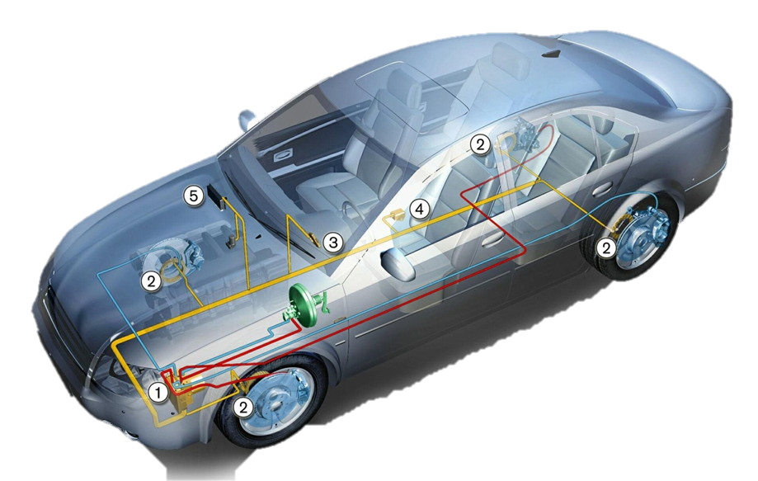

1. Identify possible accidents and hazards at the system level
2. Identify the control structure
3. Inadequate Control Actions (ICAs)
4. CASUAL FACTORS
SAFETY CONSTRAINTS
SAFETY REQUIREMENTS
SAFETY MEASURES
STPA – How does it work?
Electronic Stability Control
Traction Control
Back Camera
Stop & Go Adaptive Cruise Control
Reverse Backup Sensors
Anti-Lock Braking Systems (ABS)
Adaptive Cruise Control (ACC)
SAFE AV
Electronic Brakeforce Distribution Systems
Airbags
Automatic Braking Systems

Slide 13
How to evaluate safety : AUDIT
UN Regulation 79 - approval of vehicles with regard to steering equipment (Annex 6)
ISO 26262 – Functional Safety
ISO/PAS 21448 (SOTIF) – Safety of the intended Functionality
  Design phase
  Verification phase
  Validation phase

Slide 14
How to evaluate safety :TESTING
Track & on-road testing (e.g. driving license)
TRACK: limited test cases database (mathematical model + extended), random selection of scenarios plus variable parameters (speed, weather conditions, etc…)
ON-ROAD: mixed U+R+H (similar to RDE) assessing driving capabilities within vehicle operational domain plus handover to driver
Is it sufficient? Need for in use compliance reporting by manufacturer?

Slide 15
PHASE 2: 5-10y
Different Approaches
Mathematical model formalizing the duty of care
Horizontal Regulation
Scenario based approach
Software audit & driving license
Tool-chain for HIL tests
Proactive safety analysis performed at early stage
Tests & audit
OEMs certification plus technical tests

Slide 16

Next steps
3rd Technical Workshop in May
Feedback on JRC proposal
Discuss the "new assessment method" on a concrete use case (e.g. L3 Lane keeping)
Ideas, comments, contributions are welcome !

Slide 17
Any questions?
Maria-Cristina.Galassi@ec.europa.eu

