Slide 1

Comment:
Provide evidence that the deploying bonnet does not cause additional risks for the pedestrian hitting the bonnet
(Task 27 of the IWG Task List)
27.02.2019

Slide 2
Content
  Motivation of Proposal
  Item 1: Bonnet may still move during head impact
  Item 2: Opening angle of the bonnet
  Summary

Slide 3
Motivation of Proposal
In the 1st IWG-DPPS meeting in April 2018, document IWG-DPPS/1/05 was presented by OICA.
The aim of the proposal was to accept a guaranteed (intended) height for the testing of a deployable system and NOT only a fully deployed system. Intended height is a minimum height specified by the manufacturer to fulfill legal requirements. Higher positions of “lifted vehicle outer surfaces” cause better performances (e.g. for larger pedestrians with later HIT) and covers a wider range of real world cases.
During the meeting the question was raised if a moving bonnet can have an influence on the HIC values and if the different angles between the intended height and the fully deployed height could lead to different test results.
In this document both cases are further discussed.

Slide 4
TF-DPPS Comments
Item 1: Bonnet may still move during head impact

Slide 5
TF-DPPS Comments
Static Headform Test Procedure: TRT vs HIT
CASE 1 – HIT 6yo < Fully Deployed Time (FDT):
The main criterion during development is TRT < HIT, where TRT is based on intended deployment height. Additionally, a Fully Deployed Time (FDT) can be defined as the total response time until the system has reached its full deployment height.
In exemplary case 1: HIT 6yo < FDT which can happen for higher cars and depending on the system.
Depending on the remaining deployment velocity and the specific kinematic behaviour of the bonnet, further discussion will be needed. Acknowledging the possibility of a suitable substitute / replacement system (instead of dynamic testing) is strongly recommended.

Slide 6
TF-DPPS Comments
Static Headform Test Procedure: TRT (Total Reaction Time) vs HIT (Head Impact Time)
CASE 1 HIT 6yo < FDT
Fully Deployed
hinge
Deploy height (intended)
hinge
Stroke of active elements
[ mm ]
Fully Deployed
lock
Sensor Time
ST
Max. Deployment Time
DT
Deploy height (intended)
lock
FDT
HIT
6yo
HIT
5%-
female
HIT
50%-male
Total Reaction Time
TRT
FDT: Fully Deployment Time

Slide 7
TF-DPPS Comments
Static Headform Test Procedure: TRT vs HIT
CASE 2 – HIT 6yo > Fully Deployment Time (FDT):
The main criterion during development is TRT < HIT, where TRT is based on intended deployment height. Additionally, a Fully Deployed Time (FDT) can be defined as the total response time until the system has reached its full deployment height.
In exemplary case 2: HIT 6yo > FDT which applies to the majority of passenger cars.
Static testing is applicable in this case.

Slide 8
TF-DPPS Comments
Static Headform Test Procedure: TRT vs HIT
CASE 2 HIT 6yo > FDT
Fully Deployed
hinge
Deploy height (intended)
hinge
Stroke of active elements
[ mm ]
Fully Deployed
lock
Sensor Time
ST
Max. Deployment Time
DT
Deploy height (intended)
lock
FDT
HIT
6yo
HIT
5%-
female
HIT
50%-male
Total Reaction Time
TRT
FDT: Fully Deployment Time

Slide 9
TF-DPPS Comments
Static Headform Test Procedure: TRT vs HIT
Summary for item 1- Bonnet may still move during head impact :
Case 1 - bonnet still moving during head impact:
Depending on the remaining deployment velocity and the specific kinematic behaviour of the vehicle, further discussion will be needed. Acknowledging the possibility of a suitable substitute / replacement system (instead of dynamic testing) is strongly recommended.
Case 2 – bonnet not moving during head impact:
Static testing is applicable in this case.

Slide 10
TF-DPPS Comments
Item 2: Opening angle of the bonnet

Slide 11
TF-DPPS Comments
Static Headform Test Procedure: OPENING ANGLE
Methodology:
Aim: Check whether the bonnet opening angle considerably changes the impact angle
Comparison of the opening angles of different vehicle types with different bonnet lengths and active systems between intended and fully deployed height.
Determination of the difference in opening angles of the bonnet with intended and fully deployed height
Comparison of the opening angle difference with the allowed angle tolerance for a headform test (+/-2°)
In vehicles where the angular difference between fully deployed bonnets and bonnets in intended height is below this test angle tolerance, the angular difference should not play a role, by definition.

Slide 12
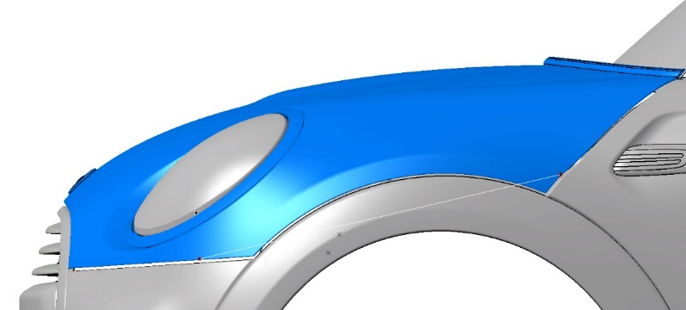
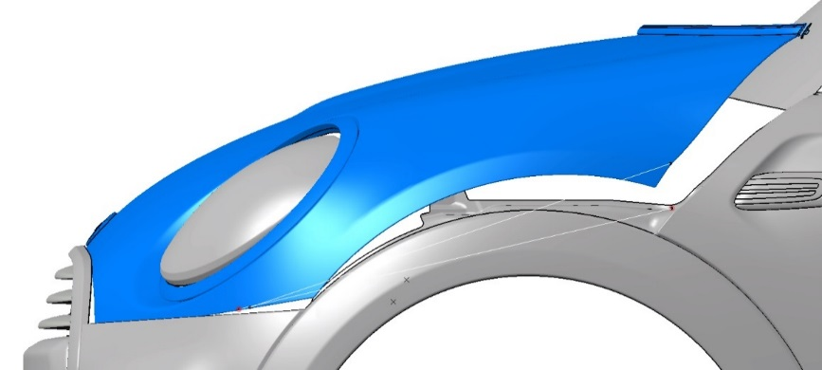

TF-DPPS Comments
Static Headform Test Procedure: OPENING ANGLE
1. Partial active system
(only hinge), short bonnet
Closed
Δ 0.5°
Intended height
Fully
deployed
5.7°
5.2°

Slide 13
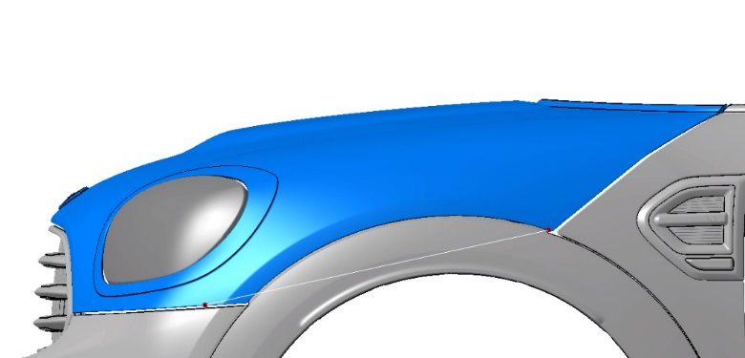
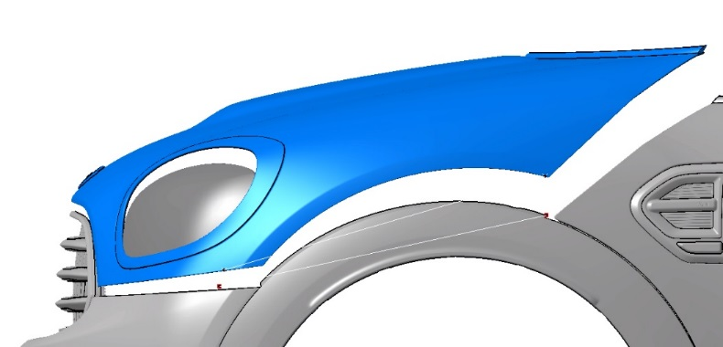
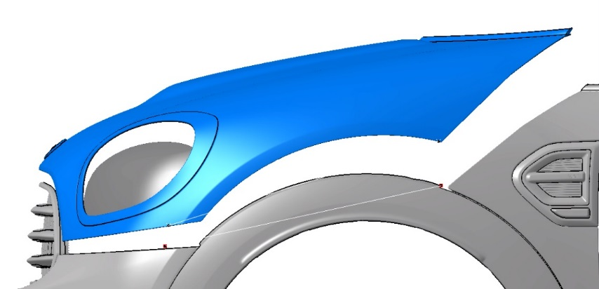
TF-DPPS Comments
Static Headform Test Procedure: OPENING ANGLE
2. Fully active system
(hinge and lock), short bonnet
Closed
Δ 0.9°
4.9°
4.0°
Intended height
Fully
deployed

Slide 14
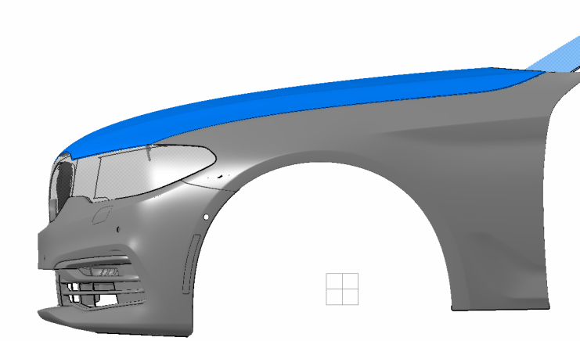
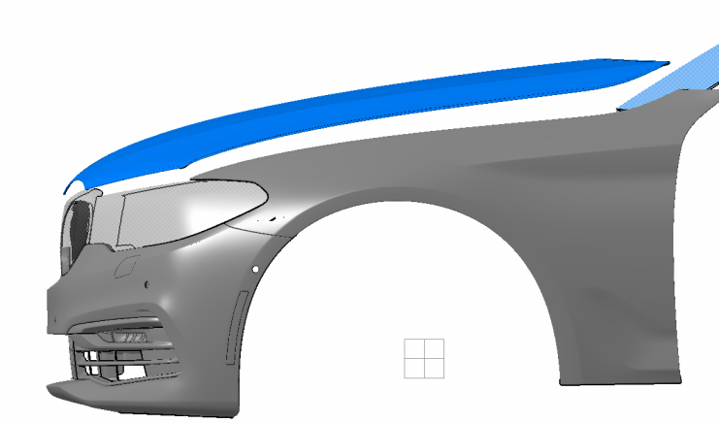
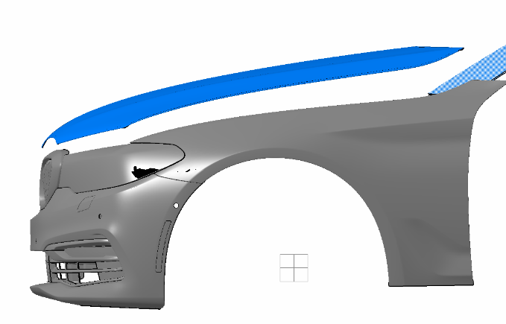
TF-DPPS Comments
Static Headform Test Procedure: OPENING ANGLE
3. Fully active system
(hinge and lock), long bonnet
Closed
1.7°
Δ 1.1°
2.8°
Intended height
Fully
deployed

Slide 15
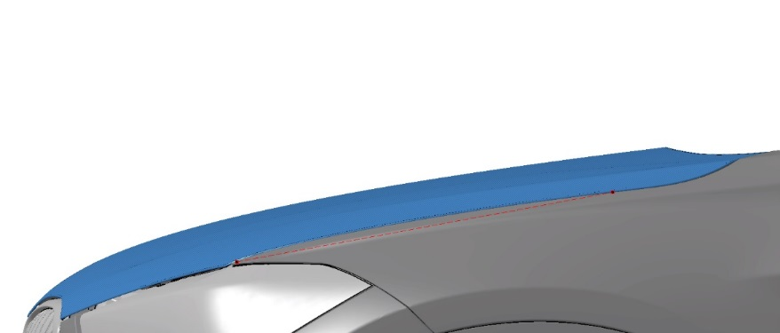
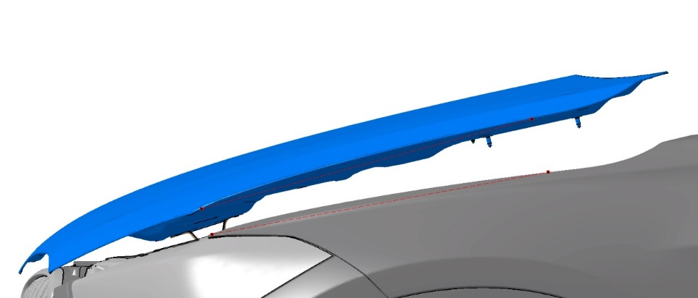
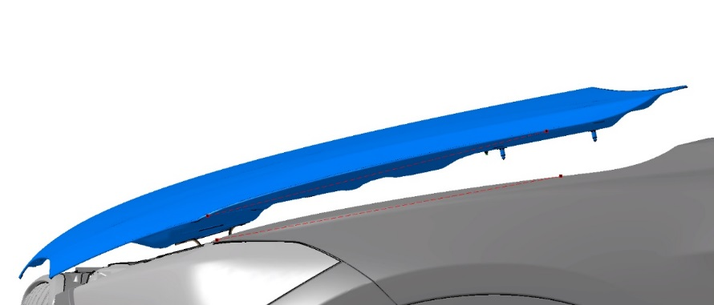
TF-DPPS Comments
Static Headform Test Procedure: OPENING ANGLE
4. Fully active system
(hinge and lock), long bonnet
Closed
Δ 1.2°
Intended height
4.7°
3.5°
Fully
deployed

Slide 16
TF-DPPS Comments
Static Headform Test Procedure: OPENING ANGLE
SUMMARY / RESULT
Opening Angle of the bonnet – intended height vs fully deployed height:
The angle deviation between intended height and fully deployed height for the different bonnet types is between 0.5°and 1.2°
All of the above example vehicles have an angular difference of less than the permissible test angle tolerance of +/- 2°
The difference between the intended height and fully deployed height is less than the permissible test angle tolerances even with different hood lengths and therefore can not be classified as significant.

