Slide 1

Test Procedure for Pedestrian Dummy to calculate HIT
12.03.2019

Slide 2
Test Procedure for Pedestrian Dummy to calculate HIT

Slide 3
Full-scale Dummy Test Procedure
Discussion at 2nd IWG-DPPS
  Test/simulation procedure for predicting HIT needs to be defined
Review of existing procedure
  SAE J2782 specifies full-scale test conditions, including pedestrian posture, impact direction, impact speed and release timing of hanging dummy
Needed to be investigated
  Tolerances of impact conditions need to be defined based on sensitivity to HIT
  Impact conditions need to be consistent with HBM simulation setup

Slide 4
Influence of Testing Tolerances on HIT
Methods
Testing tolerance specified in SAE J2782
  Impact speed: 40km/h±1km/h
  Posture：knee height(±10mm)、angle of joints(±5 degree)
Sensitivity analysis
  Calculate variation of HIT by simulation
  Impact velocity: 39km/h (lower limit) and 41km/h (upper limit)
  Posture (head height): highest and lowest
Combination of simulations
 | Impact speed | Head height from ground
Base | 40km/h | J2782
L-L | 39km/h | Lowest in tolerance
L-H | 39km/h | Highest in tolerance
H-L | 41km/h | Lowest in tolerance
H-H | 41km/h | Highest in tolerance

Slide 5
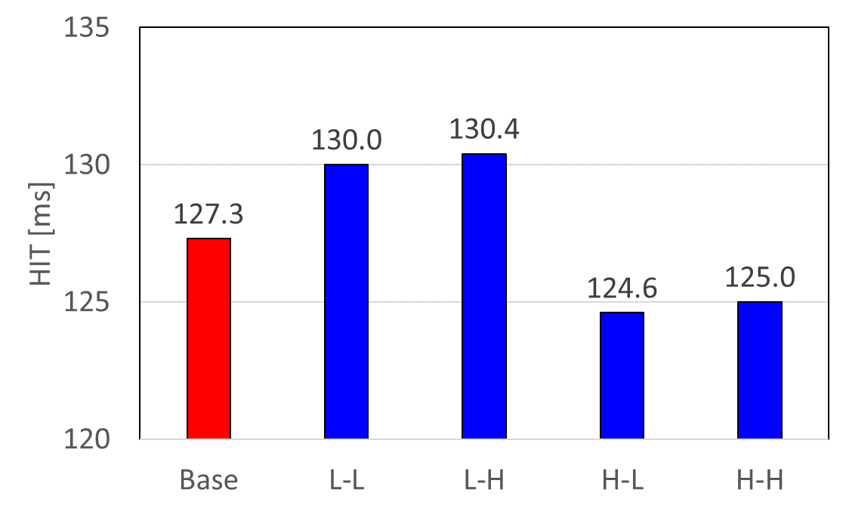
Influence of Testing Tolerances on HIT
Results
5.8ms
HIT variation range compared to base simulation: 4.6%
(Smaller than HIT variation by difference of HBM (approx. 10%) in CoHerent project)
Test procedure and tolerances specified in SAE J2782 can be used

Slide 6
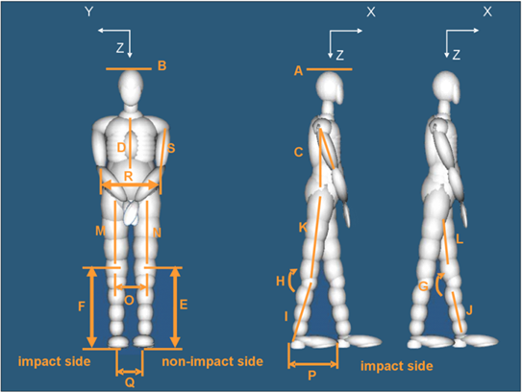
Consistency of Impact Condition
Comparison of Impact Condition
Conditions |  | Test (SAE J2782) | Simulation (Euro NCAP TB024)
Impact Direction |  | Longitudinal direction of car | Longitudinal direction of car
Impact Speed |  | 40 ± 1km/h | 40km/h
Posture | Lower limb | SAE J2782 | SAE J2782
 | Arm | SAE J2782 (The wrist shall be tightly bound in front of torso) | Natural posture
*Other conditions are specific for test and simulation
Only posture of the are is different between test and simulation

Slide 7
Consistency of Impact Condition
Justification of Difference of Arm Position
Dummy testing
  Position of each body segment including arm needs some tolerances
  In case the arm position is in the natural position (walking posture), arm stuck to the car body which strongly influence HIT(head impact time) may be caused by the tolerance of the position
  Therefore, the arm is located in front of torso and bound to keep repeatability of pedestrian kinematics
HBM simulation
  Repeatability issue does not exist even if the arms are positioned in natural posture
Considering the repeatability issue in dummy testing, it is thought that the difference of the arm position is acceptable

Slide 8
Contents for Dummy Testing Procedure
Section 4.8.1.2 of SAE J2782_201010 shall be used for car attitude
Section 4.8.2 of SAE J2782_201010 shall be used for impact speed
Section 4.8.3 of SAE J2782_201010 shall be used for dummy pre-test position, pedestrian supporting and release

Slide 9
Draft proposal for test procedure
Changes from DPPS-4-06e_rev.docx
4.1. The HIT for the relevant pedestrian statures is calculated in the deploy position of the outer surface. Relevant are those statures amongst the 6-year old child, the 5%ile female, the 50%ile male and the 95%ile male, [whose heads] contact the outer surface in the headform test areas. Pedestrian statures shall be in walking posture as defined in paragraph 8.1. of this Annex, using an appropriate simulation tool.
The HIT is calculated at the vehicle speed as specified for the legform impact in this regulation and at the centerline of the vehicle.
In case HIT is calculated from physical testing, test conditions defined section in 4.1.2 of this Annex shall be used.
In case HIT is calculated from numerical simulation, numerical simulation conditions defined section in 4.1.1 of this Annex shall be used.
4.1.1 Conditions for numerical simulation
4.1.2 Conditions for physical testing
4.1.2.1 Section 4.8.1.2 of SAE J2782_201010 shall be used for car attitude
4.1.2.2 Section 4.8.2 of SAE J2782_201010 shall be used for impact speed
4.1.2.3 Section 4.8.3 of SAE J2782_201010 shall be used for dummy pre-test position, pedestrian supporting and release

