Slide 1
TF-DPPS
Marking of Bonnet in Deployed/Undeployed Position
- Update of OICA Position from 5th TF meeting April 2018 (TF-DPPS/4/05)

Slide 2
Marking of Bonnet in Deployed/Undeployed Position
OICA Position
Content:
Summary of recent documents DPPS-2-09e, DPPS-3-04e, DPPS-4-05e
Current requirements based on INF GR/PS/141 Rev. 1, GTR No.9, UN R127
  Marking up the vehicle in deployed position
  Preparation of car
  Avoidance of glancing blows
Example of type approval
  Deployable bonnet
  Exemption e.g. external airbag
Comparison with real accident scenario
Example bonnet movable in longitudinal (x) direction
Summary

Slide 3
Marking of Bonnet in Deployed/Undeployed Position
Summary of recent documents DPPS-2-09e, DPPS-3-04e, DPPS-4-05e
DPPS-2-09e (OICA)
„Keep current gtr language, Deployed Position for static testing and Closed Position for dynamic testing“
DPPS-3-04e (JASIC)
“The head impact test area may be defined with the active hood being deployed in the sensing area and when the active hood is completely deployed before head contact. Otherwise, the head impact test area shall be defined with deployable systems not deployed.”
“Reason for Proposal: The head impact test area should be defined under the same conditions as real-world accidents”
DPPS-4-05e (OICA)
“…In case of deployable systems, the determination of that area is conducted in the deployed position of the outer surface as defined in paragraphs 3.19. or 3.31. respectively.
In case of a technology that makes it impossible to mark up in deployed position, the mark-up is conducted in undeployed position.”
  Note: That decision is result of an agreement between the TA Services & OEM. (see DPPS-4-04e)
  - Static testing is not having a live deployment during the tests and comes with marking in the raised (deployed) position.
  - Dynamic testing is activation of DPPS and impactor per the timing of HIT vs. WAD and marking in closed (undeployed)
  position.

Slide 4
Marking of Bonnet in Deployed/Undeployed Position
Current requirements based on INF GR/PS/141 Rev. 1, GTR No.9, UN R127
Marking
Current requirements based on INF GR/PS/141 REV. 1:
“Marking up the vehicle in deployed position. In case of a technology that makes it impossible to mark up in deployed position (for example external airbags) it can be agreed between the manufacturer and the Technical Service to mark up in undeployed position.”
INF GR/PS/141 has no legislative status (“Informal paper”, but common practice)

Slide 5
Marking of Bonnet in Deployed/Undeployed Position
OICA Position
Content:
Summary of recent documents DPPS-2-09e, DPPS-3-04e, DPPS-4-05e
Current requirements based on INF GR/PS/141 Rev. 1, GTR No.9, UN R127
  Marking up the vehicle in deployed position
  Preparation of car
  Avoidance of glancing blows
Example of type approval
  Deployable bonnet
  Exemption e.g. external airbag
Comparison with real accident scenario
Example bonnet movable in longitudinal (x) direction
Summary

Slide 6

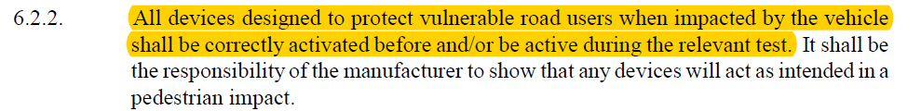

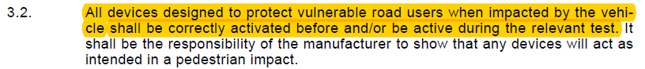
Marking of Bonnet in Deployed/Undeployed Position
Current Requirements GTR No.9 / UN-R 127
Preparation of car
Current requirements
GTR No.9 (ECE/TRANS/180/Add.9, 26 January 2009):
UN-R127

Slide 7
Marking of Bonnet in Deployed/Undeployed Position
Current Requirements
Avoidance of glancing blows
Global technical regulation No. 9 (ECE/TRANS/180/Add.9)
7.3. Child headform test procedure
…
7.3.2. No impact point shall be located so that the impactor will impact the test area with a
glancing blow resulting in a more severe second impact outside the test area.

Slide 8
Marking of Bonnet in Deployed/Undeployed Position
OICA Position
Content:
Summary of recent documents DPPS-2-09e, DPPS-3-04e, DPPS-4-05e
Current requirements based on INF GR/PS/141 Rev. 1, GTR No.9, UN R127
  Marking up the vehicle in deployed position
  Preparation of car
  Avoidance of glancing blows
Example of type approval
  Deployable bonnet
  Exemption e.g. external airbag
Comparison with real accident scenario
Example bonnet movable in longitudinal (x) direction
Summary

Slide 9
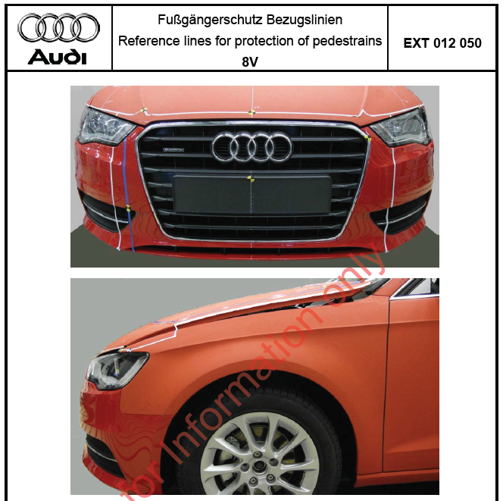
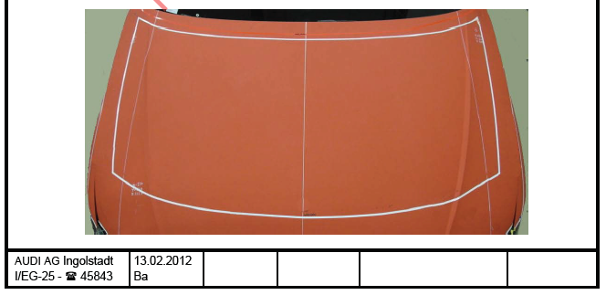
Marking of Bonnet in Deployed/Undeployed Position
Example of type approval based on UN-R 127 and INF GR/PS/141 Rev. 1
Marking in deployed position

Slide 10
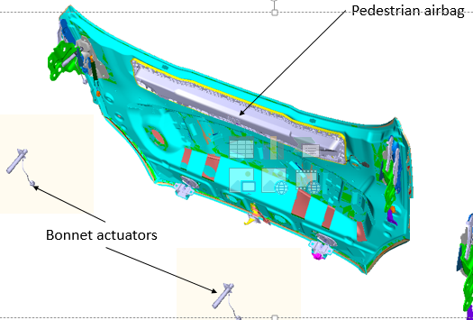
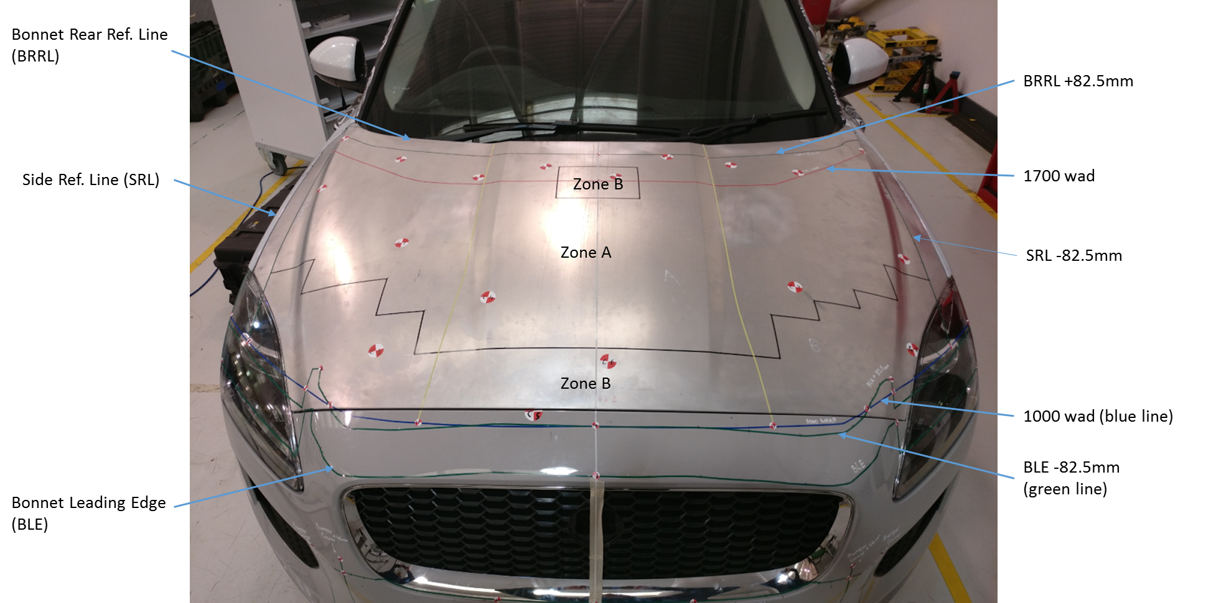
Marking of Bonnet in Deployed/Undeployed Position
Example of type approval based on UN-R 127 and INF GR/PS/141 Rev. 1
Marking in undeployed position
Vehicle is fitted with deployable bonnet and pedestrian airbag, both of which do not have a permanently
deployed position

Slide 11
Marking of Bonnet in Deployed/Undeployed Position
OICA Position
Content:
Summary of recent documents DPPS-2-09e, DPPS-3-04e, DPPS-4-05e
Current requirements based on INF GR/PS/141 Rev. 1, GTR No.9, UN R127
  Marking up the vehicle in deployed position
  Preparation of car
  Avoidance of glancing blows
Example of type approval
  Deployable bonnet
  Exemption e.g. external airbag
Comparison with real accident scenario
Example bonnet movable in longitudinal (x) direction
Summary

Slide 12
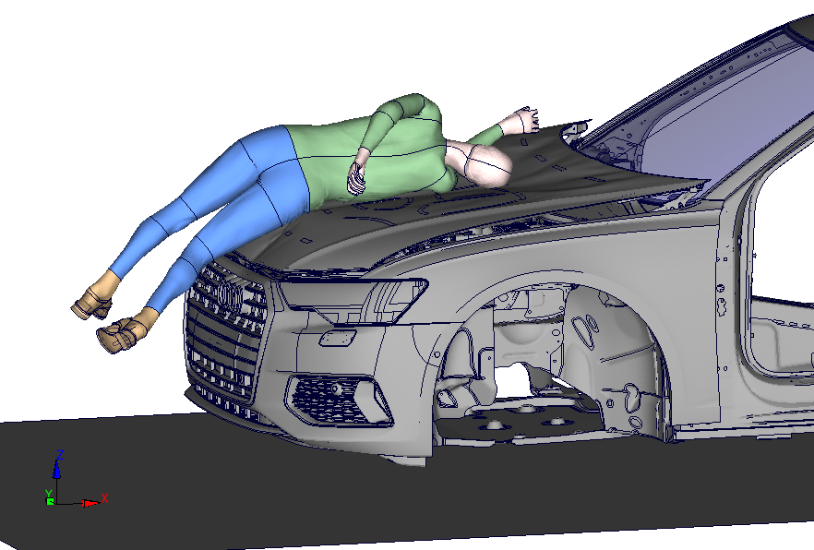
Marking of Bonnet in Deployed/Undeployed Position
Comparison with real accident scenario
In a real accident, the pedestrian hits the vehicle with the hood in a deployed position
Legislation should always depict real situations in the best possible way

Slide 13
Marking of Bonnet in Deployed/Undeployed Position
OICA Position
Content:
Summary of recent documents DPPS-2-09e, DPPS-3-04e, DPPS-4-05e
Current requirements based on INF GR/PS/141 Rev. 1, GTR No.9, UN R127
  Marking up the vehicle in deployed position
  Preparation of car
  Avoidance of glancing blows
Example of type approval
  Deployable bonnet
  Exemption e.g. external airbag
Comparison with real accident scenario
Example bonnet movable in longitudinal (x) direction
Summary

Slide 14
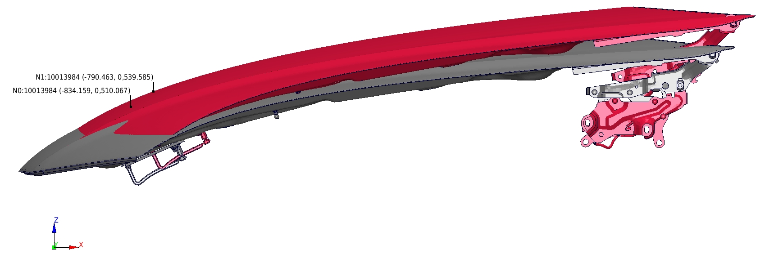
Marking of Bonnet in Deployed Position
Example of bonnet movable in longitudinal (x) direction – 1 -
Deployable bonnet is moving in x-direction
Marking in undeployed position (grey) would lead to a wrong aiming point (red)
A correct determination and marking of HIC1000 zone and HIC1700 zone (2/3, 1/3) is not possible
Point A ^{deployed}
Point A ^{undeployed}

Slide 15
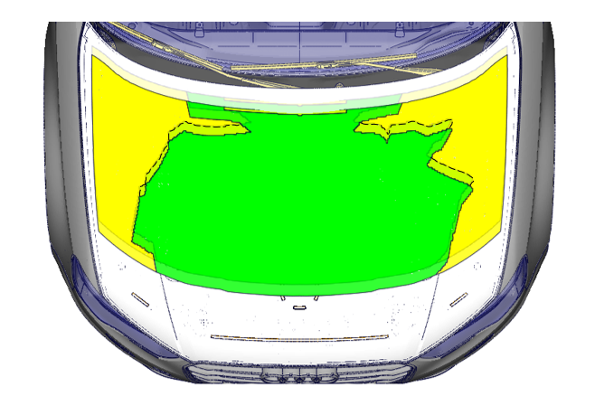
Marking of Bonnet in Deployed/Undeployed Position
Example of bonnet movable in longitudinal (x) direction – 2 -
Deployable bonnet is moving in x-direction
A correct determination and marking of HIC1000 zone and HIC1700 zone (2/3, 1/3)
is not possible if marking is done in undeployed position
Example:
Aiming Zone marked as „compliant“ in undeployed position
would be „non compliant“ in deployed position due to longitudinal movement of the bonnet
Bonnet moves
in longitudinal direction
Requirement
Zone HIC 1000: 67.66%
Zone HIC 1700: 32.34 %

Slide 16
Marking of Bonnet in Deployed/Undeployed Position
OICA Position
Content:
Summary of recent documents DPPS-2-09e, DPPS-3-04e, DPPS-4-05e
Current requirements based on INF GR/PS/141 Rev. 1, GTR No.9, UN R127
  Marking up the vehicle in deployed position
  Preparation of car
  Avoidance of glancing blows
Example of type approval
  Deployable bonnet
  Exemption e.g. external airbag
Comparison with real accident scenario
Example bonnet movable in longitudinal (x) direction
Summary

Slide 17
Marking of Bonnet in Deployed/Undeployed Position
Summary – 1 -
OICA Proposal based on GRSP-58-31:
Par. 3.1. / 3.13.: ‘Adult / Child headform test area’ …In case of deployable systems, the determination of that area is conducted in the deployed position of the outer surface as defined in paragraphs 3.19. or 3.31. respectively.
In case of a technology that makes it impossible to mark up in deployed position, the mark-up is conducted in undeployed position.
OICA Proposal based on GRSP-58-31:
3.19. ‘Deployed position’ means the position of the lifted vehicle outer surface specified by the manufacturer. The lifted vehicle outer surface shall reach a position equal to or above the deployed position during the time between the Total Response Time and the Head Impact Time that corresponds to the rear end of the test area.
3.32. ‘Outer surface’ means those components of the vehicle within the test areas, which are contacted by the pedestrian in case of an accident. The outer surface may include the bonnet, the fenders, but also external airbags or other components within the test area.

Slide 18
Marking of Bonnet in Deployed/Undeployed Position
Summary – 2 -
Conclusion:
The advantage of the current OICA Proposal (based on GRSP-58-31) is that all available systems are covered and it is in line with the current requirements based on UN R127 / INF GR/PS/141 Rev. 1
The scope of the TF-DPPS is to clarify the existing test procedure
Marking in undeployed position would lead to new technical issues
(determination of test zone, glancing blow)
Principles mentioned in document DPPS-1-11 (principles of rulemaking) shall be considered
Currently defined legislative process mirrors best real accident scenario
Successfully used for dozens of type approvals according to UN R127
(more than 5 Mio. cars safe behaving on the road)
Proposal:
Marking up of the vehicle is generally done in deployed position. In case it is impossible to mark according to the procedure (i.e. technology or specific exterior design), or if it is agreed between manufacturer and Technical Service, the mark-up may be done in undeployed position.

