Slide 1
OBD GTR phase2
Roadmap

Slide 2
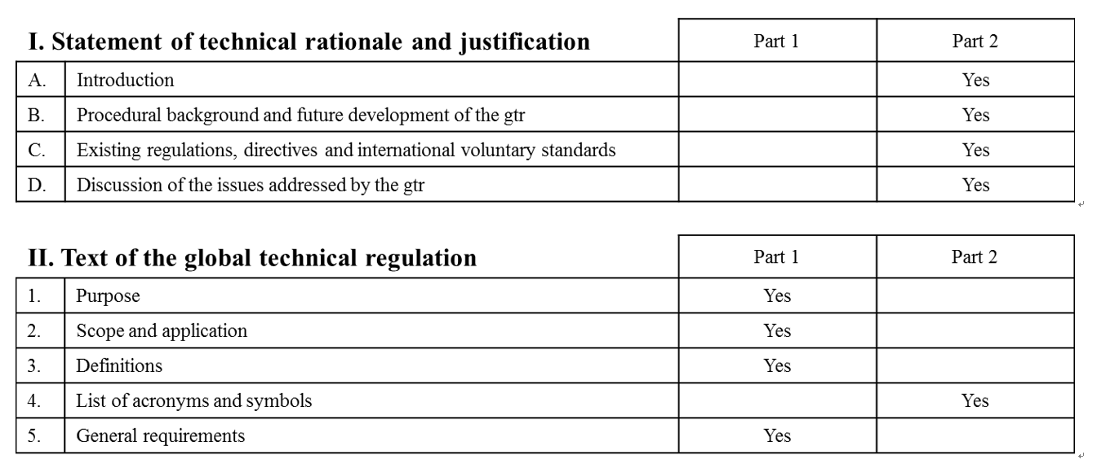
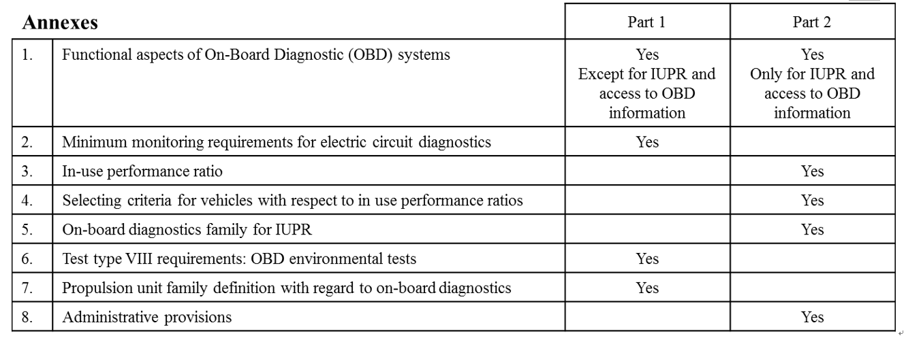
EPPR OBD2 current status
Phase1
Phase2
phase1
phase2
phase1
phase2
phase1
phase2
Discussion of Phase1 is completed.
Draft reflecting result of discussion is completed.
In May EPPR session, editorial correction will be made if any, and informal document of phase 1 will be submitted to GRPE.
In May EPPR, First draft of Phase2 will be presented from IMMA.
Roadmap of OBD phase 2 will be agreed by EPPR.

Slide 3
Roadmap of OBD2 phase
Phase1
Phase2
phase1
phase2
Mar/2020
(90)
phase1
phase2
Mar/2020
(30)
Mar/2020
Removal of square bracket on step introduction of OBD2
phase1
phase2
Oct/2019
(40)
Oct/2019
(60)
(15)
Jan/2020
(60)
Oct/2019
Mar/2020
(70)
Discussion of phase 2 is divided into 3 sessions and is planned to be completed by Mar 2020.
Formal document including phase 1 and 2 is planned to be submitted to GRPE in Jan 2021.
Amendment of GTR No.18 is planned to be adopted by WP29 in Jun 2021.

Slide 4
Future schedule for OBD2 Correspondence Group
21-22 May | OBD2 ftf meeting in Geneva Assignment announcement
28 June | Deadline for the assignment
1 – 12 July (TBD) | Telco for OBD2 Assignment announcement
30 September | Deadline for the assignment
15-18 October | OBD2 ftf meeting in California
Assignment announcement
  Annex1 Functional aspects of OBD systems
  (Only for IUPR and access to OBD information)
  Annex3 In-use performance ratio
  Annex5 On-board diagnostics family for IUPR

