Slide 1
Reversing warning measurements on competitors
  TF-RWS 6th Meeting in PARIS (OICA)

Slide 2
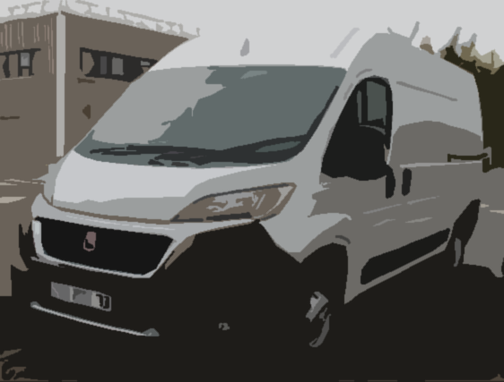
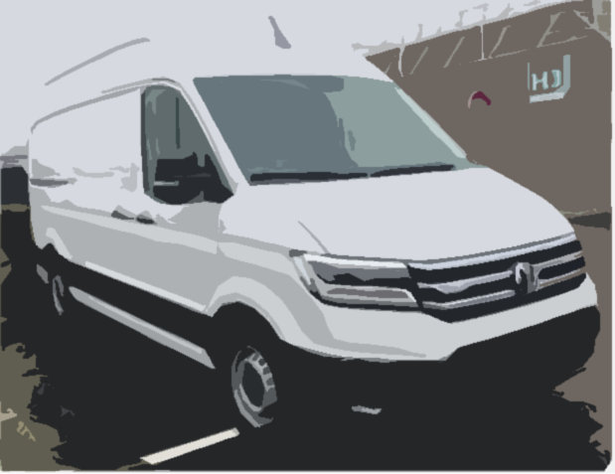
VeHicle TECHNICAL definition
Vehicle 1
    Category : N1 3,5t > MMAC >2,5t
    Length : 5,41m
    Height : 2,52m
    Engine : Thermal combustion engine
Vehicle 2
    Category : N1 3,5t > MMAC >2,5t
    Length : 5,986m
    Height : 2,59m
    Engine : Electric engine

Slide 3
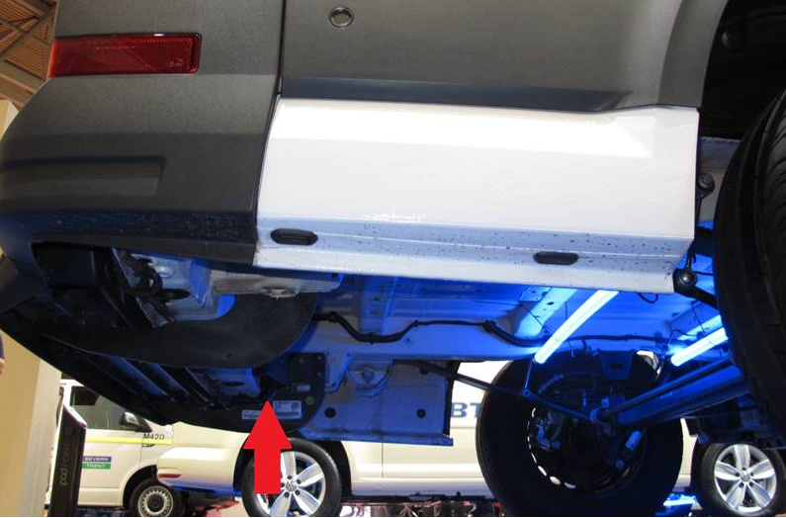
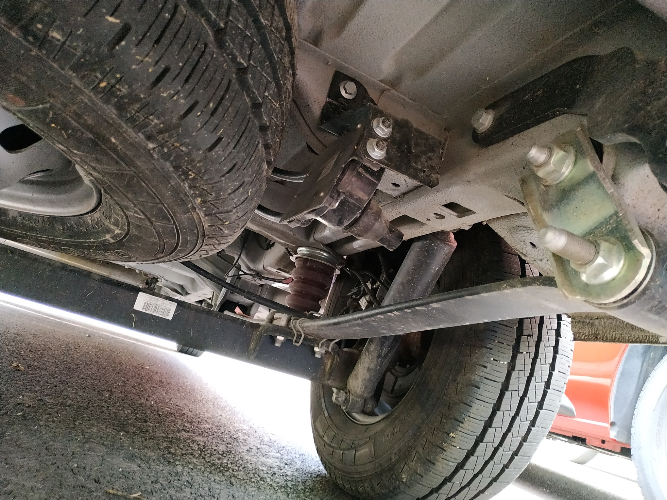
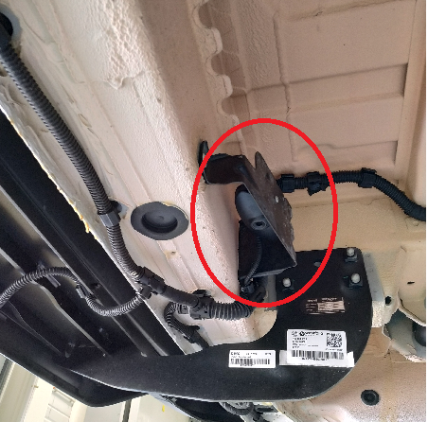
VeHicle TECHNICAL definition
Vehicle 1
    The device is located on the left rear under the body, directed to the ground.
Vehicle 2
    The device is located on the right rear under the body, directed to the right.

Slide 4
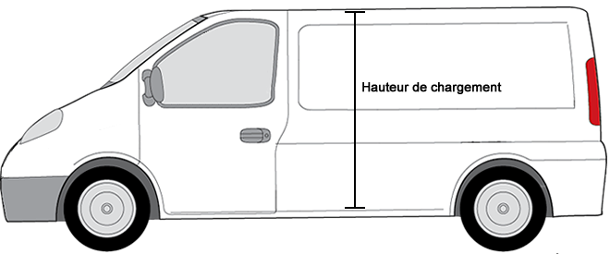
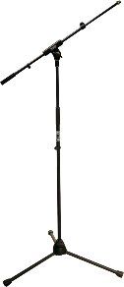
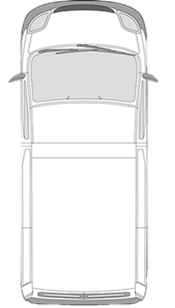
Measurement conditions
+0,5 to +1,5m from the ground
RW700
+7m from de back of the Van
RW08 (8cm under the device as a reference)
±0,10m from the longitudinal axis of the Van
RW700
Conditions : | Open area, good weather
 | Static Engine ON , reverse gear engaged
 | 3 runs each time

Slide 5
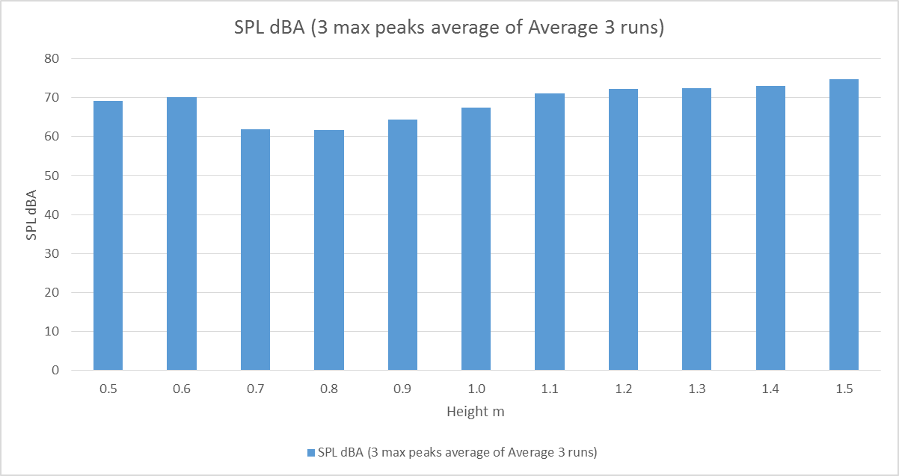
Height Impact on SPL (vehicule 2)
RW700
+0,5 to +1,5m from the ground

Slide 6

RESULTS
LAFmax : The maximum level with A-weighted frequency response and Fast time constant.
Vehicle 1 |  |  | Configuration | Duration (s) | LAF MAX (dBA) * | Measured on open asphalt area
 | back ground noise | Before | Engine Off | 10 | 51
 |  |  | Engine On | 10 | 53
 |  | After | Engine Off / Device Off | 10 | 50
 |  |  | Engine On / Device Off | 10 | 53
 | Microphone : RW700 |  | Run 1 - Engine On | 10 | 60
 |  |  | Run 2 - Engine On | 10 | 60
 |  |  | Run 3 - Engine On | 10 | 61 | * no correction applied, gap less than 10dBA
 | Noise | Tonal Sound | Intermittent : 24/min
 | Delta t | 2,5s
Vehicle 2 |  |  | Configuration | Duration (s) | LAF MAX (dBA) | Measured on ISO Track
 | back ground noise | After | Run 1 | 10 | 35
 |  |  | Run 2 | 10 | 35
 |  |  | Run 3 | 10 | 36
 | Microphone : RW700 |  | Run 1 - Engine On | 10 | 77
 |  |  | Run 2 - Engine On | 10 | 75
 |  |  | Run 3 - Engine On | 10 | 76
 | Noise | Tonal Sound | Intermittent : 100/min
 | Delta t | 0,6s |  |  |  | Max SPL @ 1,5m (height)

