Slide 1
UNECE R86
SLR-29-09
Proposal for amendment to the 01 series of amendments
Prepared by CEMA PT23
Belgium
March 2019
Contains confidential proprietary and trade secrets information of CNH Industrial. Any use of this work without express written consent is strictly prohibited.

Slide 2
UNECE R86
Proposal for amendment to the 01 series of amendments
Reasons for the amendment:
Alignment with the present requirements of Annex XII to (EU) 2015/208
Replace content of Annex XII with a reference to UNECE R86
Some editorial errors should be corrected
Special dimensional requirements for agricultural vehicles
Wider choice for the electrical connections between vehicles

Slide 3
UNECE R86
Proposal for amendment to the 01 series of amendments
 | Less demanding dimensional requirements for ag.vehicles
5.6 | The requirements concerning the symmetry of the lighting installation shall be less demanding, in order to be suitable for vehicles with asymmetric shape. Delete last sentence of 5.6
6.2.4.2.4 | Maximum height for additional dipped beam headlamps increased from 3000 mm to 4000 mm
6.15.4.2 | Exceptional upper height limit for side retro-reflectors increased from 1500 to 2500 mm
 | New requirement
5.1.1 | Additional electrical connections between towing and towed vehicles: 13 pole per ISO 11446; supplementary 7 pole type 12S per ISO 3732

Slide 4
UNECE R86
Proposal for amendment to the 01 series of amendments
 | Alignment with Annex XII to 2015/208
6.5.1 | Allow arrangement D for the direction indicator lights for all tractors: Means: no side – direction indicators required because difficult to meet required visibility angles
6.14.1 | Additional non-triangular rear-retro reflectors optional on R&S vehicles
6.15.1 | Side retro-reflectors on all vehicles exceeding 4.6 m in length; optional where conspicuity markings (6.21) are fiited on the side of the vehicle
6.15.6 | Side retro-reflectors can be installed in wheel centers
6.17.1 | Signalling panels or foils may replace front retro-reflectors
6.17.4.1 | Front retro-reflectors on cat. R & S vehicles shall be installed at a distance of not more than 150 mm from the extreme outer edge
6.18.1 | Side-marker lamps mandatory on vehicles of category T, R3 and R4, exceeding 4.6 m in length
6.18.4.3 | Dimensional requirements for side - marker lamps; Side-marker lamps may be combines with side retro-reflector
6.26.1 | Signalling panels required on all vehicles exceeding 2.55 m width
6.26 | Dimensional and colorimetric requirements for panels and foils

Slide 5
UNECE R86
Proposal for amendment to the 01 series of amendments
 | Editorial corrections
 | 6.2.4.2.1; 6.5.4.2; 6.7.4.2; 6.8.1; 6.9.4.2; 6.11.4.2; 6.14.4.2; 6.14.5.1.1; 6.15.5; 6.17.4.2; 6.25.4.2;

Slide 6
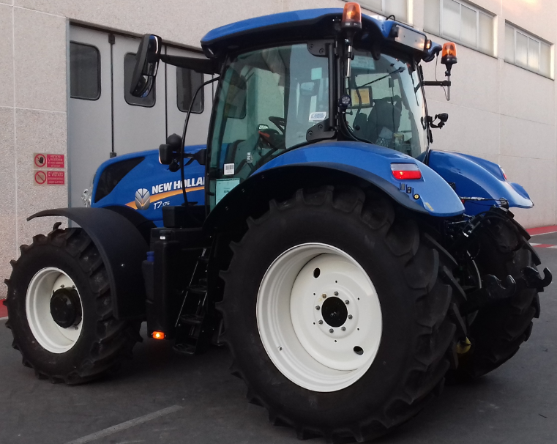
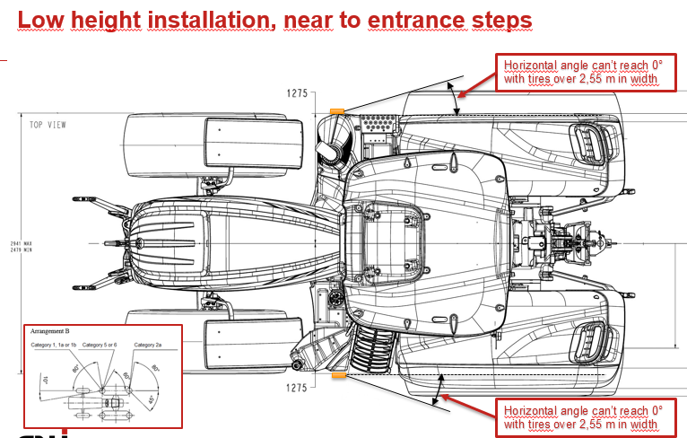
UNECE R86
Proposal for amendment to the 01 series of amendments
Example of side retro reflector combined with side marker light
Difficult to meet visibility angles and height of side direction indicators

