Slide 1


Automated Lane Keeping Systems
Examples for system reaction on different driver input
Supporting presentation to document ACSF-22-07

Slide 2

Principles for the proposal for regulatory provisions in doc ACSF-22-07
A driver override of an activated system shall always be possible using the conventional controls (pedals and steering wheel)
Any input of the driver to the conventional controls leads always to either automatic deactivation or a transition demand depending on if the driver has taken over manual control or not.
The driver input…
  to the steering control may be suppressed or mitigated by the system if it could lead to a critical situation
  to the braking control shall be suppressed if it would result in a lower deceleration than that induced by the system
  to the accelerator control shall be suppressed if it would prevent the system from meeting the requirements of this regulation.

Slide 3
Definition of “Manual Control”
2.2.y. The driver is deemed to have “taken over manual control” if one or more of the following conditions are met:
    The driver manually deactivates the system.
    The driver maintains the vehicle stationary by any braking system.
    The driver provides an input to the brake or accelerator control and is holding the steering control.
    The driver provides a steering input which
    Option 1 = [led the vehicle to cross a lane marking]
    Option 2 = [alters the vehicle’s path].
    The driver follows a transition demand by grabbing the steering control.

Slide 4


ALKS examples – Definitions and Symbols
ACTIVATED
System is active and performing the driving task
DEACTIVATED
System is not active and not performing the driving task
Driver is in manual control
OVERRIDE
The driver input forces the vehicle to a change of the lateral or longitudinal movement other than the system would do by performing the driving task
TRANSITION
DEMAND
System is active but due to a driver Input (in these examples only the driver input is considered) the driver is requested to take over the manual driving task again
System with
no steering input detected
System with
steering input detected

Slide 5
ALKS examples – list of scenarios
The driver provides a steering input which Option 1 = [led the vehicle to cross a lane marking]
The driver provides a steering input which Option 1 =[The driver is steering within the lane]
Steering override leads directly to deactivation [Option 2]
“Driver alters the vehicle’s path” = Manual control
Acceleration override not holding the steering wheel
Acceleration override suppressed by system while not holding the steering wheel
Acceleration while holding the steering wheel
Brake while holding the steering wheel
Brake while not holding the steering wheel
Two channel takeover to manual control
Automatic deactivation - “The driver follows a transition demand by grabbing the steering control.”
The driver maintains the vehicle stationary by any braking system

Slide 6
Automated Lane Keeping Systems
Steering override leads to deactivation upon lane departure [Option 1]

Slide 8

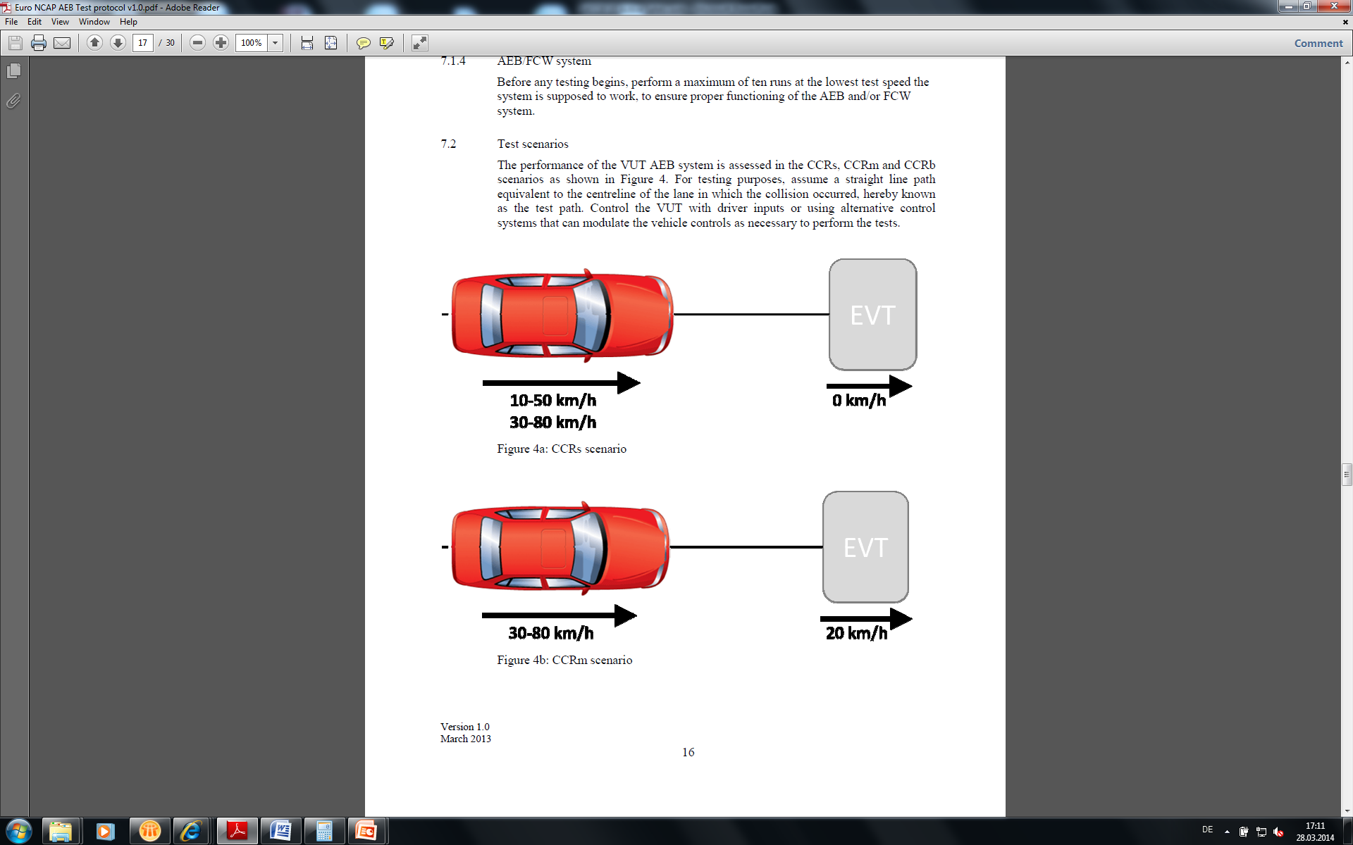





Steering override leads to deactivation upon lane departure [Option 1]
Scenario 1: the driver steers the vehicle out of the lane
V_{ALKSMax}
ALKS Status
Km/h
ACTIVATED
DEACTIVATED
ACTIVATED
DEACTIVATED
OVERRIDE
TRANSITION
DEMAND
OVERRIDE
TRANSITION
DEMAND
Safety Zone
Repeat Example
Brake
Accelerator

Slide 10
Steering override leads to deactivation upon lane departure [Option 1]
Scenario 2: the driver steers the vehicle inside the lane
V_{ALKSMax}
Km/h
ALKS Status
ACTIVATED
DEACTIVATED
ACTIVATED
DEACTIVATED
OVERRIDE
TRANSITION
DEMAND
OVERRIDE
TRANSITION
DEMAND
Safety Zone
Repeat Example
Brake
Accelerator

Slide 11
Automated Lane Keeping Systems
Steering override leads directly to deactivation [Option 2]

Slide 13
Steering override leads directly to deactivation [Option 2]
V_{ALKSMax}
Km/h
ALKS Status
ACTIVATED
DEACTIVATED
ACTIVATED
DEACTIVATED
OVERRIDE
TRANSITION
DEMAND
OVERRIDE
TRANSITION
DEMAND
Safety Zone
Repeat Example
Brake
Accelerator

Slide 14
Automated Lane Keeping Systems
Acceleration override while driver is not holding the steering wheel
(layout 1: accelerator control does have priority)

Slide 16

Acceleration override while driver is not holding the steering wheel
(layout 1: accelerator control does have priority)
V_{ALKSMax}
Km/h
ALKS Status
ACTIVATED
DEACTIVATED
ACTIVATED
DEACTIVATED
OVERRIDE
TRANSITION
DEMAND
OVERRIDE
TRANSITION
DEMAND
Safety Zone
Safety Zone
Repeat Example
Brake
Accelerator

Slide 17
Automated Lane Keeping Systems
Acceleration override while driver is not holding the steering wheel
(layout 2: accelerator control does not have priority)

Slide 19
Acceleration override while driver is not holding the steering wheel
(layout 2: accelerator control does not have priority)
V_{ALKSMax}
Km/h
ALKS Status
ACTIVATED
DEACTIVATED
ACTIVATED
DEACTIVATED
OVERRIDE
OVERRIDE
TRANSITION
DEMAND
Safety Zone
Safety Zone
Repeat Example
Brake
Accelerator

Slide 20
Automated Lane Keeping Systems
Acceleration while the driver is holding the steering wheel

Slide 22
Acceleration while the driver is holding the steering wheel
V_{ALKSMax}
Km/h
ALKS Status
ACTIVATED
DEACTIVATED
ACTIVATED
DEACTIVATED
OVERRIDE
TRANSITION
DEMAND
OVERRIDE
TRANSITION
DEMAND
Safety Zone
Safety Zone
Repeat Example
Brake
Accelerator

Slide 23
Automated Lane Keeping Systems
Brake while holding the steering wheel

Slide 25
Brake while holding the steering wheel
V_{ALKSMax}
Km/h
ALKS Status
ACTIVATED
DEACTIVATED
ACTIVATED
DEACTIVATED
OVERRIDE
TRANSITION
DEMAND
OVERRIDE
TRANSITION
DEMAND
Safety Zone
Repeat Example
Brake
Accelerator

Slide 26
Automated Lane Keeping Systems
Brake while not holding the steering wheel

Slide 28
Brake while not holding the steering wheel
V_{ALKSMax}
Km/h
ALKS Status
ACTIVATED
DEACTIVATED
ACTIVATED
DEACTIVATED
OVERRIDE
TRANSITION
DEMAND
OVERRIDE
TRANSITION
DEMAND
Safety Zone
Repeat Example
Brake
Accelerator

Slide 29
Automated Lane Keeping Systems
Two channel takeover to manual control

Slide 31
Two channel takeover to manual control
V_{ALKSMax}
Km/h
ALKS Status
ACTIVATED
DEACTIVATED
ACTIVATED
DEACTIVATED
OVERRIDE
TRANSITION
DEMAND
OVERRIDE
TRANSITION
DEMAND
Safety Zone
Repeat Example
Brake
Accelerator

Slide 33
The driver follows a transition demand by grabbing the steering control.
V_{ALKSMax}
Km/h
ALKS Status
ACTIVATED
DEACTIVATED
ACTIVATED
DEACTIVATED
OVERRIDE
TRANSITION
DEMAND
OVERRIDE
TRANSITION
DEMAND
Repeat Example
Brake
Accelerator

Slide 35
The driver maintains the vehicle stationary by any braking system
V_{ALKSMax}
Km/h
ALKS Status
ACTIVATED
DEACTIVATED
ACTIVATED
DEACTIVATED
OVERRIDE
TRANSITION
DEMAND
OVERRIDE
TRANSITION
DEMAND
Repeat Example
Brake
Accelerator

Slide 36
Thank you

