Slide 1
India Comments on
EPPR 28-05

Slide 2
Comment-1:
  3.6.: A Contracting Party may choose Class 0 vehicles to be excluded from the contracting party’s region while applying this GTR regulation.
  Justification: To bring clarity in the text with an understanding that for application to this GTR only. The current wording could be interpreted as no regulation can be made for class 0 vehicle by CPs.
Comment-2:
  4.8. "Maximum vehicle speed" (vmax) is the maximum speed of the vehicle as declared by the manufacturer, measured in accordance with Appendix 1 and Appendix 1.1 of Annex-X of European Union Regulation (EU) no. 134/2014(on the maximum design speed, maximum torque and maximum net engine power of two wheeled motor vehicles).
  4.9 "Maximum net engine power" is the maximum net engine power of the vehicle as declared by the manufacturer, measured in accordance with Appendix 2, Appendix 2.2, Appendix 2.2.1 and Appendix 2.3 of Annex X of European Union Regulation (EU) no. 134/2014.
  Comments: Clarity required on Referring to EU Regulation no EU 134/2014, To be checked with UN secretariat if not already done.

Slide 3
Table 6
Principal performance requirements.
Comment-3:
Editorial changes only
Comments: Reference fuel Specification Annexure is not correct : It should be corrected to Appendix 2 to Annex 40

Slide 4
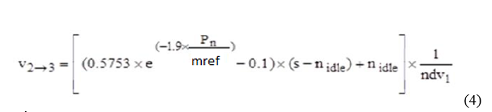
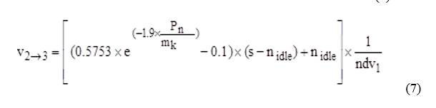
Comment-4:
Annex-1
3.4.5.3.1.1.
Editorial changes only
Equation-4:
V_{2→3} should be changed to V_{3→2}
Based on EU-5 text
Equation-5 7:
m_{k} should be changed to m_{ref}
Based on EU-5 text

Slide 5
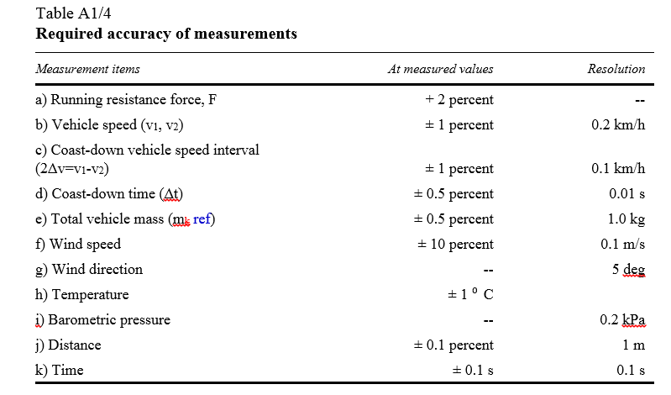
Comment-5:
Editorial changes only
3.4.7.
Based on EU-5 text

Slide 6
Comment-6:
In Appendix 1 of Annex 4 for symbols used as referred in Table B.A4.App 1/1
Comment: Format of the table- Content should be properly aligned (left aligned)
Comment-7:
In Appendix 8:
Table B.5.8.-1 Classification criteria propulsion unit family with regard to test types I, II and VII
Comment: Format of the table- Content should be properly aligned (left aligned)

Slide 7
Comment-8:
India asked for a placeholder to be added into the GTR about the need to further investigate the validity of the formulas used for the humidity correction for NOx.
Chairman to investigate the legal possibility of inserting a placeholder into the GTR text
This place holder to be inserted in the Amendment 2 to GTR2 document

