Slide 1

14th IWG on PTI Meeting
28 May 2019
PTI – 14 – 04
Outcomes of the CITA Conference
Seoul, South Korea, 2 – 4 April 2019
Hosted by KOTSA
Eduard Fernández
e.fernandez@citainsp.org

Slide 2

Main outcomes
From inspection to whole-life compliance
The legal framework of vehicles consistent with new technologies
Coordination of requirements during all stages of vehicles’ life
Engineers, not lawyers, have to contribute
Impartial assessment
Fair access to information and systems

Slide 3
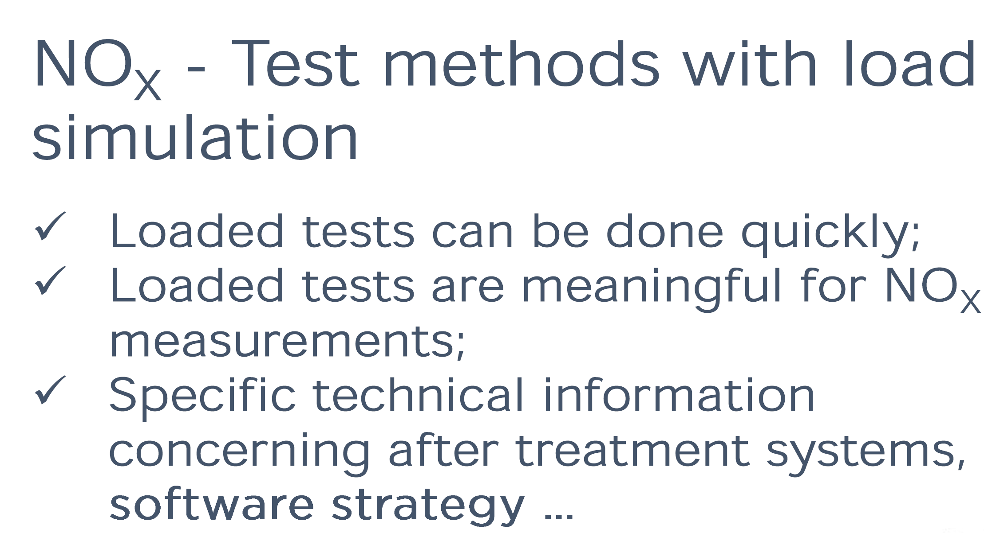
Split session “Environmental Protection”

Slide 4
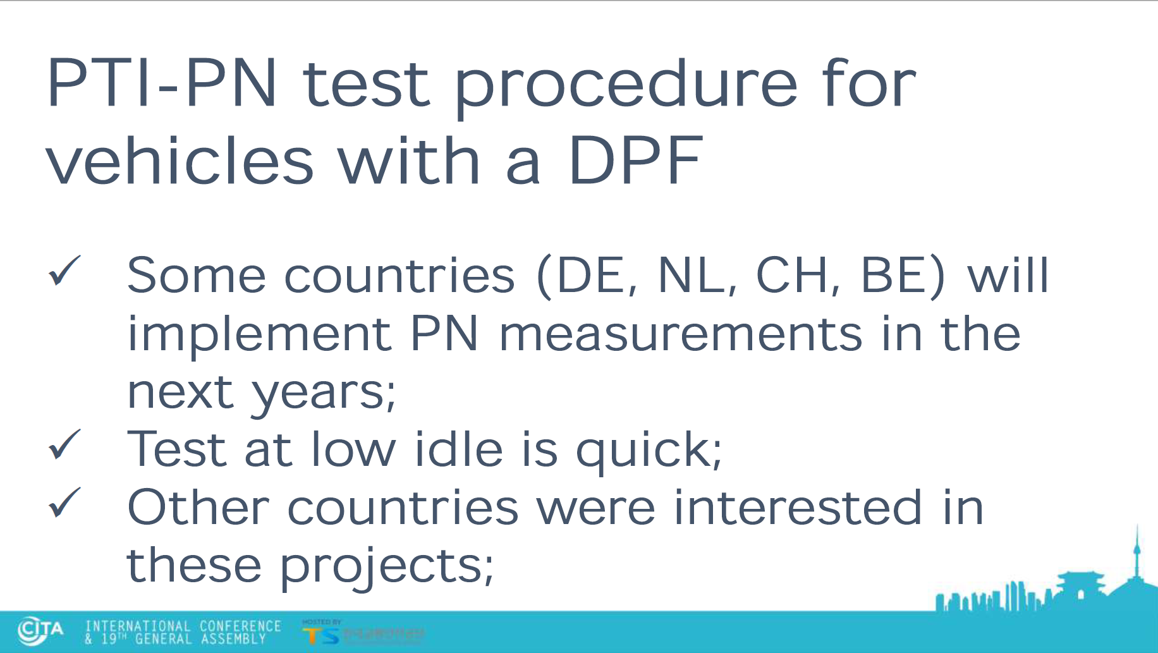

Slide 5
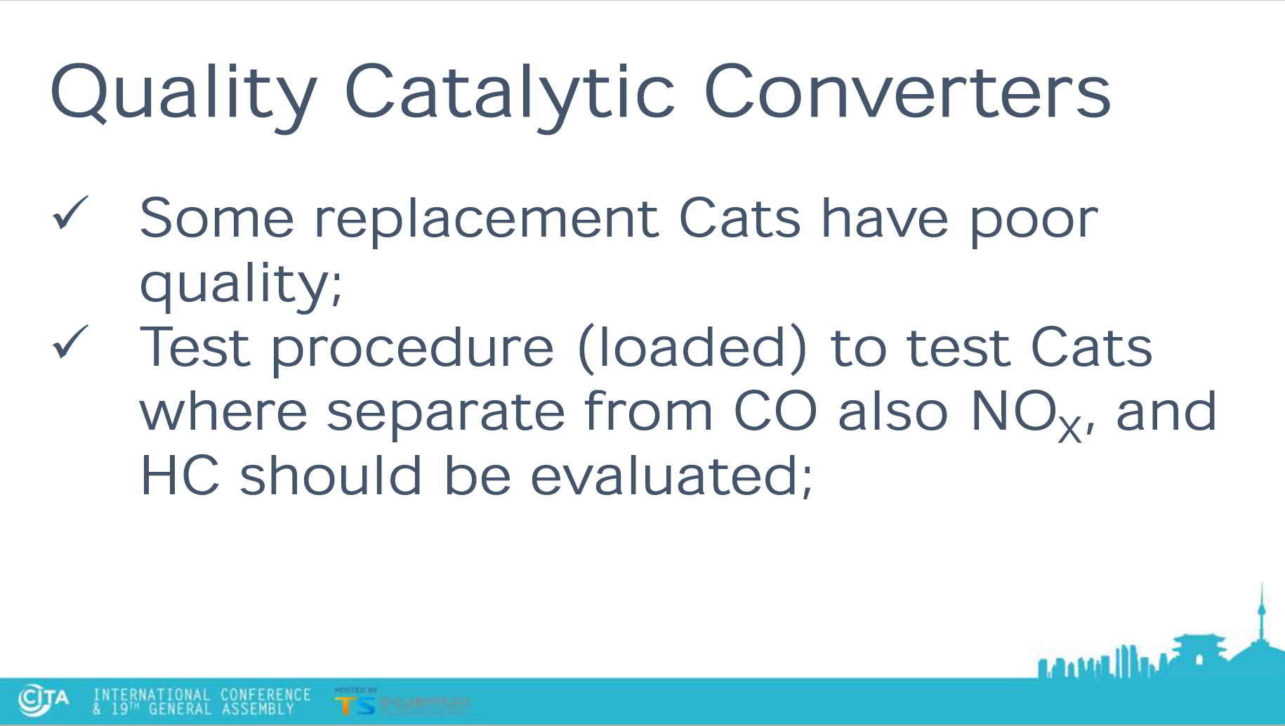

Slide 6
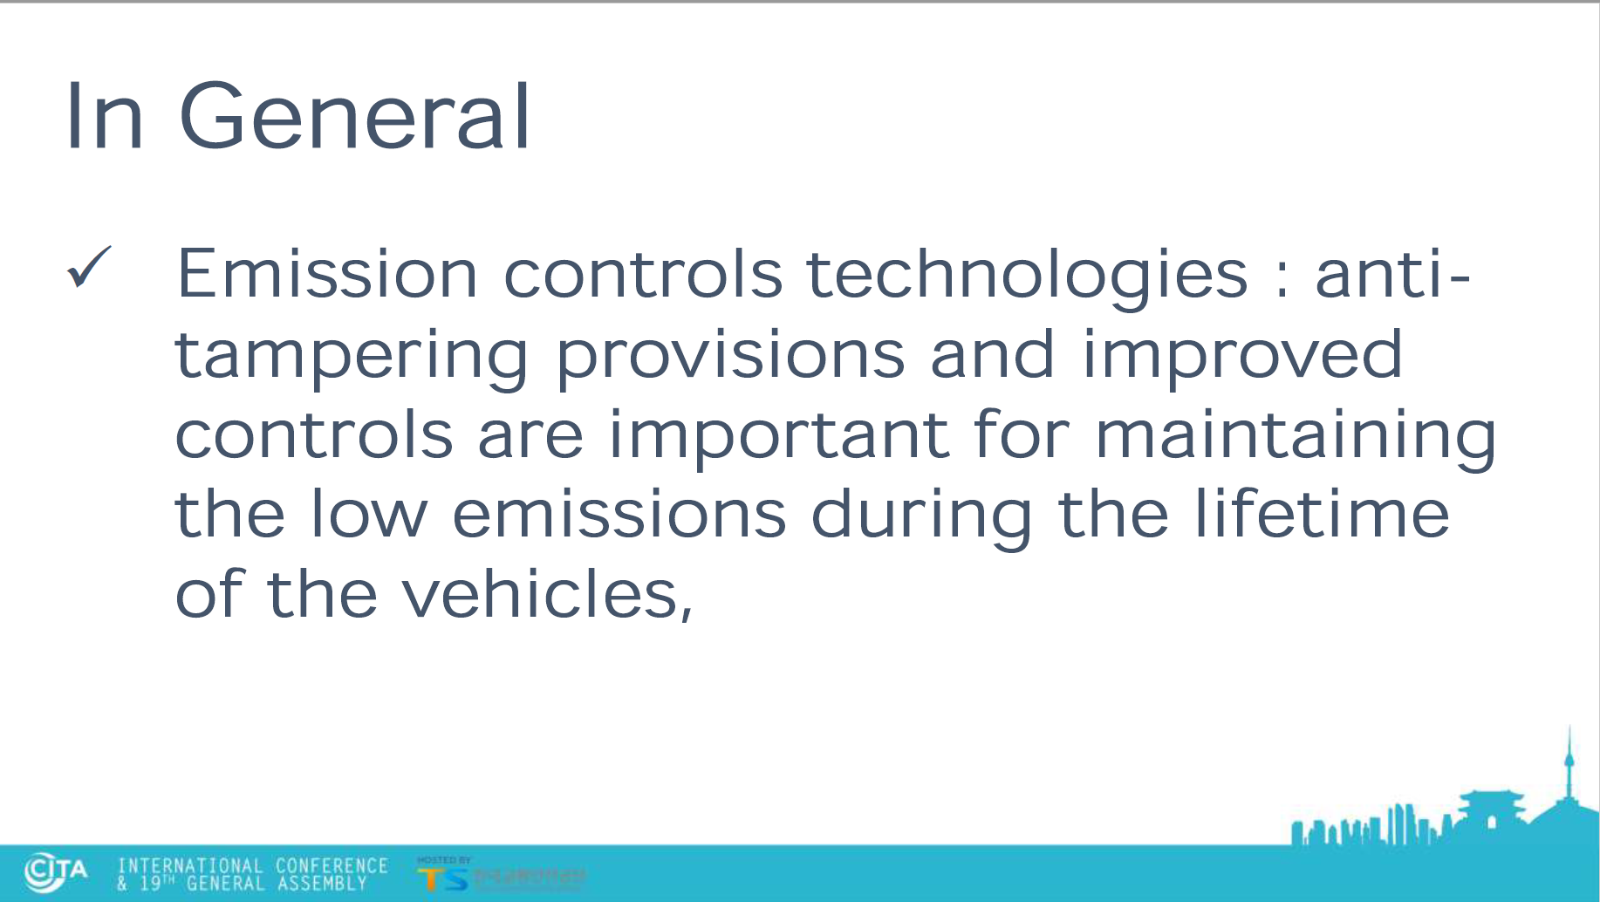

Slide 7
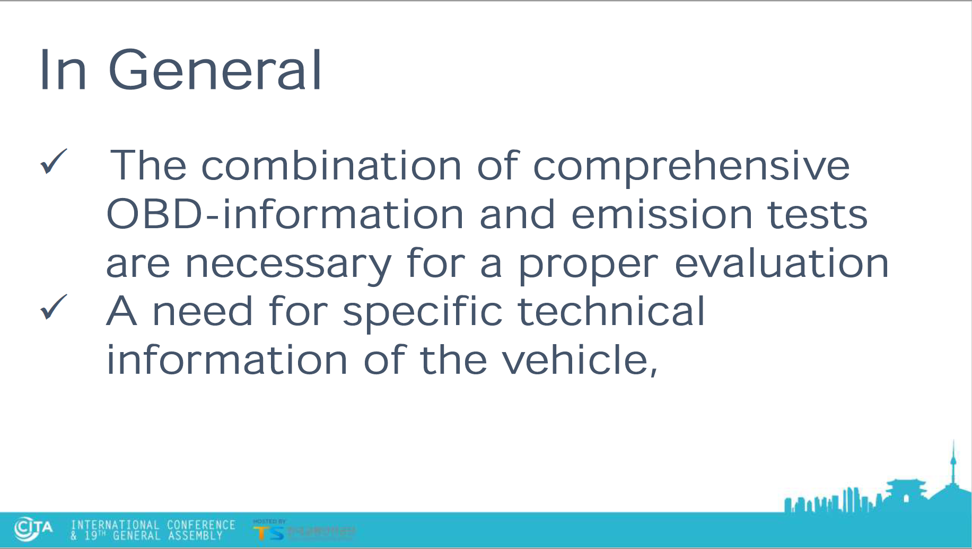

Slide 8
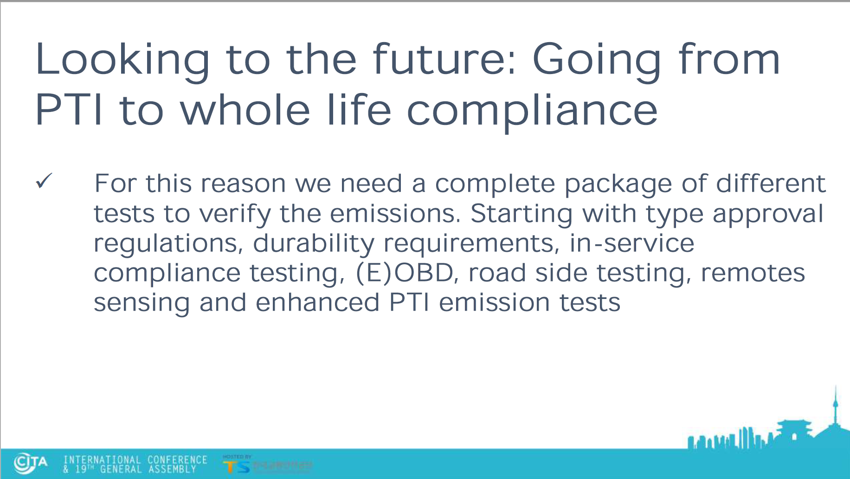

Slide 9
Split session “Future vehicle compliance requirements to meet the increasing automatization of vehicles”

Slide 10
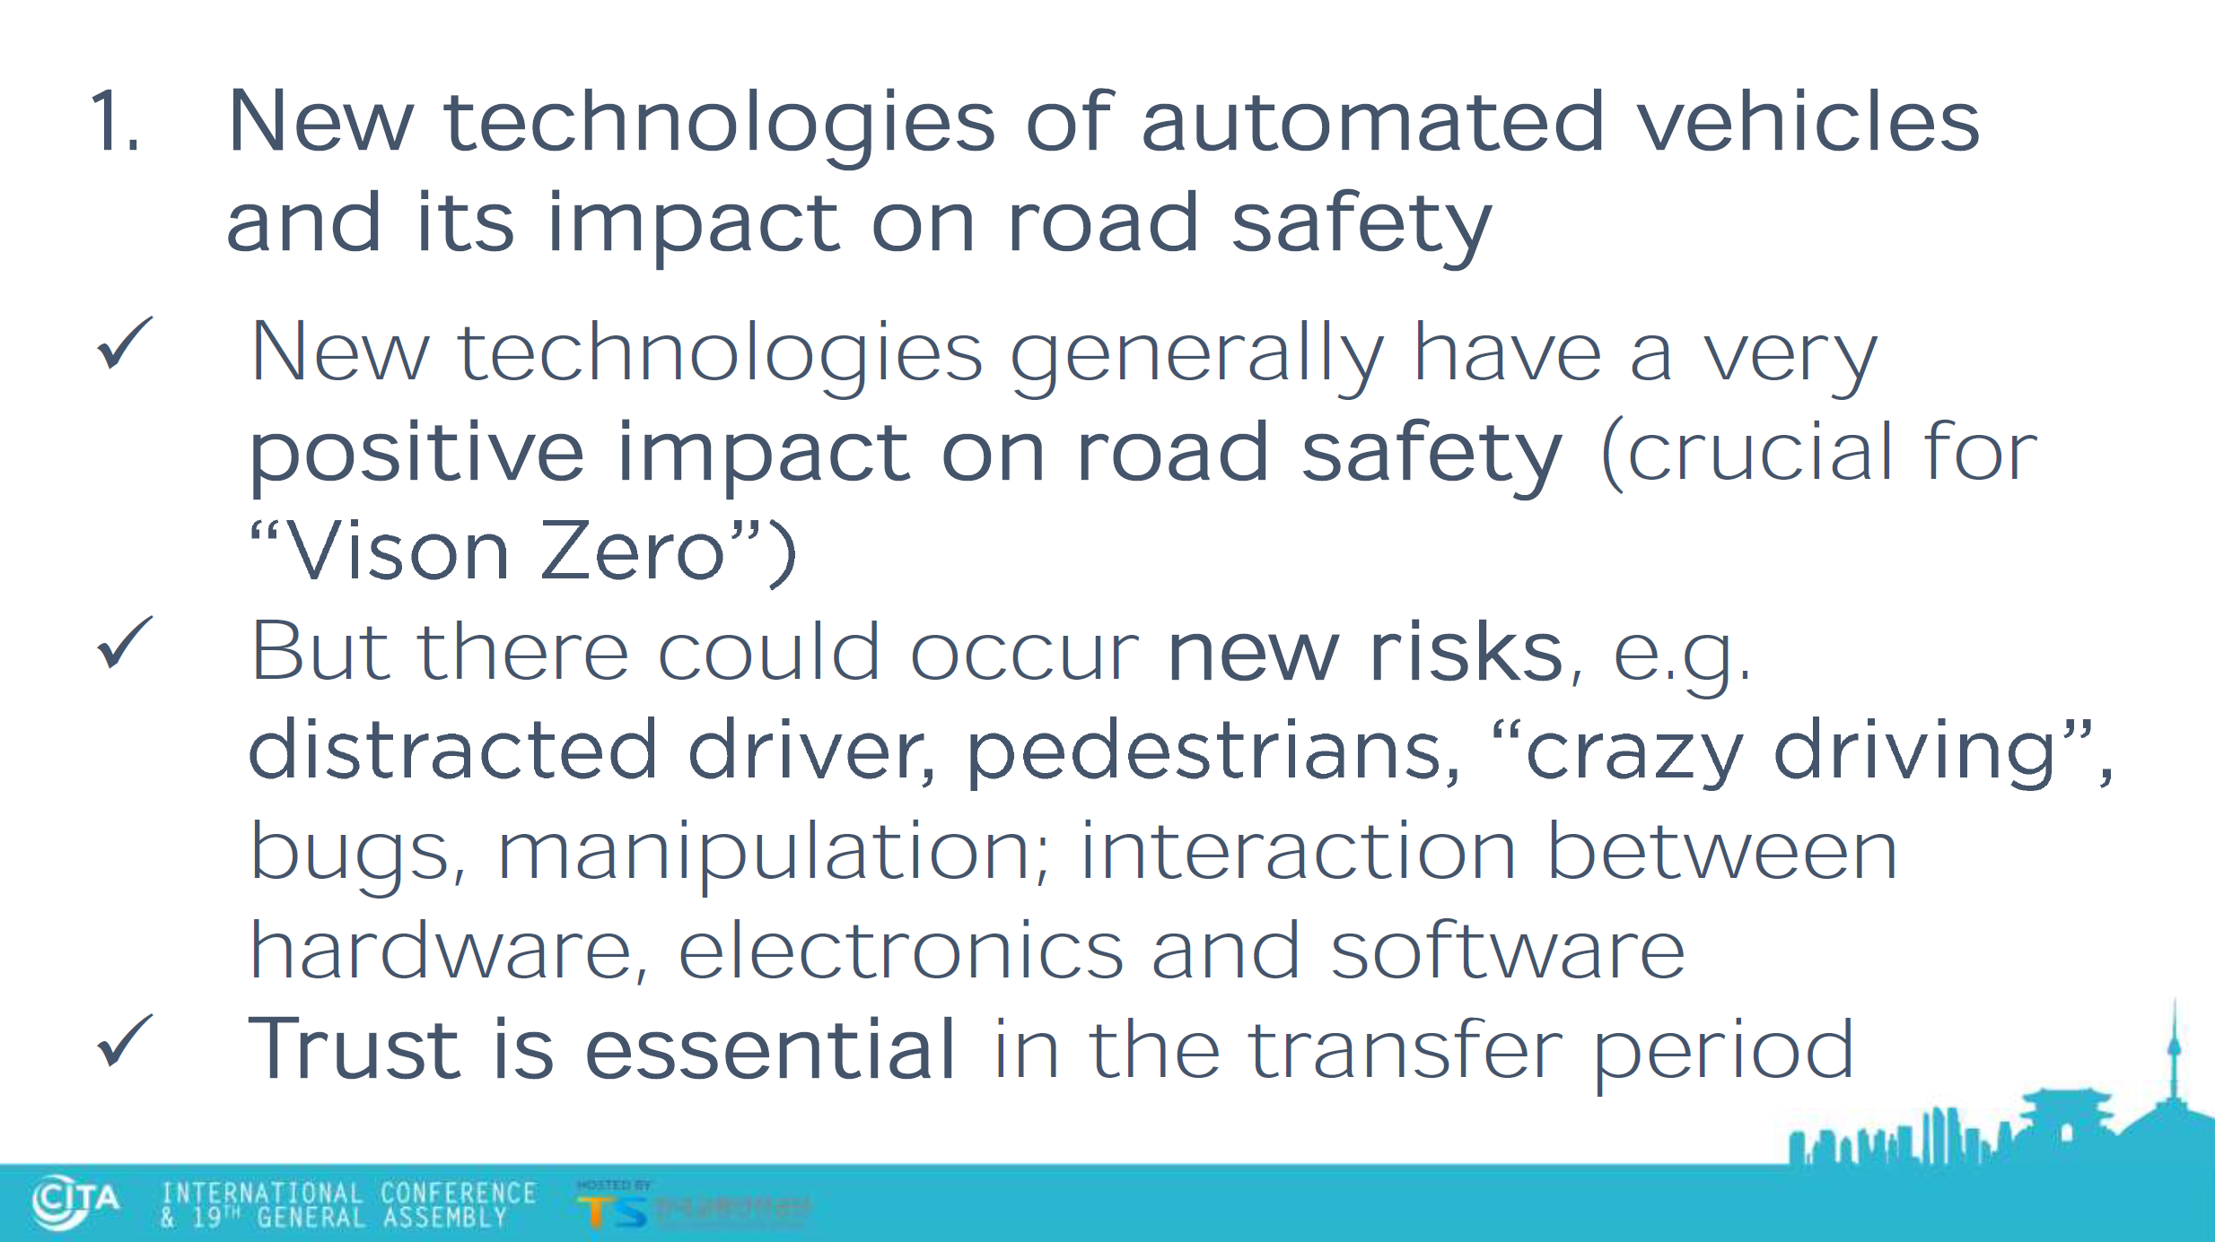

Slide 11
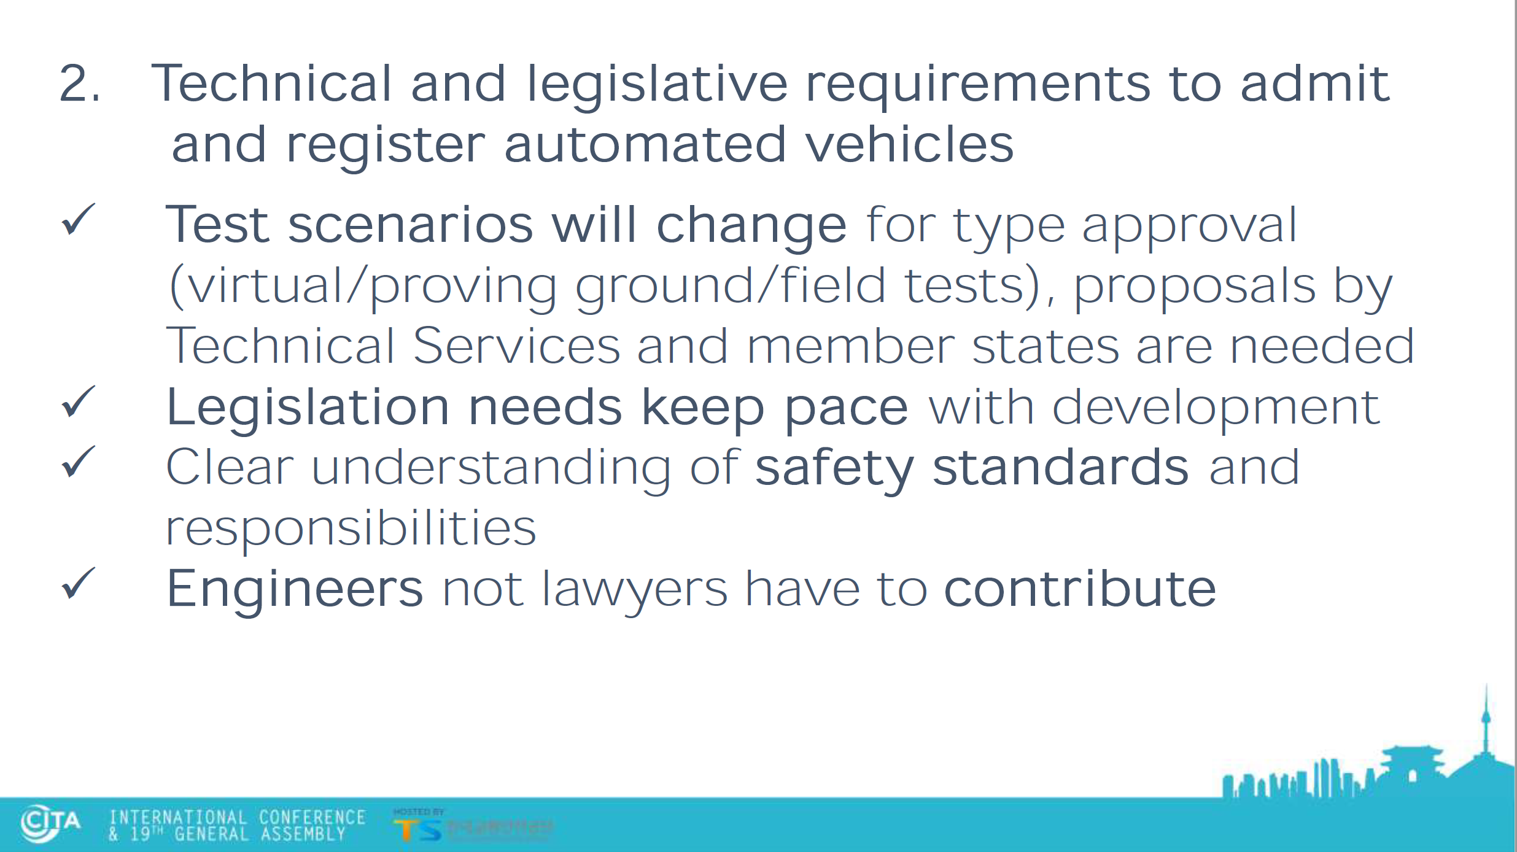

Slide 12
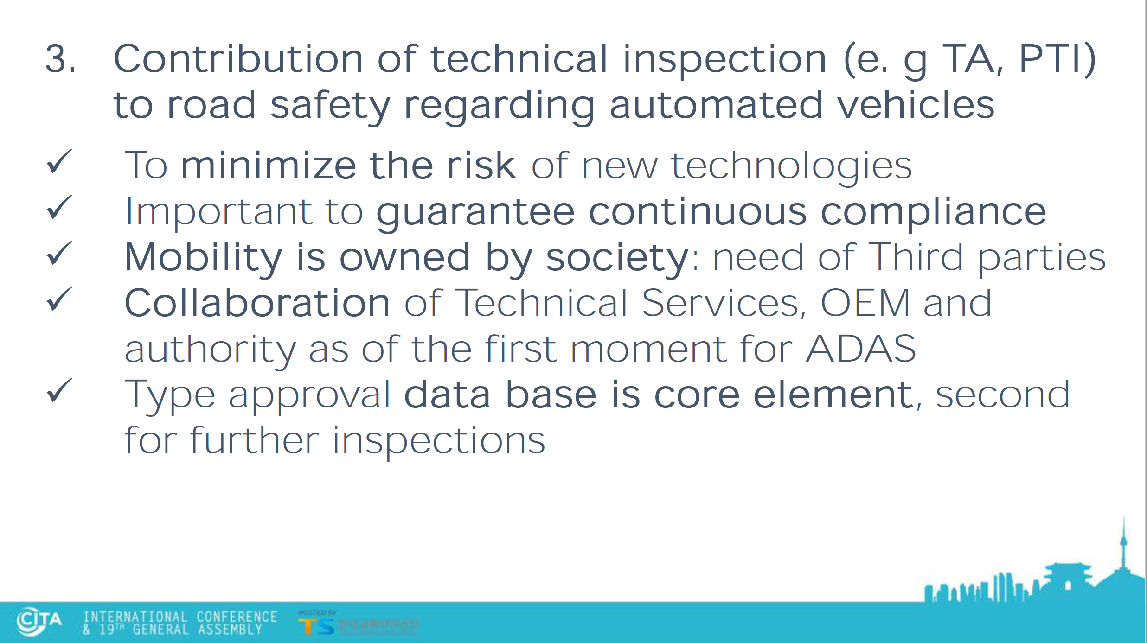

Slide 13


