Slide 1
Scenario Definition according to EN 45545-1 and
Balance of Opacity, Toxicity and Flamability

Slide 2
Structure
Scenario Definition – What is known from other standards?
Parameter balance – what can we say?

Slide 3
Scenario Definition (1)
Operation category
Class 1 – Not for use in tunnels or on long elevated track sections
  Tunnels < 10% of time
  Tunnels < 1 km
Class 2 – For use in tunnels with short time until safe stop
  <4 min
Class 3 – For use in tunnels with long time until safe stop
  >4 min
Class 4 – Safe stop after long driving time
Design category
A – Automatic, no staff on board
D – double decker
S – sleeping cars
N – all other cars

Slide 4
Scenario Definition (2) – Hazard Levels
 | Design category
Operation category | N | A | D | S
1 | HL1 | HL1 | HL1 | HL2
2 | HL2 | HL2 | HL2 | HL2
3 | HL2 | HL2 | HL2 | HL3
4 | HL3 | HL3 | HL3 | HL3

Slide 5
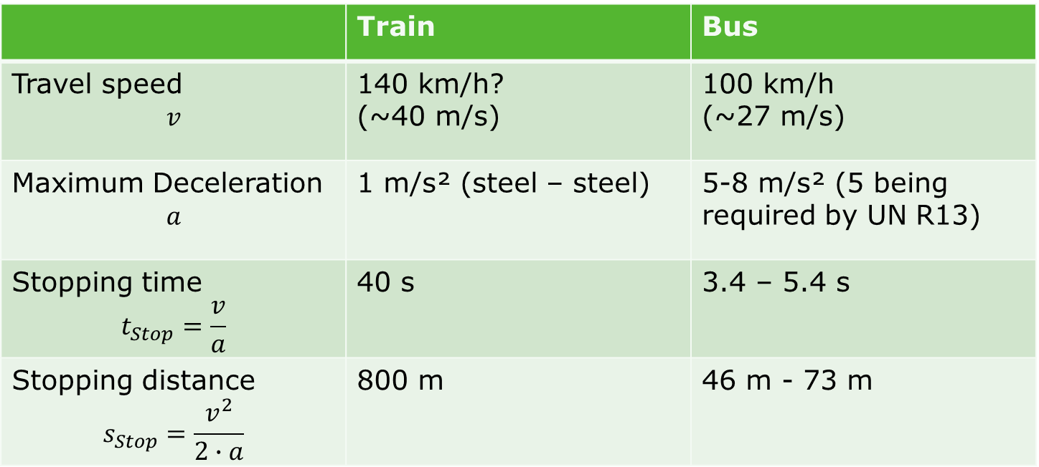
Bus vs. Train: Stopping Time
 | Train | Bus
Travel speed $$v$$ | 140 km/h? (~40 m/s) | 100 km/h (~27 m/s)
Maximum Deceleration $$a$$ | 1 m/s² (steel – steel) | 5-8 m/s² (5 being required by UN R13)
Stopping time $$t_{Stop}=\frac{v}{a}$$ | 40 s | 3.4 – 5.4 s
Stopping distance $$s_{Stop}=\frac{v^{2}}{2∙a}$$ | 800 m | 46 m - 73 m

Slide 6
Bus vs. Train: Escape
Bus is able to maneuver laterally
→ Escape expected to be possible everywhere
Trains: Escape takes time (e.g. height of doors), takes place (e.g. sufficient free space on the side of the train
What can be appropriate timing values for busses with respect to trains?

Slide 7
Balancing of Parameters – Actually Four Parameters?
Toxicity
Flamability
Opacity
Price

