Slide 1

Automatic Exit Opening : discussion of proposed changes
Ref. BMFE-06-11 UNECE 107 Draft updates

Slide 2
Automatic Exit Opening
Annex 3, add paragraph 7.5.1.6. to read:
“In the case of vehicles of Classes II, III and B, having the engine located to the rear of the driver’s compartment, and in the event of excess temperature in the engine compartment or in any compartment where a combustion heater is located
the emergency lighting system according to paragraph 7.8.3. shall automatically activate,
and the power-operated service doors situated on the side of the vehicle that is nearer of the side of the road corresponding to the direction of traffic for which the vehicle is designed shall open automatically when the vehicle is stationary or driving at a speed less than or equal to 3 km/h”

Slide 3
Automatic Exit Opening
Functional Safety for the electric/electronic system of the doors of buses & coaches is at stake.
A Hazard Analysis and Risk Assessment according to ISO26262 was used to define the requirements for the development of the door systems.
Check of the proposal as written against this HARA in order to qualify the concerns.

Slide 4
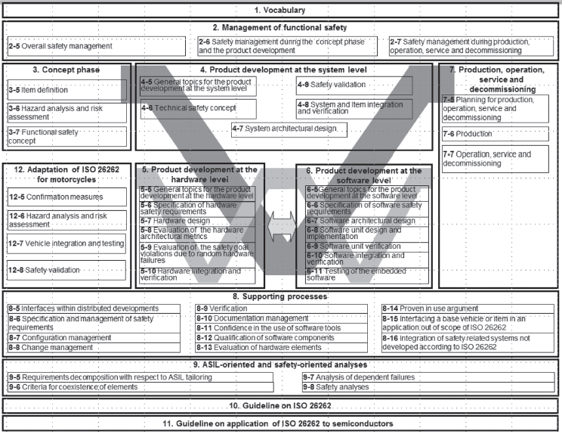
ISO/DIS 26262-3: 2016 : Concept phase
Item definition
Hazard analysis
and risk assessment
Functional safety concept
Source: ISO 26262 standard

Slide 5
Automatic Exit Opening
ASIL | Safety goal in normal operation | SG ID | Safe State
A | Driving off the vehicle shall be avoided when the door is not fully closed | SG3 | Vehicle immobilized and the driver warned
B | Unexpected opening of the door shall be avoided (when the vehicle is moving) | SG4 | Door closed
B | False interlocking of the emergency controls shall be avoided | SG5 | Interlocking removed
B | Unnecessary immobilization of the vehicle due to door control system shall be avoided | SG6 | Vehicle not unnecessary immobilized
.
The ASIL classification takes into account Severity, Exposure and Controllability of the hazard.

Slide 6
Automatic Exit Opening
The proposed automatic exit opening is considered a direct violation of the safety goal :
“ ASIL B – Unexpected opening of door shall be avoided (both when vehicle is moving or at standstill)”
The unexpected, sudden opening of a service door presents for any standee in the vicinity of this door, a potential risk to serious injuries, like e.g. falling out of the vehicle through the door, resulting in head trauma. E.g. class II.
Also a passenger entering or leaving the toilet might be in close proximity of an unexpected opening of service door. E.g. class III.

Slide 7
Automatic Exit Opening
Another safety goal might not be reached :
ASIL A – avoid moving vehicle when door is not closed
E.g. Vehicle immobilized on highway during traffic jam when traffic starts moving again on the lane close to the open doors; in tunnel; traffic lights; EU vehicle in UK?
An override function in order to facilitate the driver to mobilize the vehicle to a safe place is needed in the proposal.
Now it is still the responsibility of the driver to assess the traffic situation, the condition of the vehicle and the safety of the passengers.

Slide 8
Automatic Exit Opening
Check closely the technical requirements for power operated doors: e.g.
7.6.6. Additional technical requirements for automatically-operated service doors
7.6.6.3. Closing of automatically-operated service doors
7.6.6.3.1. When an automatically-operated service door has opened it shall close again automatically after a time interval has elapsed.

Slide 9
Automatic Exit Opening
It is clear that safety goals are defined for normal operation and emergency where the starting point is :
The responsibility of the driver to open doors;
Passengers can only exit alone in case of an emergency
How to distinguish between normal operation and emergency in order to allow in a safe way for automatic exit opening ?

Slide 10
Automatic Exit Opening
Lacking definition of excess temperature.
Using the temperature as initiator would lead to high risk of fake fire signals.
E.g. an engine may reach higher temperatures when under great pressure and the cooling system is failing. Then the driver will be warned of this situation and it is the responsibility of the driver to assess the condition of the vehicle and the safety of the passengers.

Slide 11
Automatic Exit Opening
Take succession of safety measures into consideration :
Excess temperature
Warning to driver
Fire suppression
Warning to driver
Only when after fire suppression of [X] sec and still an excess temperature, then open automatically the service door.

Slide 12
Automatic Exit Opening
Another consequence
Sufficient reliability and compliance with relevant ASIL levels is required for the fire detection system in case it is responsible to supply the “door open request in case of fire” to the vehicle controller.
Note that different suppliers of fire detection systems use different temperature limits (and technologies) to detect a fire.

Slide 13
Automatic Exit Opening
Automatic activation of ELS :
How do the passengers receive this information of the gravity of this event?
is coupled to the activation of the detection system in the event of excess temperature, but
is not coupled to the opening of the doors
neither to any form of audio or visual warning signals.

Slide 14
Automatic Exit Opening
Automatic activation of ELS :
This will have as result that :
Either passengers will panic while the doors are still closed
Or the passengers will not understand the gravity of the situation and will remain seated.
Passengers that are visual and/or hearing impaired will not receive this information

Slide 15
Automatic Exit Opening
Summary:
Exclusion of Class II
Passenger entering or leaving the toilet in close proximity of an unexpected opening passenger door, presents a risk.
An override function in order to facilitate the driver to mobilize the vehicle to a safe place
Better definition of excess temperature and course of events
Sufficient reliability and compliance with relevant ASIL levels is required for the fire detection system
Add audio and visual signal to allow signaling the impaired passengers

