Slide 1

SIMPLIFICATION.
Status GTB WG FL on May 23rd , 2019
SLR-30-11

Slide 2
Introduction
Definition of requirements for basic/”C” passing beam which is technologically neutral and performance oriented.
Definition of Low speed /”V” and Motorway /”E” Adverse weather passing beam requirements
Specific passing beams for 2 wheelers
Driving beam
  Specific beams for 2 wheelers
Front fog Lamp and Cornering lamp
How to manage beams / vehicles categories?
Next Step.

Slide 3
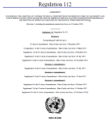
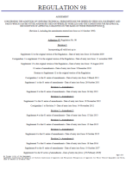
Strategy
R112 Class A
Class B
Class AR
Class BR
R98 Class DC
Class DR
R123 Class C
Class E
Class V
Class W
Class XR
ADB
R113 Class AS
Class BS
Class CS
Class DS
Class ES
Class R-BS
Class R-CS
Class R- DS
Class R- ES
R19 Class B- F3
R119 Class K
Currently RID In the future: RID stage 2
Class A
Class B
Class AR
Class BR
Class DC
Class DR
Class C
Class E
Class V
Class W
Class XR
ADB
Class AS
Class BS
Class CS
Class DS
Class ES
Class R-BS
Class R-CS
Class R- DS
Class R- ES
Class F3
Class K
Basic /”C” Passing beam
Low speed /”V” Passing beam
Motorway/”E” Passing beam
Adverse weather/”W” passing beam
Basic Driving beam
Low speed Driving beam
ADB
AS, BS for mopeds
CS, DS for motorbikes
Secondary driving beams (2 wheelers)
Auxiliary driving beam
Fog beam
Cornering beam
…
1 regulation
16 Beam patterns
6 regulations
24 Beam patterns
TC4-45 SAE J2829
Expertise of Optical engineers
1 regulation
23 Beam patterns

Slide 4
Performance oriented and technologically neutral
Proposal focused on performances:
Independantly from the technology used for that purpose
(e.g.: performances are independant from the light source technology) ,

Slide 5


Next steps?
Polishing the strategy:
  How to manage the different technical requirements → Done
    Basic passing beam, low speed/ town passing beam , Motorway Passing beam , AFS, Adverse weather…
    which light distribution for which vehicles? → Waiting for CEMA input
Technical requirements:
  Validation of basic requirement for passing beam. → Done
  Validation of Passing beams for 2 wheelers : AS, BS: same as today, new CS and new DS → Done
  Management of AFS/ ADB.
    Definition of requirement for Low speed /”V” passing beam/ “E” passing beam. → Done including 125R
    ADB → Done
    Adverse Weather Passing beam : → Done
  Definition of requirements for driving beams -> Done
  Front fog beam → Done:.
  Cornering → Done.
Redaction:
  Rewrite / optimization of RID text. on going.

Slide 6
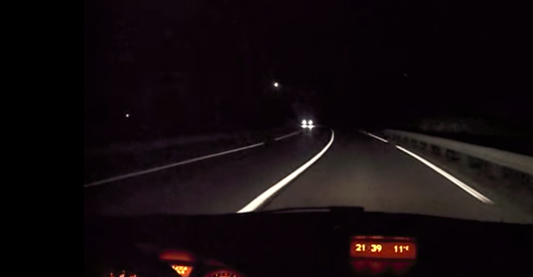
Passing beams

Slide 7
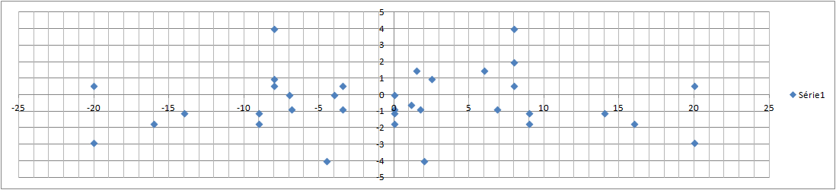
Measurement points and SEGMENTS
ZoneIII
BLL
B50L
BR
BRR
75R
50R
Seg 40LL
40L
50L
50V
Seg 50
40R
Seg 40RR
Seg 25L
Seg 25
Seg 15
25V
Seg 25R
Seg 10

Slide 8
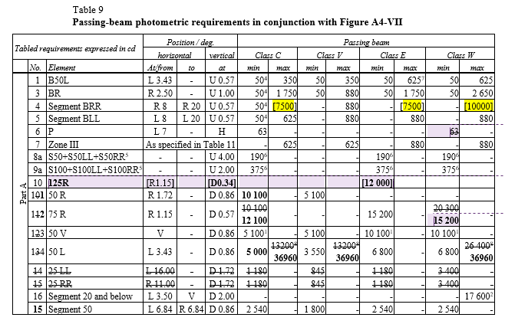
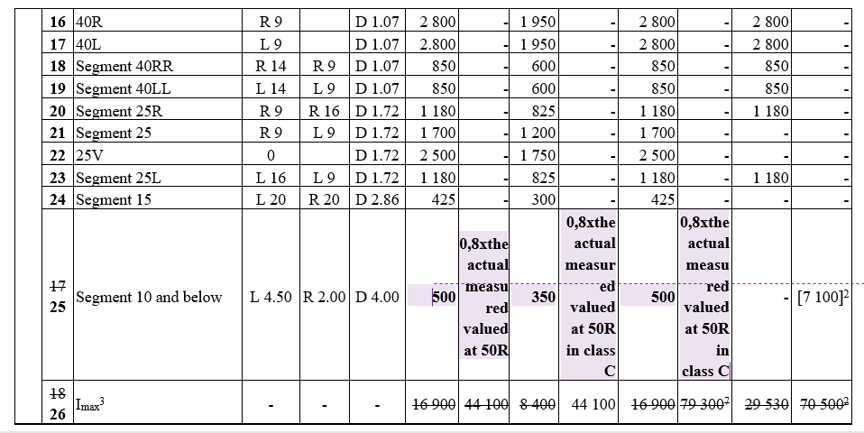
Requirements for Passing beams

Slide 9
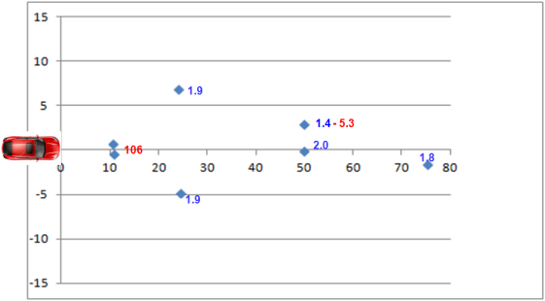
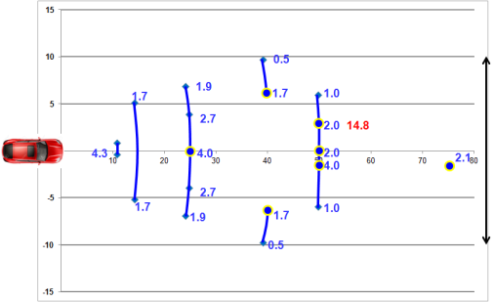
for comparison:
Illumination projected on the road for basic /”C” passing beam and current requirement RID class C (R123 Class C).
Bird’s eye view
Values in blue: Mini
Values in red: Maxi
RID class C
Proposal Basic/”C” Passing Beam
Significant improvement of the proposal / R123 class C
Width on the road : 20m instead of 11.6 m .
+20% at 75 m.

Slide 10
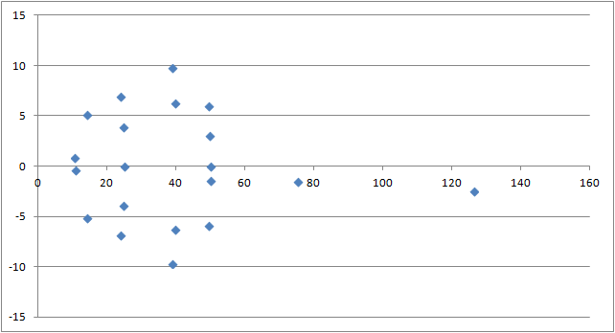
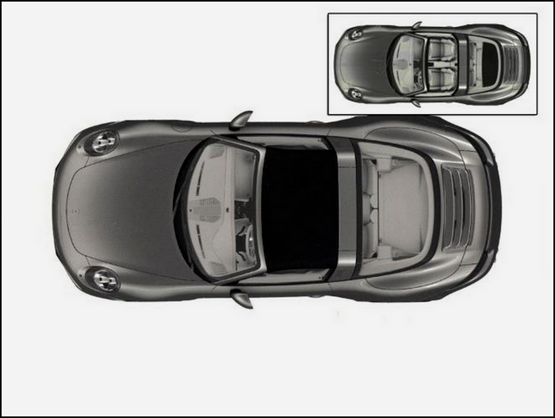
for comparison:
Illumination projected on the road for Motorway /”E” passing beam and current requirement RID class E (R123 Class E).
Bird’s eye view
Values in blue: Mini
Values in red: Maxi
0.5
1.9
1.9
1.7
1.7
1.0
2.7
2.7
2.7
106.4
4.0
4.3
4.0
4.0
106.4
2.7
2.7
2.7
0.75
1.9
1.7
1.0
1.7
1.9
0.5
RID class E
Proposal Motorway /”E” Passing Beam
Significant improvement of the proposal / R123 class E
Width on the road : 20m instead of 11.6 m .
Same illumination at 75 + requirement at 125m

Slide 11

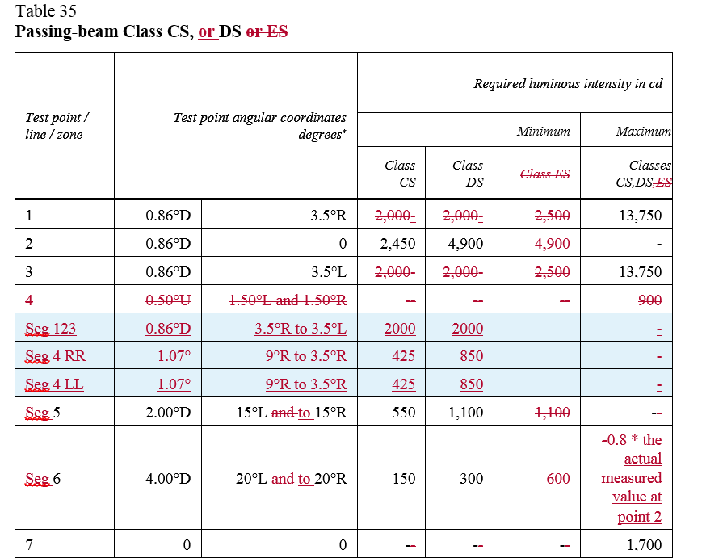
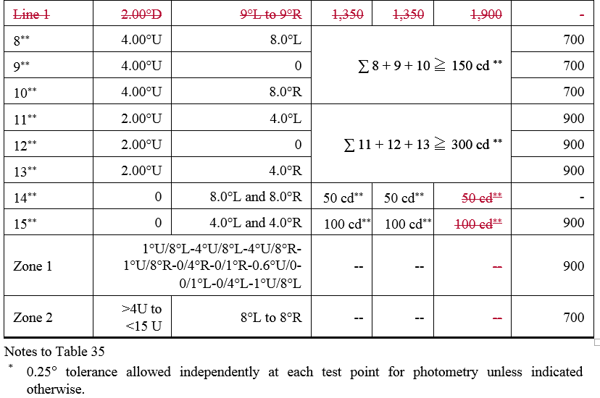
Proposal for 2 wheelers, CS, DS

Slide 12
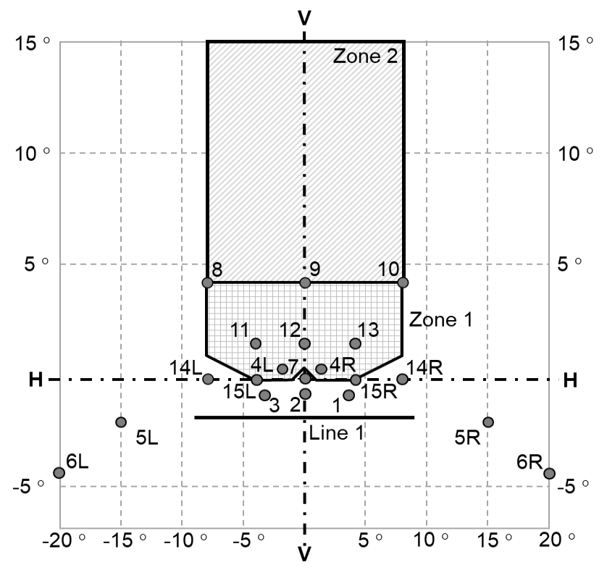
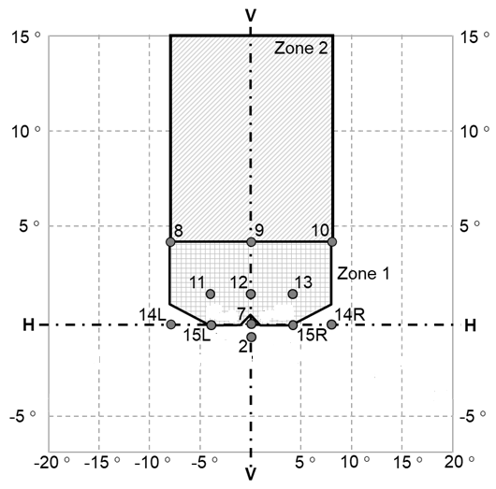

Proposal for 2 wheelers, CS, DS
R113-01/02
IMMA Symmetrical PB proposal

Slide 13
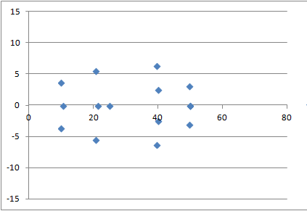
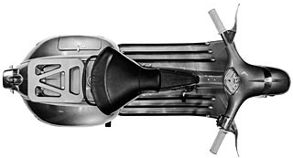
Comparison Current DS/ Proposal
2.4
2.4
0.5
0.8
5.5
2.6
0.8
5.5
2.6
2.9
Line 1
2.0
2.6
2.0
2.6
2.9
0.8
5.5
0.8
5.5
2.4
2.6
2.4
0.5
Current DS beam pattern
New DS beam pattern

Slide 14
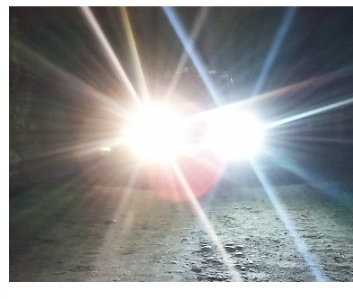
Driving beams

Slide 15
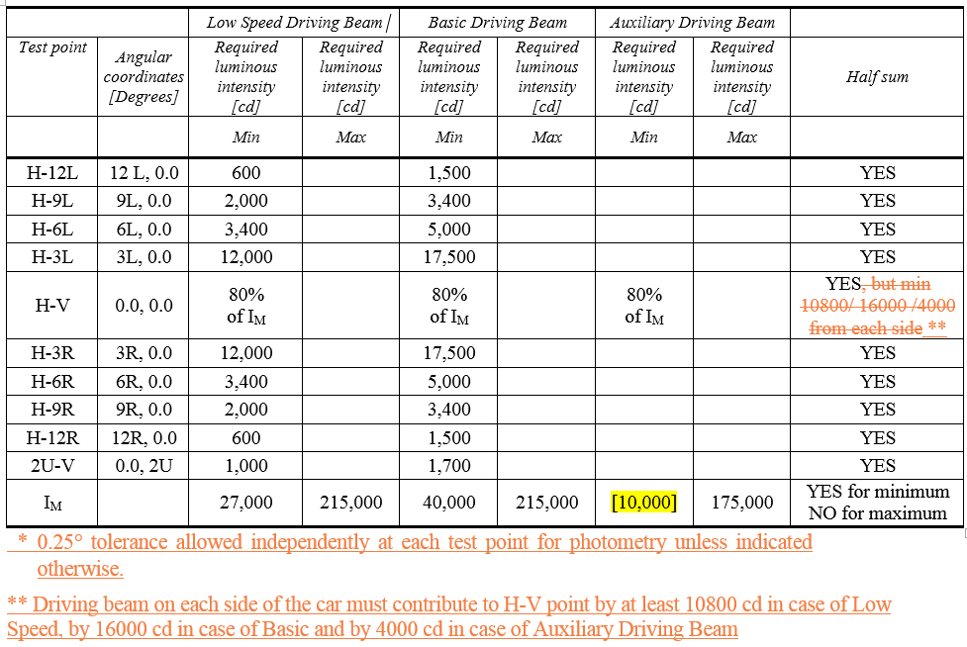
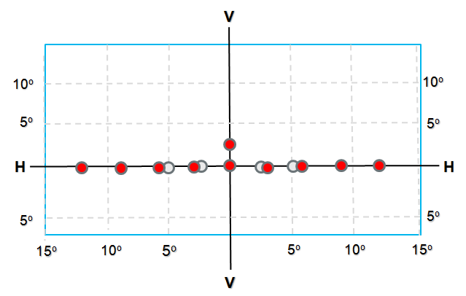
Driving beams
Red dots: new points
Grey dots : point of the current requirement

Slide 16
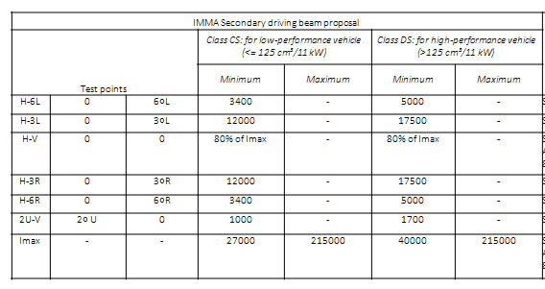
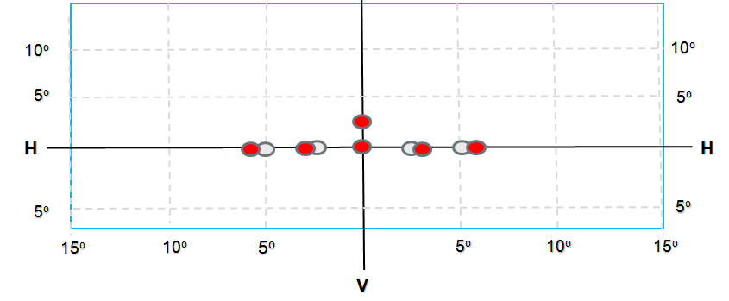
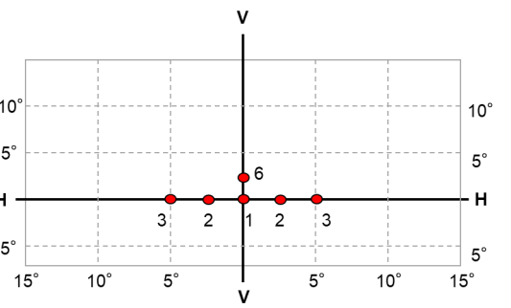
Driving beams
CS
DS
Secondary driving beam:
For motorbikes in combination with passing beam
A wider pattern and increased values
Red dots: new points
Grey dots : point of the current requirement
Current R113/ RID
Proposal:

Slide 17

Front fog lamp

Slide 18
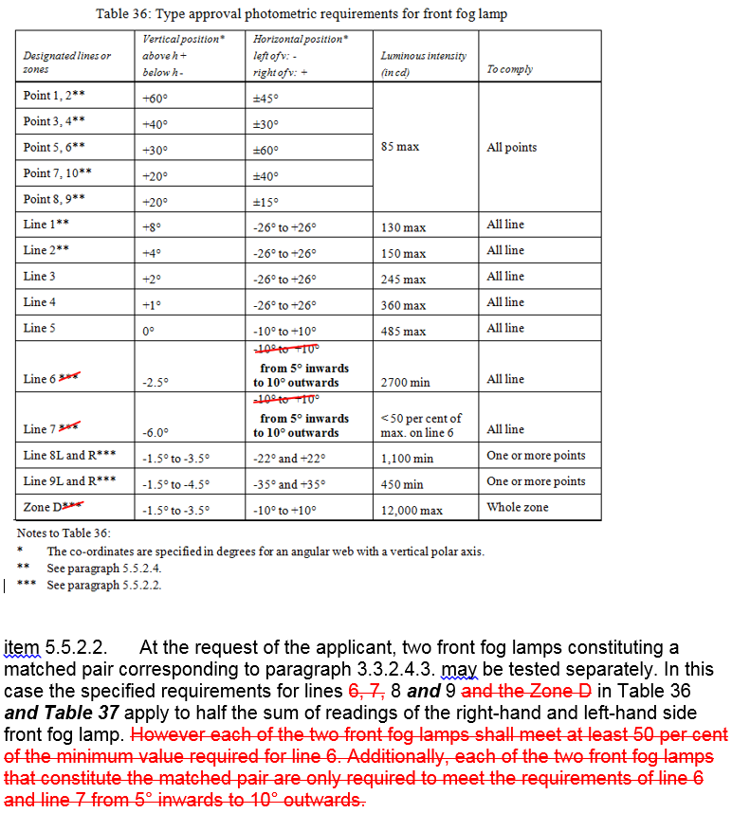
Front Fog lamp

Slide 19
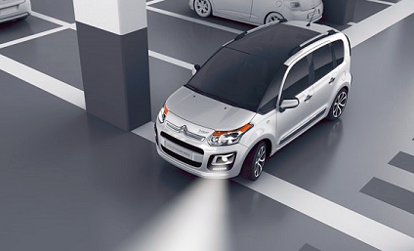
Cornering lamp

Slide 20
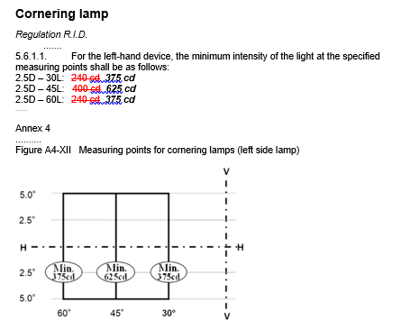
Cornering BEAM
30°

Slide 21
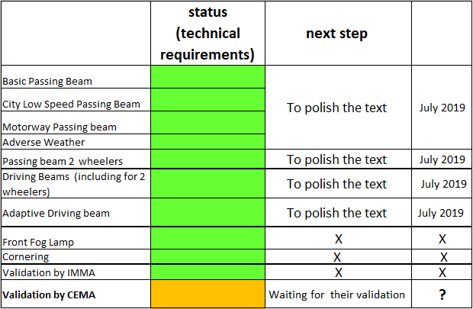
Synthesis

Slide 22


Next step:
Proposal :
To merge §5.2 and §5.3 of RID
Pending questions:
Luminous flux of light source of symmetrical passing beam,
1,000Lm thereshold for LED light sources / luminous flux in zones.
Run-up Behaviour

Slide 23
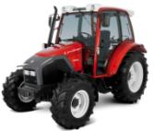
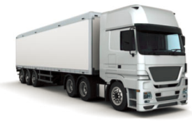
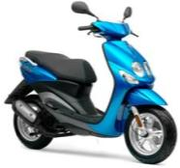

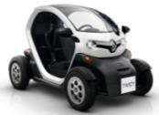
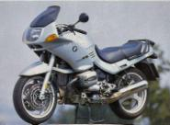
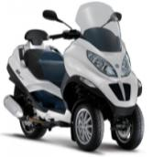

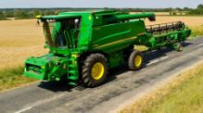
Which beam(s) for which vehicle?
To be addressed with WG-I

Slide 24

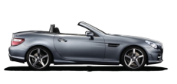


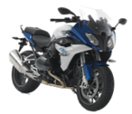
Installation requirements after SLR step 1 Regulation RID
AS
BS, R-BS
CS, R-CS
DS, R-DS
ES, R-ES
A, AR
B, BR
CS, R-CS
DS, R-DS
ES, R-ES
Class B, BR
Class DC, DR
F3
R74
Class B, BR
Class DC, DR
Class C
Class E
Class V
Class W
Class XR
ADB
Class F3
Class K
Class A, AR
Class B, BR
Class DC, DR
Class AS
Class BS, R-BS
Class CS, R-CS
Class DS, R-DS
Class ES, R-ES
Class F3
Class K
< 50 Km / h
R53
R48
R86
<125 cm³
2 x CS, 2 x R-CS
DS, R-DS
ES, R-ES
A, AR
B, BR
DC, DR
F3
Black: mandatory
Green : optional
Should the beam requirements be based on the category of the vehicle?
>125 cm³

Slide 25




Proposal
Basic/”C” passing beam, Low Speed/”V” passing beam, Motorway/”E” passing beam.
Which passing beam/speed/driving conditions?
“W”
Basic/ “C” passing beam – Basic driving beam
Low speed / “V” passing beam
Low speed driving beam
Motorway/“E” passing beam
0
[50]
[110] km/h
Waiting for confirmation from Agricultural Vehicles Industry

Slide 26
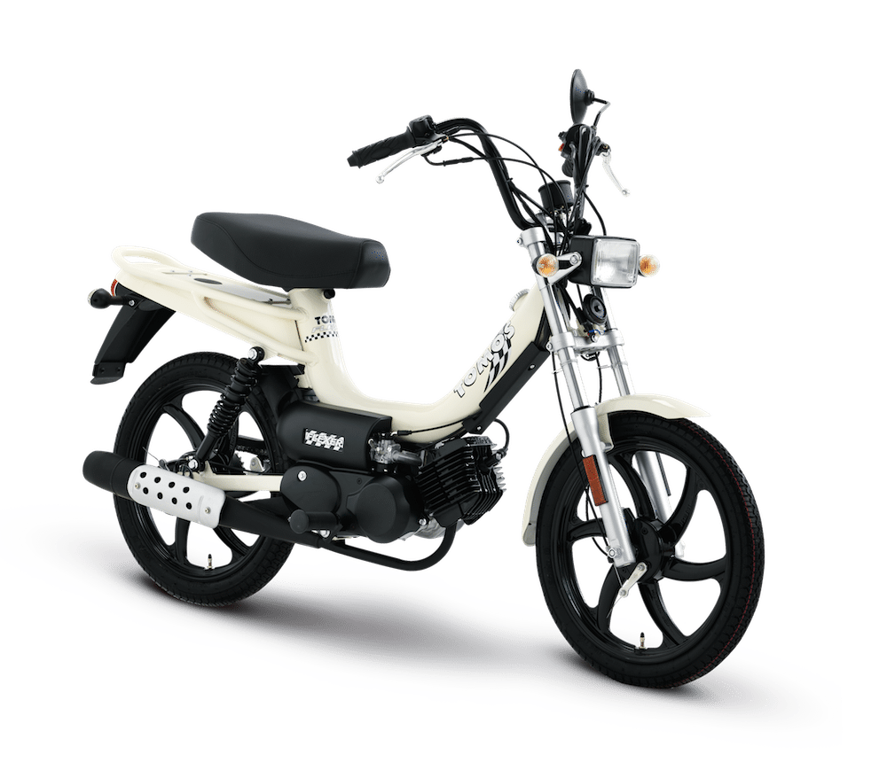
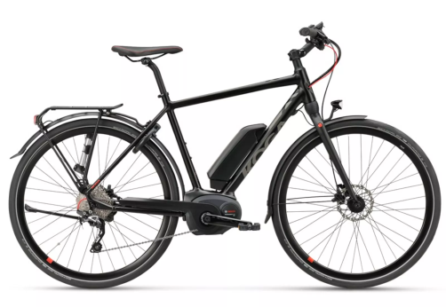
Alternative for Two Wheelers
DS (PB & DB)
CS (PB & DB)
0
11kW
125cm³
Power (kW)
Displacement (cm³)
Mopeds and electrical bikes
AS , BS
26

