Slide 1
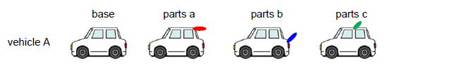
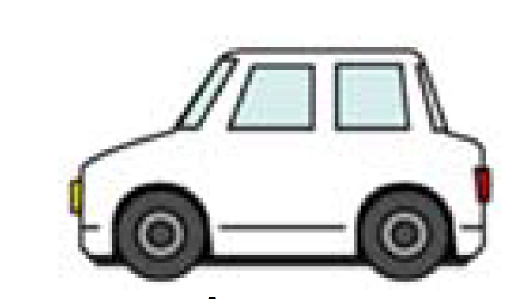

3.2.3.2.2.3.2. Alternative method for determination of aerodynamic influence of optional equipment
At the request ……
(c) The alternative method shall fulfil an accuracy for Δ(C_{D}×A_{f}) of ±0.015 m². In the case that the simulation method is used, the accuracy of CFD method shall be validated by at least 3 cases including baseline per types of parts and at least a total of X cases deltas.
Declared scope of the alternative method is certified based on design types (aerodynamic body shapes like Sedan, SUV…). Depending on a shape the certification could be done for multiple parts but with at least 3 cases including base vehicle (vehicle A). This definition leads to a multiple of 2 Deltas.
3 cases including base
3 cases including base
3 cases including base
(Sedan)
To certify the usage of CFD for 3 different types of parts (a,b,c) a minimum of 6 Deltas is necessary
Demonstration of equivalency is successful
That validation can also be used for vehicle B as long as it belongs to the same design type (Sedan, Hatchback, SUV, …)
(Sedan)
To certify for a different design type the whole set must be re-validated
3 cases including base
3 cases including base
3 cases including base
Demonstration of equivalency is successful

