Slide 1
WLTP Editorial Proposals
IWG #28
Bern
06.08.2019
Christoph Lueginger
BMW AG

Slide 2
1) Step Numbers in Additional Column

Slide 3
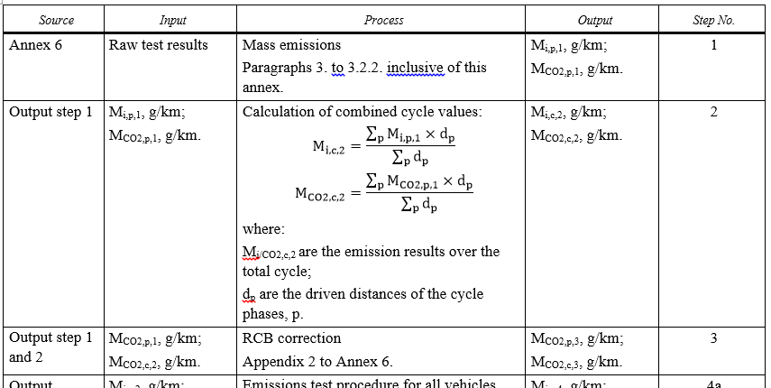
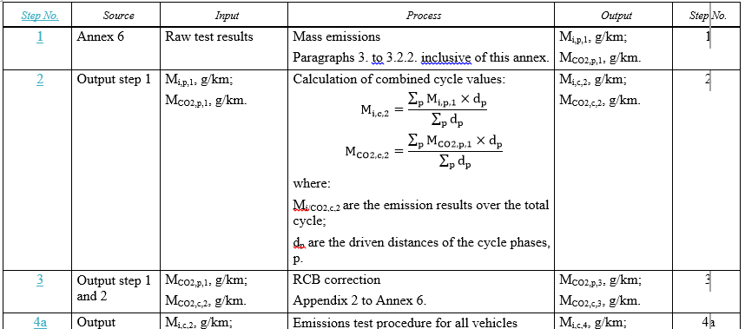
WLTP GTR Annex 7 and 8 – Post processing
Add step numbers also in a new column 1
A lot of misunderstandings are observed due to the fact, that the step number in the post-processing tables is listed in the last column.
Proposal: Add the step number in addition also as a new column 1 (copy the last column), for the following tables:
Annex 7: A7/1, Annex 8: A8/5, A8/6, A8/7, A8/8, A8/9, A8/10, A8/11.
Current text, example for Table A7/1:
New text, example for Table A7/1:
copy / move

Slide 4
2) Road load correction

Slide 5

WLTP GTR Annex 4 – road load.
Adding Remark for Correction to reference Conditions.
Description:
As coastdowns are performed on uncovered test tracks, environmental conditions (e.g. wind speed, temperature) during the measurement process always influence the results to some degree.
In order to obtain comparable results and to mitigate the influence of the environmental conditions, a correction of the coastdown results (as described in § 4.5.) to reference conditions is necessary.
To clarify this necessity when using stationary anemometry, a remark to correct the coastdown results to reference conditions acc. to § 4.5. should be added (comparable to § 4.3.2.6.9. when using on-board anemometry).
Old Text:
New Text, add §4.3.1.4.5. in Annex 4:
4.3.1.4.4.
The following equation shall be used to compute the arithmetic average of the road load where the harmonic average of the alternate coastdown times shall be used:
$$F_{j }=\frac{1}{3.6} × \left(m_{av}+ m_{r}\right) × \frac{2 × ∆v}{{∆t}_{j}}$$
[…]
4.3.2. Coastdown method using on-board anemometry
[…]
4.3.1.4.4.
[…]
4.3.1.4.5. Correction to reference conditions
The curve determined in paragraph 4.3.1.4.4. of this annex shall be corrected to reference conditions as specified in paragraph 4.5. of this annex.
4.3.2. Coastdown method using on-board anemometry
[…]

Slide 6
3) Clarification Reference Extrapolation

Slide 7
WLTP GTR Annex 6
References for CO2 Interpolation
Although it could be clear using always the final values for the defined terms, it could make sense to add a clear reference to avoid misunderstandings.
Question: Also necessary for Annex 8?
Current text for paragraph 2.3.2.3. in Annex 6:
2.3.2.3. At the request of the manufacturer and with approval of the responsible authority, the application of the interpolation method on individual vehicle values within a family may be extended if the maximum extrapolation is not more than 3 g/km above the CO2 emission of vehicle H and/or is not more than 3 g/km below the CO2 emission of vehicle L. This extrapolation is valid only within the absolute boundaries of the interpolation range specified in paragraph 2.3.2.2.
For the application of a road load matrix family, extrapolation is not permitted.
New text for paragraph 2.3.2.3. in Annex 6:
2.3.2.3. At the request of the manufacturer and with approval of the responsible authority, the application of the interpolation method on individual vehicle values within a family may be extended if the maximum extrapolation of an individual vehicle (Step 10 in Table A7/1 of Annex 7) is not more than 3 g/km above the CO2 emission of vehicle H (Step 9 in Table A7/1 of Annex 7) and/or is not more than 3 g/km below the CO2 emission of vehicle L (Step 9 in Table A7/1 of Annex 7). This extrapolation is valid only within the absolute boundaries of the interpolation range specified in paragraph 2.3.2.2.
For the application of a road load matrix family, extrapolation is not permitted.

