Slide 1
Auxiliaries Sub-Group
for
Low Temperature Task Force @UN
25sept2019-C.Petitjean (Clepa)

Slide 2
Reminder slide
Reminder slide
Auxiliaries Sub-Group for Low Temperature UN Task Force
2 main activities managed under this Auxil sub-group
as proposed and agree @ LT TF meeting by 15Sept2017
Activity 1 for Assessment Matrix:
➔ to Identify & justify the list of Auxiliaries to be included in new GTR annex
Activity 2 for Technical Grid:
➔ To draft how selected Auxiliaries (Activity 1) will be handle in new GTR annex
Reminder: Some considerations for the new Test Procedure including Auxiliaries at Low Temperature.
- Keep tests at the level of the vehicle (such as US approach).
Avoid test complexity (easy to repeat and reproduce).

Slide 3
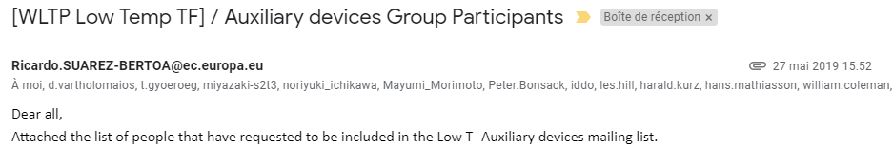
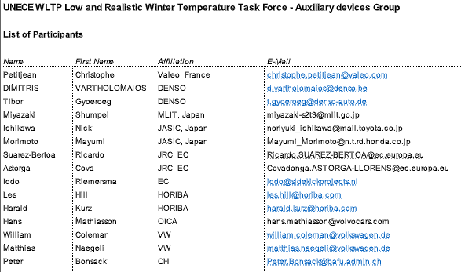
Reminder slide
Reminder slide
Auxiliaries Sub-Group for Low Temperature UN Task Force
➔ An Auxiliary Devices sub-Group has been formed @ UN Geneva meeting end may 2019

Slide 4
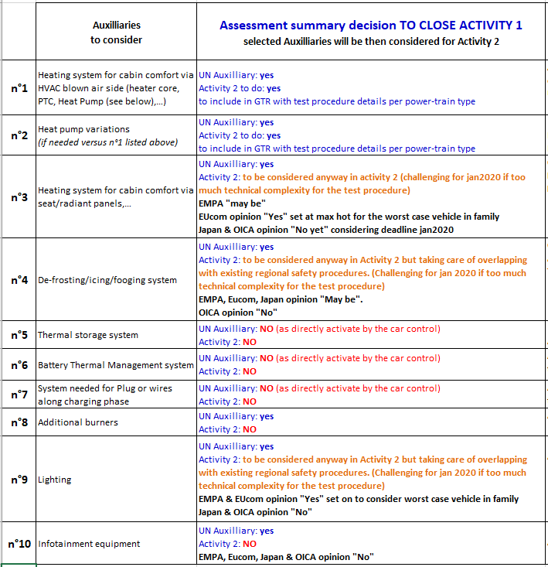
Auxiliaries Sub-Group for Low Temperature UN Task Force
Activity 1 closing: Identify & justify the Auxiliaries to be considered for drafting
Comments were received from EMPA, OICA, Japan & EU Commission along the summer 2019. Comments were discussed in a webex meeting by 20sept2019 to get the following conclusions (in below table)
Conclusion: Activity 2 to do only for
Auxiliaries n°1 & 2 to identify drafting elements to be included in new annex
Auxiliaries n°3, 4 & 9 to identify drafting elements and confirm that there is no contradiction with existing safety Regulations and that a simple test procedure can be found.
➔ key points of discussion are about the need to consider a worst case for one of the vehicle in the family together with the intended use of the test results.
So that Auxiliaries n°5,6,7,8,10 will not be considered for Activity 2

Slide 5
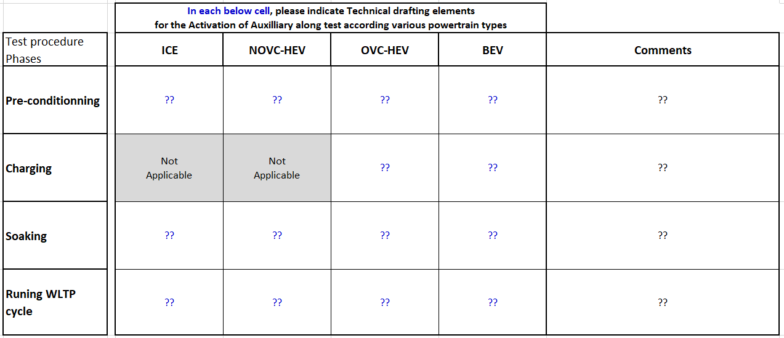
Reminder slide
Reminder slide
Auxiliaries Sub-Group for Low Temperature UN Task Force
Activity 2: Technical Grid for each of the selected Auxiliary @ Activity 1
Example below for the template to apply to each specific auxiliary
Next action for drafting: All ?? (means each combined phase & pwt type for a given auxiliary) must be drafted with Technical elements answering to the following questions:
  Is the auxiliary activated or not ?
  If YES:
    How to activate it ? (what actions manual / automatic controlled ?)
    When along the specific phase ??
    What target if requested ??
    … any other element if needed

Slide 6
Auxiliaries Sub-Group for Low Temperature UN Task Force
Activity 2 to speed-up:
Q4/2019:
  - make sure to have Activity 2 being fully performed for Auxiliaries n°1 & 2
  - identify potential clarifications needed for Auxiliaries n°3, 4 & 9
Q1/2020:
  - finalize Activity 2 for all confirmed Auxiliaries for inclusion in new Annex

