Slide 1
NRC comments and questions in advance EVS19-E1TP-0600 JASIC
Dec 3-5, 2019 19 EVS - GTR Berlin, Germany

Slide 2
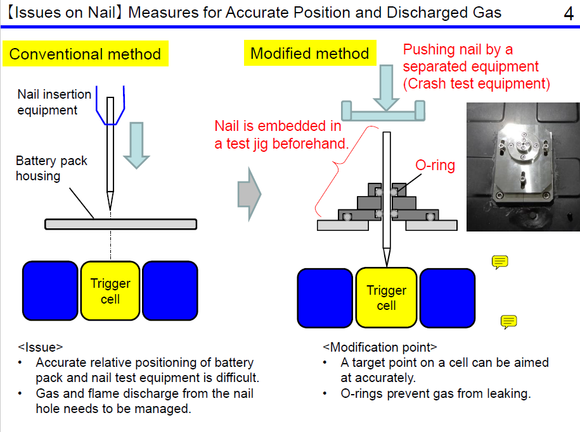
EVS19-E1TP-0600 JASIC - Slide 4
Comment:
On the previous slide, it states no modifications as an advantage. This seems like a significant modification which would involve engineering support from the battery supplier. Modules may also need to be predrilled, depending on their design and the target location/direction.

Slide 3
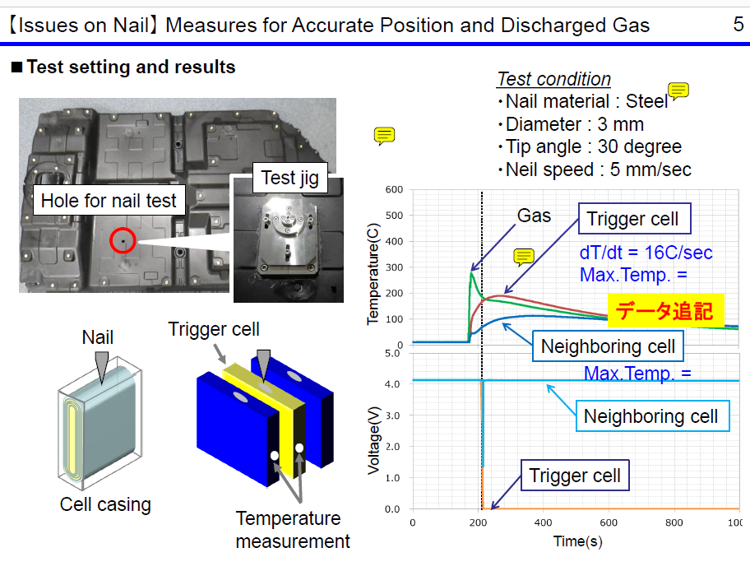
EVS19-E1TP-0600 JASIC - Slide 5
Questions:
Nail penetration direction appears to be downward from the top of the pack. How could this approach be applied at the vehicle level? What if a pack design has cells which are oriented such that up/down is parallel to the electrodes?
From the graph, the peak temperature of the trigger cell appears to be 200C. Can you please explain why this value is so low?

Slide 4
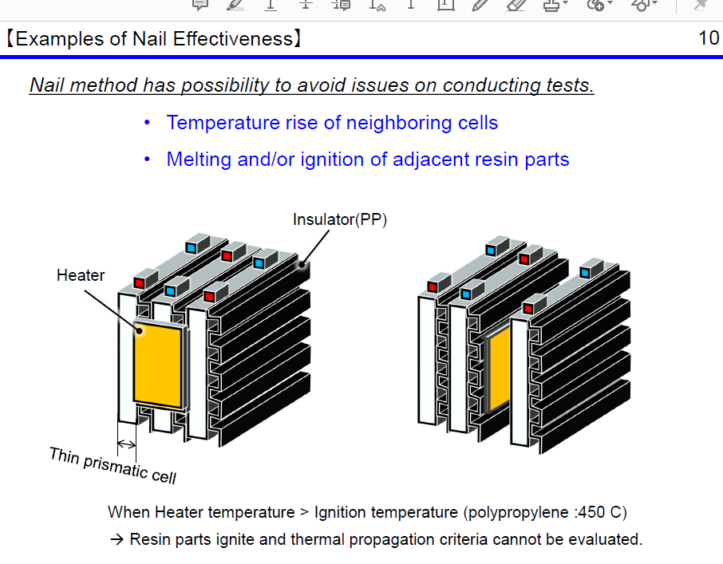
EVS19-E1TP-0600 JASIC - Slide 10
Comment:
It is best practice to remove a small volume of resin parts in the immediate area around the heating element to avoid this issue.
Question:
Can you please share experience of performing nail tests on thin prismatic cells in a pack assembly? Based on the previous slide, the nail direction options will be limited to predrilling or puncturing these resin parts and only end cells are suitable targets. From our experience during nail tests, cells will vent hot ejecta in the direction of the puncture (side wall rupture), which influences thermal propagation performance.

