Slide 1




EVS GTR IWG #19
Water immersion test
정 혁 책임연구원
December 2019
Bohyun Moon / Chief Researcher
Korea Automobile Testing and Research Institute(KATRI)
200 Samjon-Ro, Songsan-Myun, Hwasung-Si, Gyeonggi-Do, 18247
Korea Transportation Safety Authority
1

Slide 2
Water immersion test in KMVSS
Purpose
The purpose of this test is to verify the safety performance of the REESS during
vehicle immersion situation.
Scope of water immersion test of KMVSS New draft
Reason for change
The REESS installed above the passenger compartment does not affect
the evacuation of passengers in flooded situations
Test | Procedure | Criteria
Immersion | Immerse into 0.6M(3.5% NaCl) salt water for 1h | No Fire & No Explosion
Before | After
All REESS in vehicle | No requirement: REESS installed above the passenger compartment

Slide 3
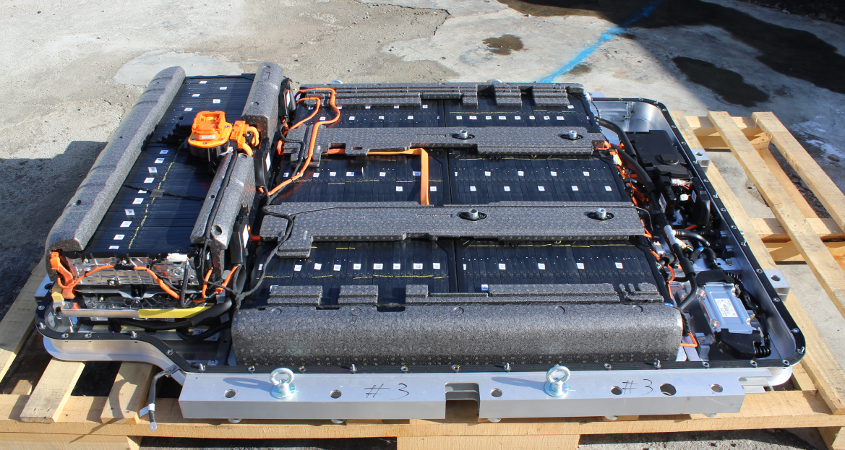
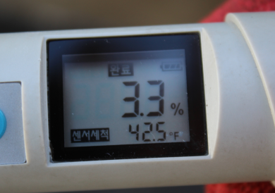
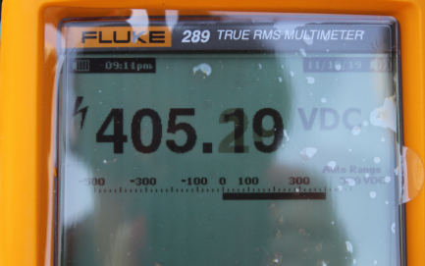
Water immersion test
Immersion test after waterproof removal
- Purpose: Observation what happen when safety designed(eg. clearance and creepage
distance) REESS immersed into salt water without waterproof
Salinity: 3.3%, SOC: 98%(405.2V), Capacity: 64kWh

Slide 4
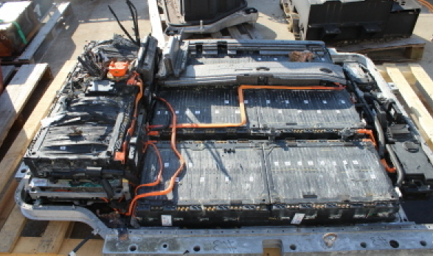
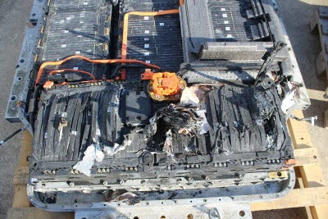
Water immersion test
Test result
- Venting, Ruptures in 2 modules, No fire, No explosion
- No safety concern in severe condition without waterproof

Slide 5
Water immersion test
Failed DUT specification of water immersion test in KR
★ EVS1533-101 [KR] Statistical analysis of Water immersion test
- All failed REESS did not meet the clearance and creepage distance of its terminals
- ISO 6469-1:2019(E) included the clearance and creepage distance
- Consider the clearance and creepage distance can be applied in the GTR
- Best scenario of water immersion test: Discharge cell level after immersion
- Therefore, the clearance and creepage distance is necessary for cell level discharge
 | Vehicle | V | Ah | kWh | Event | Remark
1 | BUS | 607.5 | 80 | 48.6 | Fire
2 | BUS | 607.5 | 80 | 48.6 | Fire | Retest of #1 DUT
3 | BUS | 607.2 | 40 | 24.3 | Fire | LTO cells
4 | BUS | 706.5 | 120 | 84.8 | Fire | Non-Insulated Case
5 | BUS | 625.6 | 94 | 58.8 | Fire | DUT floated
6 | Truck | 110.1 | 364.8 | 40.2 | Fire | 18650 cells
7 | HEV | 307.2 | 10 | 3.1 | Explosion | LFP cells / IPX7

Slide 6
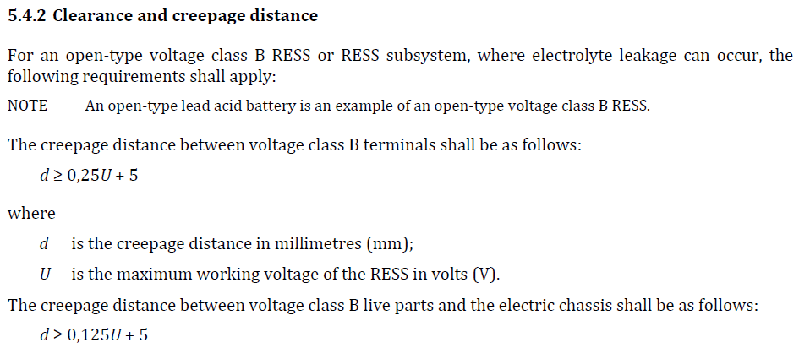
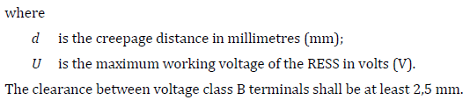
ISO 6469-1:2019(E)
ISO 6469-1:2019(E)
Electrically propelled road vehicles — Safety specifications — Part 1: Rechargeable energy
storage system (RESS)

Slide 7
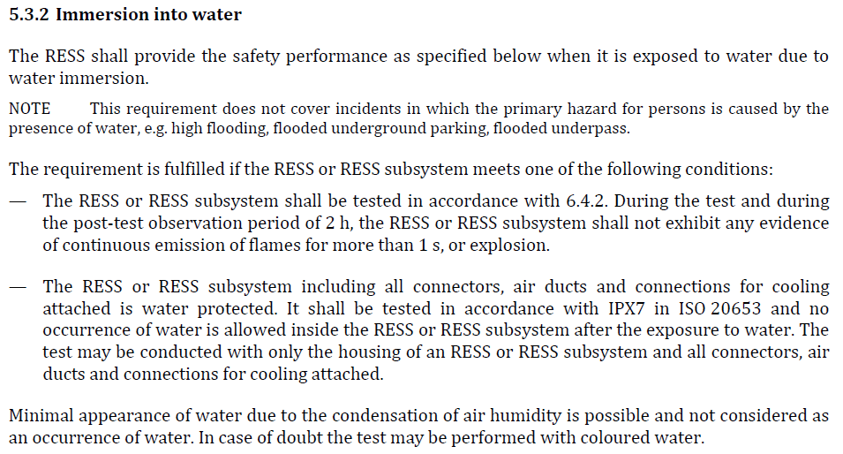
ISO 6469-1:2019(E)
ISO 6469-1:2019(E) Electrically propelled road vehicles — Safety specifications — Part 1: Rechargeable energy storage system (RESS)
- ISO 6469-1:2019(E) included salt water immersion test(3.5% -5%).
- Test rationale and necessity of water immersion test were proved?
- Consider the ISO water immersion test can be applied in the GTR

Slide 8
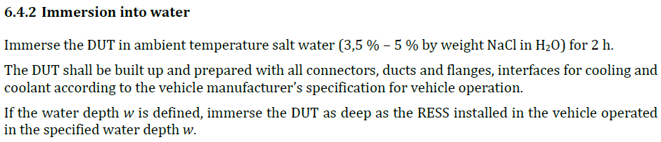
ISO 6469-1:2019(E)
ISO 6469-1:2019(E) Electrically propelled road vehicles — Safety specifications — Part 1: Rechargeable energy storage system (RESS)
- ISO 6469-1:2019(E) included salt water immersion test(3.5% -5%)
- Test rationale and necessity of water immersion test were proved?
- Consider the ISO water immersion test can be applied in the GTR

Slide 9
Thank you for attention!

