Slide 1
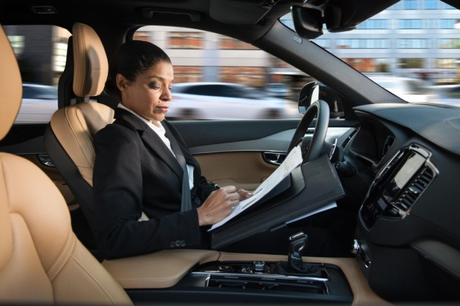
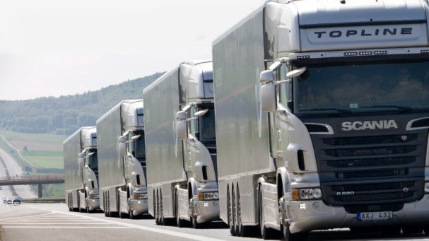
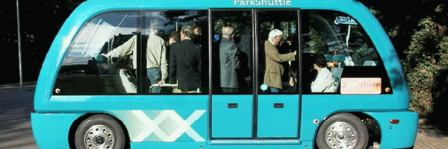


AV safety :
Commission view
FRVA
© AC.nl

Slide 2
Automated driving: concepts
Automated driving: System drives:
-Shall not cause accident
-respect traffic rules
-Allow interaction with other road users
-drive carefully
-Inform the driver/Passenger
-Is able to detect its limits for activation and minimum risk manoeuvre
Manual driving: Driver drives
-Shall not cause accident
-respect traffic rules
-drive carefully
-Allow interaction with other road users
Activation
Deactivation
Takeover request
Minimum risk manoeuvre

Slide 3
Automated vehicles: New risks to be tackled
Operational risks (i.e. driver tasks in manual driving, new AD risks)
Cyber
Mechanical/ Electronic failure

Slide 4
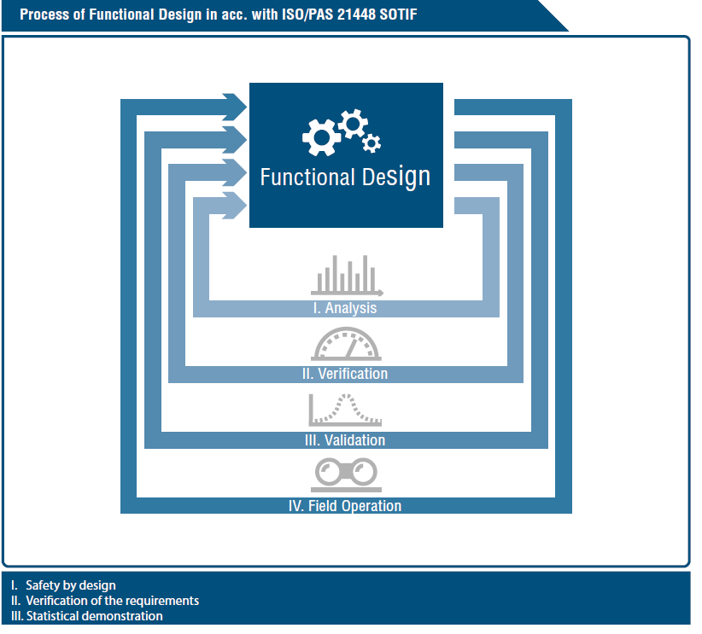
Design/Verification/validation by manufacturers
Need to clarify concepts first : Same words are used with very different meaning
We should distinguish how these instruments are used by manufacturers and authorities

Slide 5
Safety level
Overall goal: At least equivalent to human driving
Not a single criteria but a combination of qualitative criteria (all known unsafe scenarios and most unknown unsafe scenarios shall be managed) and quantitative target for residual risk (equivalent to humans or better)
Constraints: Balance between safety (focus of authorities) and drivability (also important for manufacturers).
This implies safety principles and safety capabilities in nominal and degraded conditions as well as a relevant architecture to provide these capabilities.

Slide 6
Safety level: References
National/regional guidelines
Safety principles used by manufacturers: ISO 26262 and SOTIF (ISO PAS 21448), FMEA, STPA,etc.
Safety principles used in other sectors: producer/user is responsible, equivalent level of safety, performance as intended, best effort to avoid accidents, assess/inform about residual risks
Safety principles can be applied for L3 ALKS similar to general approach but limited number of scenarios: at least equivalent to human driver, risk of misperception, reaction of the system at the edge of the OD/complex situations, risks for driver confusion/disengagement.

Slide 7
EU guidelines on automated vehicles
Goal: Approval under an EU exemption procedure
Main safety principles:
  1. SYSTEM PERFORMANCE IN THE AUTOMATED DRIVING MODE (Including Duty Of Care Principles)
  2. DRIVER/OPERATOR/PASSENGER INTERACTION
  3. TRANSITION OF THE DRIVING TASKS
  4. MINIMUM RISK MANOEUVRE
  5. INSTALLATION OF EVENT DATA RECORDERS
  6. CYBERSECURITY
  7. SAFETY ASSESMENT AND TESTS
  8. INFORMATION PROVISION TO AUTOMATED VEHICLE USERS
  ANNEX : INFORMATION TO BE PROVIDED FOR TYPE APPROVAL
Supported by Member States on 12 February 2019
Publicly available: https://ec.europa.eu/growth/content/guidelines-exemption-procedure-eu-approval-automated-vehicles_en

Slide 8

Thank you!

