Slide 1
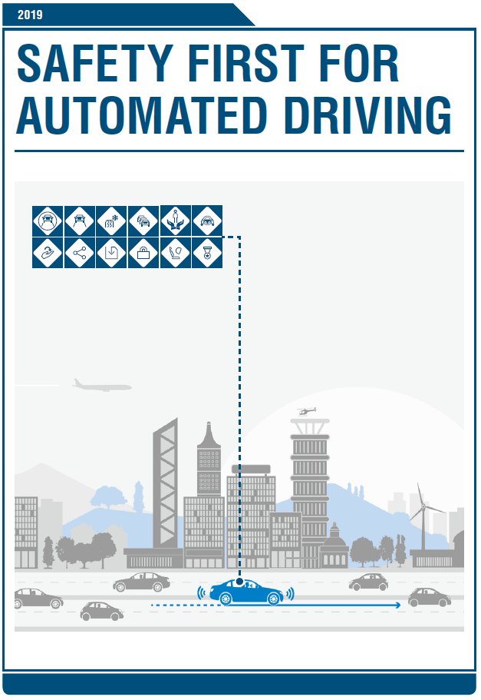











Safety First for Automated Driving
Document FRAV-01-11
Submitted by the expert from Continental
White paper globally published on 2nd of July 2019

Slide 2
Abstract
Automated Driving Systems
Publication merges input of OEMs, tiered suppliers and key technology providers
Positive risk balance
  Safety by design and verification & validation methods
  Comprehensive approach to safety relevant topics
Intends to collaborate to industrywide standardization
Notes:
This publication summarizes widely known safety by design and verification and validation (V&V) methods of SAE L3 and L4 automated driving.
This summary is required for evidence of a positive risk balance of automated driving solutions compared to the average human driving performance.
This publication promotes a comprehensive approach to safety relevant topics of automated driving and is based on the input of OEMs, tiered suppliers and key technology providers.
The objective of this publication is to systematically break down safety principles into safety by design capabilities, elements and architectures and then to summarize the V&V methods in order to demonstrate the positive risk balance.
This publication represents guidance for potential methods and considerations in the development and V&V.
Intent of this publication is to contribute to current activities working towards the industrywide standardization of automated driving.

Slide 3












The Twelve Principles of Automated Driving
SAFE OPERATION
  Deal with degradation
  Fail operational
SAFE LAYER
  Recognize system limits
  React to minimize the risk
OPERATIONAL DESIGN DOMAIN
  ODD determination
  Manage typical situations
BEHAVIOR IN TRAFFIC
  Manners on the road
  Conforming to rules
USER RESPONSIBILITY
  Responsibilities
  Mode awareness
VEHICLE-INITIATED HANDOVER
  Minimal risk condition
  Takeover request
VEHICLE OPERATER-INITIATED HANDOVER
  Engaging and disengaging of AD system
  Ensure intent of handover with high confidence
INTERDEPENDENCY (OPERATOR ↔ AD SYSTEM)
  Take effects on the driver due to automation into account
DATA RECORDING
  Record relevant data when an event or incident is recognized
  Complies with the applicable data privacy laws
SECURITY
  Protect the automated driving system from security threats
PASSIVE SAFETY
  Crash scenarios (vehicle layout modifications)
  Alternative seating position (new uses for the interior)
SAFETY ASSESSMENT
  Verification and validation to ensure that safety goals are met
  Reach a consistent improvement of the overall safety

Slide 4
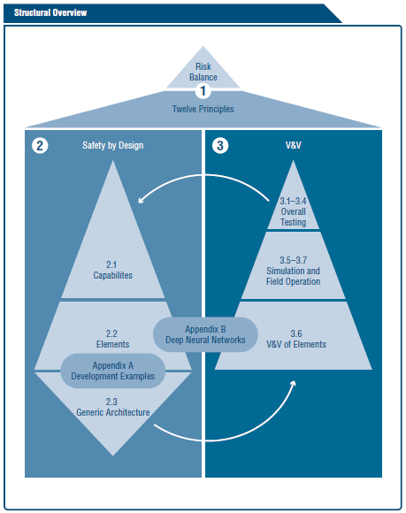
Structure of this Publication
This publication is structured as interconnected topics which build upon one another to achieve an overall safety vision.
The roof ridge in the figure represents the positive risk balance as an initial starting point and the overall goal.

Slide 5
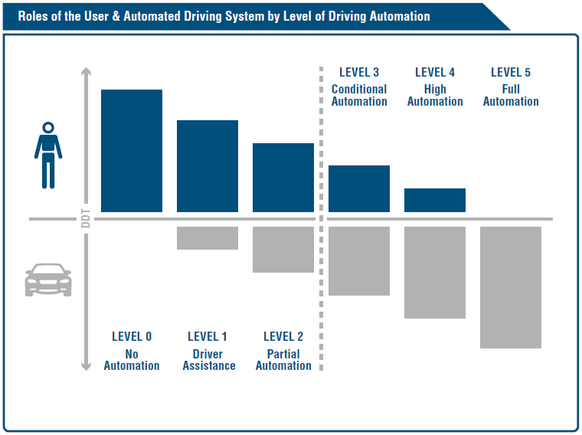
Human - Machine Interaction
Introducing L3 automated driving system,
  the vehicle operator is allowed to cede full control to the vehicle during the nominal driving task within ODD
  user’s correct interpretation of the actual driving mode and related responsibility for dynamic driving tasks (DDT) is crucial to enable safe driving
levels of automation according to SAE J3016

Slide 6
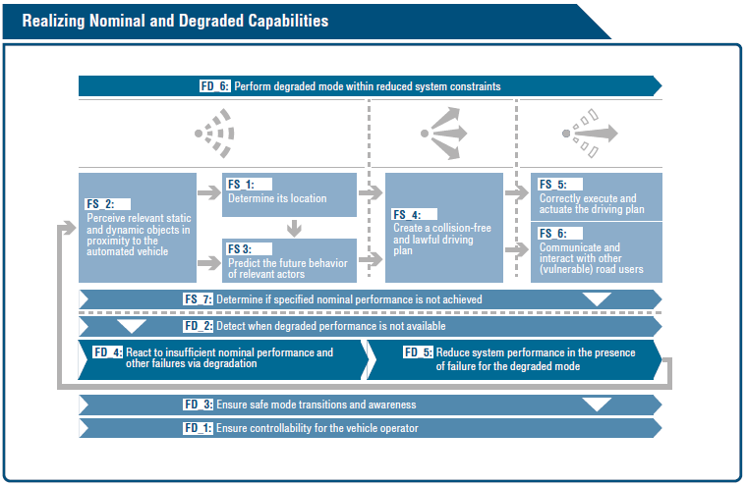
Realizing Nominal and Degraded Capabilities
Capabilities based on
Sense – Plan – Act to achieve nominal performance
Ensure degradation in case of insufficient nominal performance or other failures
Ensure safe mode transitions

Slide 7
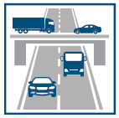
Example Traffic Jam Pilot (L3)
Nominal Function Definition | Vigilant driver with driver’s license, driving only on structurally separated roads typically no pedestrians or cyclists 60 km/h max only with leading vehicles no lane changing no construction sites only during daylight, without rain only temperatures higher than freezing point
Minimal Risk Conditions | Driver has taken over control Deactivate as soon driver has control or the vehicle is stopped Vehicle is stopped in-lane Immediately stop the vehicle with fixed deceleration lateral vehicle movement based on last valid trajectory
Sensing Elements for Localization | Determine whether the vehicle is on the highway
Sensing Elements for Perceive Relevant Objects | Leading vehicles in front of the ego vehicle Lane markings (vulnerable) road users (even though they are excluded from the ODD) Diversity object detection methods are preferred to cover the performance weakness of single sensors High-level object fusion is considered a meaningful measure
ADS Mode Manager | Check activation conditions Check deactivation conditions Ensure that the vehicle has either reached a fail-safe state Or that the user has safely taken over control

Slide 8
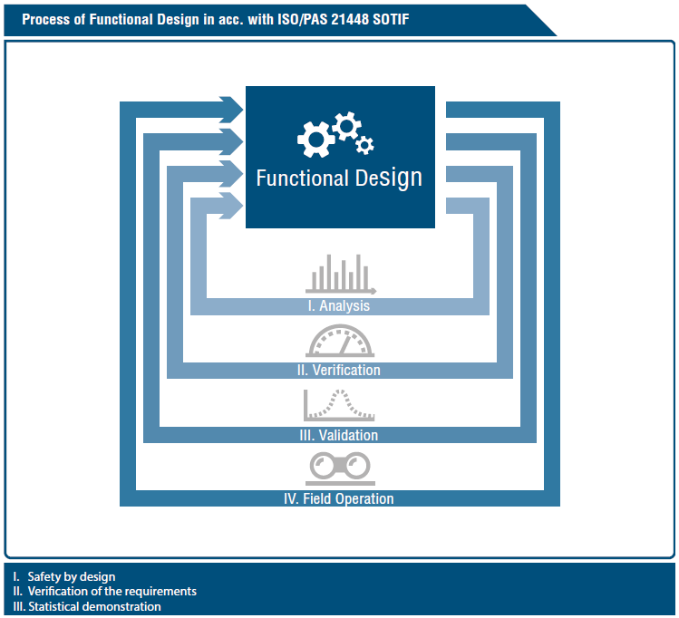
Verification and Validation
Key Challenges for V&V of L3 and L4 Systems
Statistical demonstration of system safety and a positive risk balance without driver interaction
System safety with driver interaction (especially in takeover maneuvers)
Consideration of scenarios currently not known in traffic
Validation of various system configurations and variants
Validation of (sub) systems that are based on machine learning

Slide 9
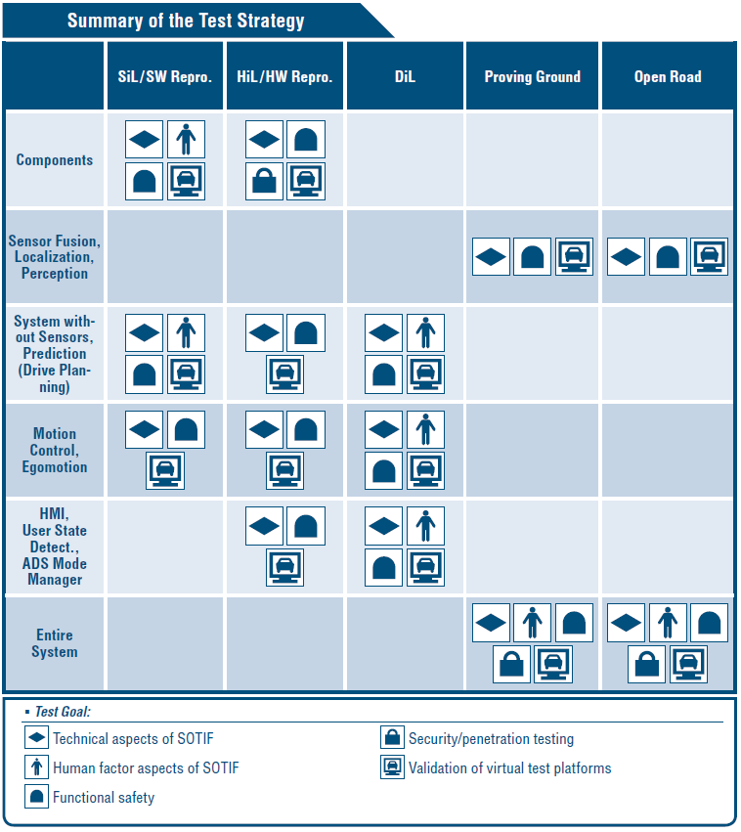
Test Strategies
A viable test strategy responds to the key challenges in the V&V of automated driving systems
  by carefully breaking down the overall validation objective into specific test goals for every object under test
  and by defining appropriate test platforms and test design techniques

Slide 10
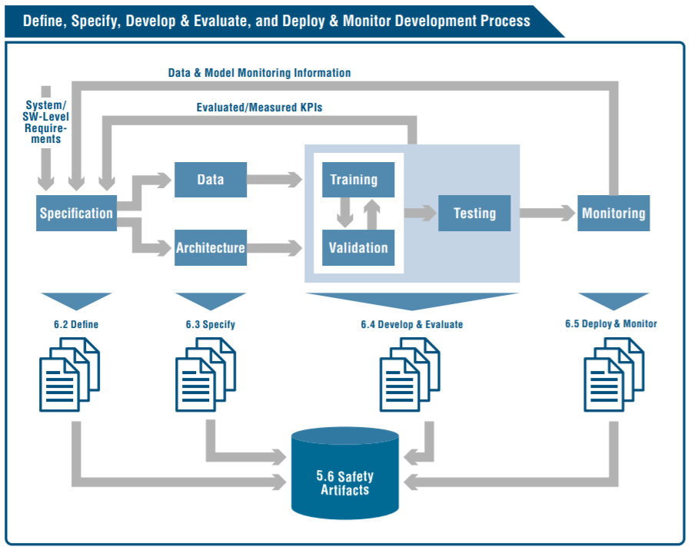
Safety Aspects of Deep Learning Implementation
General considerations
  Be agnostic to means of implementation; documentation during full process chain, creation of safety artefacts.
Define
  ODD, Data set, probabilistic output, KPIs, target hardware
Specify
  Data set specs, labelling specs, labelling quality, DL model architectures, observers.

Slide 11
Safety Aspects of Deep Learning Implementation
Develop & Evaluate
  DL model architecture (layers, connectivity, activations, pooling/upsampling, stride, …); composition of loss, regularization, optimization methods (solver, learning rate, …).
Deploy & Monitor
  Challenges: unseen data, confidence interpretation, emerging features, distributional shift.

