Slide 1
Index of the BGN level and proposal of limit value
JASIC

Slide 2
Research report about BGN level
There is a research report¹⁾ about BGN level in Japan.
25 public research institutes attend this research project.
2,383 measurement data were obtained by predefined measurement protocol. The data are 10 minutes L_{Aeq}.
The data are averaged at each predefined location category.
1) S. Sueoka., et. al, "An Investigation of the New Index of the Noise Level in Japan (in Japanese)," Journal of Environmental Laboratories Association, Vol.34, no.22, 22, 2009

Slide 3
Index of the BGN level : Road transportation areas
1.
2.
In TFRA-04-11, there are sentences about the usage situations of 3 different sound level modes.
The situations are defined as follows.
Low mode : Quiet times (e.g. during 10 pm to 5 am)
Quiet area
Normal mode : Normal traffic hours (e.g. during 5 am to 10 pm)
High mode : Very loud time and/or very loud place
These sentences were deleted from present draft of new regulation.
But TF still have common understanding.
Based on the above background, the followings are appropriate BGN levels when 3 different sound level modes are used.
(All values are L_{Aeq}. )
BGN level of High mode : 65dB -
BGN level of Normal mode : 40 - 65 dB
BGN level of Low mode : - 40 dB
Measurement results of road transportation area (Outside)

Slide 4
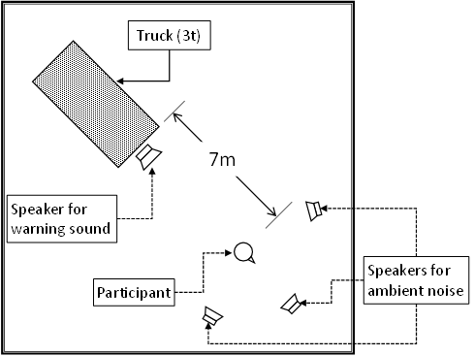
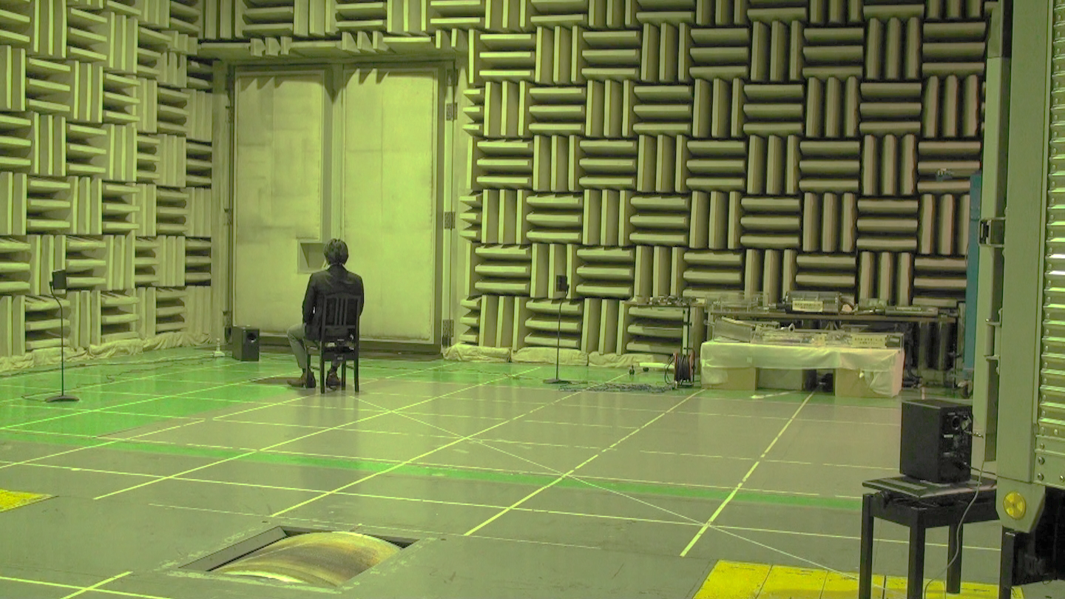
Scene of evaluation test
Layout of the test
Speaker for BGN
Heavy duty vehicle with idling
Test participant :
The ear position is set at 1.2 m height
Speaker for warning sound

Slide 5
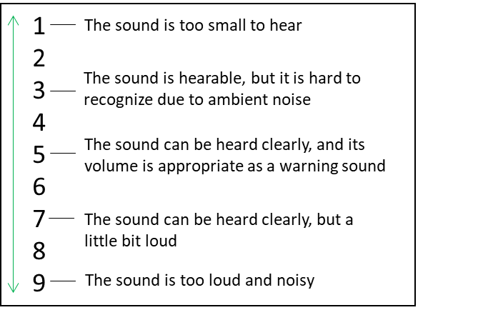
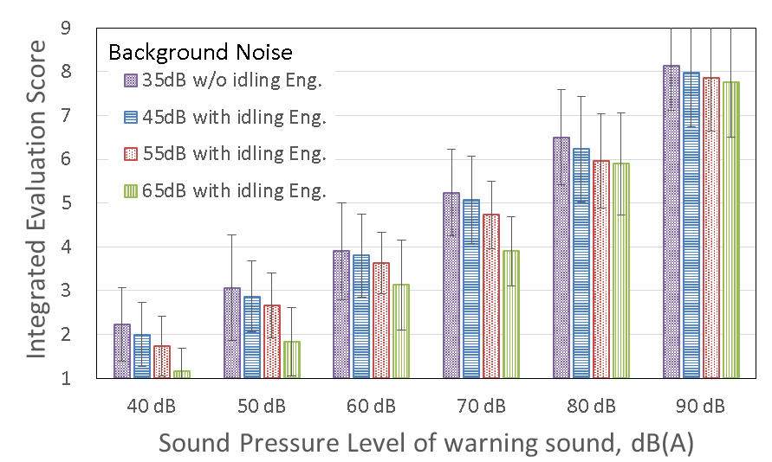
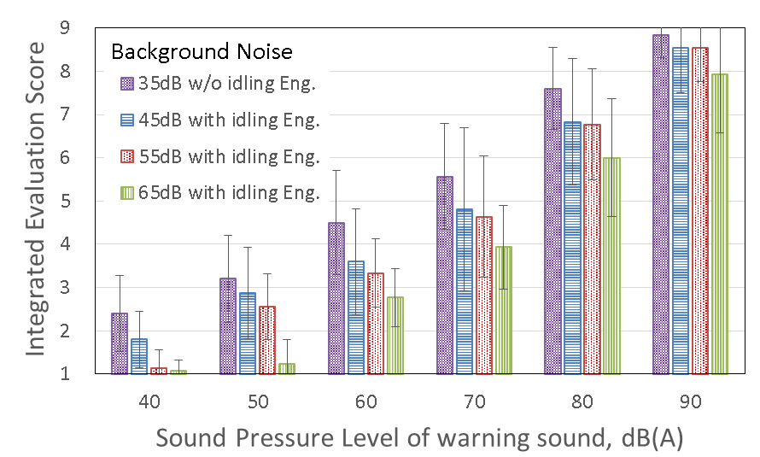
Question : Integrated Evaluation Score
Please evaluate the total impression of the warning sound in nine stages
Tonal Sound (2.1kHz)
Broad Band Sound
The result which is higher than score 3 and lower score 7 is appropriate for “Normal mode” limit value.
Taking into account normal BGN L_{Aeq}, appropriate limit values are as follows.
Lower limit value of "Normal mode" : 50 - 60dB
Upper limit value of "Normal mode" : 70 - 80dB

Slide 6
Conclusion
Results from large number of research data, the following index of BGN at 3 areas are appropriate.
(All levels are L_{Aeq}. )
High BGN area : 65dB -
Normal BGN area : 40 - 65 dB
Low BGN area : - 40 dB
Taking into account normal BGN L_{Aeq}, appropriate limit values are as follows.
Lower limit value of "Normal mode" : 50 - 60dB
Upper limit value of "Normal mode" : 70 - 80dB
The proposal of Germany and Japan is verified by these data, too.
Normal mode limit value (GRB-65-07) : Min. 58 dB, Max. 78 dB
Range of limit value should be taking into account numerical variation of sound level.

