Slide 1


Transmitted by Uber
VMAD-04-10
Building a Framework for Self-Driving Safety
October 2019
David Stamm - Product Safety

Slide 2
Safety Perspectives
Industry Perspective
Consumer Perspective
Industry Standards
Regulation
Engineering methods
Best practices
Safety frameworks
Is this vehicle safe to operate on the road?
Am I safe when near this car?
Am I safe when in this car?

Slide 3
Safety Perspectives
Industry Perspective
Consumer Perspective
26262, 21448, 21434, 9001, 16949, STPA, FMEA, FTA, ETA, HazOp, FMEDA, HARA, FMVSS, CMVSS, Voluntary Safety Self Assessment, RSS, DOT Framework for Test Cases, and more….
Is this vehicle safe to operate on the road?
Am I safe when near this car?
Am I safe when in this car?

Slide 4
Capabilities & Limitations
ISO 26262 Scope
Series production vehicles
Specific vehicle classes
Electrical and Electronic Systems (E/E systems)
Hazards resulting from malfunctioning behavior of E/E systems
ISO 26262 Limitations
Assumes human driver in the loop
Unique E/E systems in special purpose vehicles
Nominal E/E performance is out of scope
Preferred methodologies for objectives are loosely defined
ISO 21448 Scope
E/E systems and actuators
Performance limitations or insufficient situational awareness, with or without reasonably foreseeable misuse
Impact from car surroundings (other users, “passive” infrastructure, environmental conditions: weather, Electro-Magnetic Interference…)
ISO 21448 Limitations
ADAS Level 2+ requires tailoring & additional considerations
Cybersecurity attacks
Audit and assessment by 3rd parties
Preferred methodologies for objectives undefined
Notes:
ISO is designed for “typical” E/E systems found in series production autos.
Not scoped for unique or niche E/E systems that may exist on AVs

Slide 5


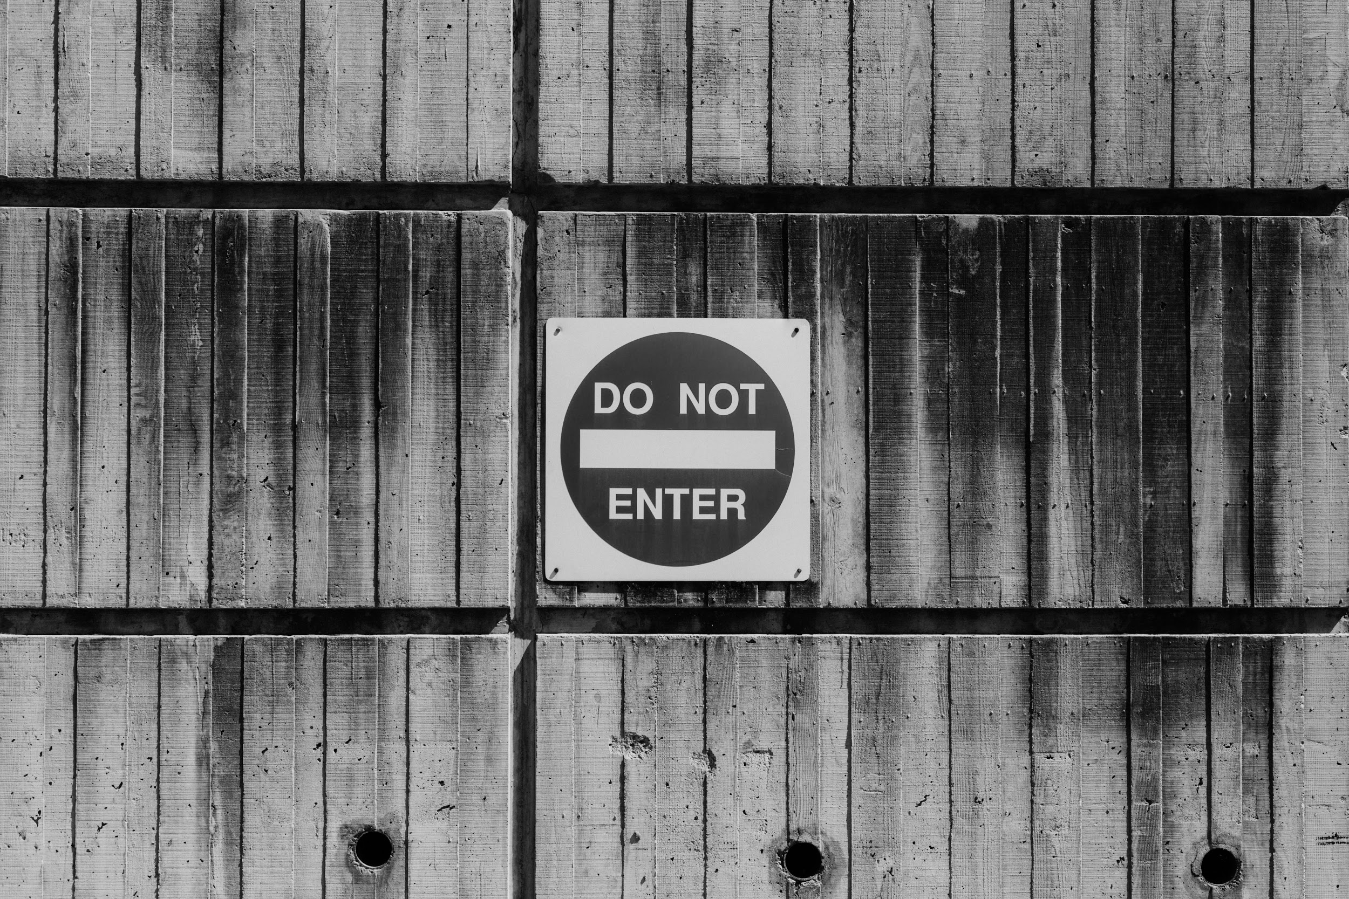
Application to SDVs
Applicable
SDV element fits fully in the intended scope and application. No tailoring or bespoke argumentation required.
Applicable w/ tailoring
SDV element is out of the intended scope, but with tailoring and additional safety argumentation the method can be utilized.
Not Applicable
The method is not appropriate to be applied to the SDV element

Slide 6
State of the art Standards & Frameworks
= applicable;
= applicable with tailoring;
= not applicable;
= optional;
 | ISO 26262 | ISO 21448 | UL 4600 | FMVSS | RSS
Perception Sensors
Compute Hardware
Compute Software
Machine Learned Models
Steering, Braking, Powertrain Control Actuators
Body Controls
Operational Training
Notes:
This matrix is by no means comprehensive. It is meant to be illustrative of the concept only. There are literally dozens of standards we could add here. But with just these few we can illustrate our point.
not one standard covers the robust engineering AND the robust testing of an SDV.
As soon as you agree we have dozens of standards that apply in full or part, you are burdened with applying them correctly. This is accounted for in process tailoring by many standards. But there is a limit, you can only tailor so far.
How do you make a convincing argument for safety on a COMPONENT when you have tailored the standards that apply to it?
How do you make a convincing argument for safety on a SYSTEM when you have COMPONENTS following tailored standards?

Slide 7

Omissions
After all the state of the art process is applied…
All process tailoring is complete…
All best practices have been applied...
Do we have gaps?
ISO 31000
ISO 21448
RSS
FMVSS
TS 16949
ISO 9001
ISO 26262
NCAP
ISO 21434
Notes:
After we apply all of the SoA methods, and we have tailored them as best we can, do we have a complete safety argument? No.
Why? There is not a standard to follow for every aspect of the Self-Driving Enterprise.
Remember the black bars from the last slide? We have no standard coverage in some areas.
Bespoke safety arguments must be created to cover these gaps.
Due to all of these partial applicability, and inapplicability of some standards, as well as the gaps in standards coverage you can see we need to tell a very careful story about how all of these elements work together for the job of safety. The complexity in the elements, the standards, their applicability makes this a complex story to tell.

Slide 8
Oil/Gas/Chemical
1990: Cullen Report recommendation following Piper Alpha Inquiry
FDA
2010: Assurance Case Report—510(k) submissions
FAA
1995: Aircrew Fatigue Alternate Means of Compliance
Rail
2003: EN 50129
UK Ministry of Defense
mid 1990s: JSP 430 and DEF STAN 0056
ISO 26262
2011
Safety Case in other industries
Nuclear
2012: IAEA SSG-23 and GSG-3
FAA
2005: Pilot training Alternate Means of Compliance
Notes:
The safety case started as a response to the Piper Alpha disaster where 167 people lost their life on a offshore oil rig. The Cullen report suggested the creation of a safety case. In the years following other industries have begun to adopt this approach, occasionally going by other names.

Slide 9
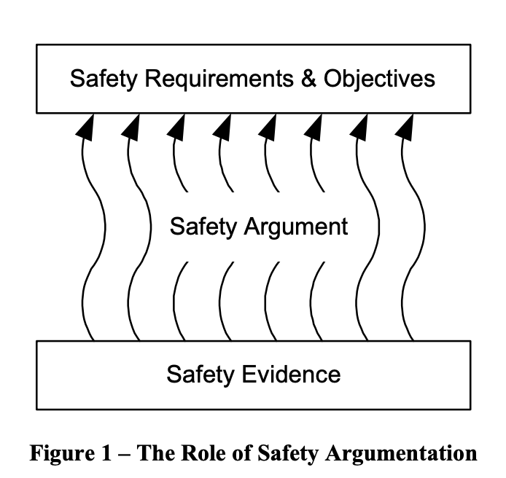
Why is Uber ATG using a safety case?
No singular piece of evidence captures the totality safety.
Complex interactions and relationships exist between the elements.
Evidence without an argument is trivial
An argument without evidence is baseless
Notes:
Because of the multiple pieces of evidence and their complex interactions, we need a way to tie them together.
A safety case links evidence to the top claim through a structured argument.

Slide 10
Challenges
Safety case pitfalls
Logical errors in the development of the argument
Errors in the relation of evidence to satisfying a goal
Incomplete decomposition of top level goal
Onerous to review by external entities
Organizational failure - box checking, paper exercise, parity with product
Notes:
A safety case is not a silver bullet. As safety cases have been around in other industries for some time now, several pitfalls have been found with them. We wholly recognize and accept the challenge. The eradication of these pitfalls are the reason we took an open and transparent approach to sharing our safety case.

Slide 11
Challenges
Safety case pitfalls
Logical errors in the development of the argument
Errors in the relation of evidence to satisfying a goal
Incomplete decomposition of top level goal
Onerous to review by external entities
Organizational failure - box checking, paper exercise, parity with product
These challenges can be met through transparency and broad stakeholder scrutiny.
US Chemical Safety Board: “the safety case has not failed. It is still accepted as the most effective way of managing major hazard industries. When properly applied it is indeed effective”
Notes:
Transparency and collaboration address many of the pitfalls of safety cases.
Organizational failure would be addressed through thoughtful independent peer review. Uber ATG feels that no single person or entity is perfectly positioned or skilled to review the safety case in totality. Thus multiple SME in different areas of the safety case would be needed to review the final safety case.

Slide 12

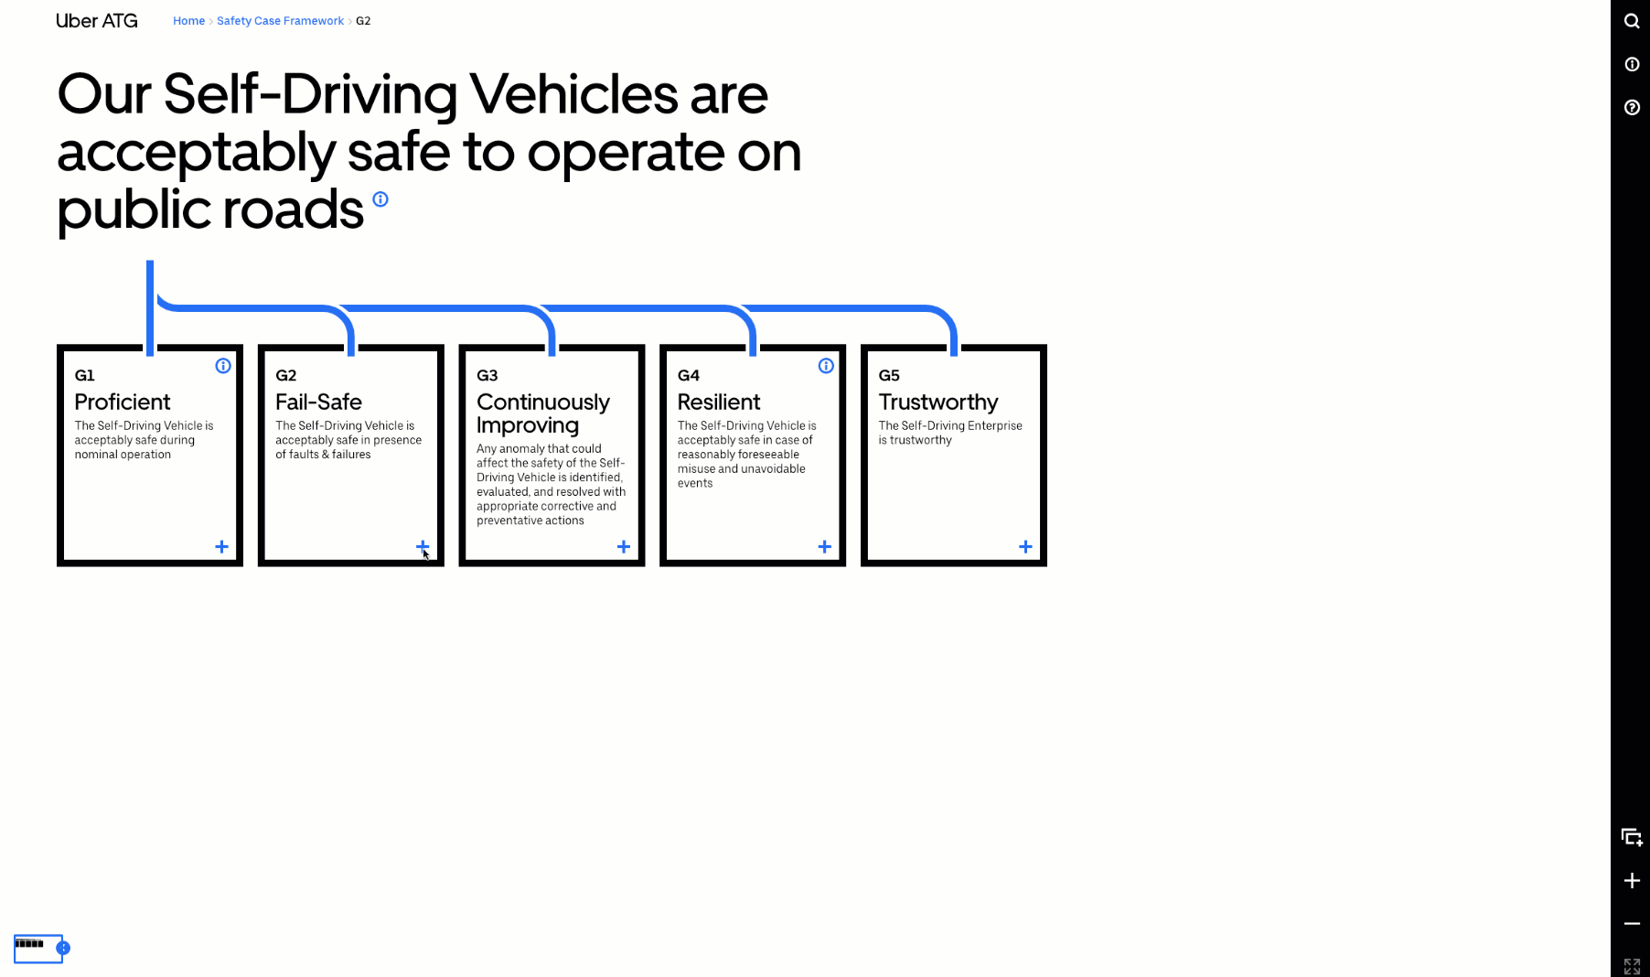
Uber ATG Safety Case Framework
Publicly released to address common pitfalls
Leverages the outputs of existing standards
Logically relate evidence to the top claim
Enables more effective review of safety argument
Notes:
As we have shown a safety case is not a silver bullet.
At ATG we aim to use the framework to harmonize all of the SoA safety initiatives
By plugging these work products into the framework as evidence the industry can agree on their applicability and place in the safety of the enterprise.
We aim to lean on transparency to help ensure the argument is sound

Slide 13
A completed safety case
Is:
A structured framework that includes the safety elements of FAVP 2.0/3.0
A clear and defensible argument
A useful tool to evaluate holistic efforts to promote safety including insight into the safety culture and development process of a company
Addresses operational safety
Includes voluntary standards
Is Not:
A regulatory framework
A single standard that addresses AV safety
A new test procedure with new metrics
A checklist

Slide 14
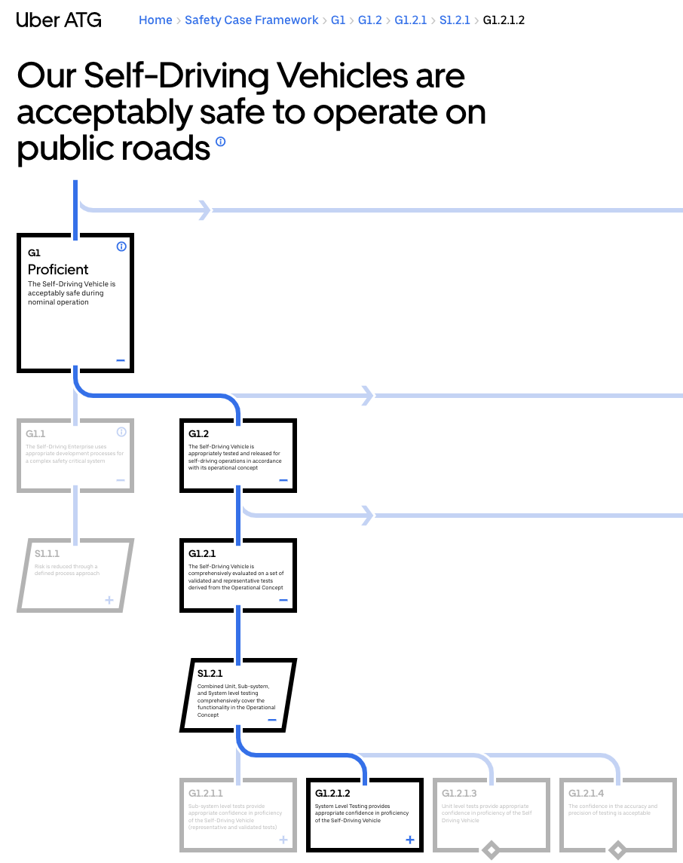
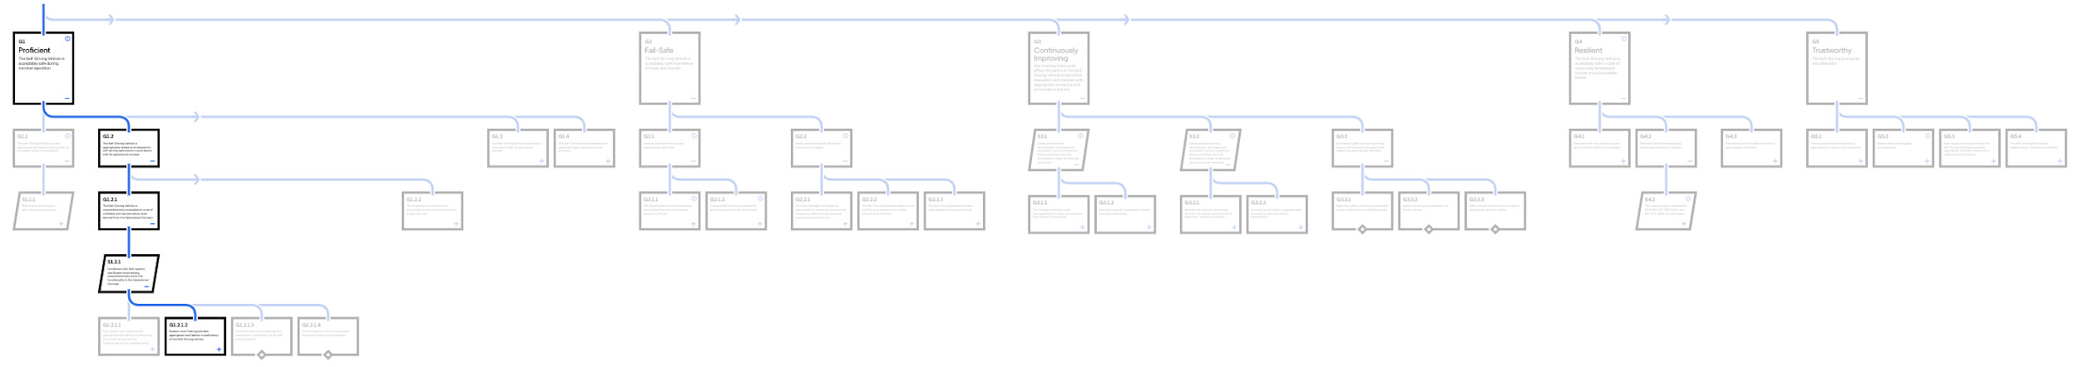
Safety is more than testing

Slide 15
Testing & The Safety Case
The goal of testing
Comprehensive, validated, and representative testing is the goal.
Unit, subsystem, system testing based on the ODD can achieve comprehensive coverage if done properly.
Validation of testing focuses on the precision and accuracy of the test results.
Representative testing derives from the ODD and misuse cases.
The structured argument
Testing must be done in context of a structured argument for safety.
Linkage of testing to safety goals is key.
Evidence without argument is trivia
Claims without evidence is baseless
Notes:
Focus on the three main keywords and break them down
Comprehensive
Validated
Representative
Testing results must be shown to satisfy these goals through a structured argument; else we risk trivia or baseless claims of safety
Note that the work of VMAD is addressing these keywords and we look forward to working with the WP to integrate and use the recommendations to hep satisfy these goals.

Slide 16
The Road Ahead
We invite critical feedback
We realize this framework is imperfect in its current form. It will take time to both finalize and fulfill.
We hope this framework can serve as a jumping off point for broadening the conversation.
We will listen and refine our approach based on emerging standards and feedback from our peers, policymakers, other key stakeholders.
Share, borrow, build
Freely use and build on this framework, whether in partnership with us or independently. No permission or attribution required.
We will be publishing further depths of the framework in the coming months.
We wish to collaborate on safety. We are willing to share openly to get started on a safe path forward, together.
Notes:
Double down on: Existing safety standards are disparate; we want to coalesce around a framework that the industry can use, but we won't get there without collaboration. We have to play nice on safety, and we want to help facilitate a constructive dialogue. .
We feel a responsibility to:
communicate with sincerity; there is no single test, threshold metric, or magic formula that will establish safety
make our work accessible to the public and their representatives; listen and hear the feedback
share knowledge within industry for both individual and greater good

Slide 17
