Slide 1
Submitted by the experts of the Informal Working Group (IWG) on TYRE GTR
Document TYREGTR-25-XX
Informal document GRB-70-XX
70th GRBP 11-13 September 2019
Agenda item 6 (e)
Amendment # 2
to UN GTR No. 16 on Tyres

Slide 2
Subject of Amendment No. 2 to UN GTR No. 16 as authorized by AC.3
Reference: Authorization ECE/TRANS/WP.29/AC.3/48
Amendment of the GTR text:
  Amendment to the GTR 16 scope
  Addition of new definitions (Section 2)
  Harmonization of the Load Range concept in relationship to Inflation Pressure (Section 2)
  Alignment of the provisions with the most recent developments in UN Regulations Nos. 30 and 54 (Sections 3.3 and 3.5, Annexes 3 and 6)
  Harmonization of FMVSS 139 requirements relative to UNECE PSI index
  (Sections 3.14 and 3.15)
  Addition of new harmonized provisions for physical dimensions of LT/C tyres (new Section 3.5.2; old Sections 3.20 & 3.21 to be deleted)
  Addition of new harmonized provisions for high speed test for LT/C tyres
  (new Section 3.6.2.2, old Section 3.16 to be modified with endurance test only, old Section 3.19 to be deleted)

Slide 3
What is submitted to GRBP
ECE/TRANS/WP.29/GRBP/2019/21: Proposal for Amendment No. 2 to UN GTR No. 16 (Tyres)
ECE/TRANS/WP.29/GRBP/2019/20: Proposal for the Technical Report on the development of Amendment No. 2 to UN GTR No. 16 (Tyres) – complements ECE/TRANS/WP.29/GRBP/2019/21
GRBP-70-02: Proposed modifications to the current version
of UN GTR No. 16 (highlighted in green)
GRBP-70-XX: Proposal for amendments to ECE/TRANS/WP.29/GRBP/2019/21

Slide 4
Part I: Statement on Technical Rationale and Justification - Updated
Not highlighted in GRBP-70-02
New Executive Summary
New paragraphs 2bis, 3bis, 22bis (substituting 23bis), 28ter
(old 28ter moved to 28quinquis), 28quater, 28sexies
to update the content of the existing Part I
New paragraphs 49 to 93 – Justification of the content
of Amendment No. 2

Slide 5
Part II:
New Harmonized Provisions
a. Physical Dimensions
Addition of new harmonized provisions for physical dimensions of LT/C tyres
(new Section 3.5.2 old Sections 3.20 & 3.21 to be deleted)
Subdivision in 3 categories:
  Physical dimension for metric sizes (excluding all sizes listed in Annex 6)
  Most stringent requirements from FMVSS 139/R54 retained
  Physical dimension for high flotation sizes (excluding all sizes listed in Annex 6)
  Requirements as per ECE/TRANS/WP.29/GRRF/2018/5 amended by GRRF-86-26,
  approved at the 86th GRRF session and submitted for adoption by WP.29/AC.1
  at the June 2018 session (ECE/TRANS/WP.29/2018/XX)
  Physical dimension for sizes listed in Annex 6 (Legacy)

Slide 6
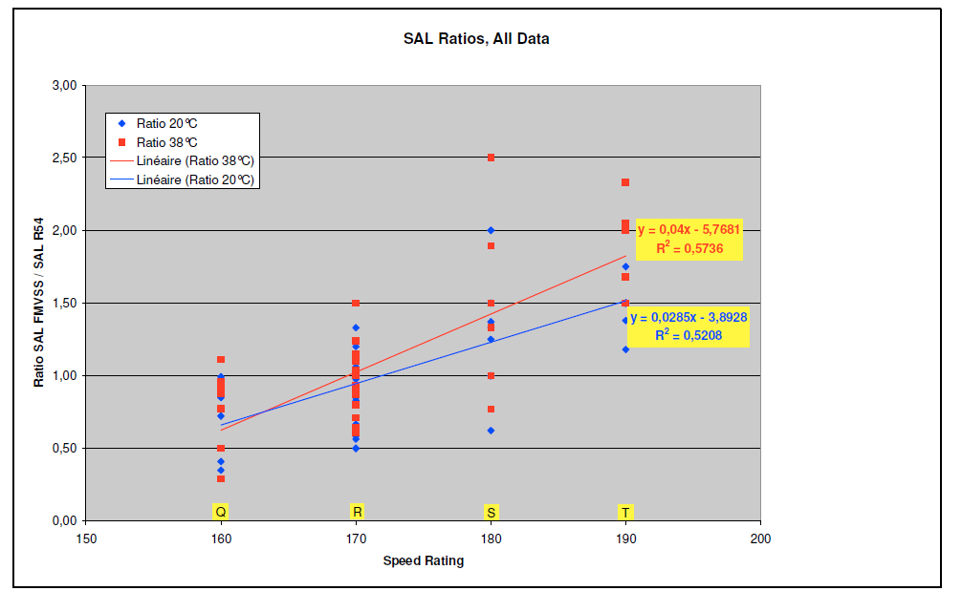
New Harmonized Provisions
b. High Speed Test
Assessment of FMVSS139 High Speed test vs R54 Load/Speed test made by tyre industry:
FMVSS 139 more severe
?
R54 more severe
Since available results did not allow to decide between R54 and FMVSS139 High Speed tests for ‘Q’ and ‘R’ Speed Symbols, one of the reasons of the extension of the IWG mandate by 2 years was requested and confirmed in order to give tyre industry the possibility to confirm the initial results on the High Speed harmonised test method.
17th IWG meeting endorsed the Industry High speed test program. Updated results and proposal were presented to IWG at its 18th session in June 2018.

Slide 7
New Harmonized Provisions
b. High Speed Test (Continued)
IWG TYRE GTR conclusion:
  Tyres with SS >/= S: Existing ECE Reg 54 HS test
    Final test speeds are based on the speed symbol of the tyre
    20° to 30°C ambient temperature
  Tyres with SS = R: test to 170 km/h (106 mph) at 38°C ambient temperature*
Modified ECE Reg 54 for SS </= R
  Test severity is equivalent
  Test efficiency (duration – impacting test lab capacity) is significantly improved
  All tyres with SS </= Q: test to 160 km/h (99 mph) at 38°C ambient temperature: existing FMVSS test

Slide 8





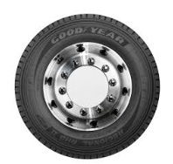
New Harmonized concepts:
a. Reference Test Inflation Pressure
Proposal by the industry:
Create a strong link between the test inflation and the tyre load rating
Industry Standards
Test Conditions
FMVSS 139
Test Condition
UN R 54
US CFR
Title 49
Transportation
Tire Stamping
Defined by the regulation
Loose relationship/Manufacturer’s decision
Proposal to para 2.61: “Reference Test Inflation Pressure applicable for LT/C tyres means the minimum cold inflation pressure for the maximum load rating of the tyre in single application;
This proposal brings clarity and coherence without changing the technical provisions intent

Slide 9
New Harmonized concepts:
b. Measuring Rim
Inconsistent usage of the term ‘Measuring rim’ in definitions and different sections of the GTR:
in some cases – a unique rim width; in other cases – any rim width
  IWG removed the concept of 'measuring rim' in the sense of rims on which a test is to be performed from GTR and replaced it by 'test rim' in line with the ISO definition.
  The GTR was made self consistent with regards to the rims to use for testing without referring to Standards Organisation

Slide 10
New Harmonized concepts:
c. Replacement of load range by a table referring to a Reference Test Inflation Pressure to define the test conditions coming from FMVSS
Reference Test Inflation Pressure Range (kPa) | Load range for Nominal section width
 | ≤ 295mm | > 295mm
170 – 199 | Not Applicable | B
200 – 299 | B | C
300 – 399 | C | D
400 – 499 | D | E
500 – 599 | E | Not Applicable

Slide 11
New Harmonized concepts:
d. Harmonized marking covering the maximum load rating and corresponding inflation pressure aligned to the reference inflation pressure
In the case of LT/C tyres, the maximum load rating and corresponding inflation pressure of the tyre,
to be shown as follows:
"Max load single ______ kg (_____ lb) at ____ kPa (_____ psi) cold
Max load dual ______ kg (_____ lb) at ____ kPa (_____ psi) cold"
For LT/C tyres rated for single fitment only, mark as follows:
"Max load single ______ kg (_____ lb) at ____ kPa (_____ psi) cold "
The inflation pressure marked for single application shall be taken as the Reference Test Inflation Pressure,
unless a different value for the Reference Test Inflation Pressure is marked separately as follows:
"Max load single ______ kg (_____ lb) at ____ kPa (_____ psi) cold
Max load dual ______ kg (_____ lb) at ____ kPa (_____ psi) cold
TEST AT: ______ kPa*“
For LT/C tyres rated for single fitment only, mark as follows:
"Max load single ______ kg (_____ lb) at ____ kPa (_____ psi) cold
TEST AT: ______ kPa*"
*May be replaced by « TEST INFL : » or the symbol « @ »
In line with the definition of the Reference Test inflation Pressure, the inflation pressure marked for single application (and dual application if applicable) shall be equal or higher than the Reference Test Inflation Pressure.

Slide 12
New Harmonized concepts:
e. Clarification of the concept of maximum load rating and load capacity of a tyre.
The introduction of the concept of the Reference Tyre Inflation Pressure brought some inconsistency with FMVSS 139, which defines inflation pressure in relation to the tyre load carrying capacity. To harmonize these concepts, reference test inflation pressure was introduced to clearly define inflation pressure in relation to the maximum load rating.
2.34. "Load index" means a numerical code which indicates the maximum load rating.
The list of these indices and their corresponding reference loads is given in Annex 2;
2.40. "Maximum load rating" means the reference mass corresponding to the load index used to define the load capacity of the tyre;
2.61. "Reference Test Inflation Pressure" applicable for LT/C tyres means the minimum cold inflation pressure for the maximum load rating of the tyre in single application;

Slide 13
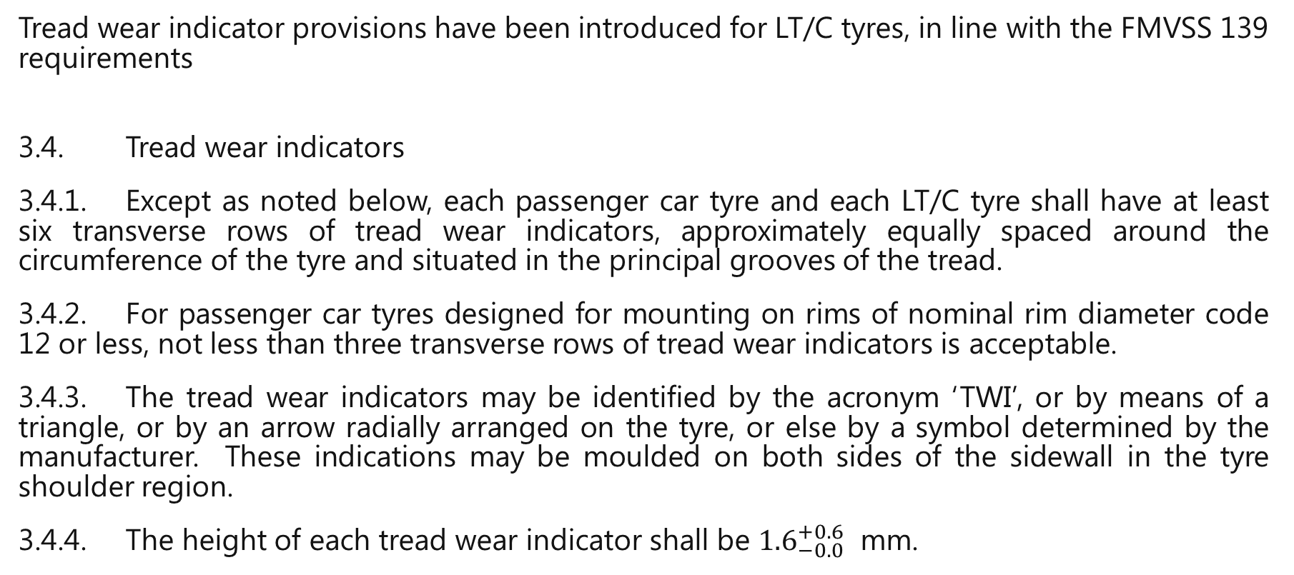
New Harmonized concepts:
f. Introduction of harmonized provisions of the Tread Wear Indicator for LT/C tyres
Tread wear indicator provisions have been introduced for LT/C tyres, in line with the FMVSS 139 requirements
3.4. Tread wear indicators
3.4.1. Except as noted below, each passenger car tyre and each LT/C tyre shall have at least six transverse rows of tread wear indicators, approximately equally spaced around the circumference of the tyre and situated in the principal grooves of the tread.
3.4.2. For passenger car tyres designed for mounting on rims of nominal rim diameter code 12 or less, not less than three transverse rows of tread wear indicators is acceptable.
3.4.3. The tread wear indicators may be identified by the acronym ‘TWI’, or by means of a triangle, or by an arrow radially arranged on the tyre, or else by a symbol determined by the manufacturer. These indications may be moulded on both sides of the sidewall in the tyre shoulder region.
3.4.4. The height of each tread wear indicator shall be ${1.6}_{−0.0}^{+0.6}$ mm.

Slide 14
New Harmonized concepts:
g. Introduction of test equipment tolerances specification guidelines
Annex 11 of UN GTR No. 16 was added to provide Contracting Parties with guidance on potential compliance tolerances for various values in the technical prescriptions of UN GTR No. 16.
It is at the discretion of a Contracting Party whether and how tolerances are applied in its national regulations when transposing UN GTR No. 16, understanding that unique tolerances could preclude mutual recognition.

Slide 15
Amendments reflecting Chinese and Indian proposals
A number of proposals made by China and India aimed at harmonization of the provisions of its domestic legislation with those of UN GTR No. 16 were considered as follows:
Table showing the relation between Load Range and Ply Rating
Number of tread wear indicators
Strength test: specific requirements for rim diameter codes 13 and below
China requirements for High-Speed test were considered together with the new provisions for the harmonized High Speed test
New Annex 11 was introduced in a table format including the requirements for test equipment
Assessment of the required and optional tyre markings
A new paragraph 1.2.(e) was introduced because some Class C3 tyres with Load Index between 122 and 131 that contain “LT” or “C”

Slide 16
Request to GRBP
GRBP is kindly requested to adopt the draft Amendment No. 2 to UN GTR No. 16 (ECE/TRANS/WP.29/GRBP/2019/21 as amended by GRBP-70-XX) together with the report (ECE/TRANS/WP.29/GRBP/2019/20) and submit those for consideration by WP.29 and AC.3.

Slide 17
Thank you for your attention!

