Slide 1
Detection Area Width
IWG-DPPS-5-09
Dirk-Uwe Gehring
BGS Böhme & Gehring GmbH
DPPS IWG
London 04 Sept 2019

Slide 2
Background
Width of the area intended to detect a pedestrian should be as independent as possible from
  Width of the deployable system (bonnet, airbag, etc.)
  Outer contour of the vehicle front (V-shape)
  Other vehicle parts (e.g. bumper beam)

Slide 3
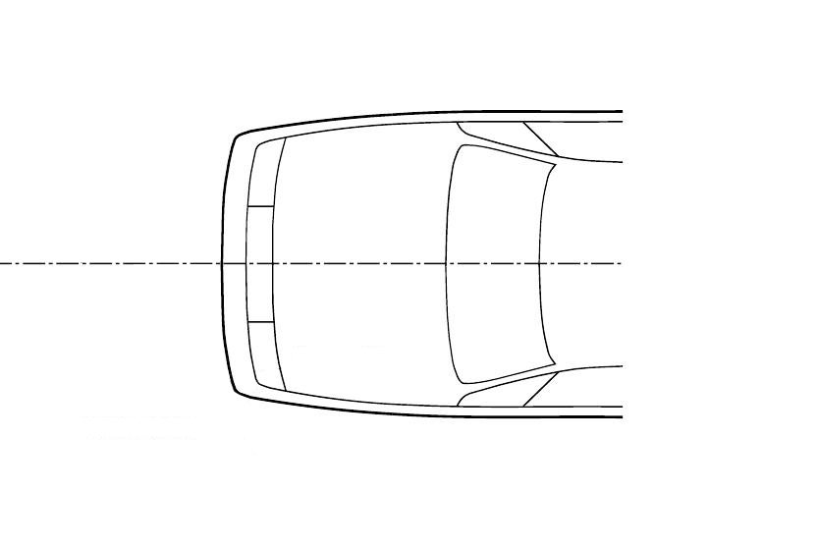
Proposal
New definitions for clarification:
„Detection area“:
The area that is designated to detect a pedestrian in order to initiate the activation of the deployable system
„Relevant vehicle width“:
Maximum width of the whole vehicle without rear view mirrors or cameras, measured at the longitudinal position of the centre of the front wheel(s).
Detection Area

Slide 4
Proposal
The width of the detection area shall be the relevant vehicle width (RW), minus a distance from each side of max. [12,5]% of the RW but not more than [250]mm.
The detection area must not be smaller than the bumper test area (BTA).
[Headform test points located further outside than the detection area shall comply with the requirements also with the bonnet in the undeployed state.]
S
S
Detection Area (DA)
Relevant Vehicle Width (RW)
(S ≤ 12.5% * RW and S ≤ 250 mm and DA ≥ BTA)

Slide 5
Thank you

