Slide 1
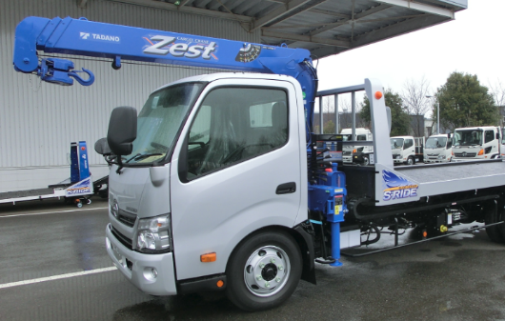
OICA Proposal for amendment to GRSG/2019/25 (BSIS)
【Proposal】 Paragraph 2.16 amend to read:
2.16. "Vehicle front right corner" means the projection of the point that results from the intersection of the vehicle side plane (not including devices for indirect vision) and the vehicle front plane (not including devices for indirect vision and any part of the vehicle which is more than 2m above the ground.) on the road surface.
【Justification】
Since the crane boom of the crane truck protrudes from the front of the cab,
the position of the vehicle front plane is changed from the standard vehicle.
crane boom
VRU-Proxi-11-04

