Slide 1
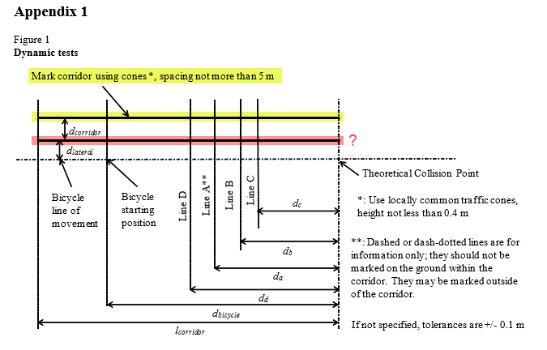


VRU-Proxi-11-10
Questions:
Does the arrow in the picture 1 mean that the cones shall be only on the far side of the vehicle?
How can one form the corridor with the bicycle dummy (6.5.1.) as it shall be 1,25 or 1,45 m away from the corridor?
If the cones are only on the far side, there will never be a possibility to get an information signal when passing the cones. So why 6.5.8.? And why having a certain height of the cones (figure 1)?
If the cones shall be also on near side they partly hide the view to the bicyclist, see next slide. That is a problem, especially as the system has difficulties to track the bicycle that far behind because of sensor limits.

Slide 2
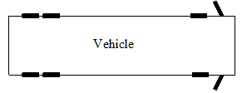
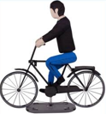
Top view of test
Cones max 5 m spacing
1,25 m
4,25 m
Sensor shadow from cone

