Slide 1
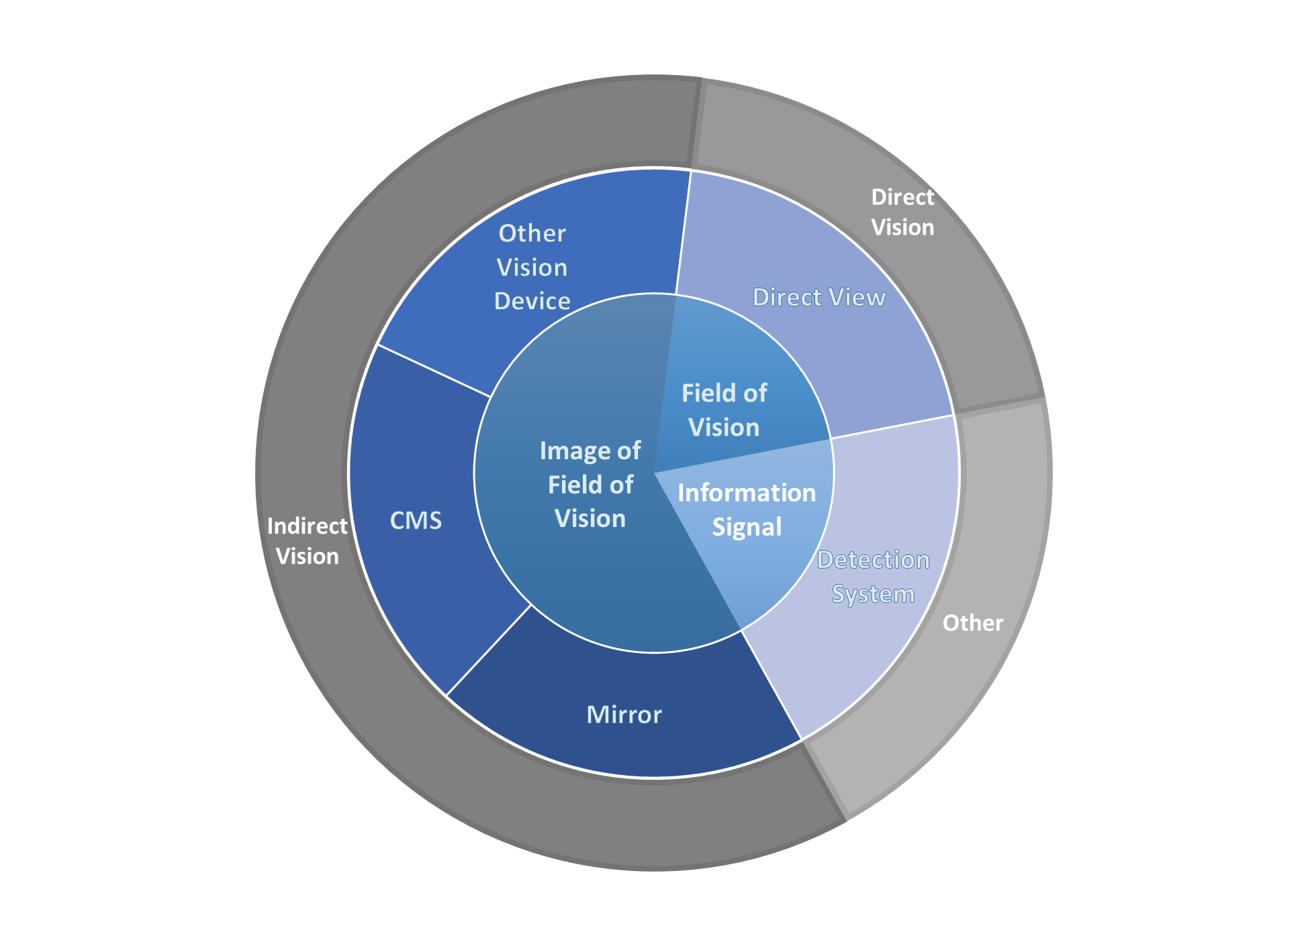
VRU-Proxi-11-13
Definition: 2.1 „Devices for reversing motion “
Definition: 2.1.6 „Close-proximity rear view device“
Updated from OICA Proposal
Definition: 2.1.2 „Other Devices for indirect vision“
Definition: 2.1.8 „Field of Vision“
Definition: 2.1.1 „Rear-View Camera (RVC)“
RVC
Definition: 2.1.4 „Detection System“
Titel 17 „ Requirements for detections ytems“
Titel 16 „Requirements for devices for indirect vision other than mirrors“
Definition: 2.1.3„Mirror“

