Slide 1
16th TFCS Meeting in Tokyo
Meeting Date: 12-14 November 2019
Venue: JASIC(Japan Automobile Standards Internationalization Centre) Meeting Room
7th Floor, Zennihon Truck Sogo Kaikan,
3-2-5 Yotsuya, Shinjuku-ku
Tokyo 160-0004, JAPAN
Phone: (+81-) 03-5362-7751

Slide 2
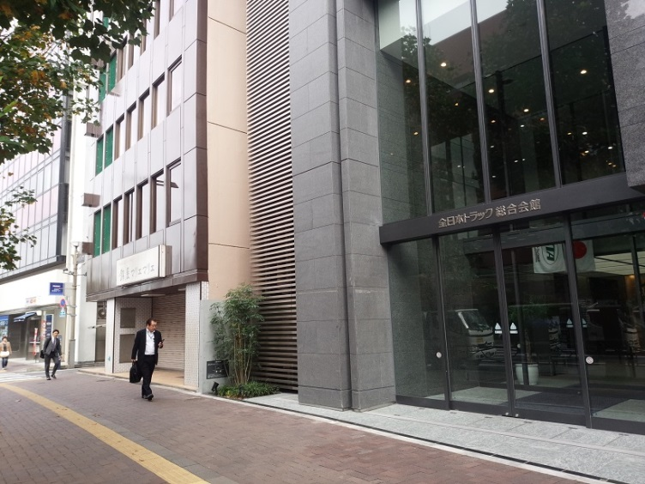
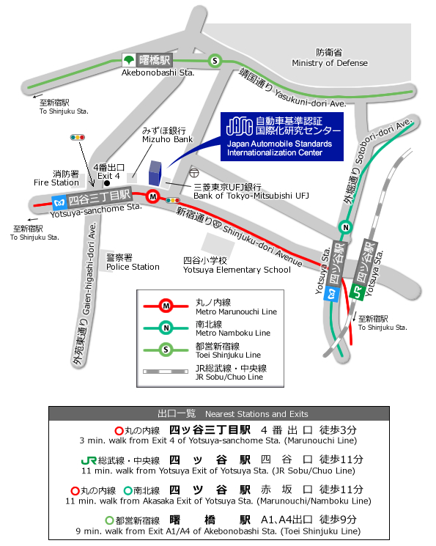

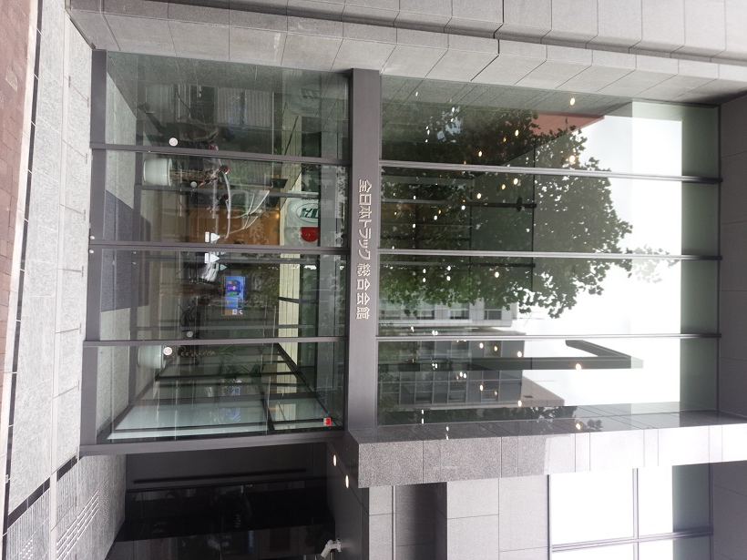
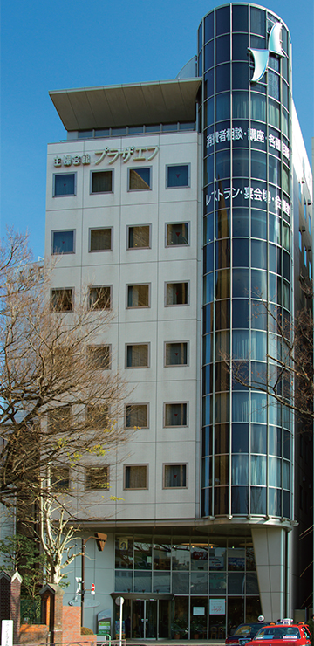

JASIC NEW OFFICE (since August 2014)
7th floor, Zennihon Truck Sogo Kaikan., 3-2-5 Yotsuya, Shinjuku-ku, Tokyo 160-0004
〒160-0004 東京都新宿区四谷三丁目２番５ 全日本トラック総合会館７階
PHONE 03-5362-7751
(Toward the direction of our previous office)
On the 7th Floor
This building!
DON’T GO THIS WAY!!
This building!
Plaza F
(welcome reception)
ENTRANCE OF THE BUILDING

Slide 3
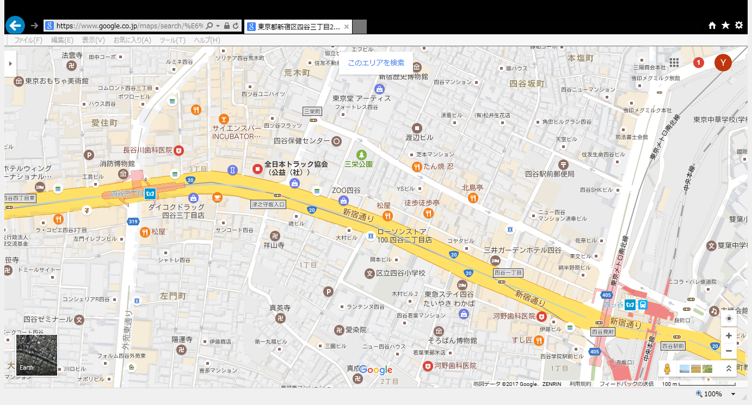
From Yotsuya Station UJR & Metro) or Yotsuya sanchome Station (Metro) to JASIC on Google Map
HERE!
Yotsuya sanchome Sta.
Shinjuku-dori Avenue
Yotsuya Sta. (JR & Metro)

Slide 4
Accommodations
Hotel Name (En) | Hotel name (Jpn) | URL | Access to the nearest station
TOKYO DOME Hotel | 東京ドームホテル | http://www.tokyodome-hotels.co.jp/e/ | 5 minutes walk to Suidobashi Sta.
Hotel Agnes | アグネスホテル | http://www.agneshotel.com | 5 minutes walk to Iidabashi Sta.
Arcadia Ichigaya | アルカディア市ヶ谷 | http://www.arcadia-jp.org/access_english.htm | 1 minute walk to Ichigaya Sta.
Tokyo Green Palace | 東京グリーンパレス | http://www.tokyogp.com/english/index.html | 1 minute walk from Kojimachi Station (Yurakucho Subway Line) 7 minutes walk from Ichigaya Station (JR Sobu Line or Yurakucho / Namboku Subway Line )
APA Hotel (Shinjuku Gyoemmae) | APAホテル＜新宿御苑前＞ | http://www.apahotel.com.e.ju.hp.transer.com/language/shutoken/33_shinjukugyoenmae.html | 1 minute walk to Sinjukugyoen Sta.
Shinjuku CITY Hotel N.U.T.S Tokyo | 新宿 CITY HOTEL N. U. T. S 東京 | http://hotel-nuts.com/eng/index.php | 5 minutes walk to Shinjyuku-gyoenmae Sta.
Hotel New Otani | ホテルニューオータニ | http://www.newotani.co.jp/tokyo/ | 5 minutes walk to Akasaka-mitsuke Sta.
ANA Intercontinental Tokyo | ANAインターコンチネンタルホテル東京 | http://www.anaintercontinental-tokyo.jp/e/access/ | 5 minutes walk to Tameike-Sanno Sat.
KEIO Plaza Hotel | 京王プラザホテル | http://www.keioplaza.com/ | 10 minutes walk to Shinjuku Sta.
Hyatt Regency Tokyo | ハイアットリージェンシー東京 | http://tokyo.regency.hyatt.com/en/hotel/home.html | 10 minutes walk to Shinjuku Sta.
The Capital Hotel Tokyu | キャピトルホテル東急 | http://www.capitolhoteltokyu.com/en/index.html | Direct access to Tameike-sanno Sta./Kokkai-gijidomae Sta.
Akasaka Excel Hotel | 赤坂 エクセルホテル東急 | http://www.tokyuhotelsjapan.com/en/hotel/TE/TE_AKASA/index.html | 1 minute walk to Akasaka-mitsuke Sta.
Hotel WING International | Hotel WING International | http://www.hotelwingjapan.com/ | 5 minutes walk to Yotsuya-sanchome Sta.
Hotel keihan | ホテル京阪 | https://yotsuya.hotelkeihan.co.jp/#_ga=2.194408616.483228356.1568171547-1317377426.1568171547 | 5 minutes walk to Yotsuya Sta.
TOKYU STAY YOTSUYA | 東急ステイ四谷 | http://www.tokyustay.co.jp/e/hotel/YOT/ | 3 minutes walk to Yotsuya Sta.

Slide 5
Other Information
JASIC Website
https://www.jasic.org/e/03_location/location.htm
Narita Airport Website
http://www.narita-airport.jp/en/index.html
Haneda Airport Website
http://www.haneda-airport.jp/inter/en/
JR lines in the Tokyo area
https://www.jreast.co.jp/e/downloads/
Tokyo Metro Guide
http://www.tokyometro.jp/en/index.html
General information on Japan
http://www.jnto.go.jp/eng/
General information on Tokyo
http://www.gotokyo.org/en/index.html

