Slide 1

Informal document WT-03-03
(3th GRBP WGWT IWG,
Geneva,
10th-11th , September 2019.)
Comments on Document WT-02-02
for tyre buffing
China Automotive Technology and Research Center Co., Ltd.
1
Notes:
1

Slide 2
Table of Contents
Wear Profile Scenario
Buffing Tolerance
Additional Information
Conclusions
2

Slide 3
Wear Profile Scenario
3

Slide 4
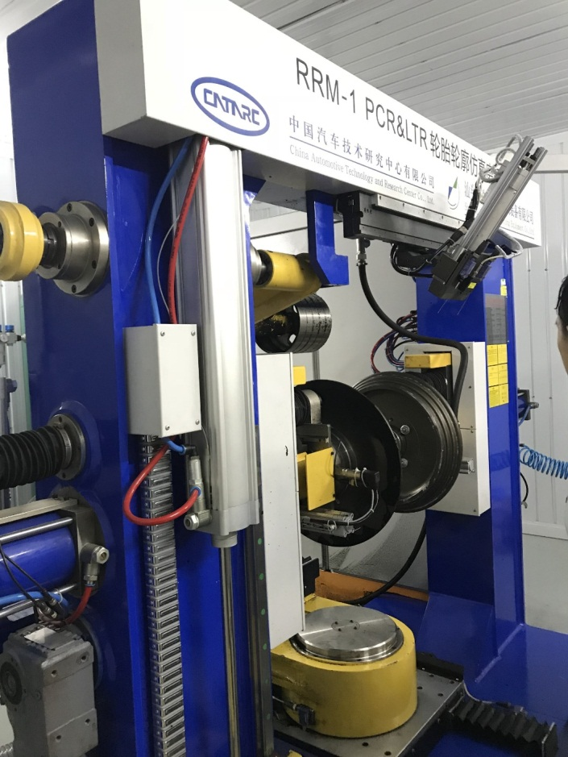
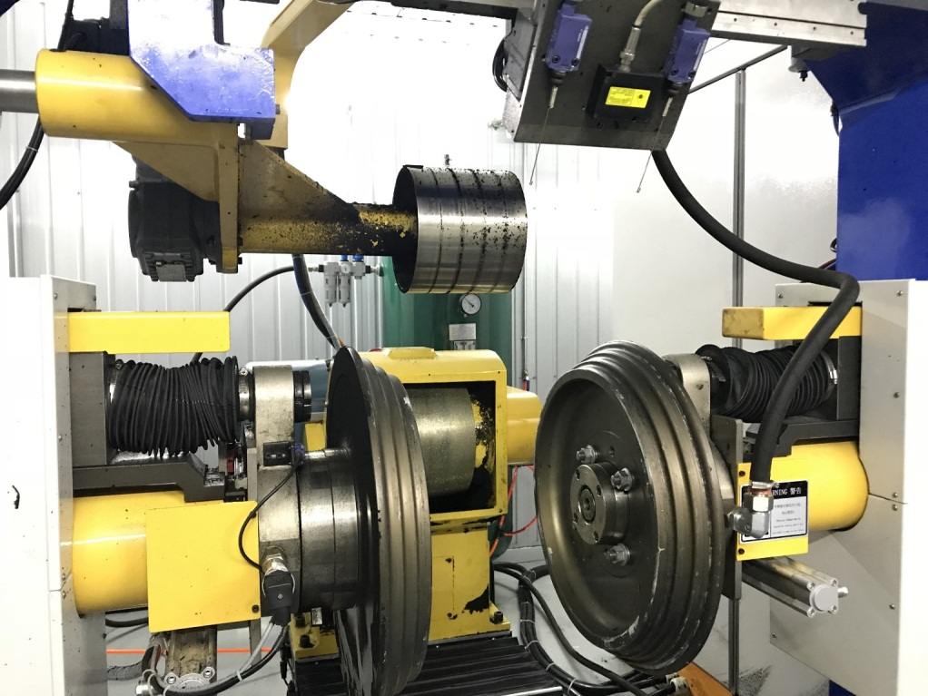
Buffing Machine
Driving wheel
Rim base
Grinding wheel
4

Slide 5
Buffing Machine Parameters
Technical Parameters
Tyre outer diameter | PCR/LTR 550mm - 1000mm
Nominal rim diameter | 14'-19'（Depend on test rims, maximum 30'）
Section width of Tyre | PCR/LTR 150mm - 400mm
Control limit of Tyre pressure | Max. 500kPa
Buffing device | Grinding wheel feed speed : 1.2mm/s - 5mm/s
 | Grinding wheel feed speed accuracy : ±0.02mm
 | Buffing tolerance of each measurement point : ±0.2mm
5

Slide 6
Tyre Status During The Buffing
Example 1
Example 2
Before buffing
Before buffing
After 2.45mm offset buffing
After 50% offset buffing
6

Slide 7
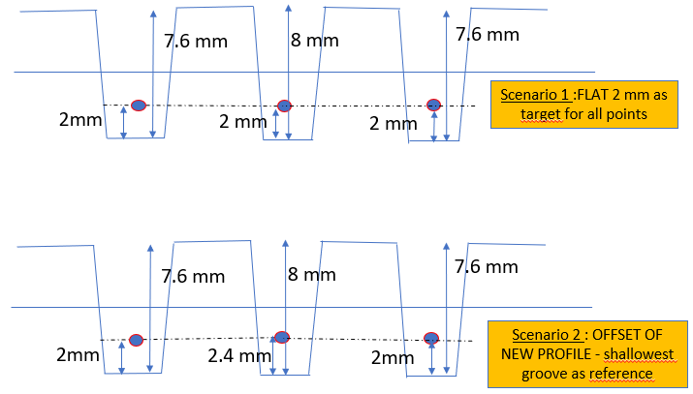
Wear Profile Scenario Comments
Following the document presented by ETRTO( WT-02-02 ), two scenarios for principal grooves are still under discussion as below:
Relevant experiences
Buffing test amounts : Totally 24 Tyres. Buffing tests in 2018:
  Flat profile : 8 tyres.
  Offset profile : 16 tyres.
Comment:
Both scenarios can be achieved according to the current practices.
Additional assessments are needed to determine which scenario is better.
7

Slide 8
II. Buffing Tolerance
8

Slide 9
Example 1
Model : 245/40 R18
Scenario : 2.45mm offset buffing
Remark : This is a conventional grinding scenario that the tolerance is allowed to accumulate on both sides.
 | Tyre 1 |  |  |  | Tyre 2
Groove | B | C | D | E | B | C | D | E
Average tread-depth before buffing | 6.85 | 6.96 | 6.94 | 6.74 | 6.97 | 7.08 | 7.05 | 6.83
Buffing target(2.45mm offset) | 4.40 | 4.51 | 4.49 | 4.29 | 4.52 | 4.63 | 4.60 | 4.38
Average Buffing target | 4.42 |  |  |  | 4.53
Average Individual tread-depth after buffing | 4.62 | 4.69 | 4.62 | 4.38 | 4.48 | 4.55 | 4.48 | 4.26
Average tread-depth after buffing | 4.58 |  |  |  | 4.45
Deviation of Average Individual tread-depth | 0.22 | 0.18 | 0.13 | 0.09 | (0.03) | (0.07) | (0.11) | (0.12)
Deviation of Average tread-depth total measurements | 0.16 |  |  |  | (0.09)
 | Tyre 3 |  |  |  | Tyre 4
Groove | B | C | D | E | B | C | D | E
Average tread-depth before buffing | 6.87 | 6.98 | 6.96 | 6.76 | 6.90 | 7.01 | 6.98 | 6.75
Buffing target(2.45mm offset) | 4.42 | 4.53 | 4.51 | 4.31 | 4.45 | 4.56 | 4.53 | 4.30
Average Buffing target | 4.44 |  |  |  | 4.46
Average Individual tread-depth after buffing | 4.58 | 4.69 | 4.64 | 4.30 | 4.61 | 4.70 | 4.64 | 4.40
Average tread-depth after buffing | 4.55 |  |  |  | 4.58
Deviation of Average Individual tread-depth | 0.17 | 0.17 | 0.12 | (0.01) | 0.17 | 0.14 | 0.10 | 0.10
Deviation of Average tread-depth total measurements | 0.11 |  |  |  | 0.13
9

Slide 10
Buffing Tolerance of Example 1
Upper limit
245/40 R18
(2.45mm offset buffing )
Lower limit
10

Slide 11
Example 2
Model : 225/45 R19
Scenario : 50% offset buffing
Remark : The tolerance is only allowed to accumulate on one side.
 | Tyre 1 |  |  |  | Tyre 2
Groove | B | C | D | E | B | C | D | E
Average tread-depth before buffing | 7.19 | 7.46 | 7.36 | 6.95 | 6.92 | 7.34 | 7.33 | 6.85
Buffing target | 3.60 | 3.73 | 3.68 | 3.48 | 3.46 | 3.67 | 3.66 | 3.42
Average Buffing target | 3.62 |  |  |  | 3.55
Average Individual tread-depth after buffing | 3.90 | 3.86 | 3.76 | 3.74 | 3.62 | 3.62 | 3.45 | 3.39
Average tread-depth after buffing | 3.82 |  |  |  | 3.52
Deviation of Average Individual tread-depth | 0.30 | 0.13 | 0.08 | 0.27 | 0.16 | (0.06) | (0.22) | (0.04)
Deviation of Average tread-depth total measurements | 0.20 |  |  |  | (0.03)
 | Tyre 3 |  |  |  | Tyre 4
Groove | B | C | D | E | B | C | D | E
Average tread-depth before buffing | 6.34 | 6.86 | 6.76 | 6.26 | 6.84 | 7.28 | 7.28 | 6.76
Buffing target | 3.17 | 3.43 | 3.38 | 3.13 | 3.42 | 3.64 | 3.64 | 3.38
Average Buffing target | 3.28 |  |  |  | 3.52
Average Individual tread-depth after buffing | 3.62 | 3.52 | 3.40 | 3.49 | 3.87 | 3.87 | 3.66 | 3.60
Average tread-depth after buffing | 3.51 |  |  |  | 3.75
Deviation of Average Individual tread-depth | 0.45 | 0.09 | 0.02 | 0.36 | 0.45 | 0.24 | 0.03 | 0.22
Deviation of Average tread-depth total measurements | 0.23 |  |  |  | 0.23
11

Slide 12
Buffing Tolerance of Example 2
Upper limit
225/45 R19
(50% offset buffing )
Lower limit
12

Slide 13

Buffing Tolerance Comments
Following the document WT-02-02 , ETRTO considers buffing tolerance limits as follows：
Individual tread-depth: 2,0 +/- 0,4mm
Average tread-depth in principal groove: 2,0 +/- 0,3mm
Average tread-depth total measurements: 2,0 +/- 0,2 mm
Comments:
According to the current tests’ results, we consider that the buffing tolerance is acceptable through a current buffing machine.
BUT it shows also a negative result when choosing a different buffing scenario (e.g. 50% offset buffing).
More work is in progress right now…
13

Slide 14
III. Additional Information
14

Slide 15



Additional information on Tyre buffing
Grinding wheel rotation direction:
Easier to buff the tyre if opposite to the tyre rotation.
Additional assessments are needed to measure any influence on buffing roughness.
Number of grinding cycles：
Affect buffing uniformity and grinding amount.
Additional assessments are needed to find the particulars.
Buffing temperature：
Stop buffing when tread temperature reach to 45℃, tread compound needs to be cooled down to avoid possible damages.
15

Slide 16
IV. Conclusions
The requirement about buffing tolerance is acceptable according to the current practices.
Both buffing scenarios can be achieved, additional assessments are needed to determine which scenario is better.
Several factors are found to influence the buffing effect, such as grinding wheel rotation direction, number of grinding cycles, buffing temperature and so on.
16

Slide 17




National Automotive Standardization Technical Committee
Thanks for your attention
Web site：www.catarc.org.cn
17

