Slide 1


Event Data Recorder
GIOK, PARK
KATRI(Korea Automobile Testing & Research Institute)
Notes:
Hello everyone. My name is GIOK PARK and I am working for KATRI in KOREA. I'm going to present today is to show current EDR sample and which element need for field investigation?

Slide 2


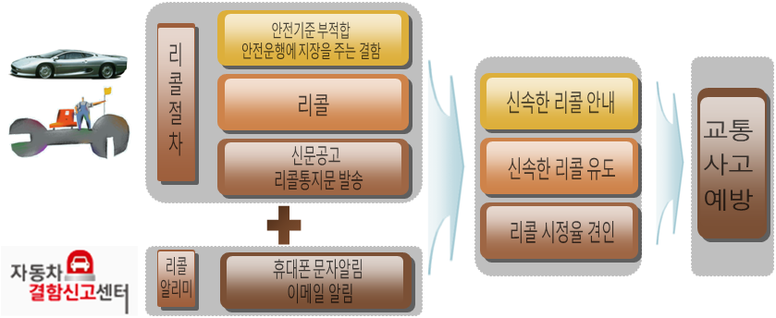

EDR Overview in KOREA
EDR Status
Korea introduced the EDR regulation in 2015(if equipped)
Korea introduced Early Warning Report regulation and manufacturer submit the field report once a month with EDR data copy.
Korea review the field report and EDR data to check the reliability(about 240 EDR data/month)
Manufacturers are expanding their EDR recordings voluntarily
EDR data is objective evidence
Notes:
This is the over view in Korea.
Korea introduced the EDR regulation in 2015 and Early Warning Report regulation in 2017. If automobile manufactures investigated the accident which are crash or burning whatever they have to submit the investigation report with EDR data to KATRI.
These data is reported average over 100 a month and KATRI review the reliability of EDR data over 20 copies a month.

Slide 3
EDR Case Study
CASE
Sudden Unintended Acceleration 1
- The driver does not operate the accelerator pedal, but claims the vehicle has
accelerated and caused the accident.
- As a result of the EDR data check, the TPS value was recorded at 100%.
- Aren’t there any defects in the TPS system? Human error?
➪ The manufacturer records APS and TPS respectively. Also records whether
or not cruise function is operated.
Sudden Unintended Acceleration 2
- The driver operate the brake pedal, but claims the vehicle has accelerated
and caused the accident.
- As a result of the EDR data check, the TPS value was recorded at 100% and
Service Brake switch is ON.
- Is this Sudden Unintended Acceleration?
➪ The manufacturer records APS and TPS respectively. Also records whether
or not BOS is operated.
Notes:
From now on, I would like to talk about some case that was often an issue when I investigate traffic accidents.
The first case is sudden unintended acceleration.
The driver claim that didn’t operate the accelerator pedal, but the vehicle has accelerated and occurred the accident.
As a result of the EDR data check, the TPS value was recorded at 100%. Is this an electric throttle control system error or Human error?
To explain the cause of the accident more easily to the driver, the manufacturer records APS and TPS respectively. Also records whether or not cruise function is operated.
Second case is similar as previous case. The driver claim that operated the brake pedal, but the vehicle speed didn’t reduce and occurred the accident. As a result of the EDR data check, the TPS value was recorded at 100% and Service Brake switch was ON.
What happen? Stuck of the gas pedal or something wrong?
To explain the cause of the accident more easily to the driver, the manufacturer records APS and TPS respectively. Also records whether or not BOS function is operated.

Slide 4
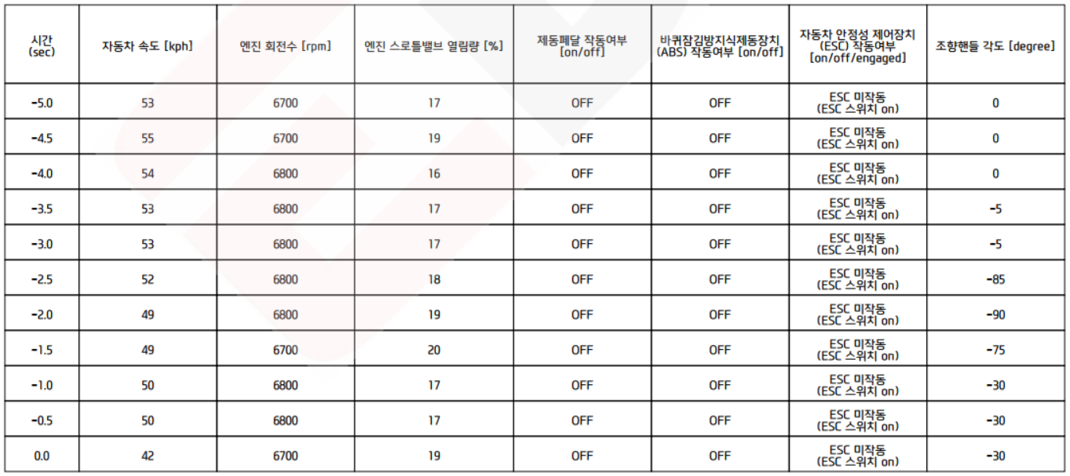
EDR Case Study
EDR data(2012)
Final Rule published 2012 : 15 mandatory, 30 optional items
Pre-crash data sample
Time
(sec)
Speed
(kph)
Engine
RPM
Engine
Throttle
Service
Brake
ABS
Activity
Stability
Control
Steering
Input
4
Notes:
This is the sample of the previous case.
At the early EDR System, manufacturer recorded the Engine Throttle value.

Slide 5
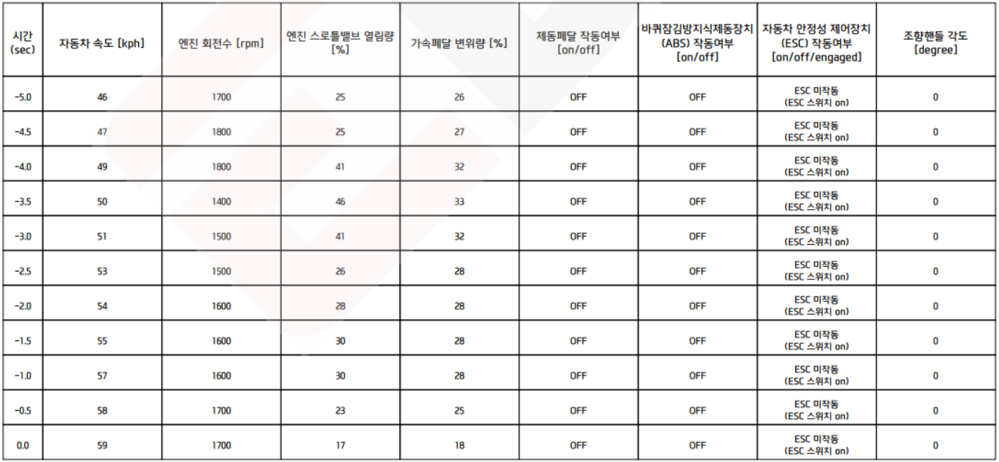
EDR Case Study
EDR data(2014)
Pre-crash data sample
Time
(sec)
Speed
(kph)
Engine
RPM
Engine
Throttle
Accelerator Pedal
Service
Brake
ABS
Activity
Stability
Control
Steering
Input
5
Notes:
As you see, from 2014,,,
the accelerator pedal and engine throttle were separated and recorded.
This was to respond to claims sudden unintended acceleration issue.

Slide 6
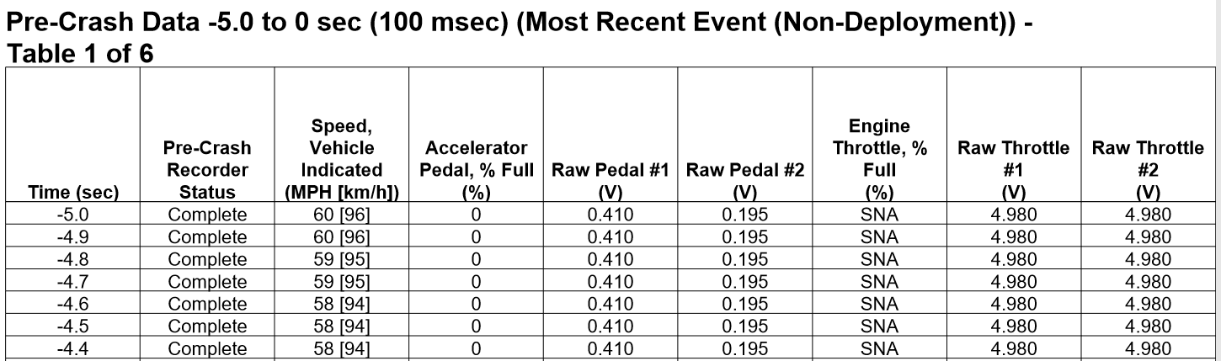
EDR Case Study
EDR data
Pre-crash data sample
6
Notes:
This page shows the another sample of edr data
As you see,various information is recorded data about accelerator and engine throttle. We can check more detail information.
These data are more reliable to investigate.

Slide 7
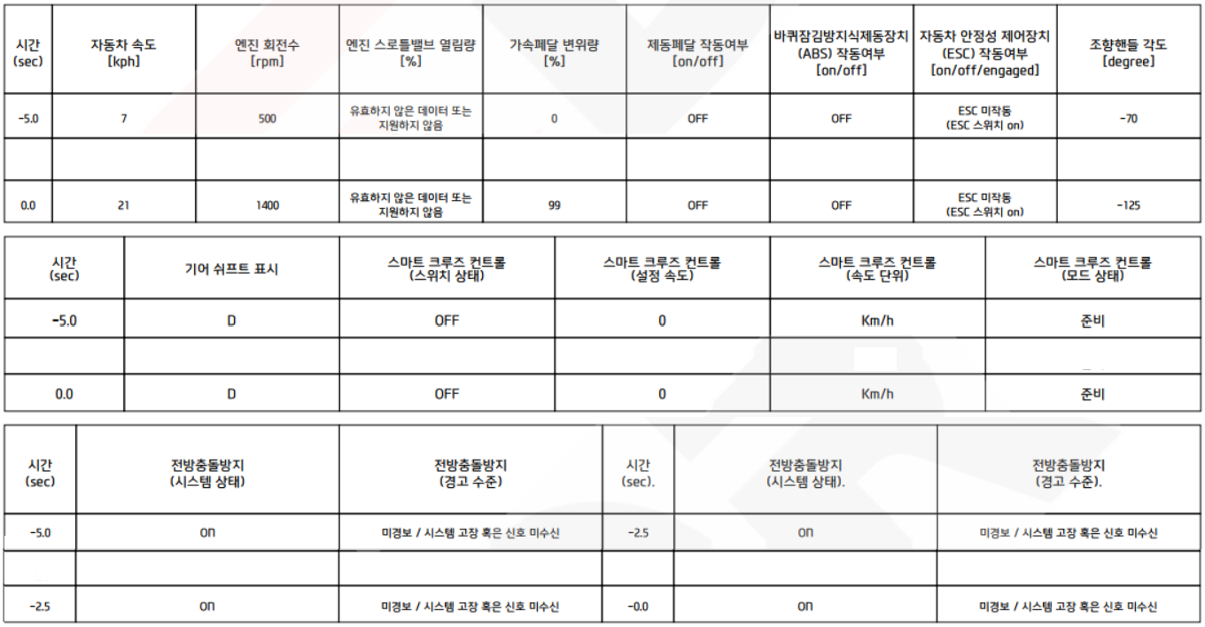
EDR Case Study
EDR data(2019)
Pre-crash data sample
Time
(sec)
Speed
(kph)
Engine
RPM
Engine
Throttle
Accelerator Pedal
Service
Brake
ABS
Activity
Stability
Control
Steering
Input
⦙
⦙
⦙
⦙
⦙
⦙
⦙
⦙
⦙
Time
(sec)
Shift Position
Smart Cruise
Control(On/Off)
Smart Cruise
Control(Speed)
Smart Cruise
Control(Unit)
Smart Cruise
Control(Status)
⦙
⦙
⦙
⦙
⦙
ready
⦙
Time
(sec)
Forward Collision-Avoidance Assist
(Status)
Forward Collision-Avoidance Assist
(Warning)
Time
(sec)
Forward Collision-Avoidance Assist
(Status)
Forward Collision-Avoidance Assist
(Warning)
⦙
⦙
⦙
⦙
⦙
⦙
7
Notes:
Recently, automobiles are equipped with self-driving functions. And more data is being recorded to determine the cause of these car accidents.
The blue-looking part was recently added to the EDR system and red box for cruise control.
This much data is being voluntarily recorded regardless of the EDR regulation.

Slide 8
EDR Case Study
CASE
Defect of Brake system
- The driver operated the brake pedal, but claims the vehicle is not reduced the
speed and caused the accident.
- As a result of the EDR data check, the Service Brake switch is ON.
- The manufacturer claims that the driver did not operate the braking pedals
sufficiently, but the driver didn’t say that..
- What is the truth?
➪ The manufacturer records Brake switch and the pressure of master cylinder
actual brake force, brake booster vacuum level.
Notes:
The third case is for braking system.
The driver claim that operated the brake pedal, but the vehicle is not reduced the speed and occurred the accident.
As a result of the EDR data check, the Service Brake switch is ON.
But,, The manufacturer claims that the driver did not operate the braking pedals sufficiently, but the driver didn’t say that.
What is the truth?
Therefore, the manufacturer records Brake switch and the pressure of master cylinder. Some of manufacturer record actual brake force, brake booster vacuum level.

Slide 9
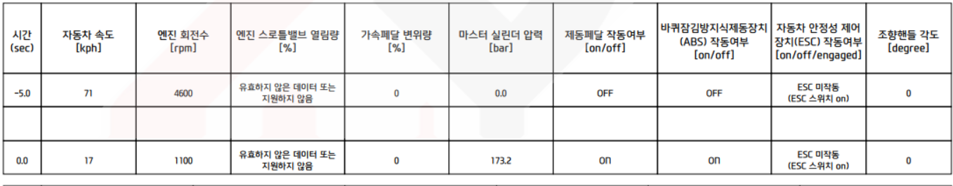
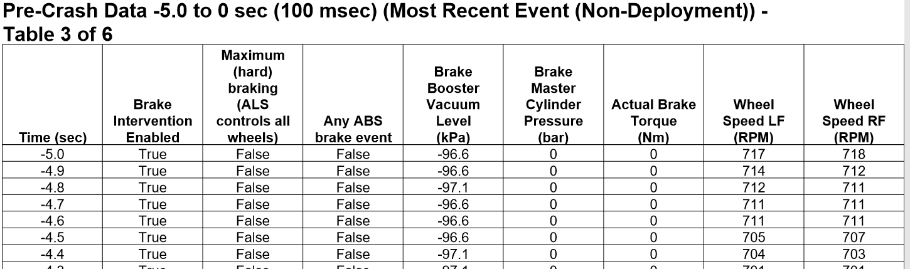
EDR Case Study
EDR 2019
Pre-crash data sample
Time
(sec)
Speed
(kph)
Engine
RPM
Engine
Throttle
Accelerator Pedal
Master Cylinder Pressure(bar)
Service
Brake
ABS
Activity
Stability
Control
Steering
Input
⦙
⦙
⦙
⦙
⦙
⦙
⦙
⦙
⦙
⦙
9
Notes:
This is the sample data of the previous case.
There are more information about the brakes system in the below table.

Slide 10
EDR Case Study
CASE
Defect of Transmission system
- The driver changed gear from P to R and operated the accelerator pedal, but
the vehicle starts to move forward. Finally accident is occurred. Moreover, the
vehicle later moved back and the accident had happened again.
- Shift lever position is not recorded in EDR data
- How can we understand the accident and explain easily?
➪ The manufacturer records the position of shift lever
Notes:
The last case is for transmission system.
The driver changed gear from P to R and operated the accelerator pedal, but the vehicle started to move forward.
Finally accident is occurred. After that the vehicle moved back and the accident had happened again.
- Shift lever position is not reordered in EDR data
- How can we understand the accident and how can we explain more easily to the driver?
➪ To do that.. The manufacturer records the position of shift lever

Slide 11
EDR Case Study
EDR data(2019)
Pre-crash data sample
Time
(sec)
Speed
(kph)
Engine
RPM
Engine
Throttle
Accelerator Pedal
Service
Brake
ABS
Activity
Stability
Control
Steering
Input
⦙
⦙
⦙
⦙
⦙
⦙
⦙
⦙
⦙
Time
(sec)
Shift Position
Smart Cruise
Control(On/Off)
Smart Cruise
Control(Speed)
Smart Cruise
Control(Unit)
Smart Cruise
Control(Status)
⦙
⦙
⦙
⦙
⦙
ready
⦙
11
Notes:
Can you see the read box?
Gear position status is recorded now.

Slide 12
Conclusion
EDR Data Element
EDR data is helpful for accident analysis, but EDR alone cannot analyze the cause of the accident.
It is necessary to investigate which data is needed to analyze the accident.
After that we should add the data element in EDR.
Data element name | Definition | Required | Recording interval/time | Data sample rate (per second)
Engine throttle, % full | Percentage ratio of the engine throttle opening position | Mandatory | -5.0 to 0 sec. | [to be determined]
accelerator pedal, % full | Percentage ratio of the accelerator pedal position | Mandatory | -5.0 to 0 sec. | [to be determined]
Cruise Control System | Operating status of the cruise control system. | Mandatory (if equipped) | -5.0 to 0 sec. | [to be determined]
Adaptive Cruise Control Status | Operating status of ACC. | Mandatory (if equipped) | -5.0 to 0 sec. | [to be determined]
Brake override System | Operating status of the brake override system. | Mandatory (if equipped) | -5.0 to 0 sec. | [to be determined]
Master cylinder pressure | Pressure of the Master cylinder | Mandatory | -5.0 to 0 sec. | [to be determined]
Gear position | Gear (shift lever) position | Mandatory | -5.0 to 0 sec. | [to be determined]
EDR data element list will be proposed in EDR-DSSAD-03 session
Notes:
This is the conclusion for EDR data element. When the accident is occurred, we have to investigate the accident vehicle, location, the video such as dash board camera or CCTV, and we have to check the EDR data.
EDR data is helpful for accident analysis, but EDR alone cannot analyze the cause of the accident.
It is necessary to investigate which data is needed to analyze the accident. after that we should add the data element in EDR.
I have introduced the most common cases that occur in the field, and we have introduced the changes in data.
The Data which are recorded in EDR should be expanded.
We are going to introduce the whole data element at the next meeting.

Slide 13

THANK YOU
giok.park@gmail.com
parkgiok@kotsa.or.kr
Notes:
My presentation is over. Thank you for your attention.

