Slide 1

Discussion on the display of HIT over WAD Data
21.02.2020

Slide 2
Content
  Introduction
  Data Plot Examples
  Considerations
  Proposal

Slide 3
Introduction
For determination of testing Deployable Pedestrian Protection System (DPPS) dynamically or in static condition, a comparison of Head Impact Times (HIT) and the corresponding Wrap Around Distances (WAD) is needed.
This data is generated using computer simulation Human Body Models (HBM), representing different statures and percentiles of a human normal distribution (6-year old child (6yrs), fifth percentile female (5th%'ile), fiftieth percentile male (50th%'ile) and ninety-fifth percentile male (95th%'ile))
For every individual vehicle, the contact time of those HBMs that impact the DPPS are calculated.
The data will result in up to 4 individual points on the vehicle and the question is to determine how to connect the data points for inter- and extrapolation of impact points on WADs between or beyond the data points.

Slide 4
Introduction
Three different concepts are under investigation (generic chart):
6-year
old child
5th
percentile female
50th
percentile male
95th
percentile male

Slide 5
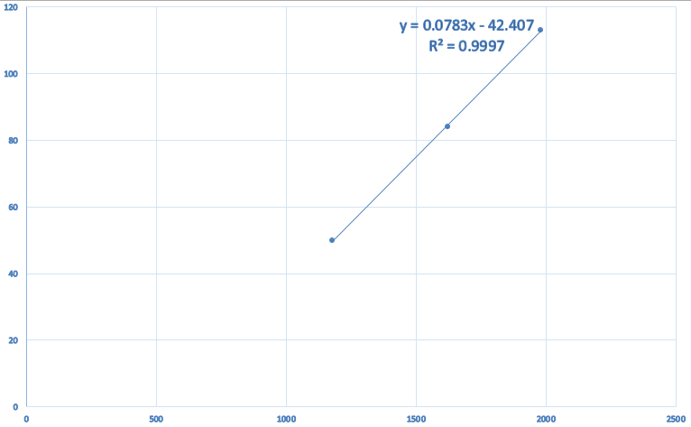
Data Plot Examples
Vehicle Class: Saloon
THUMS DUMMY OUTPUT
Dummy | WAD | Time HBM Contact | Regression Line Time
6yrs | 1177 | 50 | 50
5th%'ile | 1623 | 84 | 85
50th%'ile | 1981 | 113 | 113
95th%'ile | Not applicable

Slide 6
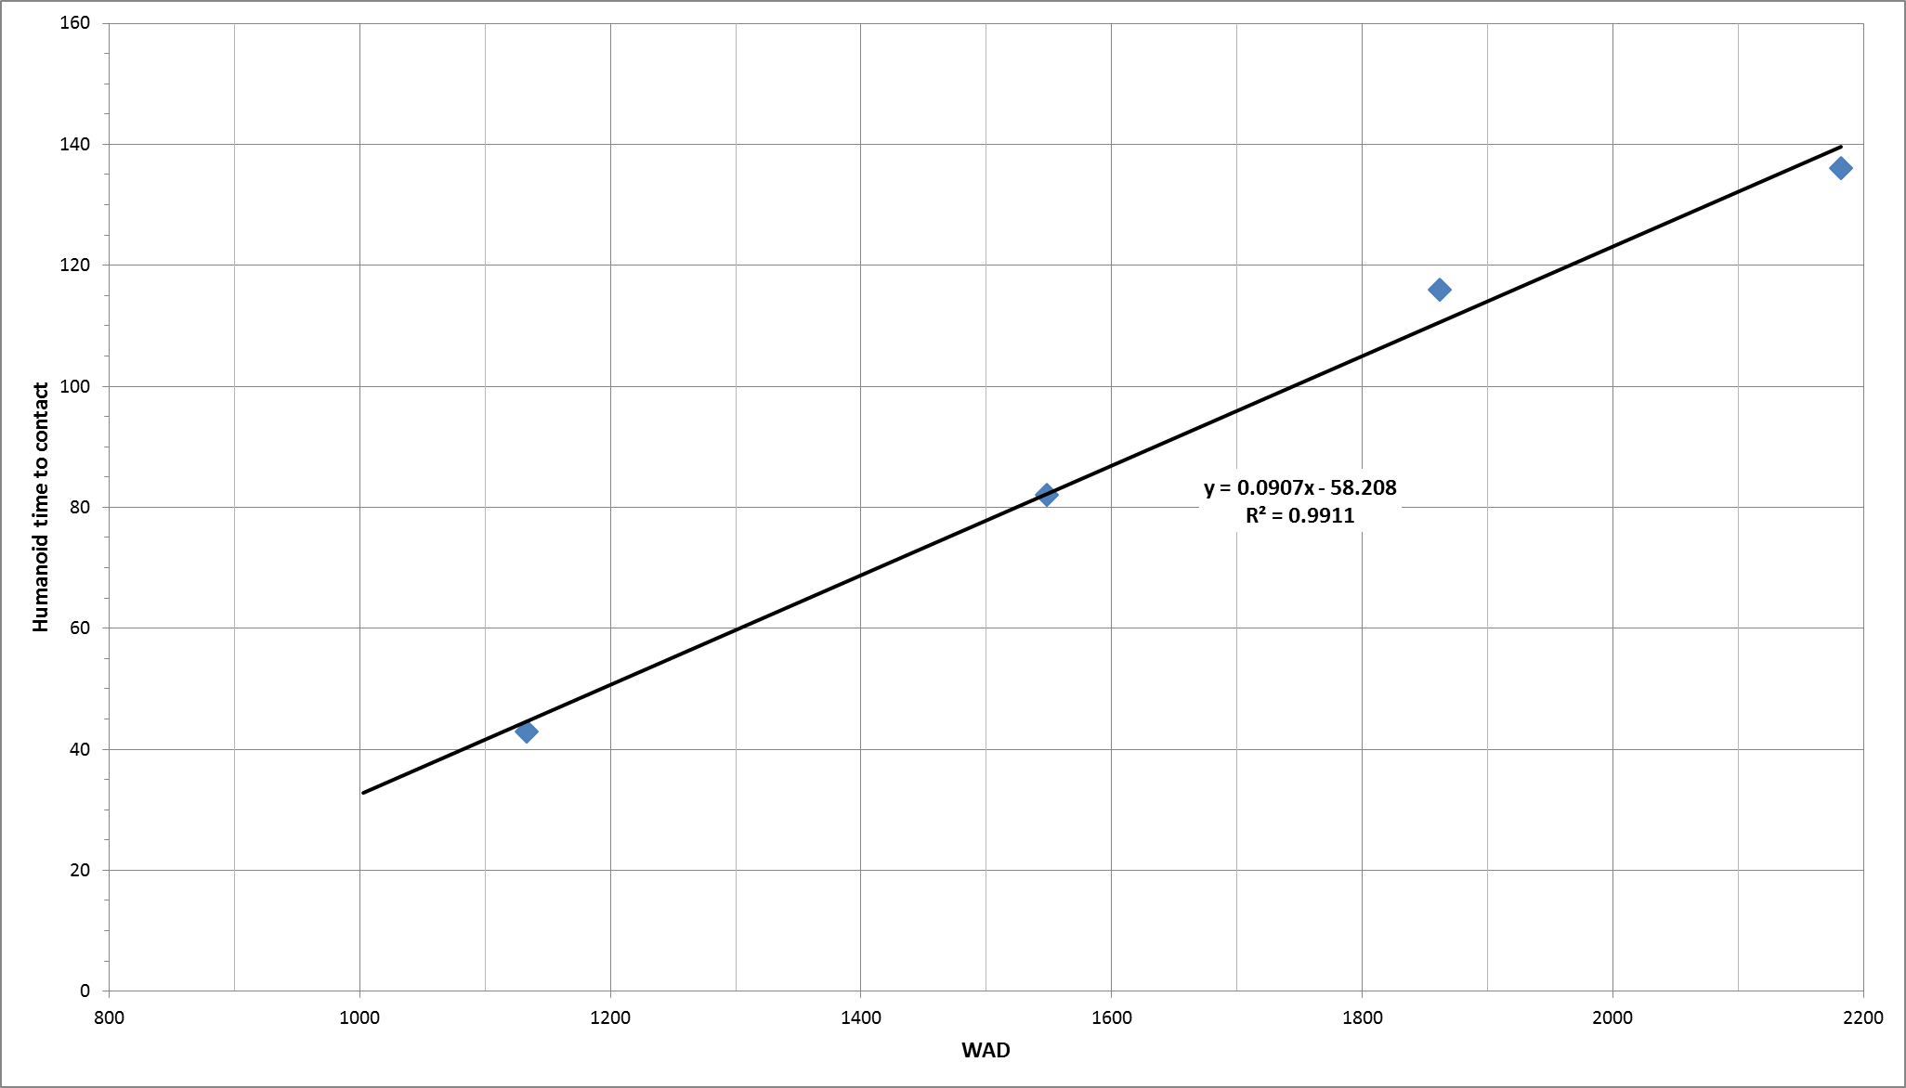
Data Plot Examples
Vehicle Class: Crossover
THUMS DUMMY OUTPUT
Dummy | WAD | Time HBM Contact | Regression Line Time
6yrs | 1133 | 43 | 45
5th%'ile | 1548 | 82 | 82
50th%'ile | 1862 | 116 | 111
95th%'ile | 2182 | 136 | 140

Slide 7
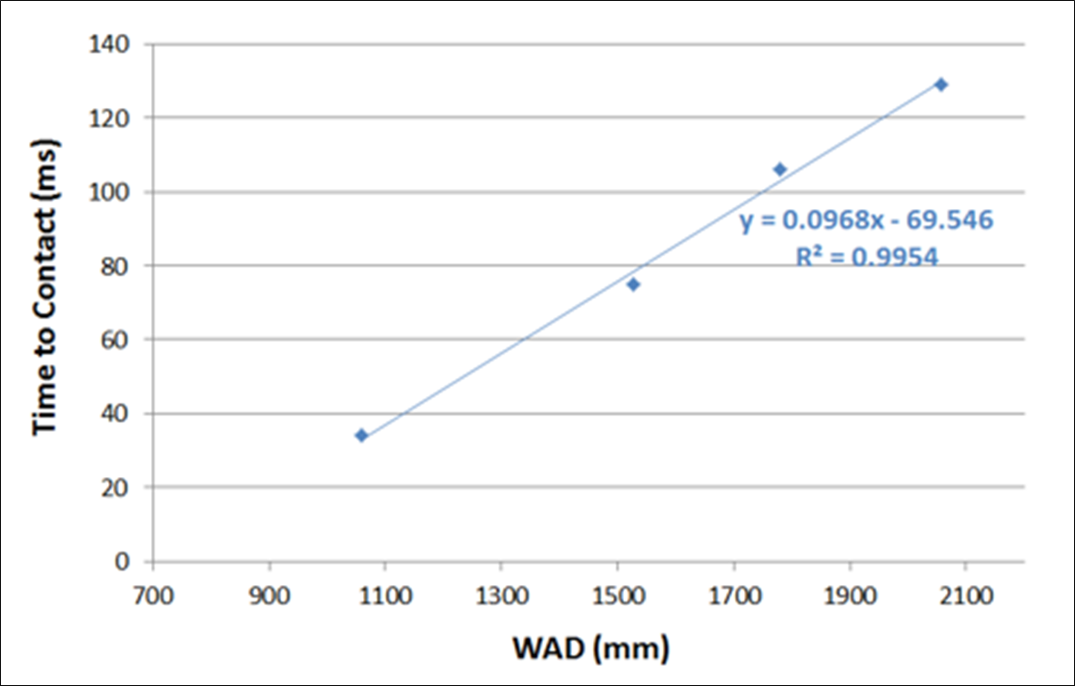
Data Plot Examples
Vehicle Class: SUV
THUMS DUMMY OUTPUT
Dummy | WAD | Time HBM Contact | Regression Line Time
6yrs | 1060 | 34 | 33
5th%'ile | 1528 | 75 | 78
50th%'ile | 1780 | 106 | 103
95th%'ile | 2058 | 129 | 130

Slide 8
Considerations
Linear interpolation allows for extrapolation
  Example: Saloon and Crossover and 6YO Hit point extrapolated to WAD1000
  Extrapolation may also be needed for the rear
High R²-statistical fit values
For dynamic test synchronization, same set of data as would be used for Euro NCAP,
so no ambiguities for the same car having different HIT/WAD values.
  Sources of error are reduced (mixing NCAP and regulation data).
For dynamic testing, different tests would be required for NCAP and homologation, due to alternative HITs.

Slide 9
Considerations
Linear regression takes care of all statures, while interpolating between just two statures may lead to inaccurate conclusions.
Dot-to-dot connection will be closest to the data points from the CAE HBM.
  It is still a regression line between two HBMs.
The R²-value of data plots provides good evidence of the fit quality of a linear regression to the actual data points.
While an R²-value of 1 represents a perfect fit, an R²-value of 0 indicates no correlation of the data under consideration at all.

Slide 10
Proposal
The HIT vs. Wad graph should relate closely to the impact data of the HBMs.
WADs may be in front or in the rear of the HBM impact points, so not just interpolation between statures, but also extrapolation will be required.
Extrapolation of a line from direct connection of points is hardly possible.
Compromise:
  If R²-value of HIT vs. WAD regression line is higher than [0.85], linear regression is allowed.
  If R² is less than [0.85], direct percentile connecting lines are drawn.
Still, it needs to be evaluated how to enable extrapolation in those cases.

