Slide 1
National Road Authorities: preparing for Connected & Automated Driving
Steve Phillips
Secretary-General

Slide 2
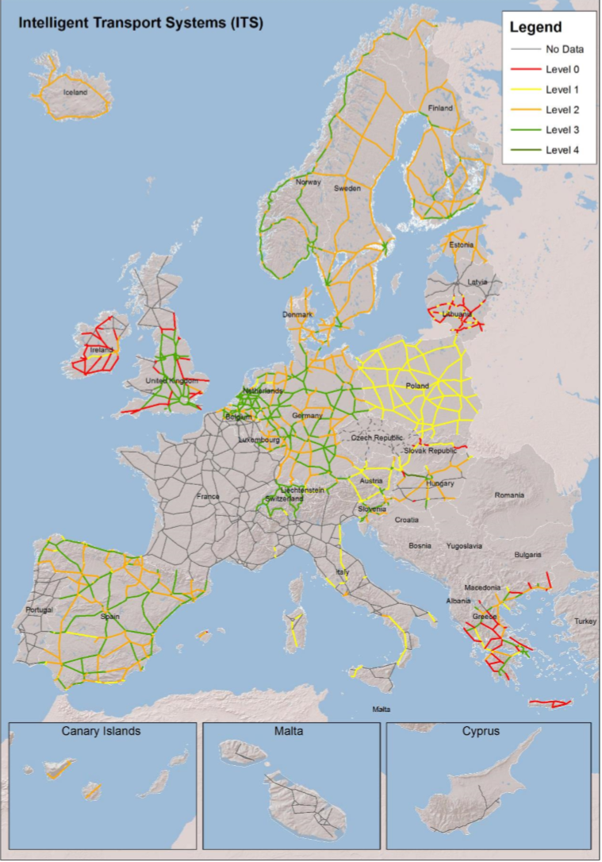
What and Why a network of CEDR?
National Road Authorities (NRAs) connected by;
Physical and digital interfaces
Common vehicle standards
‘EU’ Legislation & Standards
Performance expectations
Changing environment and expectations
Good neighbours
Cooperate with other regions

Slide 3
Challenges of a changing world

Slide 4


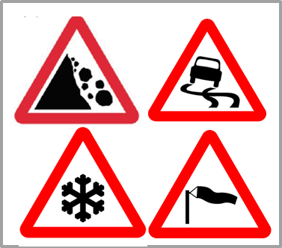
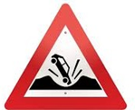
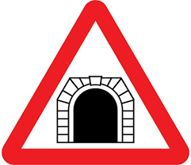
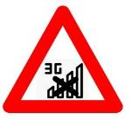

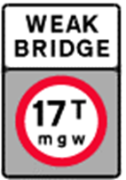
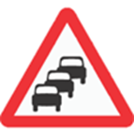











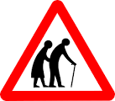
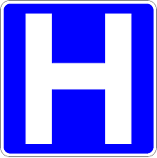



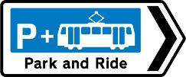




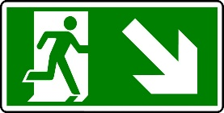
Common NRA ’opportunities’
Maintenance & ageing infrastructure
Connectivity & Digitilisation
Climate change & resilience
Intermodal
transport
Liveability
& Health
Resources &
Procurement
€

Slide 5
A changing world – for NRAs and for CEDR
Climate change creates enormous pressure on politics to reduce greenhouse gas emissions whilst transport is a major emitter
The ‘digital revolution’ changes our societies dramatically
  It’s an opportunity as well as a challenge
  all aspects of society are affected, including challenges but also opportunities for the transport sector
  digitalisation re-shuffles structures and transport policies have to align with
  industry policy (⇒ vehicle automation) and connectivity master plans (⇒ 5G)
European countries have to react and align their National action plans – including those for transport

Slide 6




What does that mean for NRAs?
Policy
NRAs have to define their role in this changing world
Four major areas need to be addressed and become green & digital:
Environment | Economy
Safety | Demography

Slide 7
Towards a sustainable and healthy world
Policy
Environment:
  Greenhouse gas emissions from transport need to be at least 60% less than 1990 in 2050 in the EU (future perspective: zero)
  Actions to be taken: low emission energy and vehicles, modal shift (incl. new modes) and increased traffic efficiency
Safety:
  ‘Traditional’ safety measures have achieved significant improvements in road safety (ca. 40% reduction from 2007 to 2013 in the EU)
  But: The number of road accident fatalities is almost stagnant since 2013

Slide 8
Managing societal changes
Policy
Economy:
  Economic growth requires maintaining an efficient transport system; congestion is a limiting factor, in particular in areas, where building new roads is no longer an option
  Europe’s economic strength requires a competitive and innovative transport sector
Demography:
  Drastic demographic changes create needs for new, innovative mobility approaches to ensure inclusion and participation

Slide 9
What tools have we got in our hands? (1)
Tools
Environment:
  Low emission energy and vehicles, modal shift (incl. new modes) and increased traffic efficiency all need digital infrastructure support – including connectivity – and all can benefit from automation
Safety:
  Innovation and disruptive change, caused by digitalisation and behavioral changes, are needed for further safety improvements: connectivity (between vehicles an with infrastructure) and higher levels of automation

Slide 10
What tools have we got in our hands? (2)
Tools
Economy:
  Conventional traffic management systems are saturated in the road sections mostly affected – Innovative approaches (‘TM2.0’) will depend on better stakeholder cooperation, data sharing and interaction with vehicles, building on digitalisation and connectivity
  Developments in digitalisation, connectivity and automation are significant and dynamic in other parts of the world – we have to make sure to keep current.
Demography:
  Emerging and future innovative mobility services are based on – digital – sharing concepts and include connected and automated vehicles, e.g. for the last mile

Slide 11
Conclusions
Tools
For all four sectors presented, digitalisation, automation and connectivity are tools to address today’s challenges, if used correctly
All three topics are horizontal, cross-cutting our current organisational structures
All three are disruptive in that they require new skills, new roles, new processes – they can not be reduced to investment in systems and infrastructure

Slide 12
Co-operation challenges

Slide 13
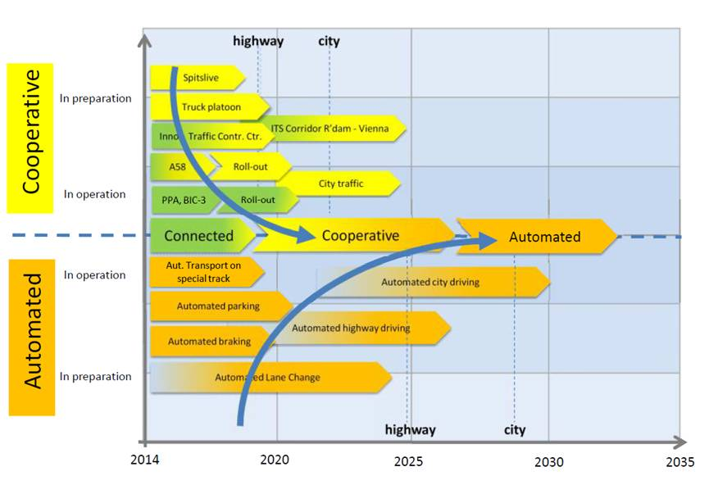
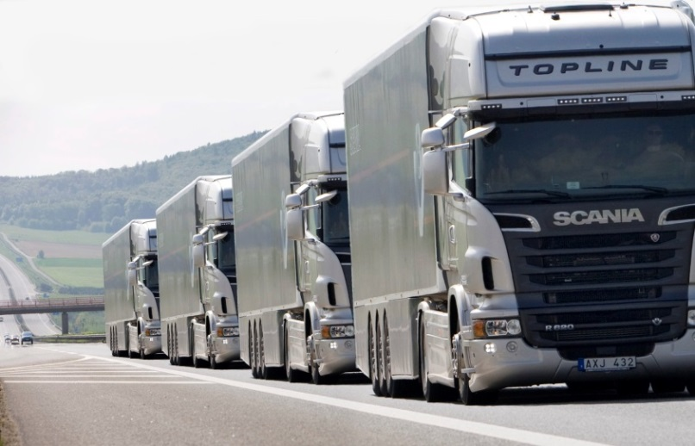
Connected & Automated Driving
From cooperative ITS to connected automation
  Demands to NRAs in very near future
  Benefits – safety, efficiency, sustainability
Major cultural change
  cooperation with key stakeholders (e.g. vehicle manufacturers, telecom & IT industry
  new roles for the NRAs
New challenges and opportunities
  legal issues, data security, road safety, road damage and traffic management.

Slide 14
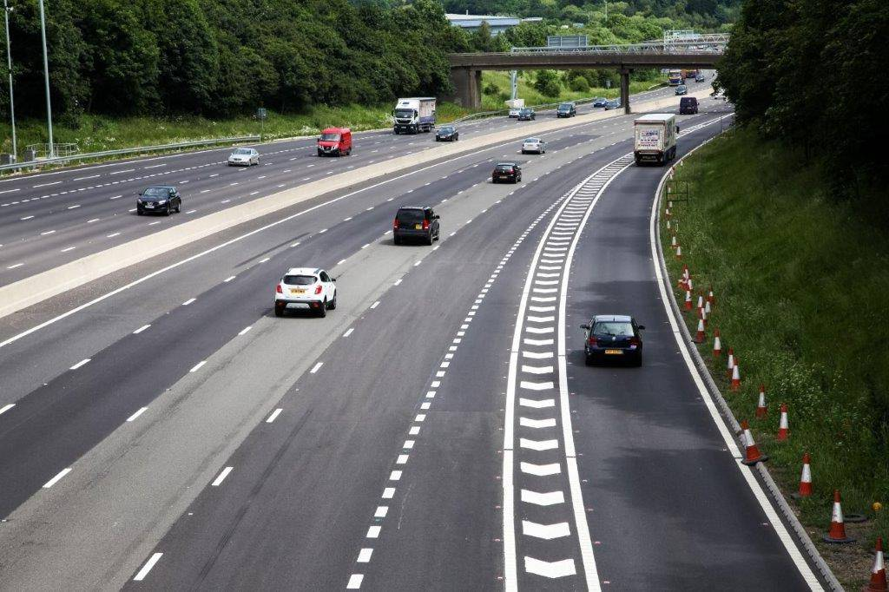
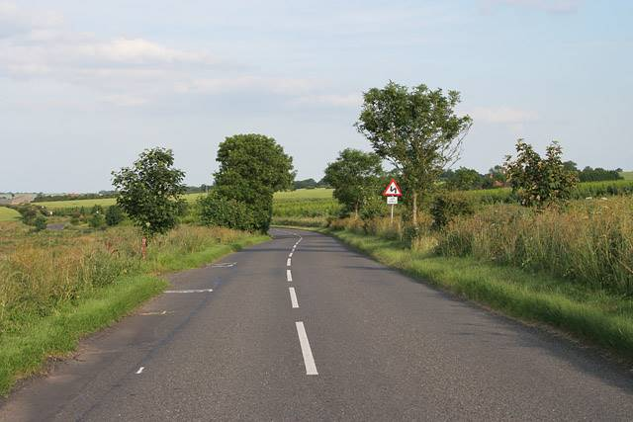
Infrastructure Support for automation?
Designed for motorways….. and used on all roads?

Slide 15
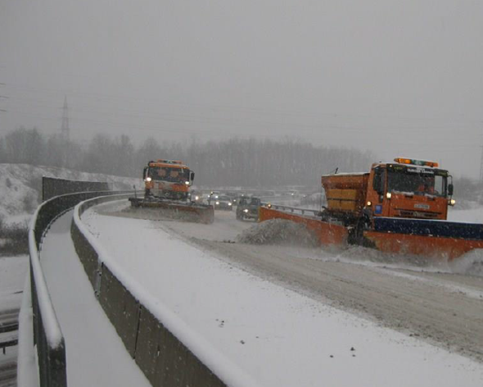
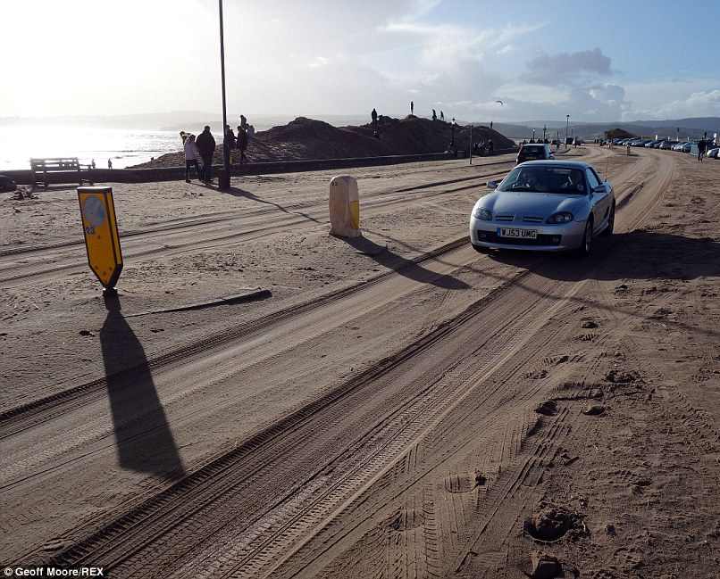
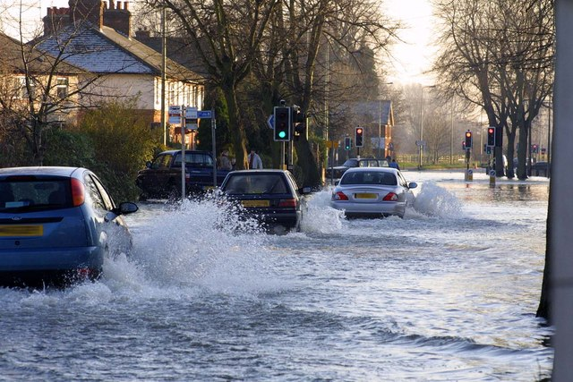
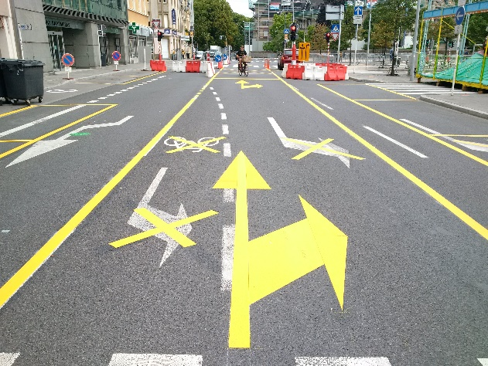
Roads in a variety of conditions
Not just in the snowy north, but across Europe; lane markings can be hidden for a variety of reasons.

Slide 16
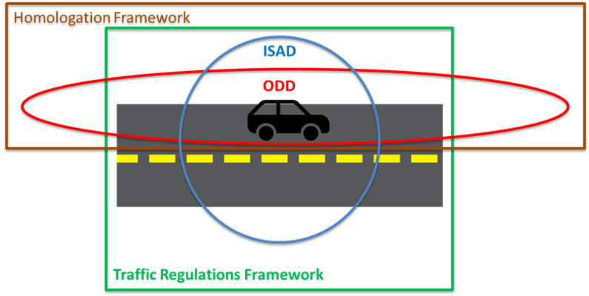
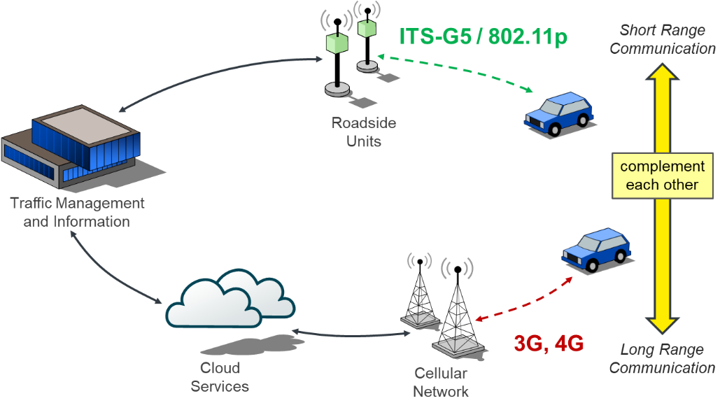
CCAD - Key Instruments
ISAD … Infrastructure Support Levels for Automated Driving
ODD … Operational Design Domain of Driving Automation System

Slide 17

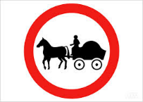
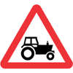
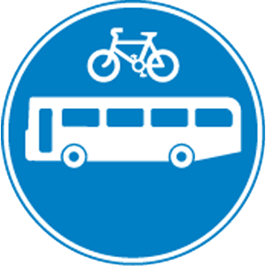


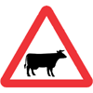

spectrum of vehicle infrastructure access?
- Level X Automated passenger car, bus and truck
- Truck weights and dimensions
- Zero and low emission vehicles
- Platooning trucks
- EMS, HCV (eg 25m+)
- Low noise vehicles
- Winter truck restrictions
- Dangerous goods
- Animal transport
- Oversized and abnormal loads

Slide 18

Co-operation in technology in the infrastructure lifecycle
Value Chain
Pre-Development
(R&I)
Pre-competitive stakeholder
co-operation
Development to Market
(D2M)
No collaboration with private sector (e.g. Automotive)
Deployment & Life-Cycle
(D&L)
Need for collaboration for Roll-Out and system evolution
European
CCAM
Roads &
Services &
Vehicles
Moderate collaboration on
European level
Moderate collaboration on
European level

Slide 19
Connected & Automated vehicles will require closer cooperation between vehicle regulators and infrastructure operators.
It will require a new approach….. and we need to work together
Contacts
Steve.Phillips@cedr.eu www.cedr.eu
References: National Road Authority Connected and Automated Driving strategy 2018-28 www.cedr.eu/download/Publications/2018/NRA-CAD-strategy-2018-final-v2.doc

