Slide 1
Proposal from Japan with regard to the proposal of the test threshold for cutting in from Germany/France
Submitted by Japan
Informal Document – ACSF-25-18

Slide 2

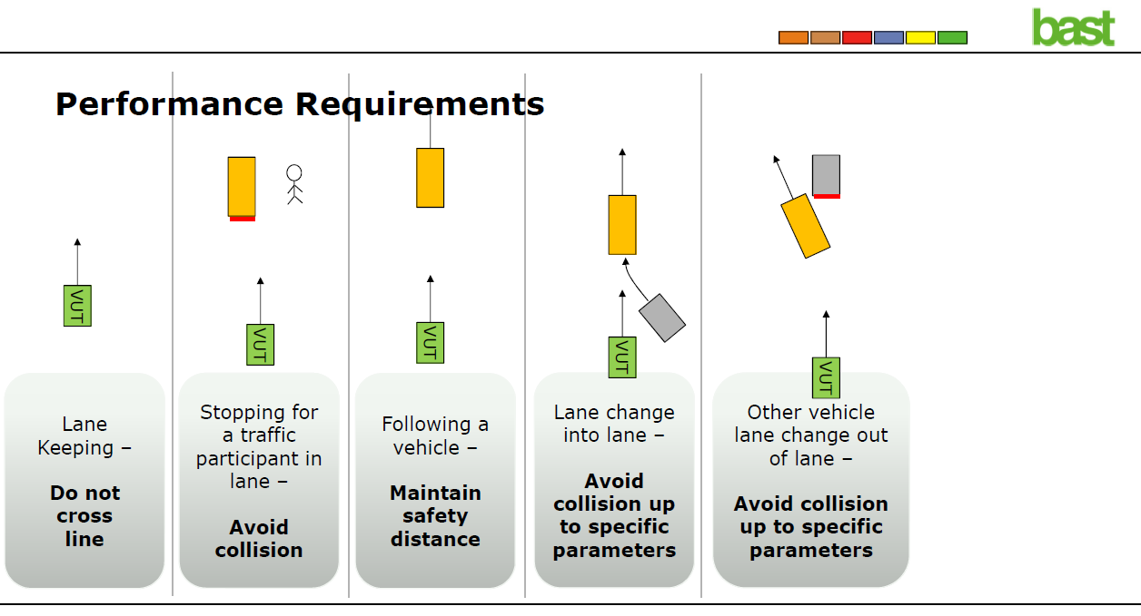
Global approach
Introduction
Methodology
Test Scenarios

Slide 3
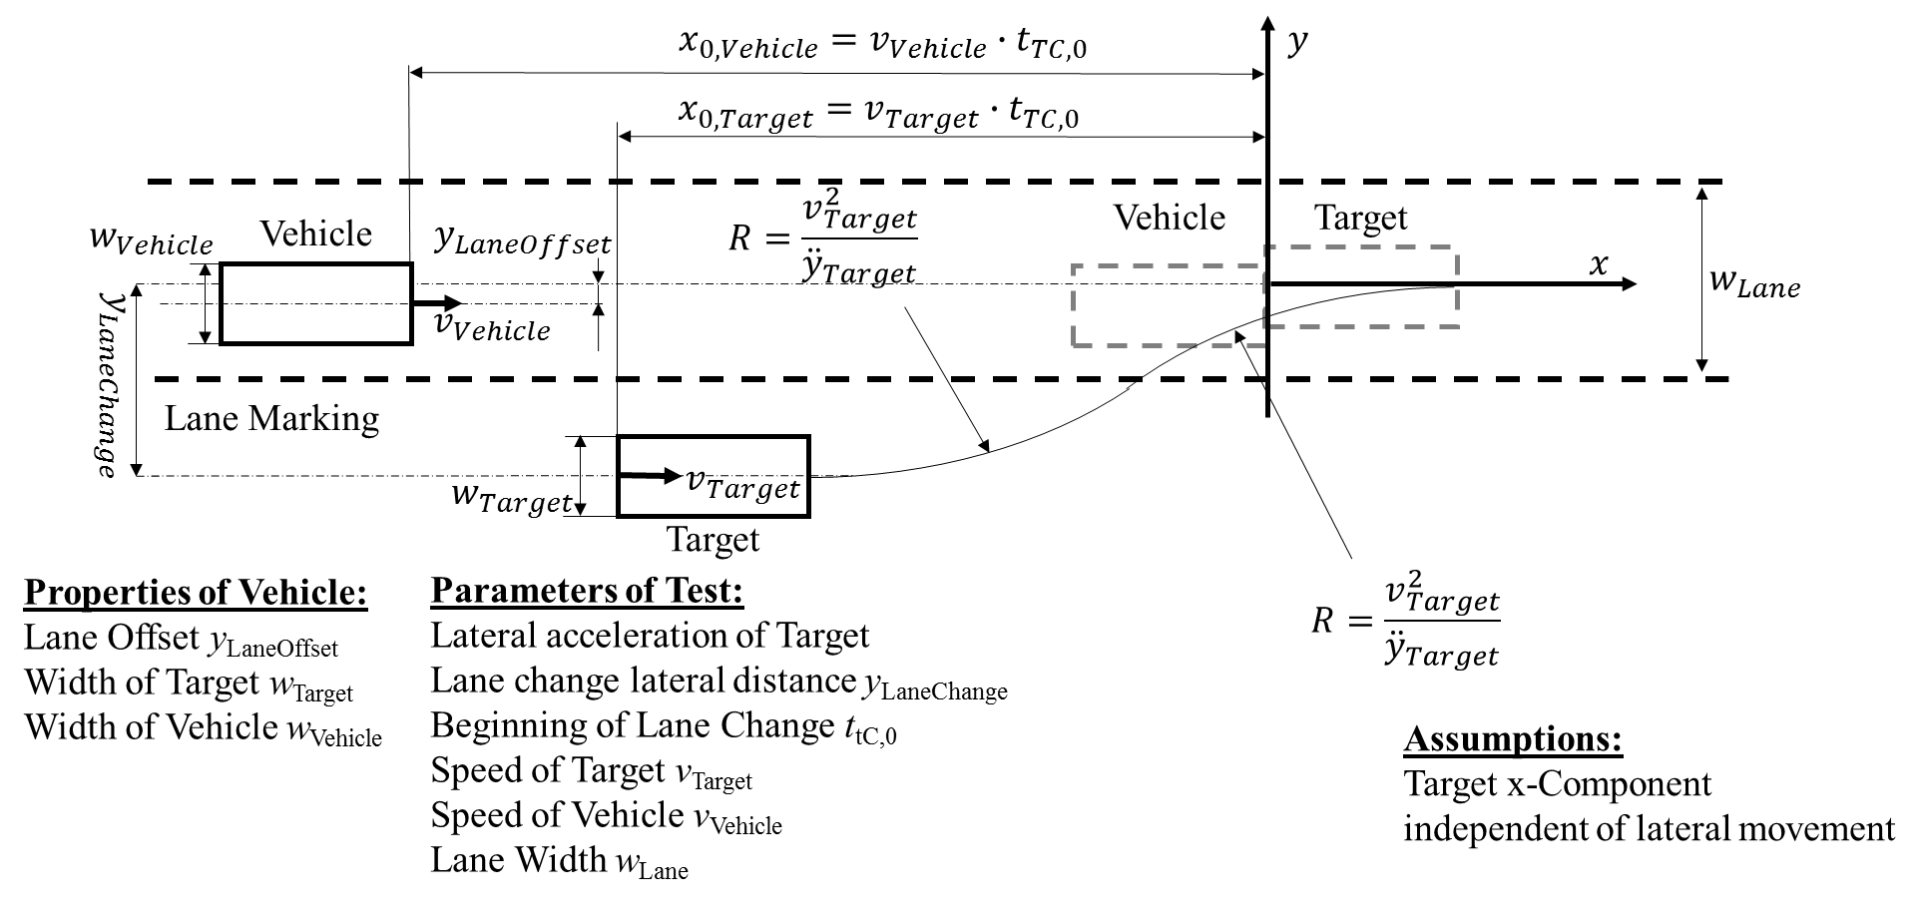
Proposal from Germany/France with regard to the proposal of the test threshfold for cutting in
𝑇𝑇𝐶_{𝐿𝑎𝑛𝑒𝐼𝑛𝑡𝑟𝑢𝑠𝑖𝑜𝑛}>𝑣_{𝑟𝑒𝑙}/(2∙6m/s²)+[0.35𝑠]
Where:
v_{rel} = relative velocity between both vehicles, positive for vehicle being faster than the cutting in vehicle
TTC_{LaneIntrusion} = The time-to-collision value when foremost point of the intruding vehicle has fully crossed the lane marking.

Slide 4
Proposal from Japan with regard to the proposal of the test threshfold for cutting in

Slide 5
Proposal from Japan with regard to the proposal of the test threshfold for cutting in

Slide 6
Proposal from Japan with regard to the proposal of the test threshfold for cutting in

Slide 7
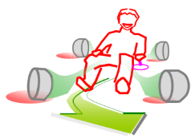

Driver Model Structure
In low-speed ALKS scenario, the avoidance capability required for the driver model is braking control only. This driver model is separated into the following three segments: “Risk perceive situation”, “Delay in time”, and “Deceleration degree and Max. G-force”
Brake pedal
Brake pedal
Accelerator pedal
Accelerator pedal
Delay in releasing accelerator pedal
Delay in pressing brake pedal
A
B
C
Risk perceive
Situation
Delay in time
Deceleration degree
and Max. G-force
Page 5
Notes:
Now, let’s move on to the driver model to be used as the reference.
Generally, when a dangerous situation occurred, driver recognizes it first. Then, makes a decision on braking maneuver, releases the accelerator pedal and moves foot to the brake pedal, and finally applies brake.
To study the driver model, we have separated this operational sequence into 3 segments. The first segment is “Risk perceive situation”, in which the risk is recognized. The second one is “Delay in time” which represents the time from the release of accelerator pedal to the application of brake pedal. And the third one is “Deceleration degree and maximum g-force” of braking maneuver.
In the following slides, I will present the further details.

Slide 8
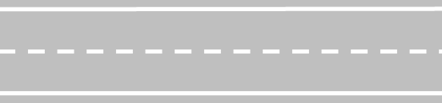
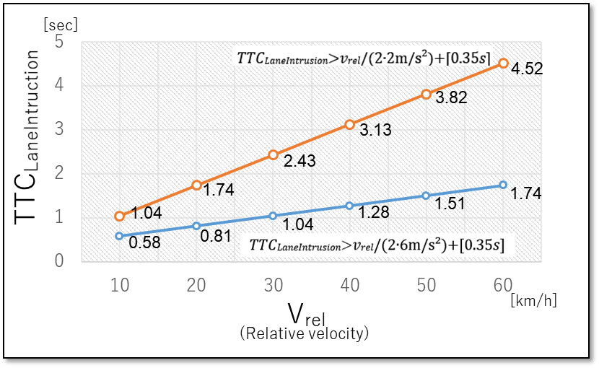


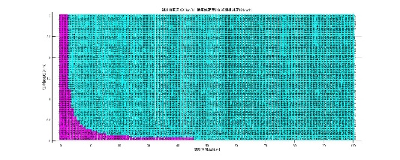
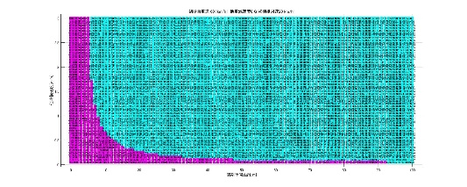
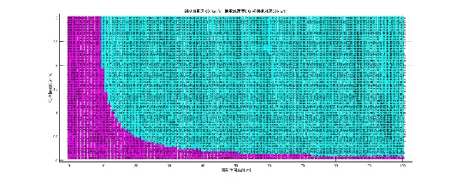
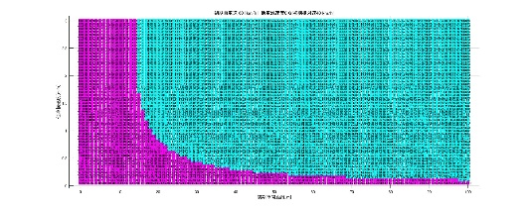
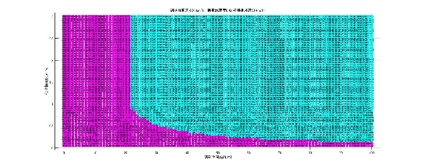





Test Requirement Comparison between GE/FR and JAPAN
𝑇𝑇𝐶_{𝐿𝑎𝑛𝑒𝐼𝑛𝑡𝑟𝑢𝑠𝑖𝑜𝑛}>𝑣_{𝑟𝑒𝑙}/(2*6m/s²)+[0.35𝑠]
Ego
dx_LaneIntruction
=TTCLaneIntruction × Vrel
3.5ｍ
dx0 = dx_LaneIntruction + Vrel × t_LaneIntruction
t_LaneIntruction=((3.5-1.9)/2)/Vy
t_LaneIntruction：time duration between the beginning of the lateral movement and lane intrusion.
dx0：Distance at the beginning of the lateral movement and lateral velocity
In order to compare the GE/FR and JAPAN threshhold, both are described on the same axis X:dx0, Y:Vy
Relative Velocity(V_{ref}):10km/h
20km/h
30km/h
40km/h
50km/h
GE/FR
1
2
3
4
5
3.0
3.0
3.0
3.0
3.0
2.0
2.0
2.0
2.0
2.0
Lateral Velocity(Vy [m/s]
1.0
1.0
1.0
1.0
1.0
0
50
100
0
50
100
0
50
100
0
50
100
0
50
100
Initial Distance(dx0)[m]
Initial Distance(dx0)[m]
Initial Distance(dx0)[m]
Initial Distance(dx0)[m]
Initial Distance(dx0)[m]
VMAD1a Draft
3.0
Unforeseeable
3.0
Unforeseeable
3.0
Unforeseeable
3.0
Unforeseeable
3.0
Unforeseeable
2.0
2.0
2.0
2.0
2.0
Lateral Velocity(Vy [m/s]
1.0
1.0
1.0
1.0
1.0
0
50
100
0
50
100
0
50
100
0
50
100
0
50
100
Initial Distance(dx0)[m]
Initial Distance(dx0)[m]
Initial Distance(dx0)[m]
Initial Distance(dx0)[m]
Initial Distance(dx0)[m]

Slide 9
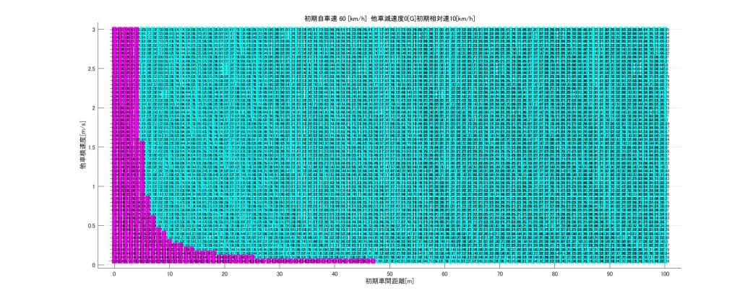
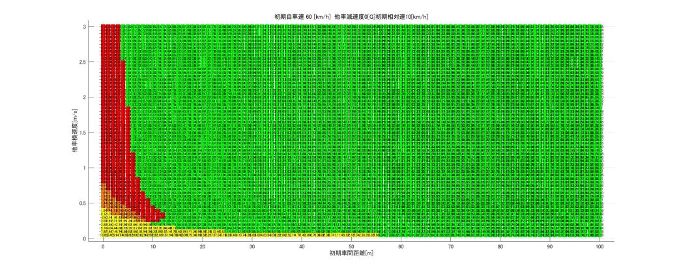
a
Ego vehicle velocity【Ve0】
: 60[kph]
Relative velocity【Ve0-Vo0】
: 10[kph]
GE/FR Draft Boundary: 𝑇𝑇𝐶𝐿𝑎𝑛𝑒𝐼𝑛𝑡𝑟𝑢𝑠𝑖𝑜𝑛>𝑣𝑟𝑒𝑙/(2*6m/s²)+[0.35𝑠]
[m/sec]
3.0
dy0=1.6m
2.5
Unforeseeable
2.0
1.8
Lateral velocity 【Vy】
1.5
1.0
0.5
0.17
Unforeseeable
0
[m]
0 20 40 60 80 100
Longitudinal distance 【dx0】

Slide 10
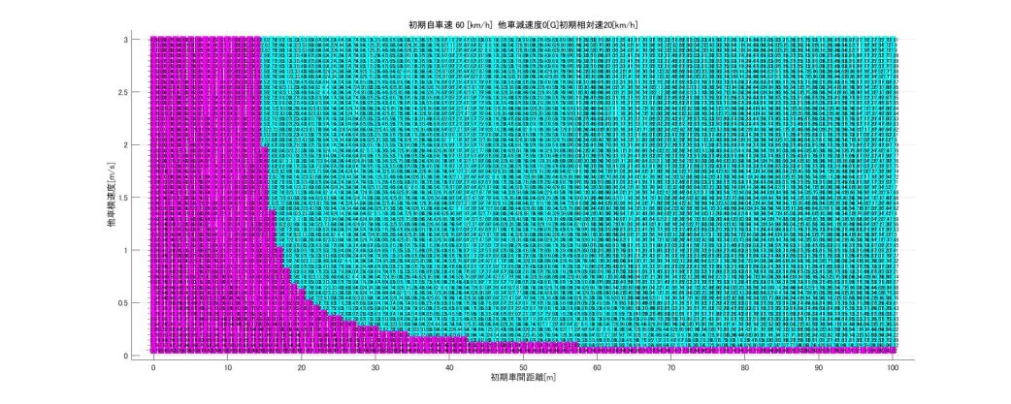
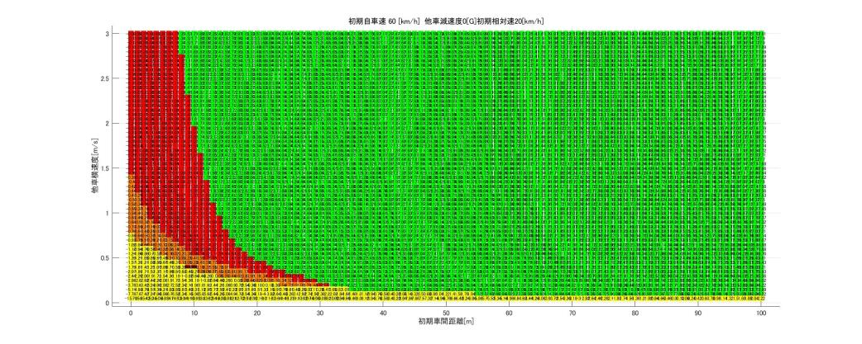
b
Ego vehicle velocity【Ve0】
: 60[kph]
Relative velocity【Ve0-Vo0】
: 20[kph]
GE/FR Draft Boundary: 𝑇𝑇𝐶𝐿𝑎𝑛𝑒𝐼𝑛𝑡𝑟𝑢𝑠𝑖𝑜𝑛>𝑣𝑟𝑒𝑙/(2*6m/s²)+[0.35𝑠]
[m/sec]
3.0
dy0=1.6m
2.5
Unforeseeable
2.0
1.8
Lateral velocity 【Vy】
1.5
1.0
0.5
0.17
Unforeseeable
0
[m]
0 20 40 60 80 100
Longitudinal distance 【dx0】

Slide 11
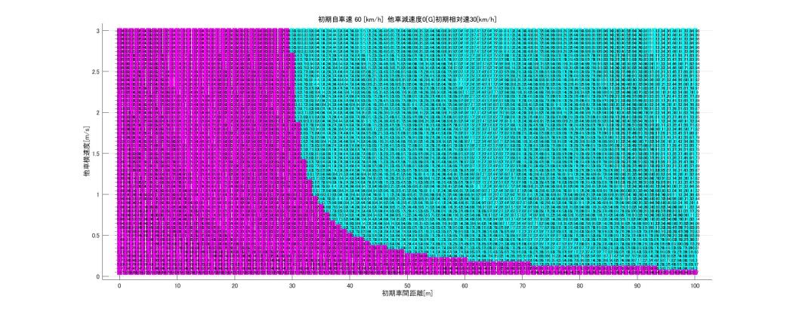
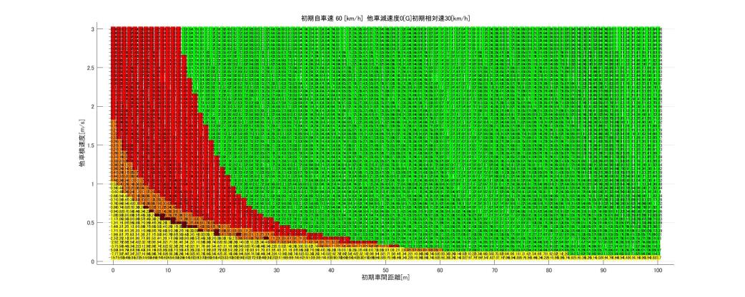
c
Ego vehicle velocity【Ve0】
: 60[kph]
Relative velocity【Ve0-Vo0】
: 30[kph]
GE/FR Draft Boundary: 𝑇𝑇𝐶𝐿𝑎𝑛𝑒𝐼𝑛𝑡𝑟𝑢𝑠𝑖𝑜𝑛>𝑣𝑟𝑒𝑙/(2*6m/s²)+[0.35𝑠]
[m/sec]
3.0
dy0=1.6m
2.5
Unforeseeable
2.0
1.8
Lateral velocity 【Vy】
1.5
1.0
0.5
0.17
Unforeseeable
0
[m]
0 20 40 60 80 100
Longitudinal distance 【dx0】

Slide 12
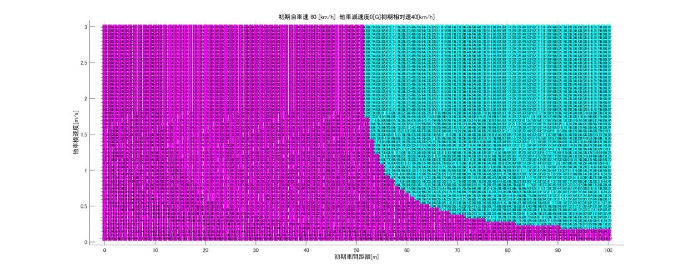
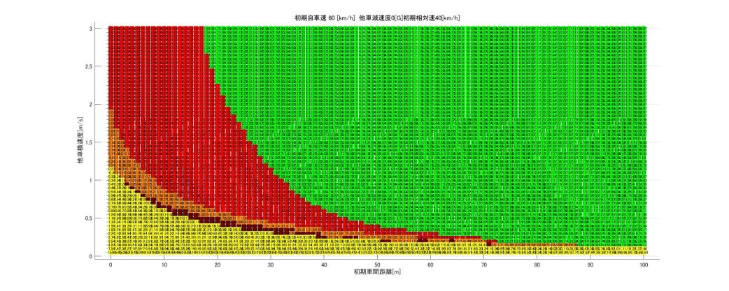
d
Ego vehicle velocity【Ve0】
: 60[kph]
Relative velocity【Ve0-Vo0】
: 40[kph]
GE/FR Draft Boundary: 𝑇𝑇𝐶𝐿𝑎𝑛𝑒𝐼𝑛𝑡𝑟𝑢𝑠𝑖𝑜𝑛>𝑣𝑟𝑒𝑙/(2*6m/s²)+[0.35𝑠]
[m/sec]
3.0
dy0=1.6m
2.5
Unforeseeable
2.0
1.8
Lateral velocity 【Vy】
1.5
1.0
0.5
0.17
Unforeseeable
0
[m]
0 20 40 60 80 100
Longitudinal distance 【dx0】

Slide 13
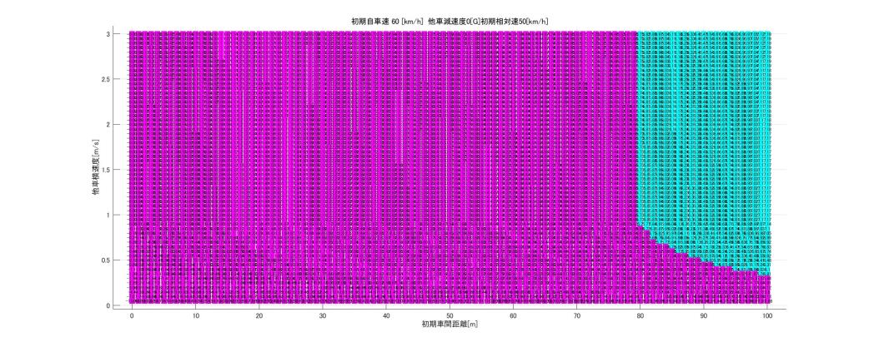
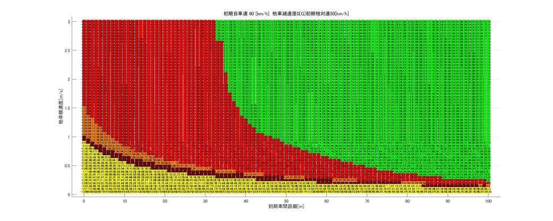
e
Ego vehicle velocity【Ve0】
: 60[kph]
Relative velocity【Ve0-Vo0】
: 50[kph]
GE/FR Draft Boundary: 𝑇𝑇𝐶𝐿𝑎𝑛𝑒𝐼𝑛𝑡𝑟𝑢𝑠𝑖𝑜𝑛>𝑣𝑟𝑒𝑙/(2*6m/s²)+[0.35𝑠]
[m/sec]
3.0
dy0=1.6m
2.5
Unforeseeable
2.0
1.8
Lateral velocity 【Vy】
1.5
1.0
0.5
0.17
Unforeseeable
0
[m]
0 20 40 60 80 100
Longitudinal distance 【dx0】

Slide 14

Accident Rate Caused by Human Factors of Driver (Highway)
97% of the accidents were related to the human factors of driver. (of which 60% was due to delay in perception)
Most of the accidents can be prevented if the driver’s
level of attentiveness is high.
■Data collection criteria:
Accidents occurred on highways in Japan in which the primary responsible party was
a vehicle (automobile/motorcycle) (2017)
Accidents related to human factors: 97%
Delay in perception
Misjudgment
Delay in perception
Delay in
perception
Operation
mistake
Number of accidents
(n=8,686)
Accidents due to low level of attentiveness: 85%
Delay in perception
(inattention to the forward roadway (external))
Delay in perception (safety check insufficient)
Misjudgment (traffic environment)
Misjudgment
(inattention to the movement)
Operation mistake
Unknown
Delay in perception
(inattention to the forward roadway (internal))
Misjudgment (wrong assumption)
Special cases
Page 3
Notes:
We researched how much accident reduction effect can be expected by applying attentive skilled human drivers as a boundary.
I will explain this using the highway accident data in Japan.
The data on this slide is taken from the accident research results in 2017. The number of accidents researched was 8,686 in total. Out of which, 97% were related to the human factors.
The detailed factors are shown at the bottom of this page.
From this data, we can see that most of the accidents were due to the low level of attentiveness of drivers.
(Not shown the data here, as well in the US, 94% of accidents in total is based on the human factors.)
As seen from the above, most of the highway accidents were caused by the human factors arose from insufficient attentiveness.

