Slide 1
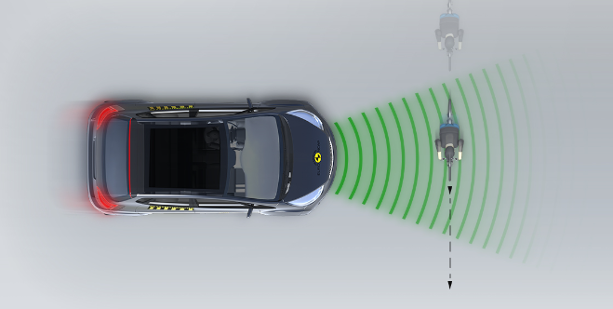
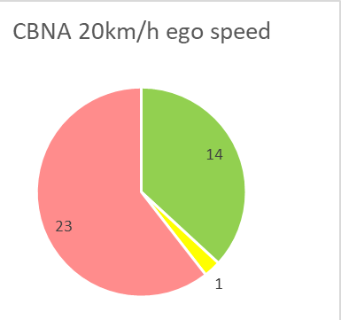
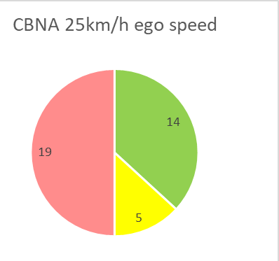
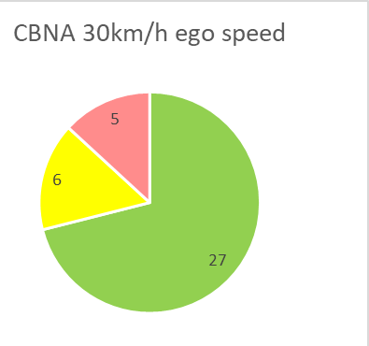
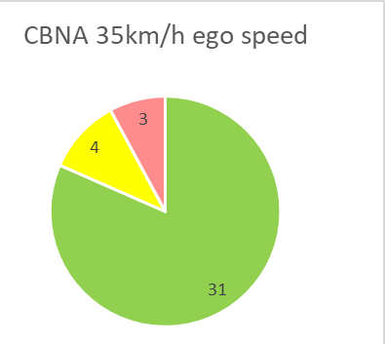
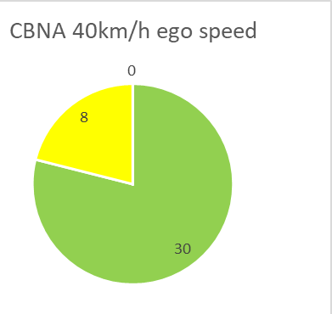
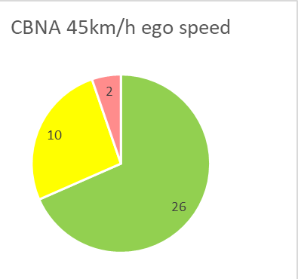
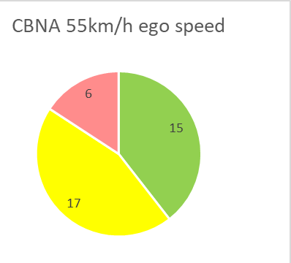
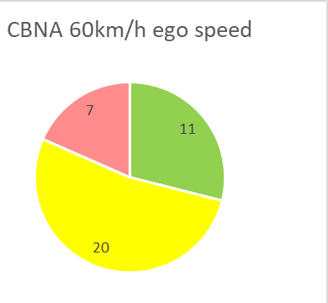
Performance in Car-to-Crossing Bicyclists (CBNA-50%) scenario Euro NCAP results 2018-19 (as for November 13th 2019)
63% of recently tested vehicles have AEB-Cyclist in Crossing scenarios
60 vehicle models were rated in 2018-19 (time period when AEB-Cyclist was introduced)
45 of 60 models offered AEB-Cyclist (in longitudinal and/or crossing scenarios)
38 out 60 offered AEB-Cyclist with crossing scenario CBNA
Source: Euro NCAP
CBNA Scenario – Ego vehicle speed 20km/h to 60 km/h
Bicyclist crossing with 15km/h
Projected Impact position – 50% (middle of front bumper)
Performance by Ego vehicle speed
Observations:
For 20-25km/h ego speed many vehicle have “No performance due to limited FoV (Field Of View)
For 30-35km/h ego speed only few vehicles have “No performance” probably limited FoV or performance
For ego speeds above 50km/h some vehicles show “No performance” probably intentionally due to robustness risks

