Slide 1

Two-factor authentication (2FA)
DETA | March 2020

Slide 2
Introduction
The login into DETA is done with a user & password.
For some authorities, the access in the DETA system with User & Password is not secure enough.
It is needed a stronger authentication method to access to the documents in the DETA.
It is important that unauthorized users gain access. For example, the test reports that may contain sensitive information.
To improve the security, it is proposed to use Two-factor Authentication (2FA).
With this authentication, the user will have to deal with two actions to gain access into the DETA system.

Slide 3
What is Two-factor authentication?
Two-factor authentication (also known as 2FA):
It is a type of Multi-factor authentication (MFA).
It is a method of confirming users identities by using a combination of two different factors.
So it requires the user have two things to get into his/her account
1. Something that the user knows → user & password.
2. Something that the user has/is → one-time password, USB stick, fingerprint…

Slide 4
Why should it be used in DETA?
Two-factor authentication is needed in DETA due to:
RDW is requesting this secure method.
DETA systems contains sensible data.
User & password is not secure enough nowadays.
Unauthorized person can gain access to the documents easily by stealing the credentials.
To increase the security of DETA system and reduce the risk that an unauthorized third-party accesses it.

Slide 5
First possibility: Google Authenticator (1)
Google Authenticator is a free app for smartphones that generates a new code every 30 seconds.
How does it work?
Add an account at Google Authenticator app using one of the following options:
a) Scan a barcode
b) Enter a provided key
a) or b) will be provided by DETA system/administrator. It is a one time action.
Then Google Authenticator app this ready to generate a new code every 30 seconds.
Once the user introduces the right user & password, the system will ask for the 6 digit code from Google authenticator.
The user has to introduce the code that it is given by the app.
If the code is correct, the user can access the system.

Slide 6
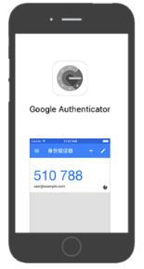
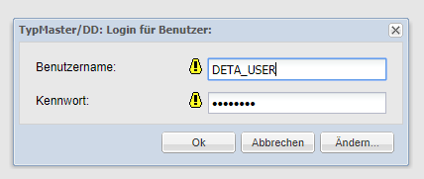
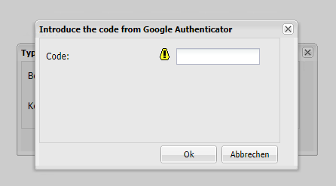

First possibility: Google Authenticator (2)
Use case:
One factor
Two factor
Introduce the user & password
Get the code in Google Authenticator
Introduce the code
Login

Slide 7
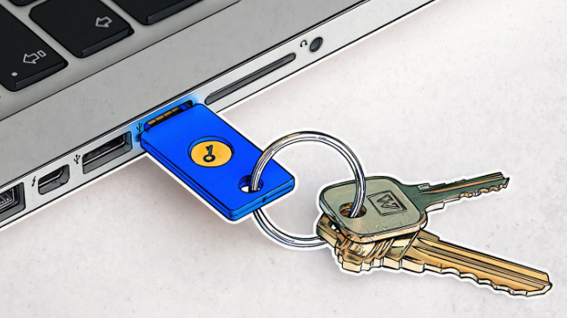
Other possibilities (1)
Hardware tokens:
It uses a real physical key.
After the login with user & password, you will need to connect the token
to the device from which you are logging.
Some devices require a PIN or fingerprint scan additionally.
One popular hardware token is the YubiKey, a small USB.
TAN: transaction authentication number
It is used by some online banking services as a form of single use one-time passwords (OTPs).
TANs are a second layer of security above and beyond the traditional single-password authentication.
If the physical document or token containing the TANs is stolen, it will be useless without the password.

Slide 8
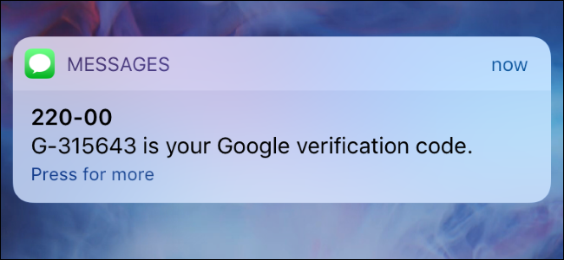
Other possibilities (2)
SMS-based:
The service sends to the user phone number a text message containing a one-time code whenever the user signs in.
So if someone has your username and password for that account, they won’t be able to sign into your account without access to your text messages.
SMS-based two-factor authentication isn’t considered ideal because someone could steal the phone number or intercept your text messages.

