Slide 1
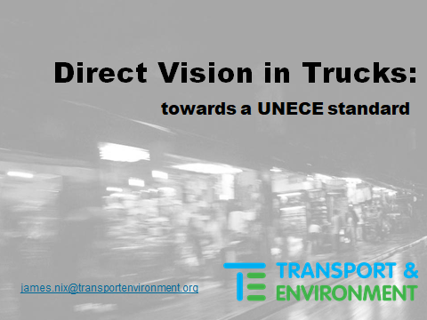
VRU-Proxi-13-05 Rev 1
UNECE VRU meeting
Osaka, Feb 2020

Slide 2
Areas covered
Substantive standards
N2
N3
  Rigids
  Articulated (including potentially different application dates for EU / non-EU UNECE contracting parties)
- Progressivity over time
Methodology governing the standard
Level of sophistication needed
One system v. multiple systems
Relationship with indirect vision
Adult height
What must be seen?
Cost: software v. field testing
Precedents for software
Access to CAD drawings and the truck for a physical check

Slide 3

A quick reminder of what EU lawmakers agreed:
“Vehicles of categories M2, M3, N2 and N3 shall be designed and constructed so as to enhance the direct visibility of vulnerable road users from the driver’s seat, by reducing to the greatest possible extent the blind spots in front and to the side of the driver, while taking into account the specificities of different categories of vehicles”

Slide 4
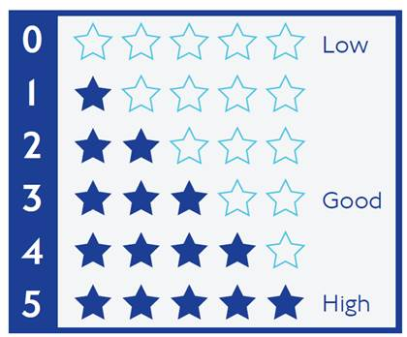
Evaluation (star rating) of all new types and all new vehicles to be published
From Jan 2026 all new types should be star-rated with this rating published; 2029 for all vehicles
This requirement needs to be part of the UNECE Direct Vision Standard but independent of the minimum star(s) to be achieved (covered further below)
This is to provide market information, i.e. the buyer knows the star rating of different new trucks, and can compare
Providing this information is central to reducing blindspots to the greatest possible extent

Slide 5
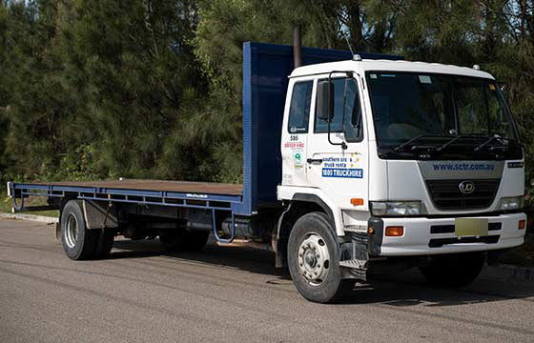

N2 vehicles
References to star ratings in these slides are to the TfL Direct Vision Standard (Oct 2019).
T&E advocates that the UNECE standard provide that:
N2 new types meet minimum 4 stars by 2026
N2 new types meet 5 stars by 2030
Truck-makers come forward with dates by when all new vehicles meet 4, and then, 5 stars
Considerable sophistication in measurement methodology is needed so that N2 reach their 5 star potential in line with improvement “to the greatest possible extent”

Slide 6
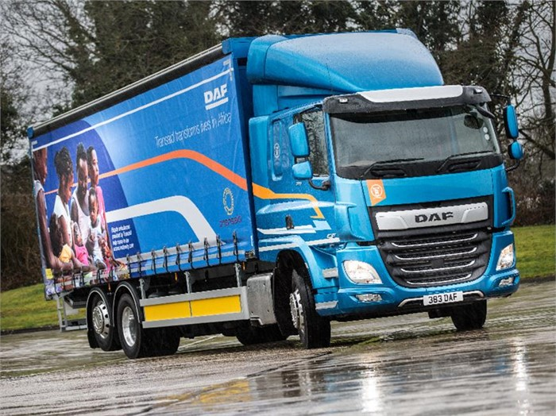
N3 rigid trucks
For rigid trucks, and drawing particular attention to the evidence presented by Apollo Vehicle Safety at the Brussels meeting, T&E advocates for:
New rigid types meet at least 2 stars by 2026, except Category G (i.e. certain construction) trucks which meet 1 star by 2026,
Cat G new types meet at least 2 stars by 2028
New rigid vehicles must meet min. 2 stars by 2029, except Cat G,
Cat G new vehicles meet at least 2 stars by 2031
Truckmakers come forward with date by when all rigid new types meet at least 3 stars, and date all new vehicles meet at least 3 stars

Slide 7
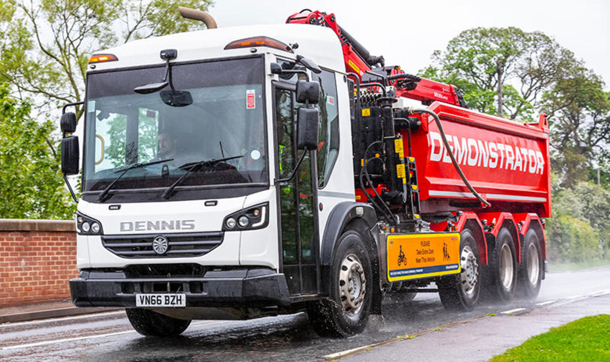
N3 rigids: construction is primarily in urban areas
72% to 92% of the population of the EU, Japan, South Korea and Australia is urbanised. Most construction takes place in urban areas and this trend will increase as urbanisation grows
Hence the ambition level for rigid trucks just outlined
London will only permit 3 star by Oct 2024 - unless trucks add ‘safe system’ technology (costing around 2,000 GBP, per truck, under 2020 to 2024 requirements). And so truck-makers are already producing 3+ star construction trucks. London’s milestone 2024 date is therefore important to note in advance of OEMs coming forward with a date by which they commit all new N3 rigids to be at least 3 star

Slide 8
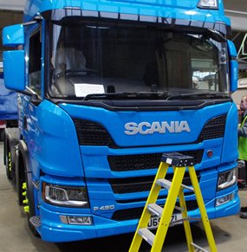
N3 Articulated trucks (artics)
It’s acknowledged that differences in timing as between EU and non-EU contracting parties may be necessary:
For all UNECE: by 2028, new artic types must be at least 1 star; 2031 all new vehicles (UNECE)
For the EU: by 2026: new artic types must be at least 1 star; by 2029 all vehicles (EU)
By 2032 all new types meet at least 2 stars; truck-makers come forward with date all new vehicles meet at least 2 stars
Truck-makers come forward with date by when all new artic types meet at least 3 stars, and a date for all new vehicles

Slide 9
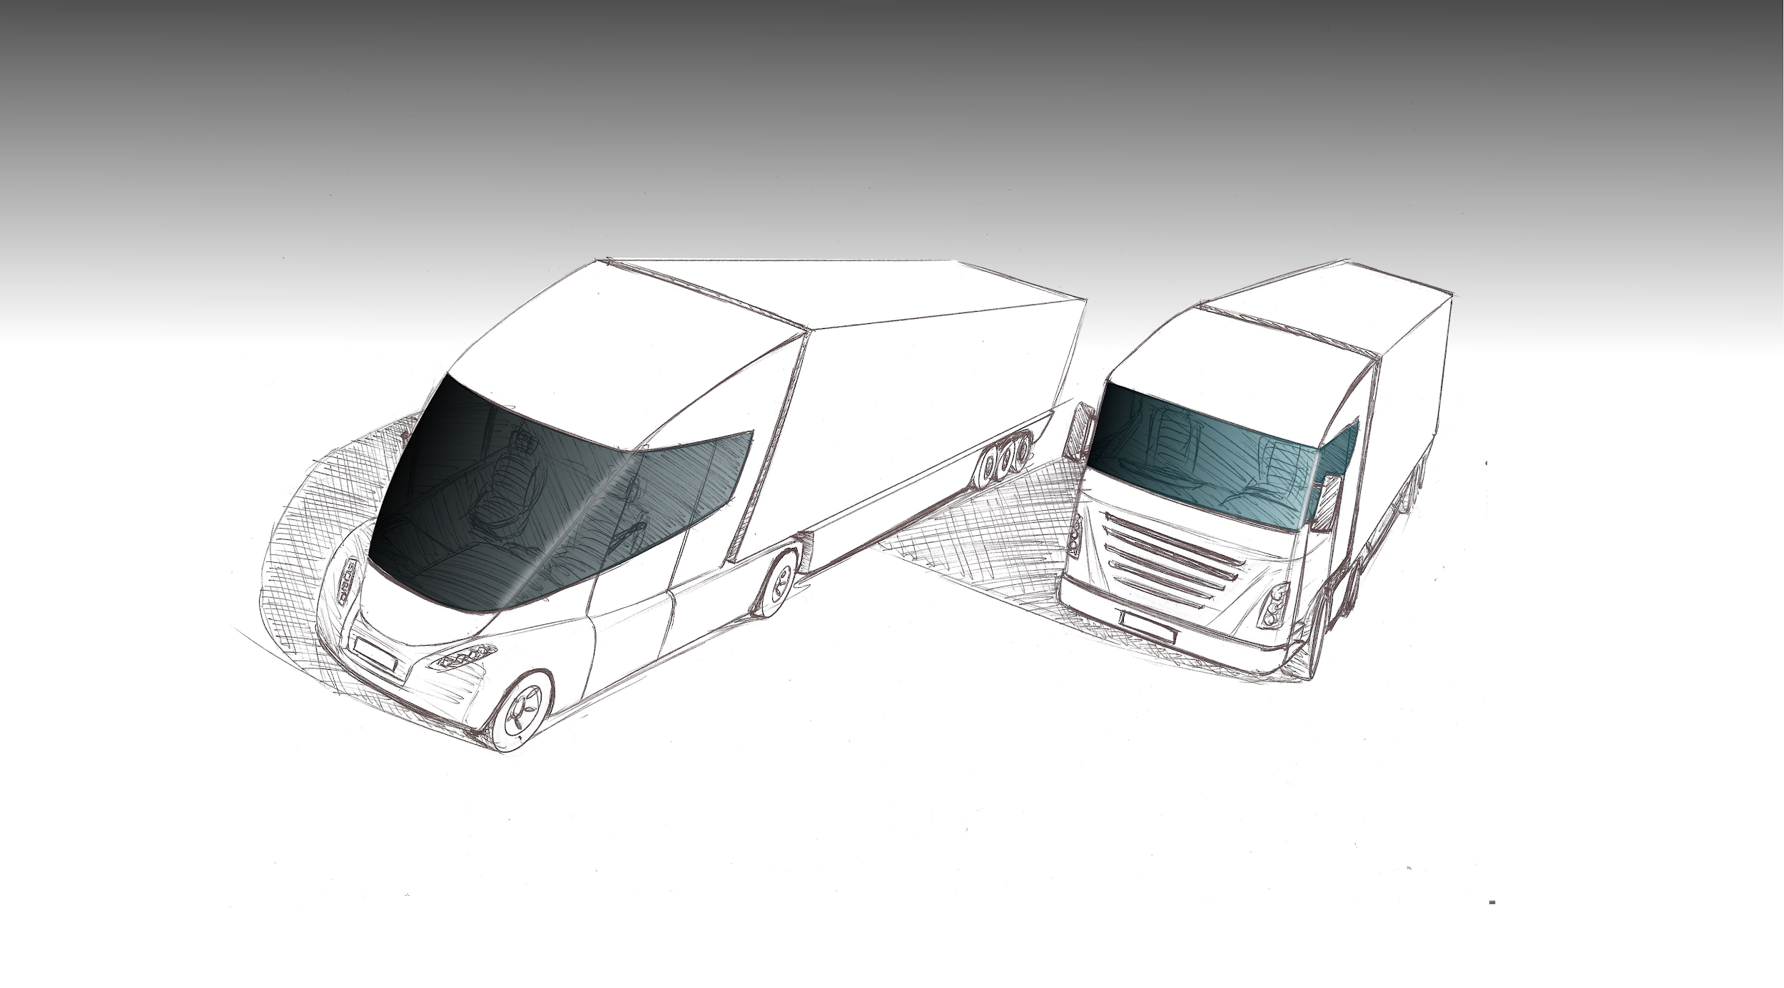
Law-makers foresee longer cabs enhancing vision
Recital 4 to the EU legal act on Weights & Dimensions (2019/984) permitting longer, rounder cabs by 1 Sept 2020:
“With a view for the benefits of aerodynamic cabs, in terms of energy performance of heavy goods vehicles, but also in terms of better visibility for drivers, safety to other road users as well as safety and comfort for drivers, to materialise as early as possible, it is necessary to ensure that such aerodynamic cabs can be introduced without unnecessary delay, as soon as the necessary type-approval requirements are in place." (emphasis added)

Slide 10
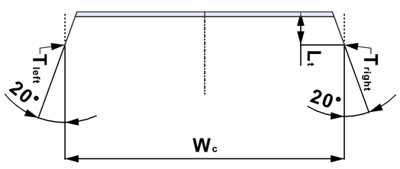
Greater flexibility within the EU with the W&D reform
Inside the EU, the Weights & Dimensions reform gives design flexibility (for OEMs that wish to use high mounted cabs that would otherwise not meet one star); this presentation assumes some non-EU contracting parties may need longer to adopt equivalent measures (TBC), or otherwise adapt their law.
W&D cabs are set to be applied in long haul, also capturing aero and fuel saving benefits. We will then likely see a phasing out over time of high mounted cabs which do not undergo W&D modernisation - in line with the Direct Vision standard

Slide 11
N3 Articulated trucks - public policy background
By 2032, all artic new types must 2 reach at least stars (all UNECE)
This will influence a minority of long haul trucks, ie lowering those with very high-mounted cabs, and this is acceptable on the basis of public policy as follows:
Absence of evidence to suggest very high mounted cabs are involved in fewer highway collisions than mid-mounted cabs,
Law-makers have been clear on the need to enhance the direct visibility of pedestrians and cyclists to the greatest possible extent, and
If a driver putting her/his foot on one step to reach the bed behind the seats is seen as detracting from driver comfort, this can be compensated by a wider bed and toilet/shower in the cab, as enabled by the length extension under the W&D reform. This is a sensible trade-off (see next slide)
Industry needs to come fwd with dates by when all new types & vehs meet at least 3 star

Slide 12
Summary table
N3 | Minimum star rating | Date for new types | Date for new vehicles
N3 rigids (ex Cat G) | 2 | 2026 | 2029
Cat G rigids | 1 | 2026 | 2029
Cat G rigids | 2 | 2028 | 2031
N3 rigids | 3 | [20 ] | [20 ]
EU artics | 1 | 2026 | 2029
Non-EU artics | 1 | 2028 | 2031
All UNECE | 2 | 2032 | [2035]
All UNECE | 3 | [20 ] | [20 ]

Slide 13
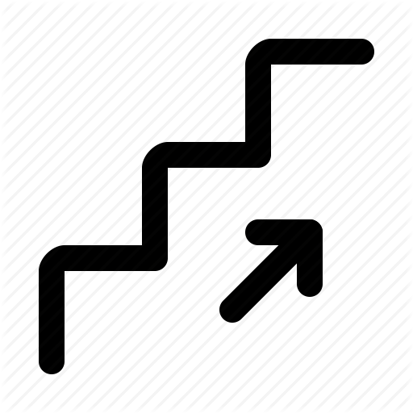
Progressivity - and the methodology for the standard
“Greatest possible extent”: the level of improvement required under EU law
Only a sophisticated measuring tool can meet this requirement “while taking into account the specificities of different categories of vehicles”. And progressive approach gives truck-makers more time to improve to the “greatest possible extent”:
Moving up from 4 stars to 5 in the case of N2
Moving up from minimum 1 star to minimum 3 stars in the case of N3

Slide 14
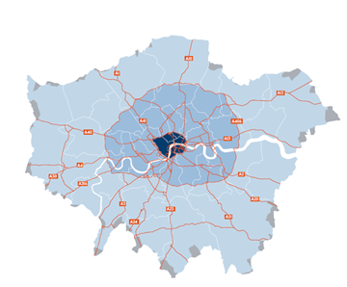
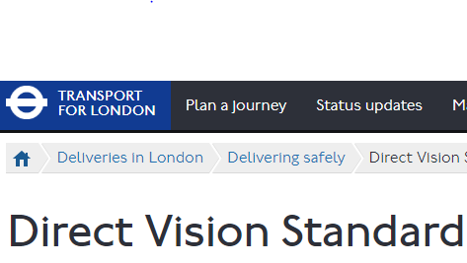
Methodology: avoiding the higher burden of 2 systems
Approx 565,000 trucks will be given star ratings under Transport for London’s DVS
Already 123 make/model variants account for around 470,000 trucks
As new trucks are produced and placed on the London / southern English market, OEMs are obtaining a star rating for them
It would be excessive and unnecessary regulation to introduce an additional rating system: 2 systems = higher burden

Slide 15
A standard that gives credit where credit is due
Test must record improvements right across the zone of greatest danger
Indirect vision, i.e. the space overseen by mirrors, has well documented deficiencies. Better direct vision helps address these long-known shortcomings
Unacceptable to measure at the mirror boundary as this would ignore area of greatest risk for pedestrians and cyclists
Test must enable a progressive standard, i.e. rising star levels over time, also supported by the publication requirement regarding the star rating
TfL: Why improve direct vision?
Indirect vision = slower response time
Indirect vision has a 0.7s slower response time
Risk increases with speed as more distance travelled
Extra distance in urban environment especially high risk (5m more via indirect vision when travelling at 25kph)
Indirect vision = bigger collision risk
Indirect vision resulted in increased incidence of simulated pedestrian collisions by 23%
Limits to technology benefits
Drivers processing a cognitive task increased simulated collision by 40

Slide 16
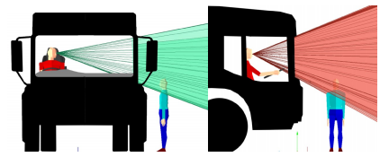
How tall?
Height of pedestrian: to have regard to approx 99% of the European adult population, TfL’s star ratings are based on the height of the 5th percentile Italian female (1.5m)
Average height in highly populous UNECE contracting parties (such as South Korea, Japan, Egypt) implies that the TfL approach is the most appropriate
Caution! If regulators were to pick 1.6m instead, this would exclude almost 50% of FR and IT women and nearly 40% of German women.
Implications for Asian women would be similarly stark.

Slide 17
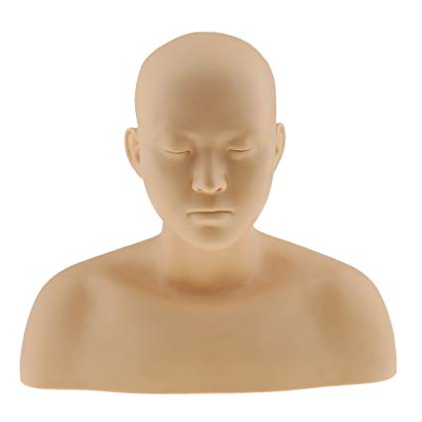
What must be seen?
The test must be based on seeing a clearly identifiable minimum area of the person, namely the full head. There is good consistency here as all truck-makers will have situations where most but not all of the head is visible; hence all are treated equally
Completely unacceptable would be a situation where the edge of the forehead, or tip of the crown of the head, qualifies as “seen”

Slide 18

Methodology: assumptions around cost
Occasionally regulators assume software-based testing is more expensive than manual field trial type tests. More often, the opposite is the case, as shown using a worked example:
One person paid €100 per hour takes 30 min to conduct CAD test. Add a (very high) software related payment of €10 and total cost = €60 per truck
Now contrast this with a field-trial type test requiring 2 persons 2 hours to set it up correctly, and one hour to conduct it and calculate the result: 6 person hours = €600 per truck

Slide 19
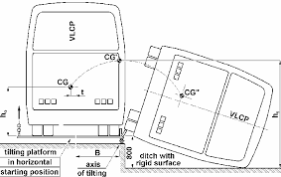
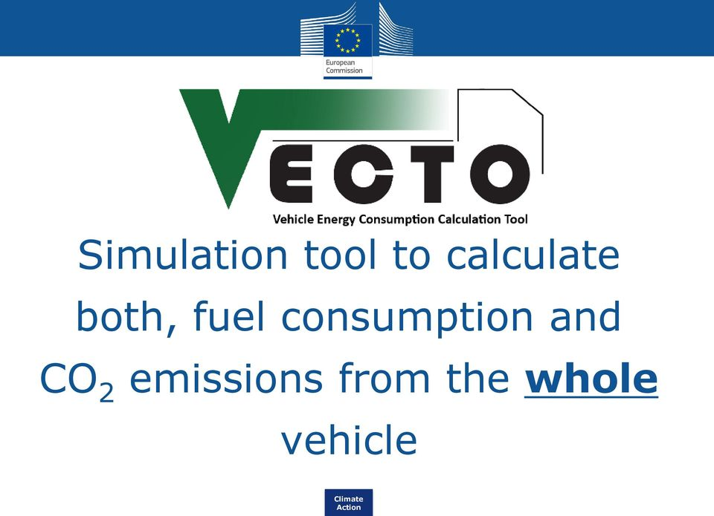
Use of software: precedents
CAD software is already used at UNECE, eg Reg 66 to test the roof strength of buses
Approved universal software can be developed by the EU/UNECE and supplied to all interested OEMs and TAAs
This approach is used for truck CO2 emissions (VECTO software - see image)
EU and UNECE can replicate this for direct vision, and this is worth doing as trucks are only 2% of vehicles - but cause 15% of fatal collisions, nearly 25% of whom are ped’s or cyclists

Slide 20

Solving software issues & physical validation
Assume an issue arises with the approved universal software. Solution: as there is one form of the software only, updates are issued to all users (as is done with VECTO today)
Assume CAD data suspected of being inaccurate or false is supplied to the TAA (i.e. not corresponding to the truck for which a rating is sought). Solution: as well as the CAD files, the OEM must grant access to the physical truck on request, allowing the CAD files to be compared to the reality - with the UNECE standard providing for this.

Slide 21

Summary slide - proposed standard
N3 | Minimum star rating | Date for new types | Date for new vehicles
N3 rigids (ex Cat G) | 2 | 2026 | 2029
Cat G rigids | 1 | 2026 | 2029
Cat G rigids | 2 | 2028 | 2031
N3 rigids | 3 | [20 ] | [20 ]
EU artics | 1 | 2026 | 2029
Non-EU artics | 1 | 2028 | 2031
All UNECE | 2 | 2032 | [2035]
All UNECE | 3 | [20 ] | [20 ]
N2: all new types must meet at least 4 stars by 2026, and 5 stars by 2030
Truck-makers are asked to come forward with dates by when all new N2 vehicles meet at least 4, and then, 5 stars
Publication requirement: as part of the standard, the rating of all new types must published by 2026; all new vehicles by 2029

Slide 22
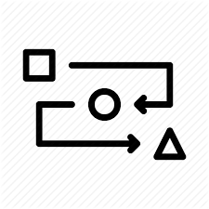
Summary slide - proposed methodology
Sophisticated methodology, and a step-by-step approach over time, is needed to enhance direct vision “to the greatest possible extent”, including a requirement to publish the rating, independent of the minimum star(s) to be achieved (slide 4)
More than 120 model variants have already been rated under the TfL system and new trucks are added over time: a process with a different method would make little sense
The direct vision standard must help address the very well-known deficiencies of indirect vision (overseen by mirrors) where the impacts take place
Adult height must think of Asia as well as Europe; the whole head must be seen
Software is typically far cheaper than field-type (floor-based) testing
Software is already used to test buses (roof strength) and truck CO2
The UNECE DV standard can provide that CAD drawings and the physical truck be made available to the TAA to allow for a physical test (i.e. empower TAA)
Notes:
The only - be resolved by two different TAA…

Slide 23
Thank you
james.nix@transportenvironment.org
00 32 48 77 90 281

