Slide 1
UN Regulation Development on
Heavy-Vehicles Direct Vision
OICA/ACEA position
VRU-PROXI 13
VRU-Proxi-13-07

Slide 2
Overview of Contents
OICA / ACEA General View
Understanding the London Direct Vision Standard Approach
Considerations for UN Direct Vision Regulation
VRU Height and Visibility
Eliminating the Blind Spot to the Greatest Possible Extent
Potential Measures to Improve Direct Vision
Arguments for Limitations to Lower Cab Heights
Summary and Conclusions

Slide 3
OICA/ACEA General View
OICA/ACEA supports:
  Safety improvement by increasing direct vision performance of heavy vehicles
  Technically and economically feasible regulation and adapted to technical progress (according UN 58 agreement)
  An objective methodology to evaluate direct vision performance with a feasible baseline level
  Type approval of vehicle / systems based on the worst case vehicle of the family (verified by simulation)
  Any use of a common database for setting parameters for evaluation of threshold values and pass/fail criteria's must be owned and maintained by a neutral party (authority).
Active safety systems will be introduced in EU (2024) addressing VRUs, this will already improve the safety of heavy vehicles long before direct vision will be mandatory. These active safety systems will be further improved in the future.
Focus of this presentation is on definition of the threshold for the Direct Vision regulation for N3 trucks

Slide 4
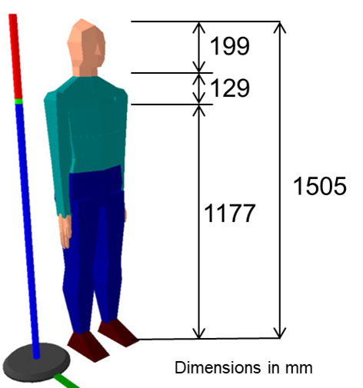
Understanding the London Direct Vision Standard Approach
Stature of 5th %ile Italian female
Scope of Transport for London is trucks that are driving in the City of London (Greater London)
Definition of 1 star on DVS scale:
1 star rating means an average distance of VRUs to be seen by the driver (head and shoulders) at a distance of 4.5m to near-side, 2m to the front and 0.6m to the off-side. The VRU chosen was a 5th %ile Italian female covering 99% of Europeans (Loughborough Design School, VRU-Proxi-10-07)
Height of 5th %ile Italian female 1177 mm up to shoulders by using a stick, VRU width not respected
Determinant for 1 star level was existing vehicle (Volvo FE) meeting requirement at least on all sides, this 1 star vehicle fulfils visibility exactly on one side but performs better on the other two sides
  This means 1 star on current DVS scale goes beyond the aim of eliminating the blind spot
28 of 51 current in EU available vehicle models would be banned, therefore TfL allowed safety systems as alternative
Volvo FE (H) determinant for 1 star level

Slide 5
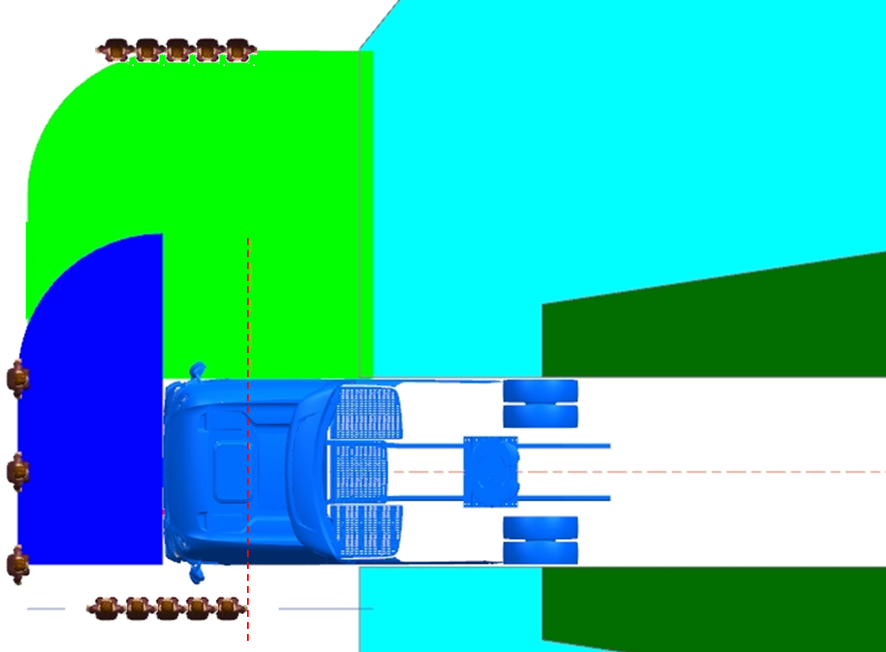

Considerations for UN Direct Vision Regulation
Scope of UN Regulation is Type Approval for all trucks and buses driving on all roads (not in city only)
At least in EU all trucks will have safety systems as from 2024 (MOIS & BSIS)
Direct vision regulation will be the 3rd regulation addressing the close proximity area at the near side and off-side of the truck
MONITORING AREAS BSIS + MOIS (EU >2024)
BSIS
MOIS
TRAILER
BSIS = Blind Spot Information System (ECE R151)
MOIS = Moving-Of Information System (ECE R xx)
ECE R46 = Colored areas (in theory not blind spots)

Slide 6
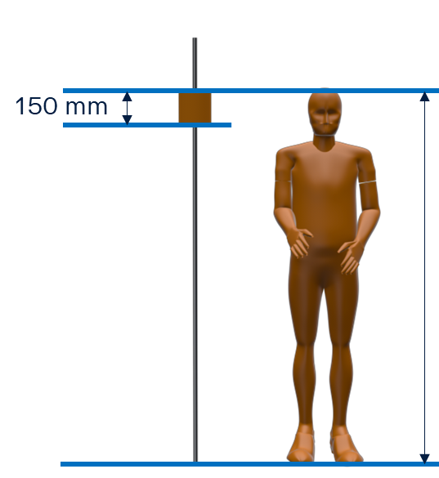
VRU Height and Visibility
Proposal for UN regulation
(part of head)
Sliding surface
VRU height to be discussed
VRUs and driver’s head will move in real-life traffic
Lean stick is not representing width of VRU body
Any body part of VRU 150 x 150 mm to be considered for determining Direct Vision level
150 x 150 mm also considered in regulation for Reversing Motion
Loughborough Design School is asked to investigate the effect of this proposal on the direct vision evaluation (DVS)
any body part of VRU (150 mm width) will be noticed by the driver

Slide 7
Eliminating the Blind Spot to the Greatest Possible Extent
The blind spot is eliminated when the VRUs are visible while standing exactly on outer border of R46 indirect vision FoVs and 0.6 m at driver side:
5 VRUs at 4.5 m to the near-side
5 VRUs at 0.6 m to the off-side
3 VRUs at 2.0 m to the front
This means that blind spot will be exactly eliminated at an average VRU-distance of ~2400 mm
This corresponds to an equivalent direct vision performance of more than 1 star on current DVS scale based on 5th %ile Italian female (head and shoulder)
See next slide
Class IV
Class V
4.5m
Class II
Class VI
Class II
2.0m
Class II
0.6m
Class IV
Class II

Slide 8
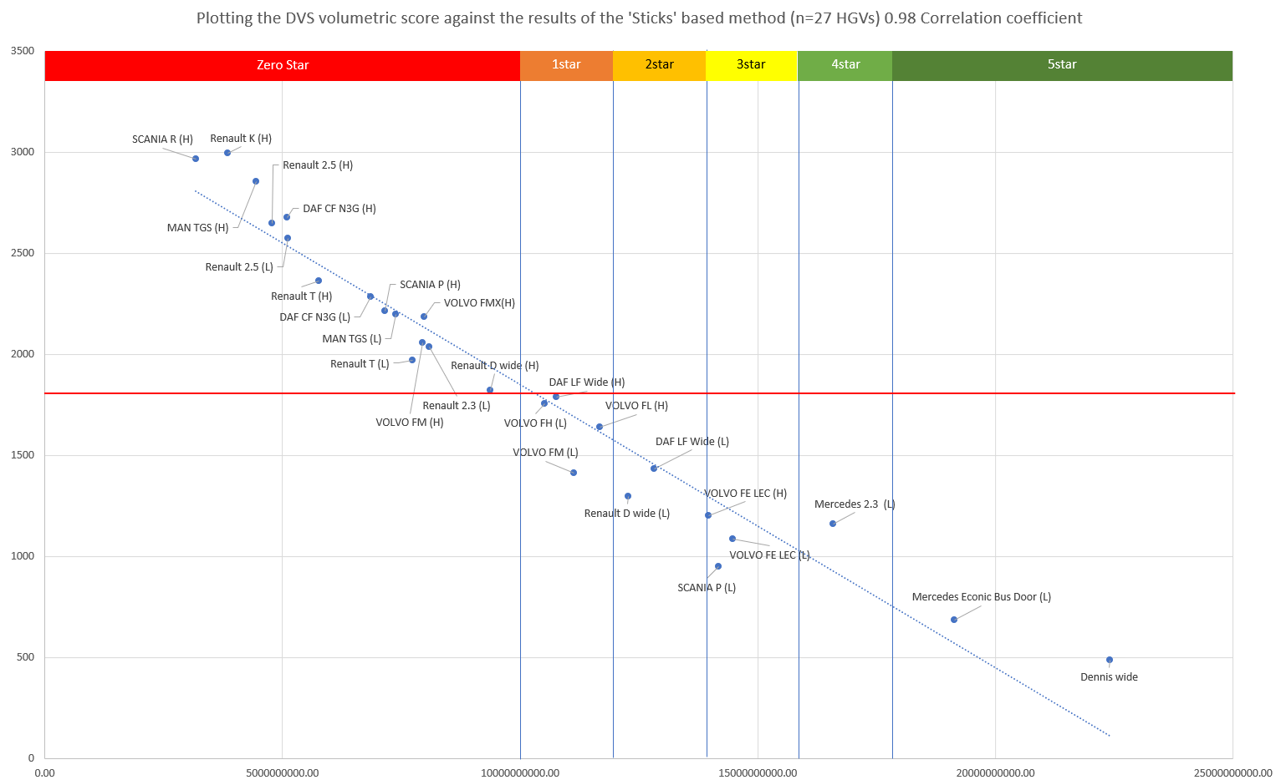
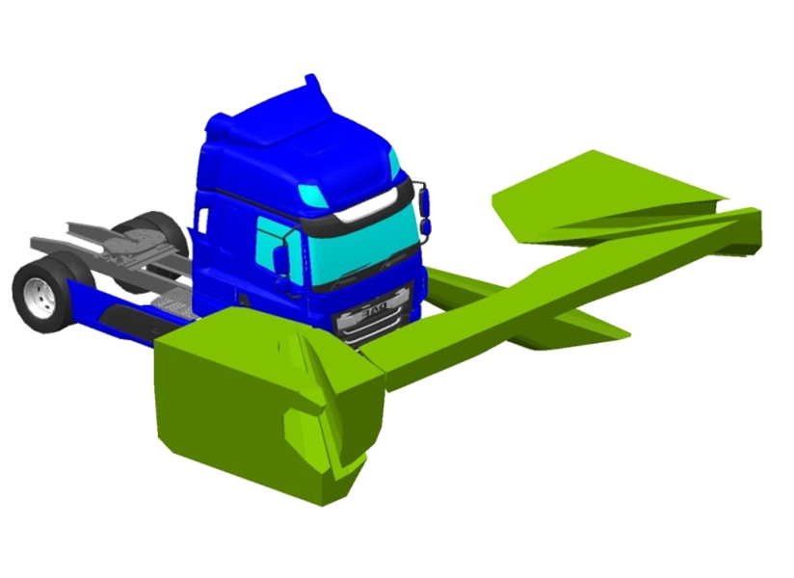
Eliminating the Blind Spot to the Greatest Possible Extent
Full overview of 51 truck models (H+L)
28 truck models below 1 star
(HGV DVS Expert Panel meeting 21-2-2018)
2400
Green area =
DVS volume
Average ‘Stick’ distance to the front left and right of the cab (mm)
Average distance of ~2400 mm corresponds to ~7 m³ DVS volume which means that blind spot is eliminated at 7 m³ DVS volume or more
With setting this baseline level ~15 out of 51 truck models would be banned
7 m³
Digital DVS volumetric score

Slide 9
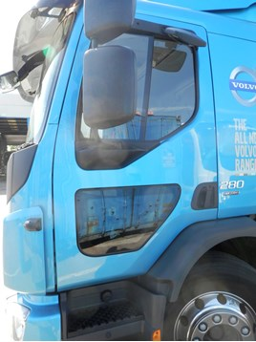
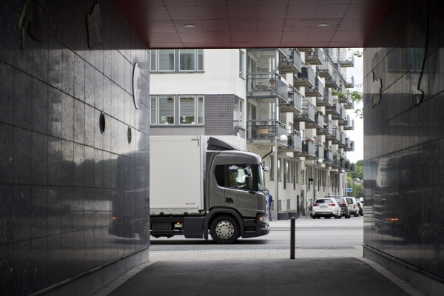
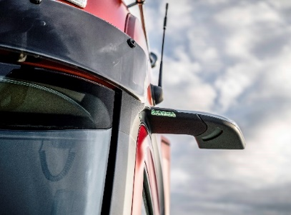
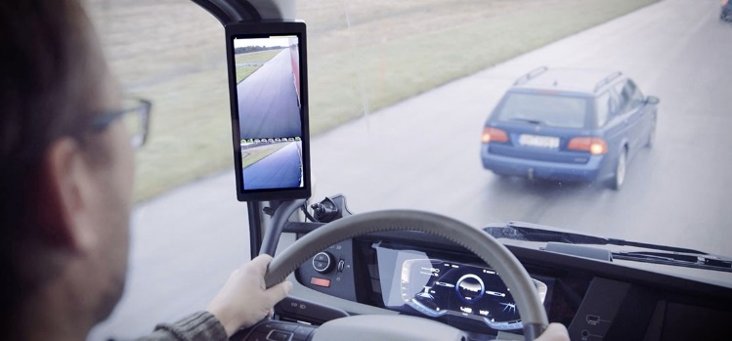
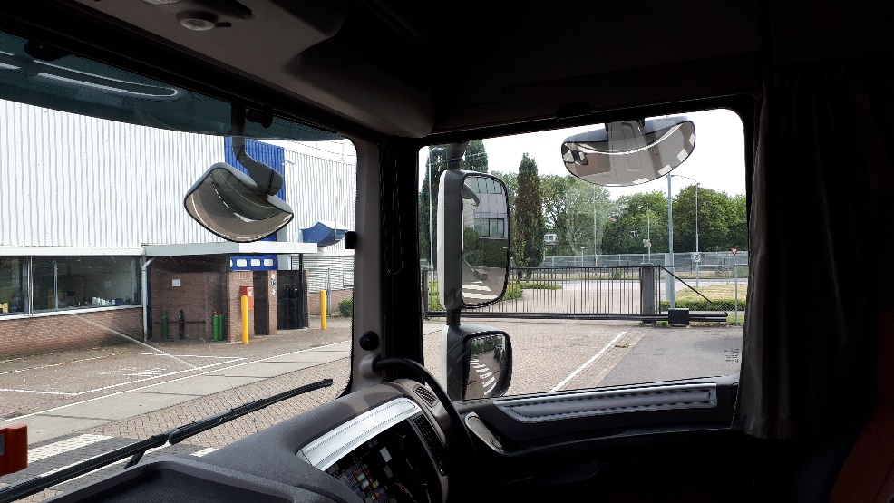
Potential Measures to Improve Direct Vision
FEASIBLE MEASURE
FEASIBLE MEASURE
FEASIBLE MEASURE
Lower door window
Extended front
Camera monitor systems (no mirror housings)
REQUIRES MAJOR
RE-DESIGN AND RESOURCES
Note:
A-pillars shall be compatible
with requirements of R29.03
Lower dashboard and changed cab structure (A-Pillars / Freezeline / Beltline)

Slide 10
Potential Measures to Improve Direct Vision
Direct vision performance
1 star equivalent (10 m³ DVS volume)
Extended front is suitable for Long haul vehicles, less for Construction vehicles
Lower door window is suitable for Construction vehicles, less for Long Haul
Feasible
level
Changed cab structure
Feasible
level
Changed cab structure
Baseline for direct
vision performance
Extended front (aero)
Extended front (no aero)
Lower dashboard
Lower dashboard
(Lower door window)
Lower door window
CMS- no mirror housings
CMS- no mirror housings
Cab
Height
Range
Cab
Height
Range
Full operational cab height range must be taken into account for setting baseline direct vision level
Current level
Current level
Figure not on scale!
Typical
Long Haul vehicle
Typical
Construction vehicle

Slide 11
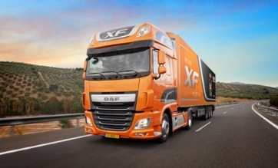
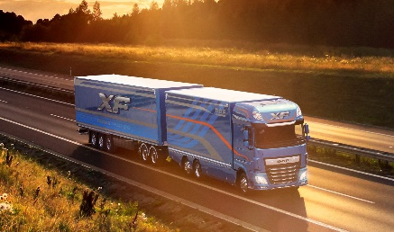
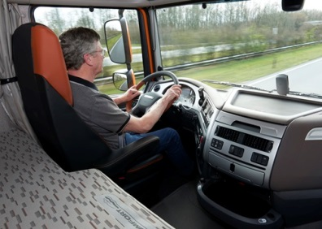
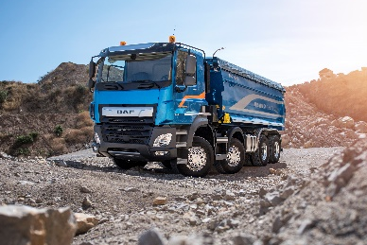
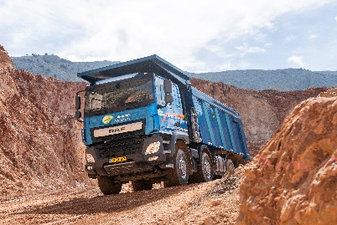
Arguments for Limitations to Lower Cab Heights
Long Haulage
High seating position and “flat” floor cab
Good look ahead possibilities
Better anticipation on traffic situation
Fuel consumption /
CO2 emission /
Environment
Driving comfort / situational awareness
More calm and
safe position
Road safety
Collision safety
Living comfort and overnight stay
Better driver fitness
Construction
High cab position
Fit for purpose /
Off-road capabilities
Big engines for heavy transport
Cooling capacity
(low emissions)
Intended for construction sites
Ground clearance / approach angles
Commercial vehicles are designed for purpose
High cab position is crucial for driving safely, economically and effectively on highway and construction sites

Slide 12
Summary and Conclusions
OICA / ACEA Considerations:
OICA / ACEA Position:
Regulation for direct vision shall be based on a sound direct vision performance that is a well-balanced compromise between “eliminating the blind spot” versus other important aspects, such as driver comfort, road safety, cab structural behavior, situational awareness, fit for purpose, etc.
Direct Vision performance shall be evaluated by an objective methodology with a well-founded, economical and societal justified and technical feasible baseline level
This level shall be at maximum 7 m³ DVS volume (for N3*) on current Direct Vision Standard rating scale, this would eliminate the blind spot when taken a 5th %ile Italian female into account
OICA/ACEA asks for a sound Type Approval procedure. Contracting parties should have a deep look into this..
  UN 58 agreement:
  Regulations shall be technically and economically feasible and adapted to technical progress
  Close proximity Direct Vision interacting with
  ECE R46 and Regulations for VRU-detection
  BSIS & MOIS (EU GSR >2024)
  Industry accepts feasible measures to improve direct vision like lower door window, extended front, CMS, reasonable cab re-design respecting ECE R29
  Regulation shall fit for all N2, N3, M2, M3 trucks and buses without unreasonable banning of vehicles
  Safety, economical and effective limitations to lower cab heights (long haul & construction)
* for other vehicle categories to be decided in later stage

